Slide 1



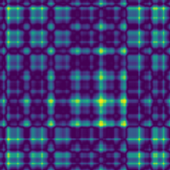
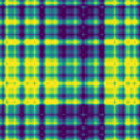
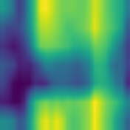
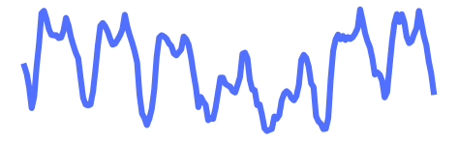
(a) TimeXer (baseline)
(b) TimeXer-DINOv3 (ours)
Output
Output
Projection
Projection
(e) Change vs. (a)
removed
Patch embedding + L encoder layers
→ image + pretrained ViT
Cross-attention in every layer
→ once, after the backbone
Loss, data, RevIN, exo embedding,
projection: unchanged
L ×
NEW
LayerNorm
Pool 121 → 7 tokens
NEW
Feed-Forward
Self-Attention × 1
121 patches + fused CLS
unchanged
patches
Embedding
NEW
(d) Backbone output tokens
LayerNorm
Cross-Attention × 1
query = CLS
CLS
CLS: kept
Exogenous Input
NEW
Embedding
Cross-Attention
Linear Adapter
384 → 256
4 registers:
dropped
Exogenous Input
LayerNorm
NEW
DINOv3 ViT-S/16
12 blocks · pretrained on LVD-1689M
R1: frozen · R2: top-2 blocks tuned
121 patches (11 × 11)
load & wind forecasts
replaced by
Self-Attention
(c) 1D → 2D imaging
Embedding
TS2Image
NEW
target, 168 h
GASF
GADF
Periodic fold
Endogenous Input
Endogenous Input
168 h → 3 × 176 × 176 image
patches + global token
RevIN-normalised window
NEW
new or replaced block
removed from TimeXer
zoom-in detail

