Slide 1
Сalculation and optimization of flows in networks
Mistyurin Vyacheslav Vladimirovich

Slide 2
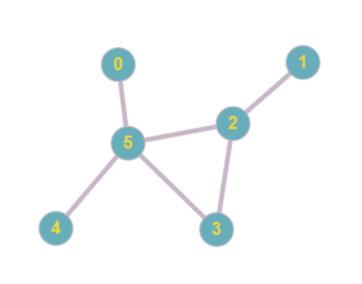
The task of master's work
Undirected graph
Each channel has its own bandwidth
Each channel is present with its probability
Find the mathematical expectation of the values of the maximum flows between all pairs of vertexes

Slide 3
The task of the course work
Undirected graph
Each channel has its own bandwidth
Find the values of the maximum flows between all pairs of vertexes

Slide 4

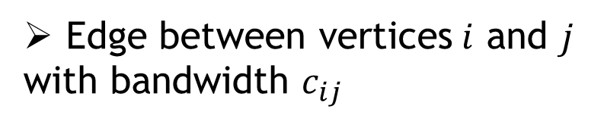
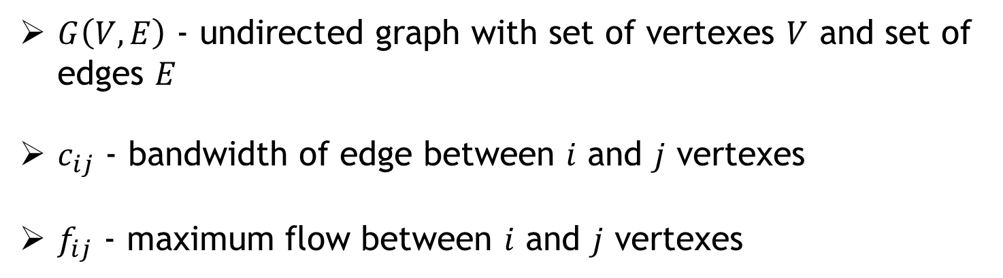
Definitions
Edge between vertices$i$ and $j$
with bandwidth $c_{ij}$
$G\left(V,E\right)$ - undirected graph with set of vertexes $V$ and set of edges $E$
$c_{ij}$ - bandwidth of edge between $i$ and $j$ vertexes
$f_{ij}$ - maximum flow between $i$ and $j$ vertexes

Slide 5

Standard algorithms for calculating the maximum flow
Standard algorithms were implemented to calculate the maximum flow–
Edmons-Karp algorithm (complexity $O( \left|V\right|∗{\left|E\right|}^{2} )$)
Dinic’s algorithm (complexity $O\left({\left|V\right|}^{2}∗ \left|E\right|\right)$)
Push relabel algorithm (complexity $O({\left|V\right|}^{2}∗ \left|E\right|)$)

Slide 6
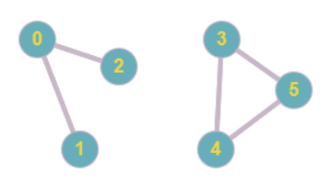

Reductions methods
Split graph into disconnected components
$$f_{ij}=0 ∀i∈\left\{0,1,2\right\}, ∀j∈\{3,4,5\}$$

Slide 7
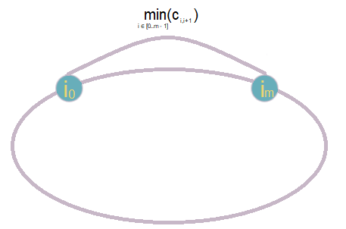
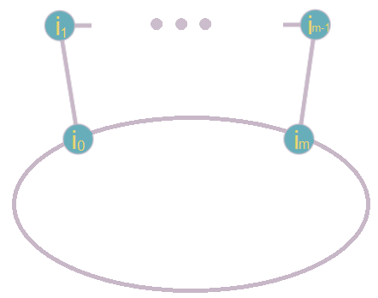
Reductions methods
Chain contractions
Both vertexes are not in chain
2. One vertexes in chain, the other not
3. Both vertexes are in chain
7

Slide 8
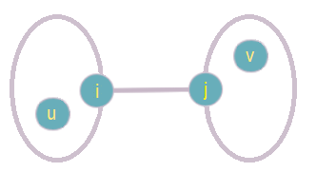
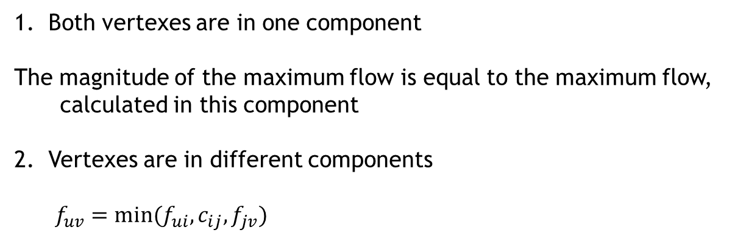
Reductions methods
Bridge handling
Both vertexes are in one component
The magnitude of the maximum flow is equal to the maximum flow,
calculated in this component
Vertexes are in different components
$$f_{uv}=min⁡(f_{ui}, c_{ij}, f_{jv})$$
8

Slide 9
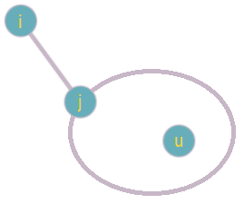
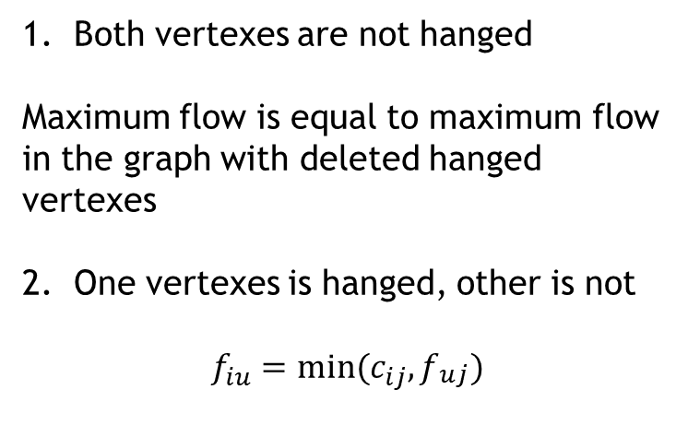
Reductions methods
Handling hanged vertexes
Both vertexes are not hanged
Maximum flow is equal to maximum flow in the graph with deleted hanged vertexes
One vertexes is hanged, other is not
$$f_{iu}=min⁡(c_{ij}, f_{\begin{aligned}uj \\ \end{aligned}})$$
9

Slide 10
Algorithms
Brute-force of pairs
Edmons-Karp algorithm
Dinic’s algorithm
Push-relabel algorithm
Brute-force with reduction use
Split graph into disconnected components
Contract the chain
Handle bridges
Remove hanged vertexes
Use brute-force of pairs algorithm

Slide 11
Results
Time (seconds) | Edmons-Karp algorithm | Dinic’s algorithm | Push-relabel algorithm | Edmonds-Karp algorithm with reductions | Dinic’s algorithm with reductions | Push-relabel algorithm with reductions
(50, 55) | 0,127 | 0,289 | 0,65 | 0,051 | 0,091 | 0,15
(60, 80) | 0,31 | 0,786 | 1,52 | 0,162 | 0,681 | 1,25
(100, 120) | 2,12 | 5,35 | 63,61 | 0,9 | 1,76 | 9,59
(150, 190) | 10,6 | 29,2 | 470,56 | 3,46 | 10,48 | 98,35

Slide 12
Conclusions
The Edmonds-Karp algorithm showed itself better both in the case of brute-force pairs, and in the case of brute-force pairs using reductions
Reductions give an increase in speed, even at small dimensions
The increase in speed from reductions increases with increasing dimension

Slide 13
Further directions
Solving problems set in the master's work
Search and analysis of new methods of reduction
Improvement of the developed algorithms
Implementation of new basic algorithms

Slide 14
Questions

