Slide 1
Health Hub
CSP-584 Project
Team No. 9
Jiabin Wang A20407756
Vidhi Mittal A20449865
Haoli Yang A20455080

Slide 2
Requirements
Customer can register and login/out to check out their account information or buy product.
Search for health clubs, doctors, medical services etc. according to location.
Customer can schedule doctors, medical services etc.
Customer can cancel, re-schedule, edit their appointment.
Recommending products according to products user bought, events/health hubs/doctors according to user’s location, search history.
Send email to confirm orders/appointments

Slide 3
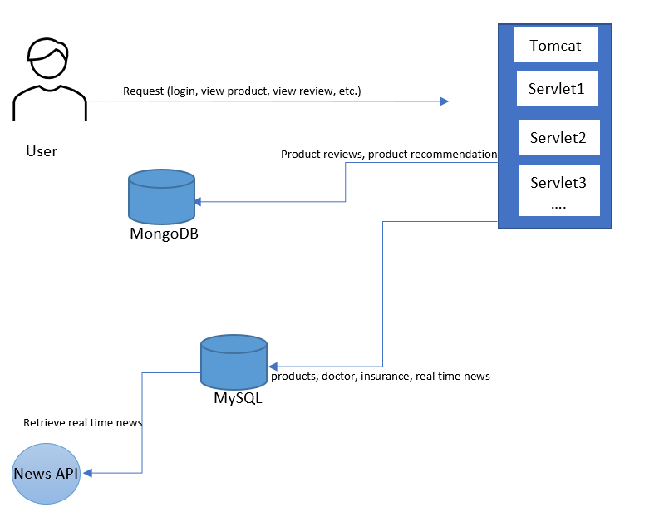
Flow

Slide 4
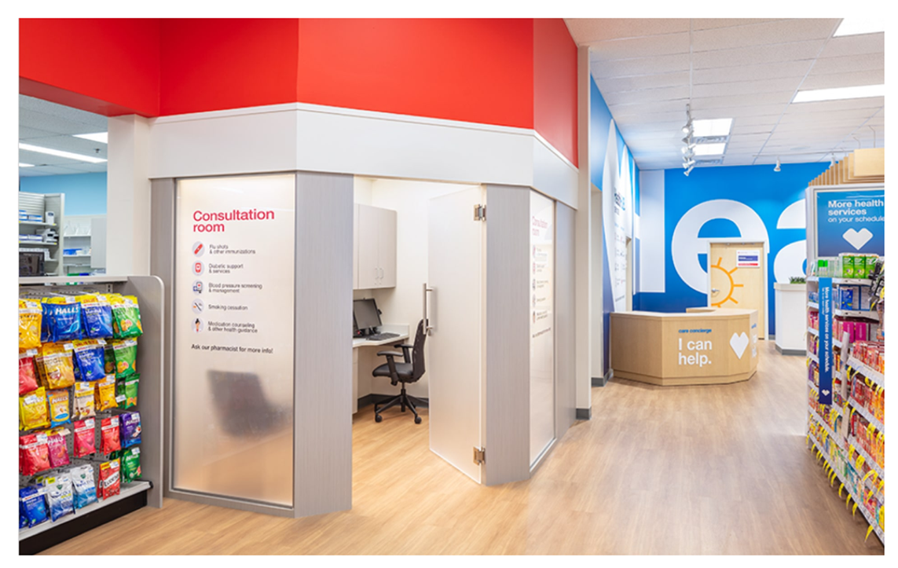
Technologies
1
Bootstrap
2
Ajax
3
jQuery
4
Servlet
5
MySQL
6
MongoDB
7
JSP

Slide 5
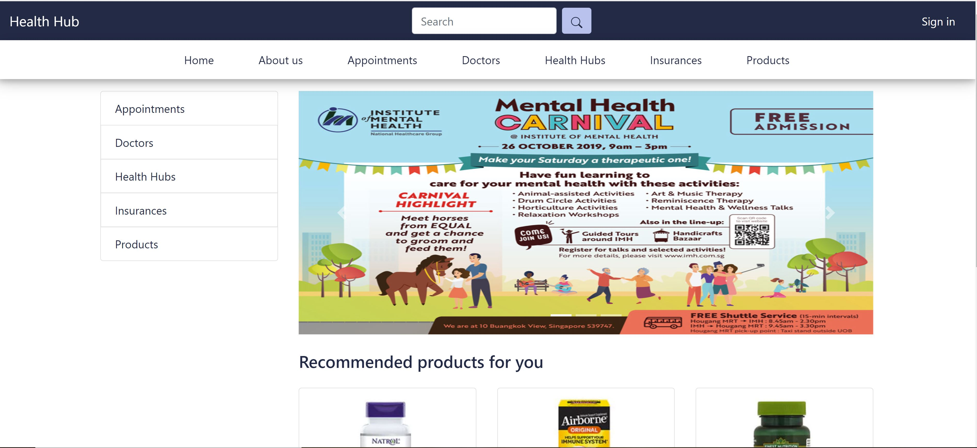
Home Page Demo

Slide 6
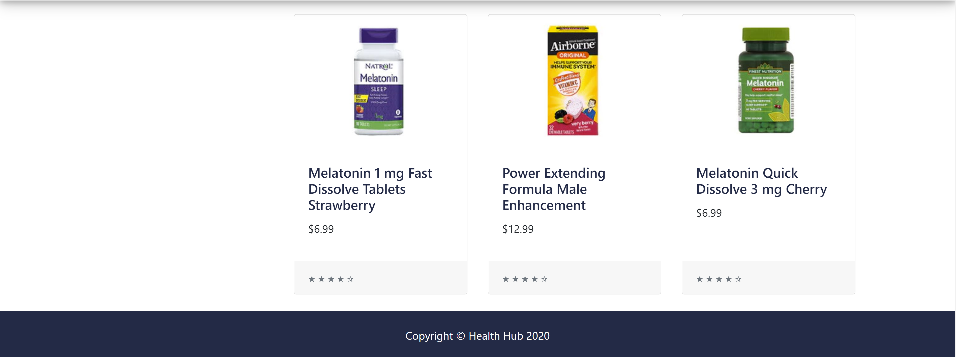
Home Page Demo

Slide 7
Thanks
Notes:
在“幻灯片放映”模式下，选择箭头访问相应链接。

