Slide 1

Truck Data Analysis
Group 9

Slide 2

Problem Statements
Analyze data set to infer factors which correspond with elevated risk of events.
Provide observations and recommendations that would help management to reduce overall risk profile of a fleet of commercial truck drivers.
Analyzed truck mileage data to understand the seasonal impacts.

Slide 3





Process Flow
VM

Slide 4
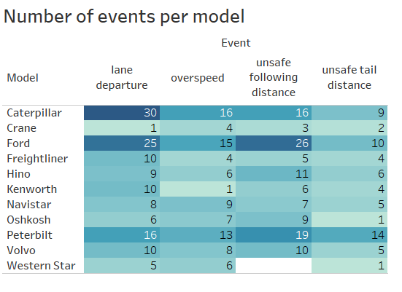
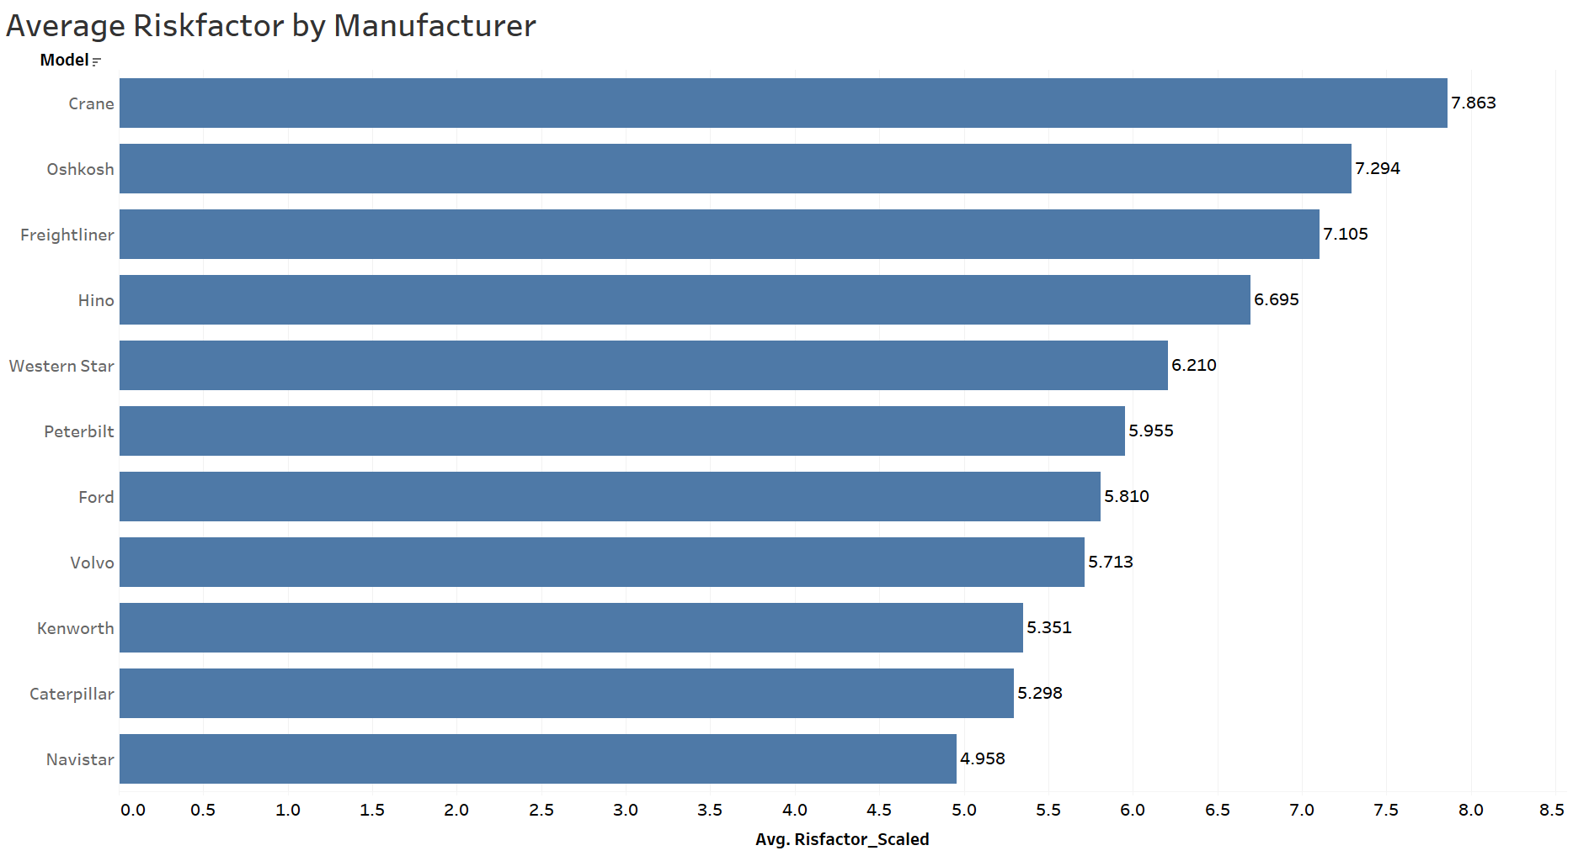
Trucks as Causal Factor
Upon initial analysis, there is evidence to show that some truck manufacturers have the largest share of safety incidents. However, upon further review, these truck manufacturers also had far more drivers overall. Therefore, in aggregate, they had lower overall risk of incidents on average, both before and after outliers were removed. Therefore, there is less evidence supporting trucks being the causal risk factor.

Slide 5
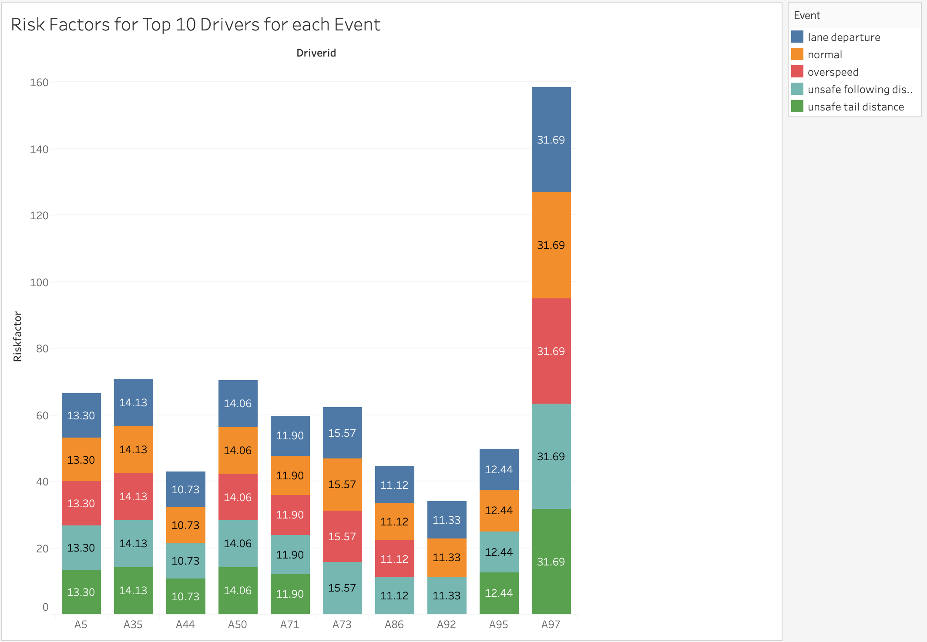
Drivers as Causal Factor
Finding:
There was evidence to support the hypothesis that some drivers were inherently riskier, regardless of the truck. Therefore, reducing these few outliers could significantly improve the overall risk profile of a fleet of drivers.
Recommendation:
Incentives for safe driving, penalties for repeated high-risk behaviors

Slide 6
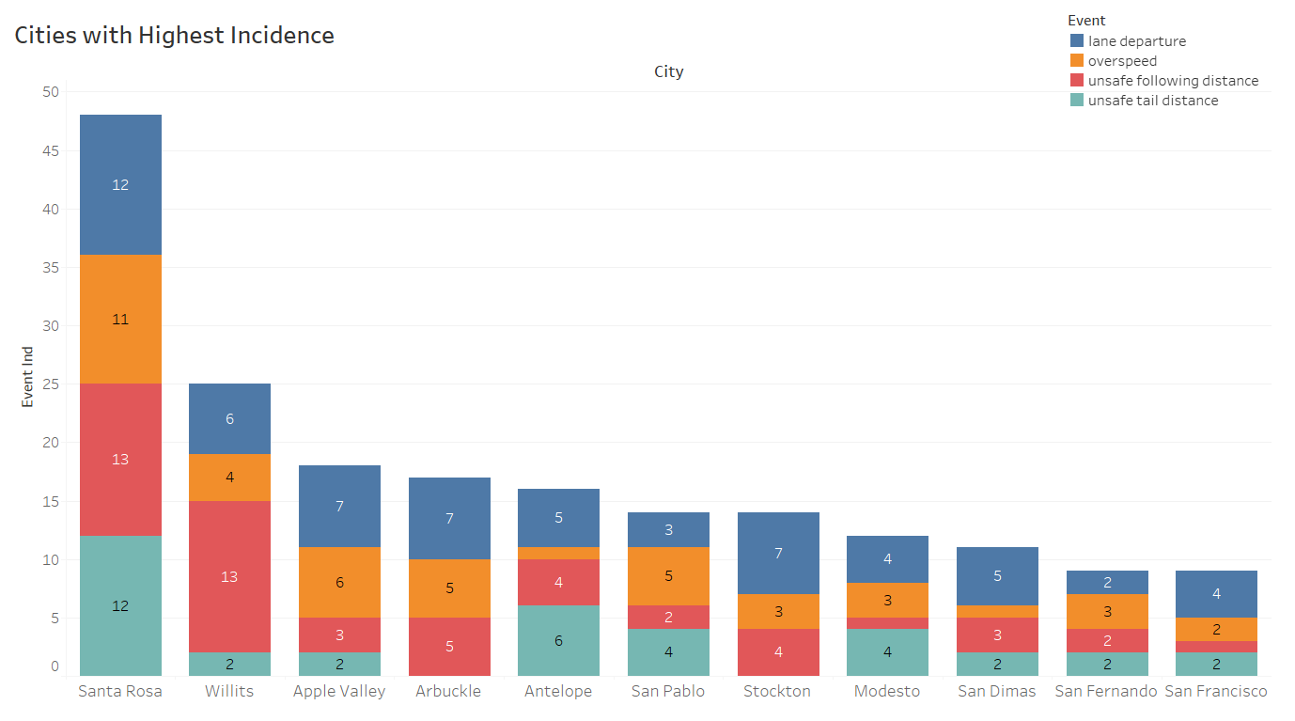
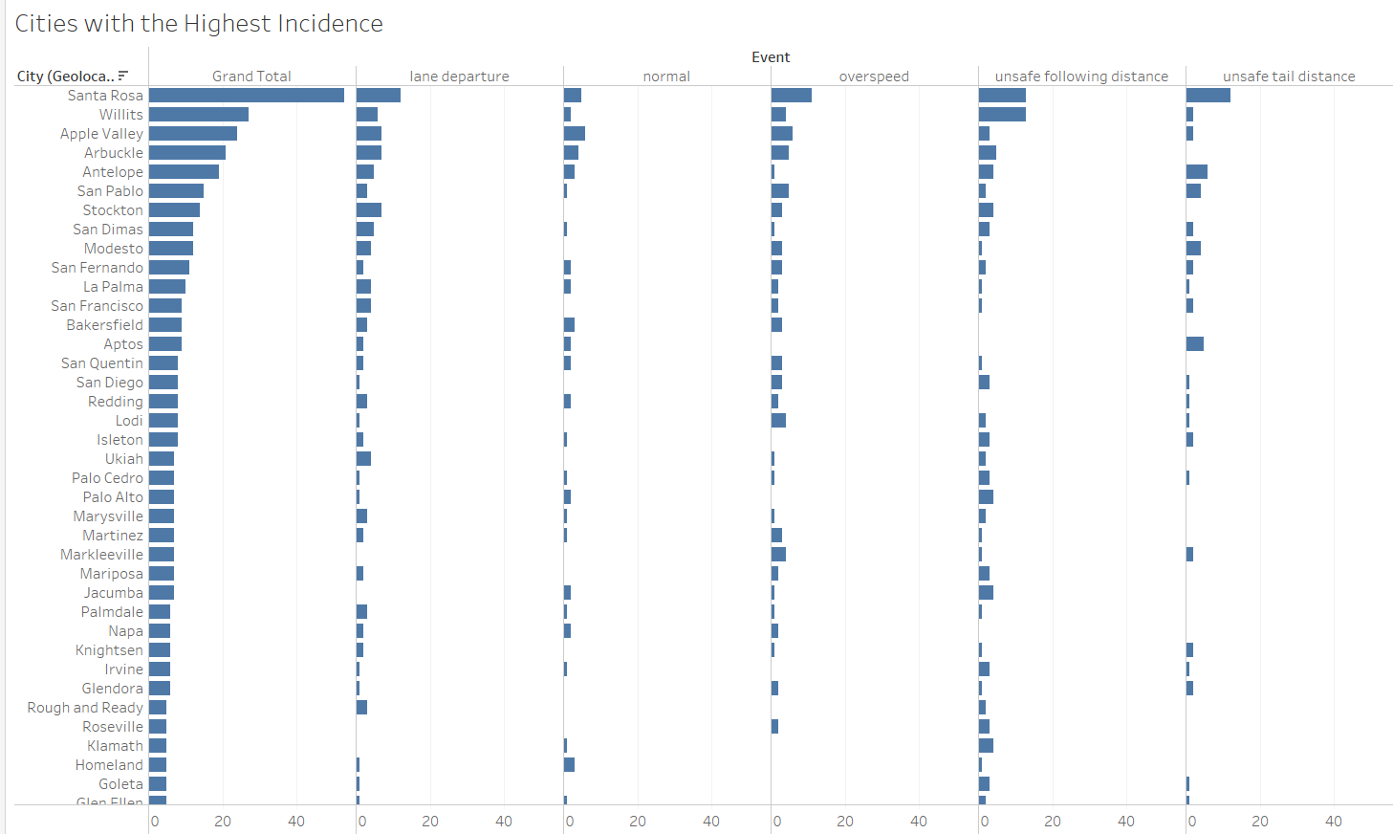
Geography as Causal Factor
Observation:
Some geographical locations had much higher incidence of occurrences. This may be due to poor road design, natural geographic features causing visual obstruction, poor signage, or the like.
Recommendation:
Require route specific training or quick reference route guides to be reviewed prior to a new driver taking a known high-risk route.
Notes:
For example, Santa Rosa, Willits, Apple Valley are Arbuckle had abnormally high occurrence rates. However, we noted differences between some of these areas. For example, while Santa Rosa had very high rates of occurrence, typically, the instances were spread relatively evenly among drivers. For example, even the riskiest drivers who had occurrences here, only had one or two, and rarely repeated. They also showed numerous normal occurrences here. Leading to a conclusion that a driver may make a mistake the first time they drive through but correct for the difficult obstacle in the future. Arbuckle, however, had a particular driver with repeated occurrences, implying that even though the driver may be aware of an obstruction, it was difficult to correct in future trips.

Slide 7
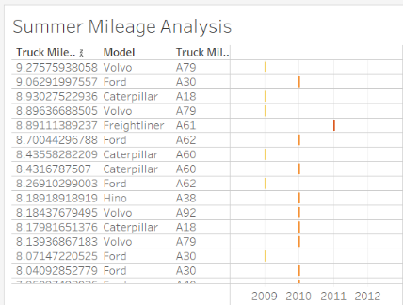
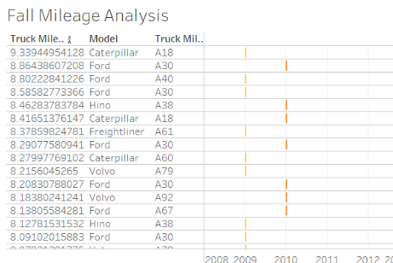
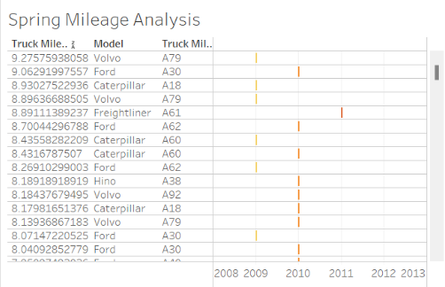
Seasonality Analysis
Data preparation
Dropped 2013 data as it had only 1.5 seasons data (Spring, Summer)
Split Trucks data season-wise to generate corresponding avg/truck mileage/riskfactor data
Other insights
2011
Spring & Summer mileage dropped around 7
Fall mileage dropped to 5.8
2012
Spring, Summer & Fall dropped around 6
Data issues
Gas & total miles are pretty much same across all seasons/years
90% of seasonally divided data had riskfactor >10

Slide 8
PySpark Machine Learning Models to Predict RiskFactor
Models | R square | RMSE
Linear Regression | 0.00766 | 4.5
Random Forest Regressor | 0.3335 | 3.65
Decision Tree Regressor | 0.6534 | 2.63
Gradient Boosting Tree Regressor | 0.7173 | 2.37
Independent Variables : event,model,avg_velocity,totmiles
Dependent Variable: Riskfactor
Gradient Boosting Tree regressor performed the best among all the different models.
The feature importance plot shows us that riskfactor should not only be calculated from number of events and totmiles but also include more independent variables.
Feature Importance GBT model
event | 0.0406
model | 0.2997
avg_velocity | 0.2492
totmiles | 0.4104

Slide 9

Summary of Findings/Recommendations
Summary:
Trucks as casual factor
Drivers as casual factor
Geographical factors
Recommendations:
Incentives for safe driving, penalties for repeated high-risk behaviors
Route specific training or quick reference route guides
Have only experienced drivers take riskier routes, until proof of route specific training
Other Desirable Data for Further Analysis:
Date to determine whether seasonality exists
Time of day
Weather Conditions

Slide 10


