Slide 1
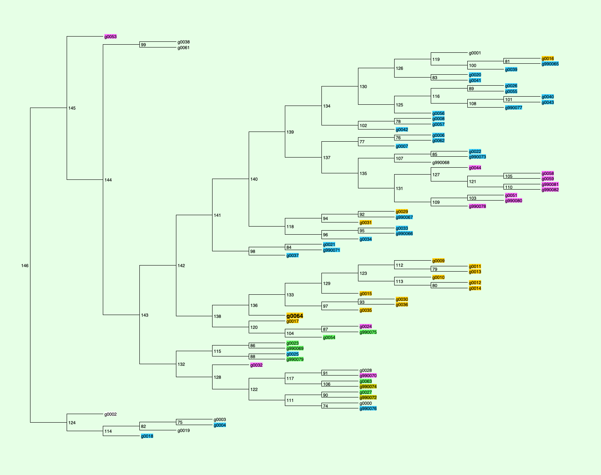
Different classes
Marine
Gut associated
Soda Lake (mostly kulunda)
Target genome isolate
Freshwater
Planctomycetota (Outgroup)

