Slide 1
Jenkins-agents
The automated process of deployment and configuration
Link - https://github.com/vmkolev/jenkins-agents

Slide 2
Jenkins CI/CD
Used tools:
Ansible
– roles & tags
Docker – images
- jenkins/jenkins:lts – master controller
- jenkins/inbound-agent – jenkins agents
Openssh
- generate ssh keys for communication between master and agents every time of new initialization
Groovy
- groovy scripts used for the Jenkins server initialization

Slide 3

Base structure
Jenkins
Virtual Machine 1
master01 - (Master controller)
Ansible host
Agent01
Virtual Machine 2
Run Ansible scripts
agent01 - (executor)
Agent02
Virtual Machine 3
agent02 - (executor)

Slide 4
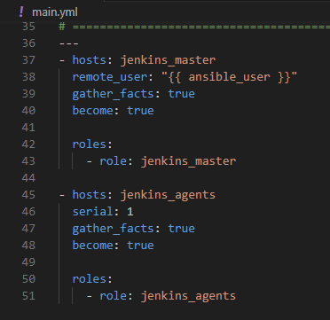
Deployment
Using roles:
jenkins_master
jenkins_slaves

Slide 5
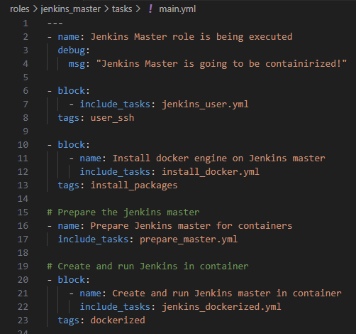
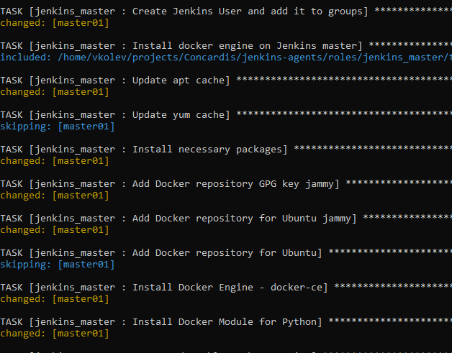
Deployment
Create Jenkins’s user
Install docker engine
Prepare ENV
Dockerized it
Health check

Slide 6
Configuration
During the deployment, the following configuration has been made
Generate new ssh keys for Jenkins’s user and copy to all VM
Setup JENKINS_HOME folder on the master controller
Setup Jenkins agent ENV and working folder
Setup and launch two agents during Jenkins initializing, each one on separate VM
Copy two simple jobs for testing purpose – if exist
Install all plugins, listed in a separate file
Configure a Jenkins user (admin) as admin
Set the numbers of executors (0) on master controller
Skip the Jenkins wizard at the first start.

Slide 7
To Do
Improve backup and restore process
Integrate it with repository

Slide 8
Q & A

