Slide 1
Project Presentation
Veeramanikandan C

Slide 2
Digital Portfolio
STUDENT NAME: VEERAMANIKANDAN C
REGISTER NO AND NMID : 2422k1908
NMID : FBC227E8801B14BA73043DC3D17155D0
DEPARTMENT: BSC.COMPUTER SCIENCE
COLLEGE: CHIKKANNA GOVT ARTS & SCIENCE
COLLEGE BHARATHIAR UNIVERSITY
TIRUPUR

Slide 3
PROJECT TITLE
Portfolio Website
"Showcasing My Skills & Projects"

Slide 4
AGENDA
Problem Statement
Project Overview
End Users
Tools and Technologies
Portfolio design and Layout
Features and Functionality
Results and Screenshots
Conclusion
Github Link

Slide 5
PROBLEM STATEMENT
Many developers struggle to showcase skills effectively.
Need a personal brand presence online.
Traditional resumes don’t highlight interactive projects.
Solution: A responsive, modern portfolio website.

Slide 6
PROJECT OVERVIEW
A personal portfolio website that displays:
Introduction & About Me
Skills (with animations)
Project showcase cards
Contact form
Social media links
Designed with modern UI/UX + animations for better engagement.

Slide 7
WHO ARE THE END USERS?
Hiring Managers / Recruiters – to check skills and experience.
Clients – for freelance opportunities.
Peers & Friends – networking & collaboration.
General Visitors – to follow on social platforms (YouTube, Instagram, X, etc.).

Slide 8
TOOLS AND TECHNIQUES
Frontend Tools:
HTML5, CSS3, JavaScript
Typed.js (typing animation)
FontAwesome (icons)
Other Tools:
Visual Studio Code
Git & GitHub (Version Control)
Canva/PowerPoint (for presentation and branding).

Slide 9
PORTFOLIO DESIGN AND LAYOUT
Sections of Website:
Header & Navigation
Home Section (Intro, Typing Animation, Social Links)
About Section (Personal Bio + Photo)
Skills Section (with Progress Bars & Animations)
Projects Section (Card-based Layout)
Contact Form (with JS Validation)
Footer

Slide 10
FEATURES AND FUNCTIONALITY
Responsive design with dark-theme UI
Animated skill progress bars
Hover animations on project cards
Typing effect for profession (using Typed.js)
Contact form with basic JS validation
Social media integration (YouTube, Instagram, Twitter, etc.)
Reload page button

Slide 11
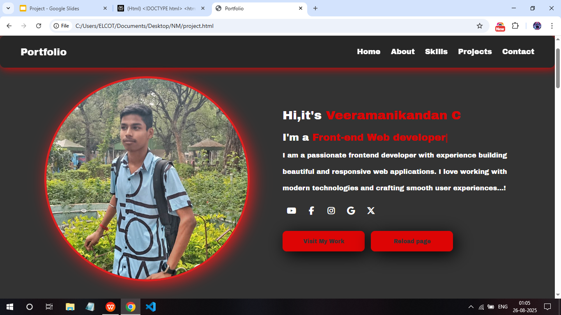
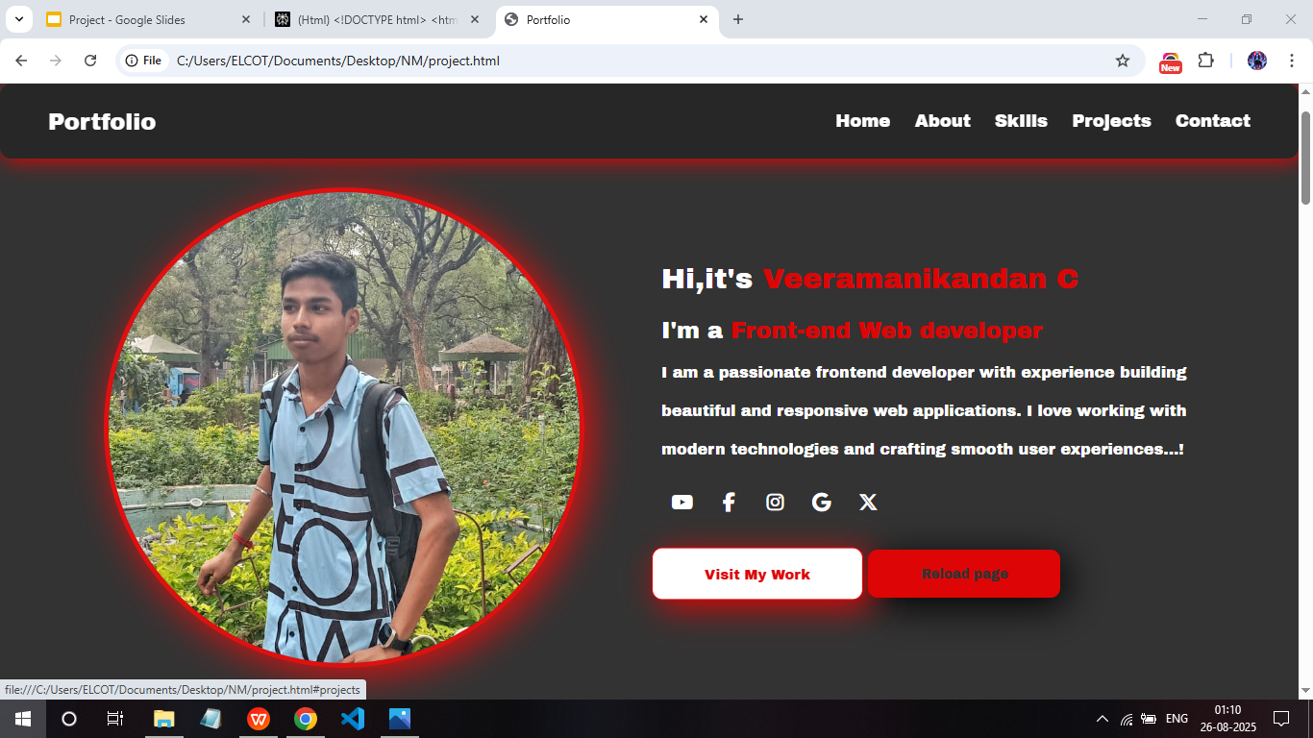
RESULTS AND SCREENSHOTS

Slide 12
RESULTS AND SCREENSHOTS

Slide 13
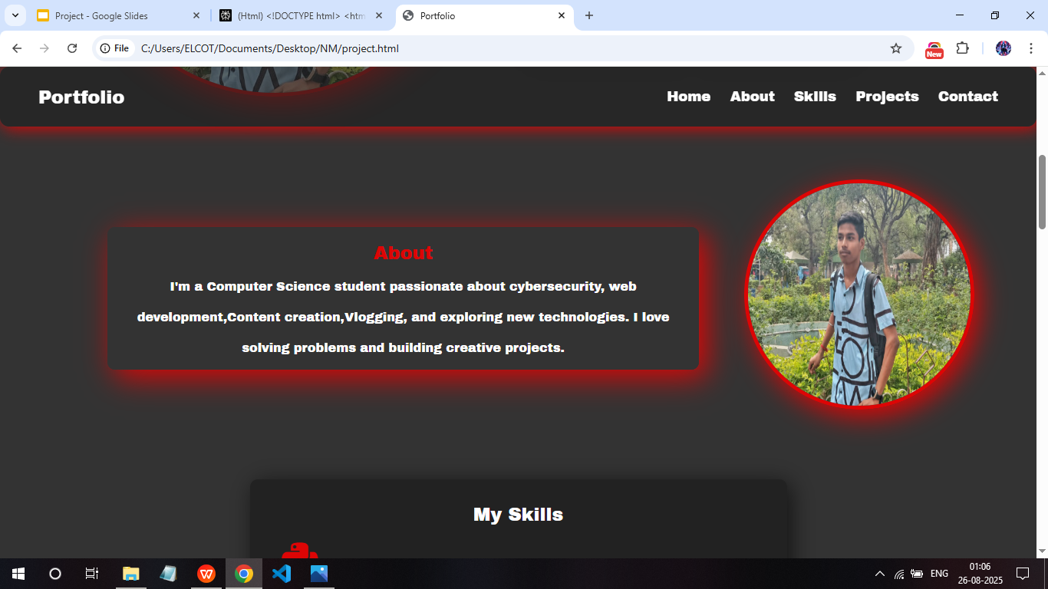
RESULTS AND SCREENSHOTS

Slide 14
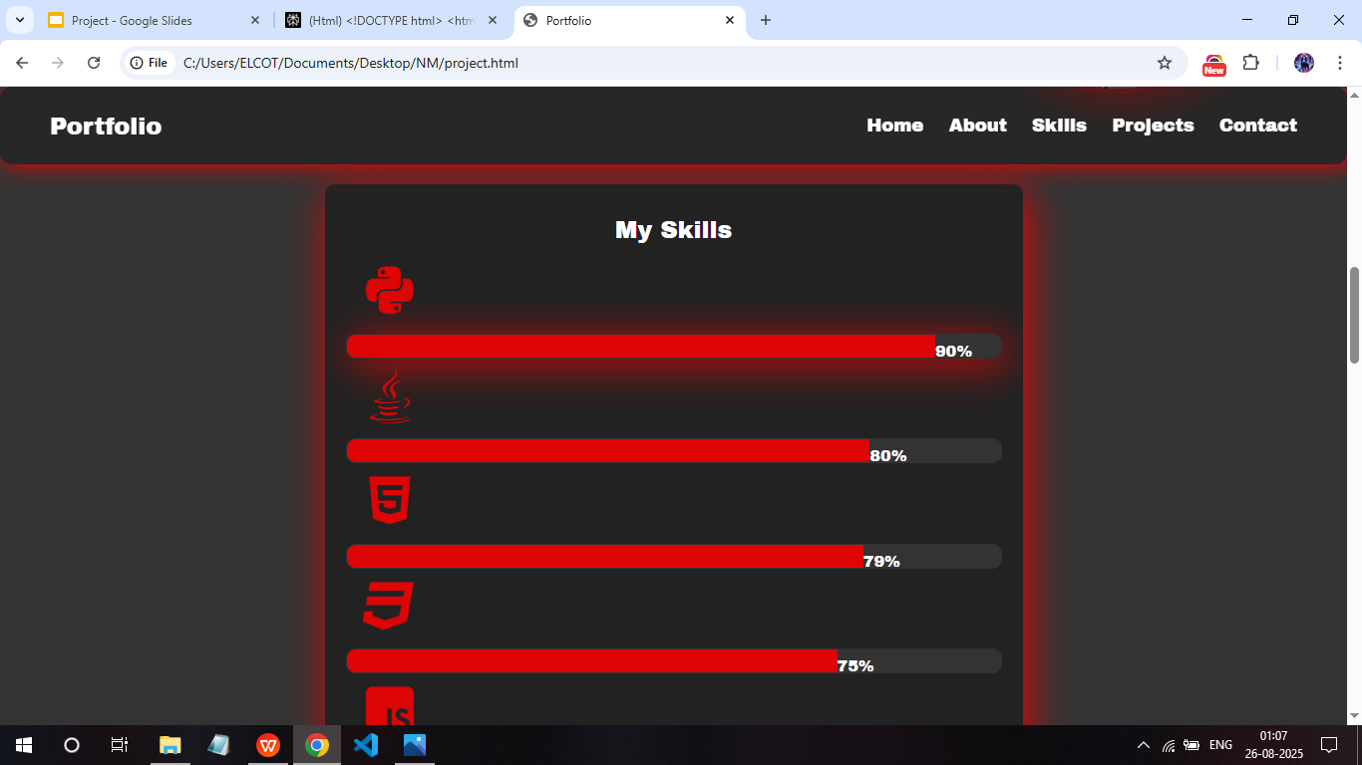
RESULTS AND SCREENSHOTS

Slide 15
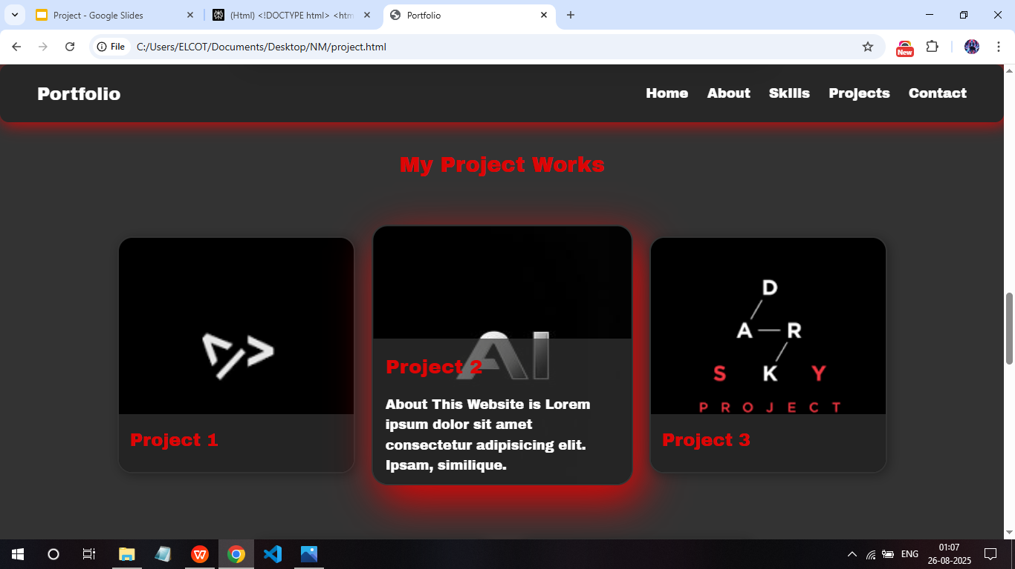
RESULTS AND SCREENSHOTS

Slide 16
CONCLUSION
Built a modern, responsive portfolio website.
Helps in showcasing projects & technical skills.
Acts as a digital resume for opportunities.
Future Enhancements:
Connect form to Email/Database.
Add more projects & blogs.
Deploy on GitHub Pages / Netlify / Vercel.

Slide 17
GitHub Link
https://vmkveeramani31-oss.github.io/Veeramanikandan-TNSDC-FWD-DP/project.html
Neocities Link:
https://vmkveeramani.neocities.org/Portfolio/project

