Slide 1

promises
the way of the angular
AngularJS Portugal
meetup.com/AngularJS-Portugal/
twitter.com/angularjspt
Google+ community

Slide 2

/$ whoami
Vitor Fernandes
vmlf01@gmail.com
15+ years developer
CTO with Gotv Media Software since 2002
Creator of AngularJS Portugal group
Visual Basic 5, Microsoft WebTv ASP/Jscript, .Net Framework 1 through 4.5 desktop apps, Titanium Mobile Javascript Mobile apps,
AngularJS last 2 months

Slide 3
what are promises
What are promises?
A promise is a container that holds or will hold a value
WHAT?!?
It's a trust thing!
With promises, you are always guaranteed
to get one and only one value back
(even if it's a failure)
Trust me :)

Slide 4
what are promises
1
What do they do?
Promises are a way of thinking synchronously
and doing asynchronously.
What is it good for?!
Unlike war, absolutely everything.
Say it again!

Slide 5
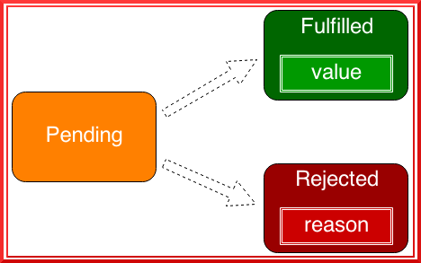
promise states
2
A promise can be:
    Pending
    Fulfilled
    Rejected
Once a Promise is fulfilled or rejected, it’ll remain in that state forever.

Slide 6
promise guarantees
3
promiseForResult.then(onFulfilled, onRejected);
Only one of onFulfilled or onRejected will be called.
onFulfilled will be called with a single fulfillment value (⇔ return value).
onRejected will be called with a single rejection reason (⇔ thrown exception).
If the promise is already settled, the handlers will still be called once you attach them.
The handlers will always be called asynchronously.
    the promised land in angular, domenic denicola

Slide 7
programming 101: algorithms
Dinner out:
How many people?
Which restaurant?
Book restaurant
Show up on time
Eat

Slide 8
programming 101: algorithms
Dinner out:
Well that's all fine and dandy,
but what about the other stuff?
In reality, you cannot block waiting for each step to complete. You need to go about your life!
(Web) programming is async.

Slide 9

parallel execution
Dinner out:
How many people?
Which restaurant?
Book restaurant
Show up on time
Eat
Done at
same time

Slide 10

handle exceptions
Dinner out:
How many people?
Which restaurant?
Book restaurant
Show up on time
Eat
What if not available?

Slide 11
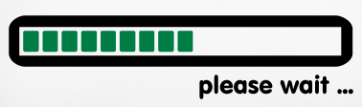
don't block, give feedback
Dinner out:
How many people?
Which restaurant?
Book restaurant
Show up on time
Eat
Table not ready,
wait a bit

Slide 12

finally
Dinner out:
How many people?
Which restaurant?
Book restaurant
Show up on time
Eat

Slide 13
promises in AngularJS
Implemented in AngularJS $q service
Inspired by Kris Kowal's Q library
Contains only the most important features
Integrated with AngularJS's digest/event loop

Slide 14
$q
function aSimplePromise() {
var deferedTask = $q.defer();
deferedTask.resolve(
'I always keep my promises!'
);
return deferedTask.promise;
}

Slide 15
$q
The deferred API
var deferred = $q.defer()
deferred.resolve(value)
deferred.reject(reason)
deferred.notify(status)
var promise = deferred.promise

Slide 16
$q
The promise API
promise.then(onFulfilled, onRejected, onNotify)
promise.catch(onRejected)
promise.finally(callback)

Slide 17
$q
The Helpers
var promise = $q.when(value)
var promise = $q.all([arrayOfPromises])

Slide 18
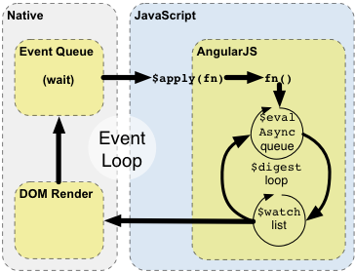
AngularJS digest cycle
    the promised land in angular, domenic denicola

Slide 19
$q resolution inside digest cycle
4
function MyController($scope, $http) {
$scope.text = "loading";
$scope.doThing = function () {
$http.get("somefile.json").then(function (response) {
$scope.text = response.data;
});
};
}
// Works! Angular’s promises are integrated into the digest cycle
    the promised land in angular, domenic denicola

Slide 20
The Tao of Angular
Promises are all around in AngularJS!
$http
$resource
$route
$timeout
...

Slide 21
the 5 commandments
5..9
then() returns a promise
Callback return values fulfill their promises
Callback errors reject their promises
Value/reason passthru if callback missing
Callbacks can return promises
    promises. the basics, from promises/A+, luke smith

Slide 22
promises problems
Can we live without them?
...
Why would you?
Wasted promises → Garbage collection
Silent fails

Slide 23
why promises are awesome
Cleaner method signatures
Uniform return/error semantics
Easy composition
Easy sequential/parallel join
Always async
Exception-style error bubbling
    callbacks, promises, and coroutines (oh my!), domenic denicola

Slide 24
how do promises work?
Wait, wait, wait...
But how does it work?

Slide 25
how do promises work
Well, eh...
Js promises are just
callbacks
in hidding!
Did you think it was magic???

Slide 26
function Promise(fn)
var state = 'pending';
var value;
var deferred = null;
function resolve(newValue) {
value = newValue;
state = 'resolved';
if(deferred) {
handle(deferred);
}
}
function handle(handler) {
if(state === 'pending') {
deferred = handler;
return;
}
if(!handler.onResolved) {
handler.resolve(value);
return;
}
var ret = handler.onResolved(value);
handler.resolve(ret);
}

Slide 27
function Promise(fn)
this.then = function(onResolved) {
return new Promise(function(resolve) {
handle({
onResolved: onResolved,
resolve: resolve
});
});
};
fn(resolve);

Slide 28
promise call flow
.resolve()
Resolve current promise
and next in chain
promise
.handle()
.then()
Add a new promise
to the chain

Slide 29
function handle(handler)
function handle(handler) {
if(state === 'pending') {
deferred = handler;
return;
}
if(!handler.onResolved) {
handler.resolve(value);
return;
}
var ret = handler.onResolved(value);
handler.resolve(ret);
}
If promise state is pending, store handler to call it back later when promise resolves
If there is no onResolved callback for this promise, then take its value and passthru to next promise in chain
Call this promise onResolved handler
Then, resolve next promise in chain with the return value

Slide 30
references
Promises/A+ Specification
http://promises-aplus.github.io/promises-spec/
Callbacks, Promises, and Coroutines (oh my!), Domenic Denicola
http://www.slideshare.net/domenicdenicola/callbacks-promises-and-coroutines-oh-my-the-evolution-of-asynchronicity-in-javascript
The Promised Land in Angular, Domenic Denicola
http://www.slideshare.net/domenicdenicola/the-promised-land-in-angular
Promises, Luke Smith
http://www.slideshare.net/drprolix/promises-16473115
JavaScript Promises ... In Wicked Detail, Matt Greer
http://www.mattgreer.org/articles/promises-in-wicked-detail/

Slide 31
Thanks
promises
the way of the angular
Vitor Fernandes
vmlf01@gmail.com
AngularJS Portugal
meetup.com/AngularJS-Portugal/
twitter.com/angularjspt
Google+ community

