Slide 1
Smart Sound Switch
WORKING VERSION

Slide 2
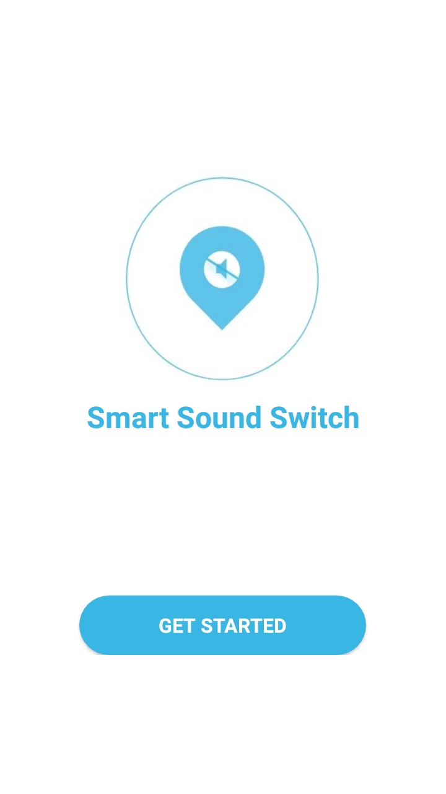
Home Page – The start page of our application

Slide 3
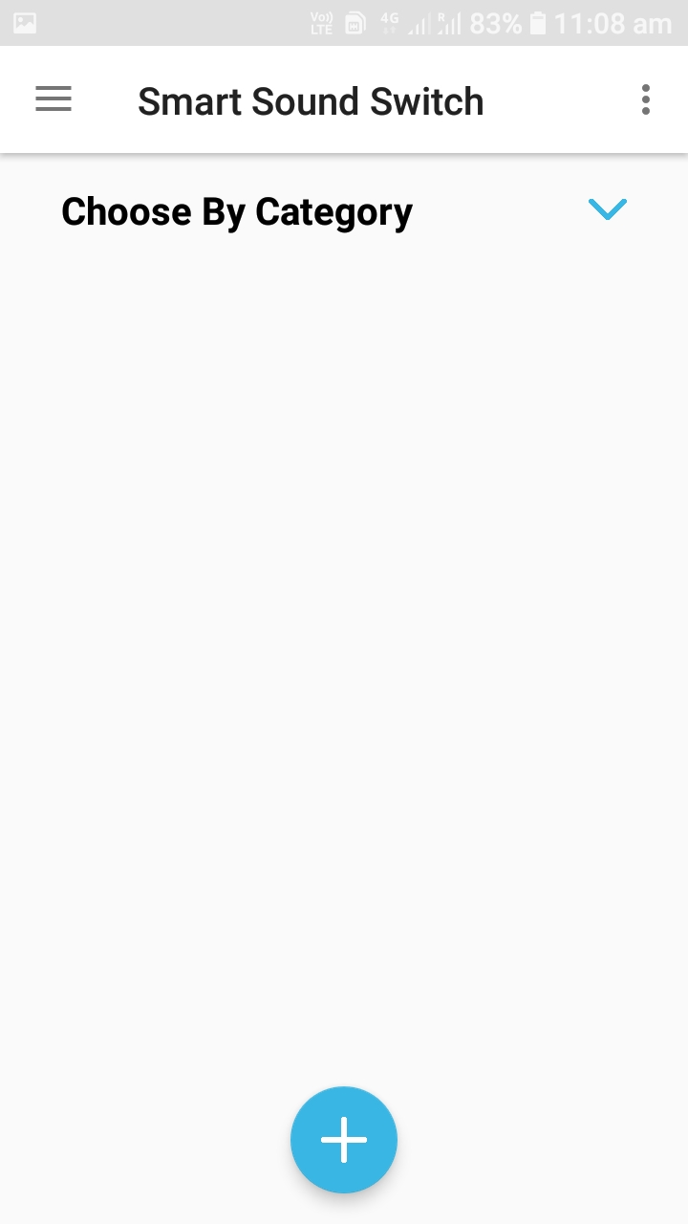
Activity – 1 Enables user to make location selections

Slide 4
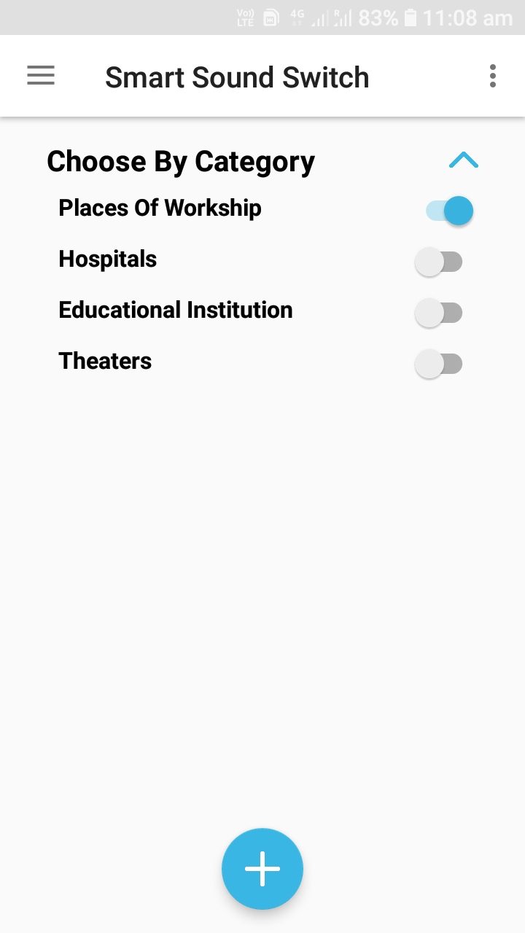
Activity – 2 User can choose preferred categories

Slide 5
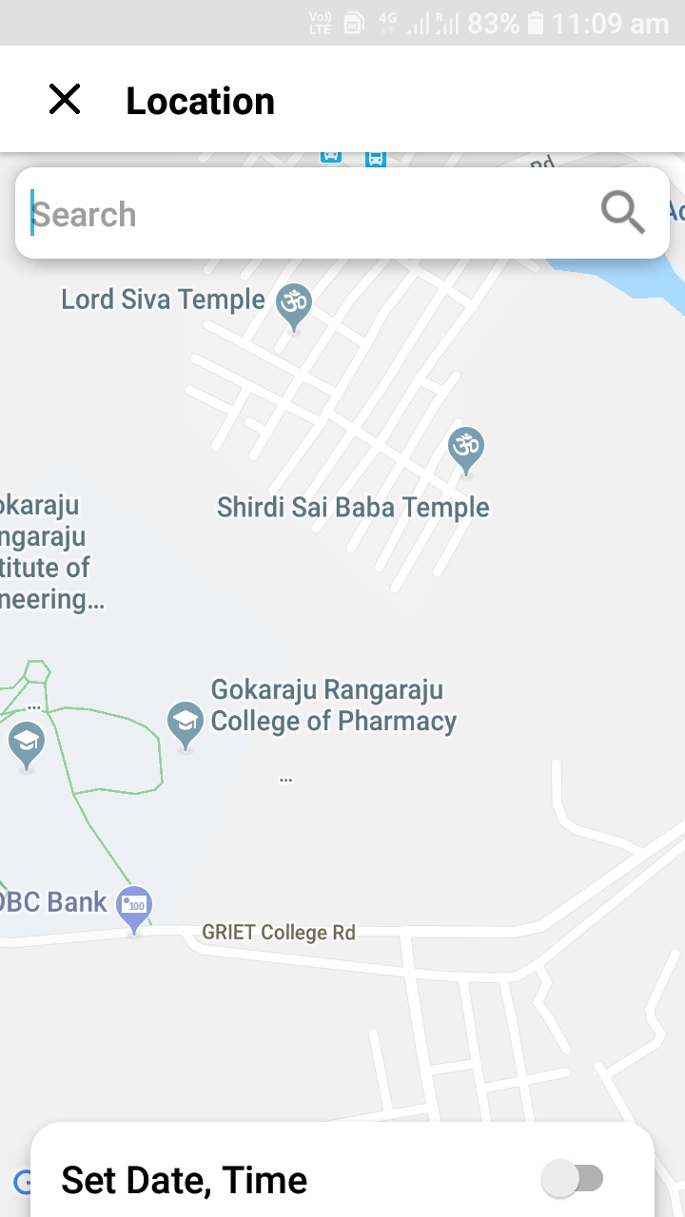
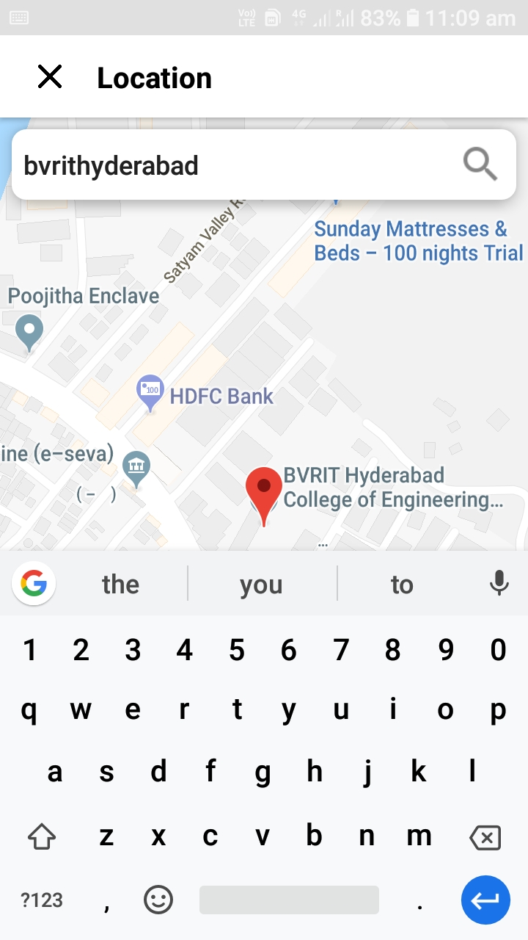
Activity – 3 User can add specific POIs from the map

Slide 6
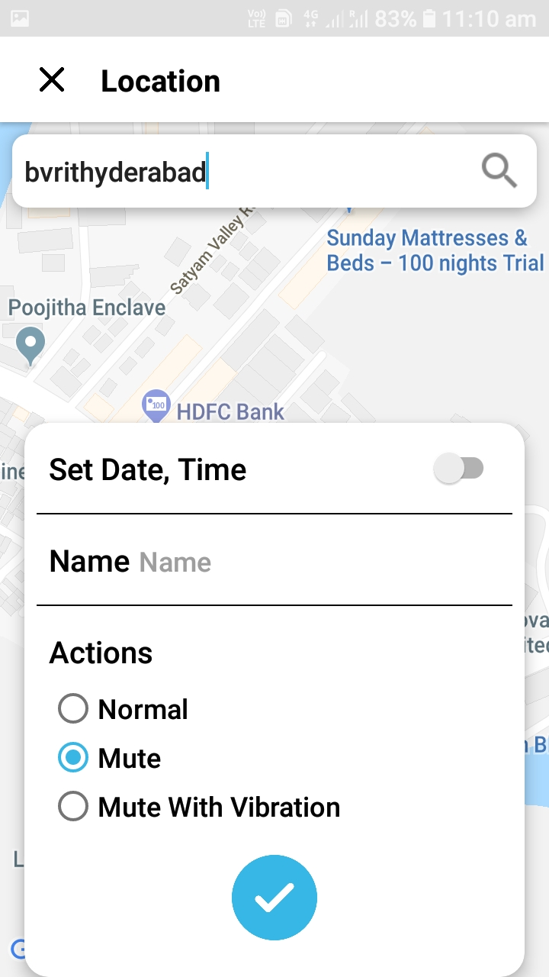
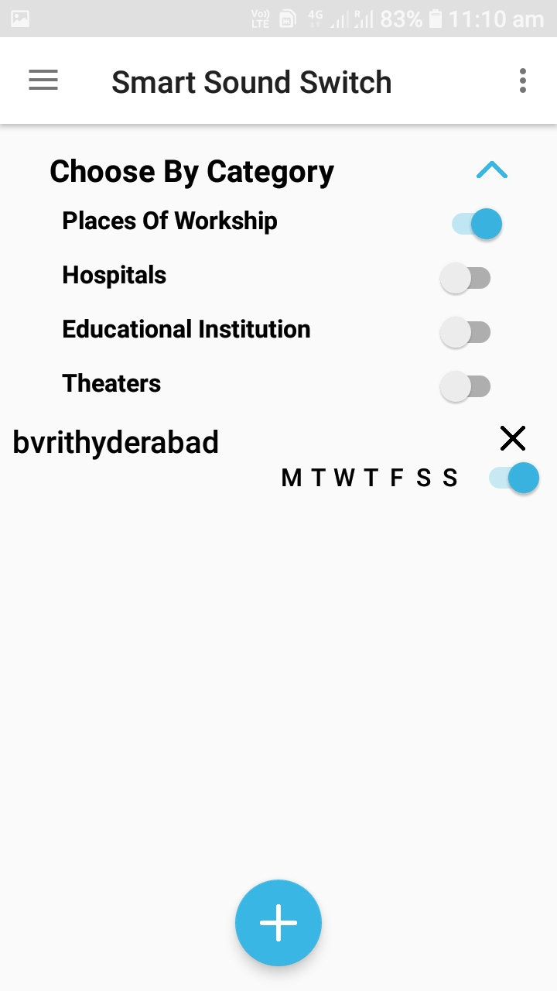
Activity – 4 User can make preferred settings for the current chosen location

Slide 7
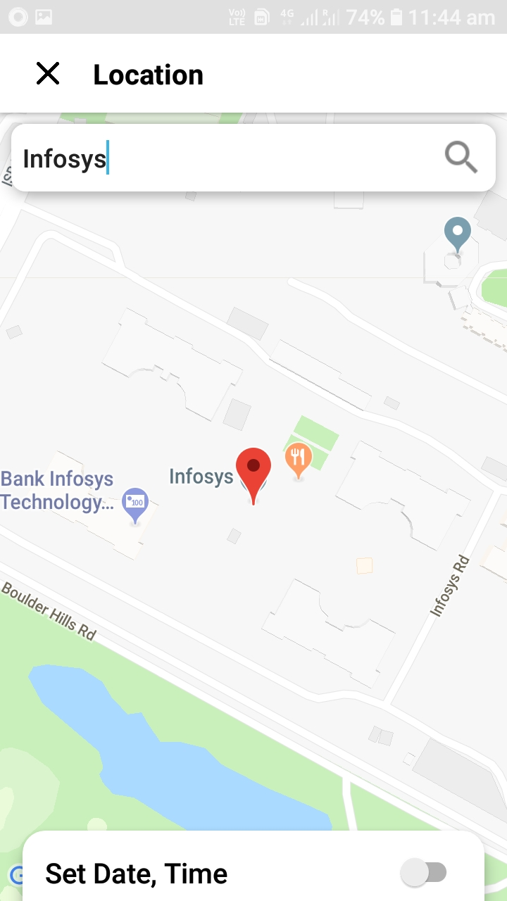
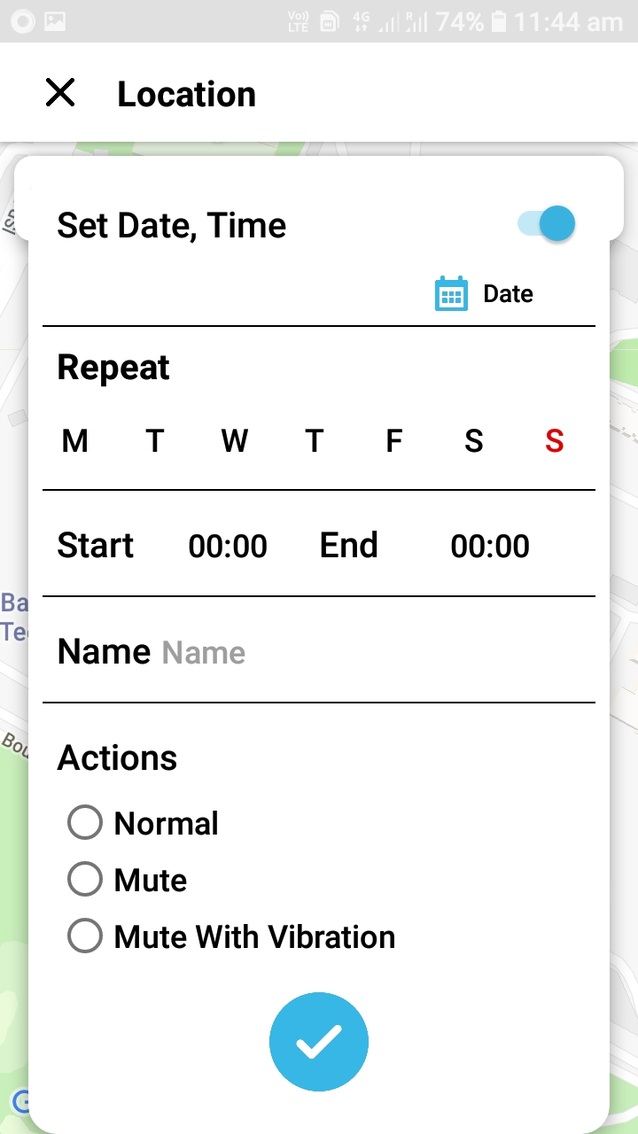
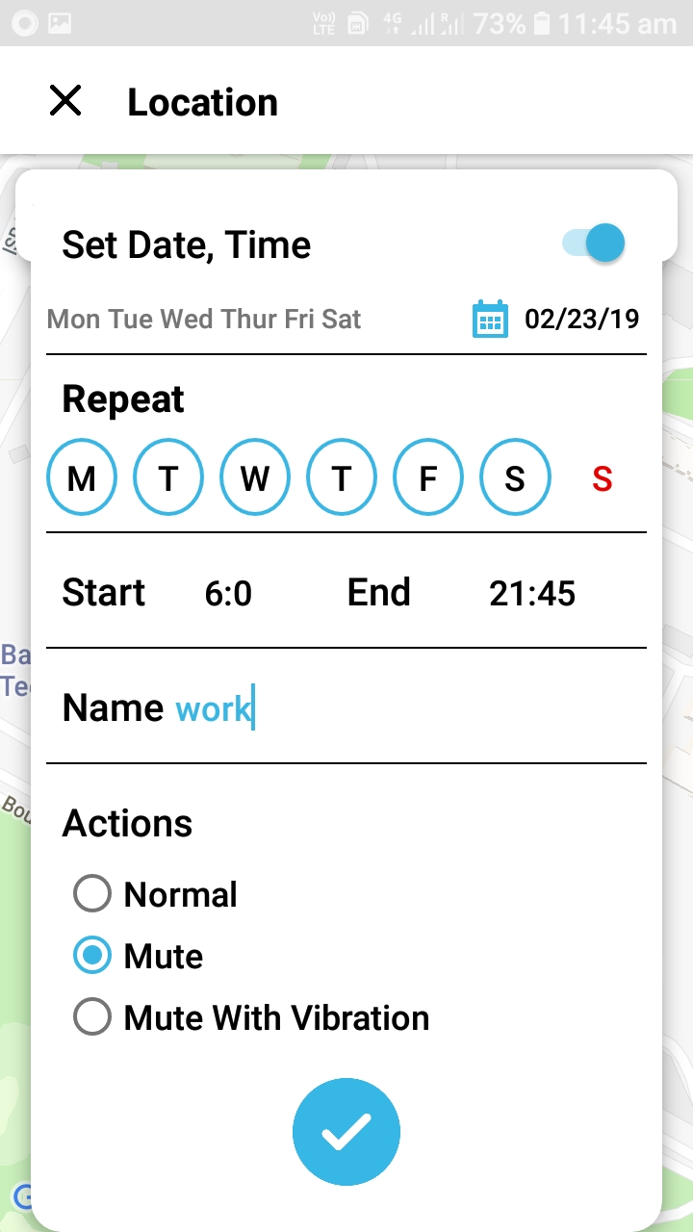
Activity – 5 User can set some specified preferences like date, time and days to be repeated

Slide 8
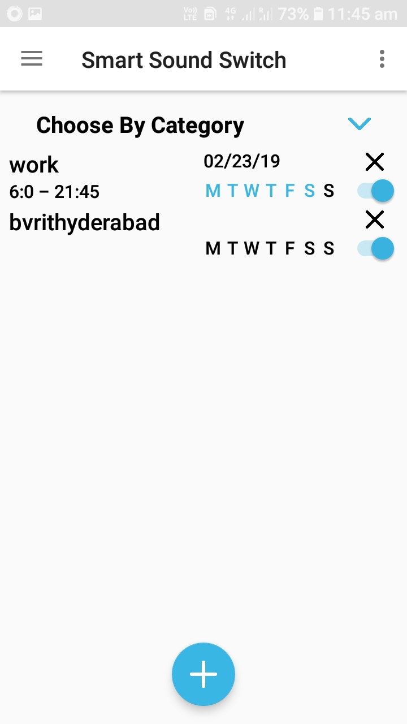
All the set preferences are saved into the database and shown by retrieving from there

Slide 9
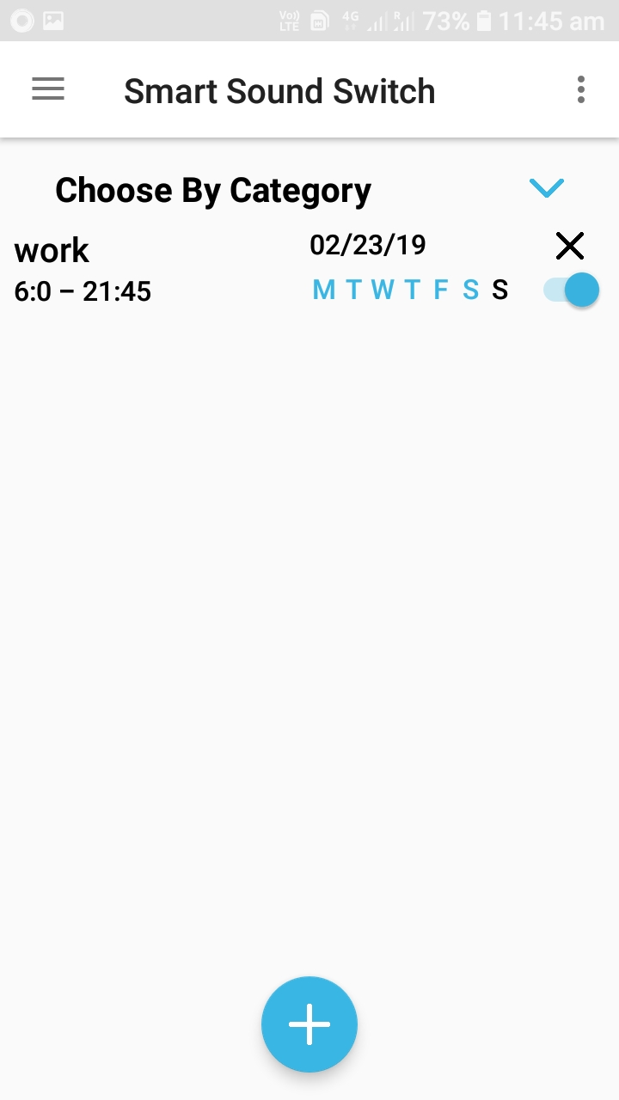
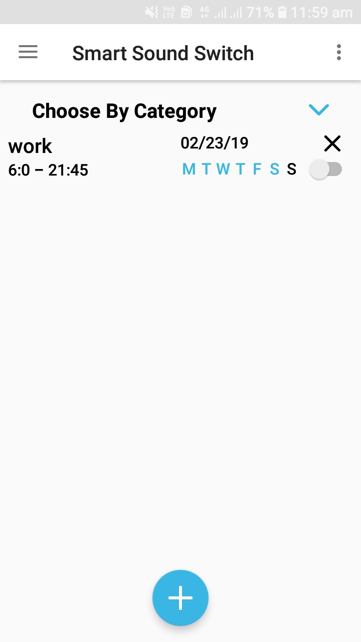
Activity – 6 The selected locations can be deleted or disabled and can be enabled again later

Slide 10
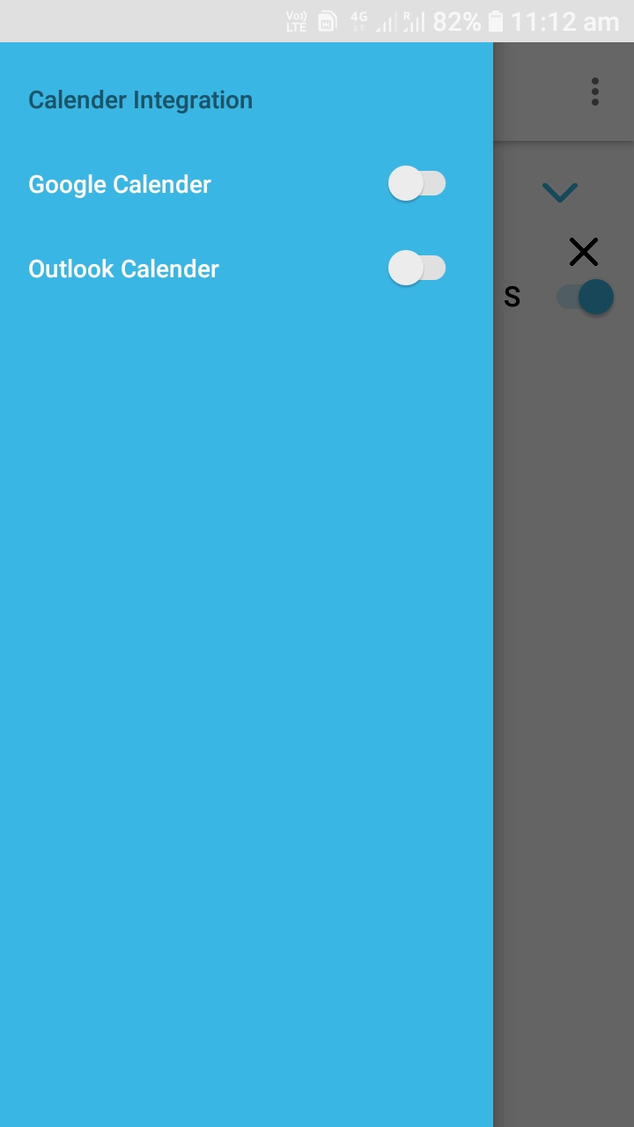
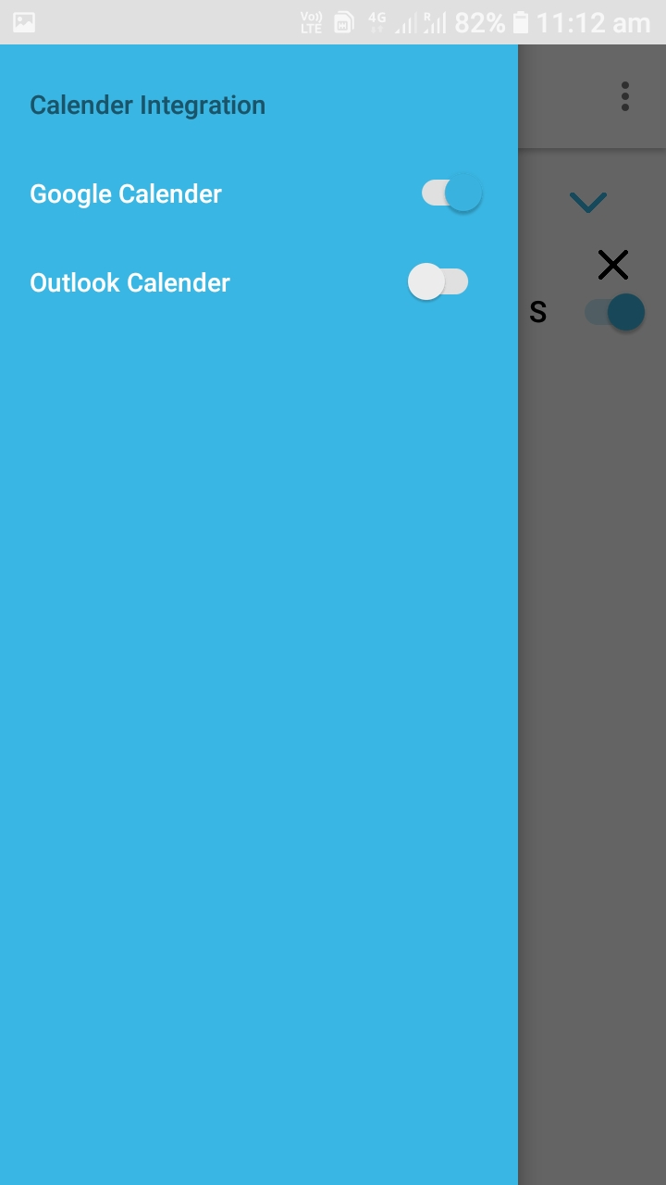
Version – 2 calendar integration

