Slide 1





Case Study: LinkedIn AI Agent using LangGraph
References:
Case studies
Building the agentic future of recruiting: how we engineered LinkedIn’s Hiring Assistant
How LinkedIn Built Their First AI Agent for Hiring with LangGraph | LangChain Interrupt

Slide 2

Case Overview:
Company: LinkedIn
Industry: Recruiting Technology
Use Case: AI Hiring Assistant for recruiters
Presented by: Mozn alzunidi
University: Majmaah University
Major: Computer Science, Data Science Track

Slide 3

Company and Industry
LinkedIn is a large professional networking platform , It operates in recruiting, hiring, and talent solutions
Why this industry matters
Recruiting involves many repetitive but high-value decisions
Recruiters spend a lot of time searching, filtering, evaluating, and messaging candidates

Slide 4

What problem was LinkedIn solving?
Recruiters often need to:
Understand hiring requirements
Search across very large talent pools
Evaluate many applicants
Write outreach messages
Keep the pipeline updated over time

Slide 5

What the System Does
Hiring Assistant can:
understand hiring needs
search for candidates
evaluate applicants

Slide 6
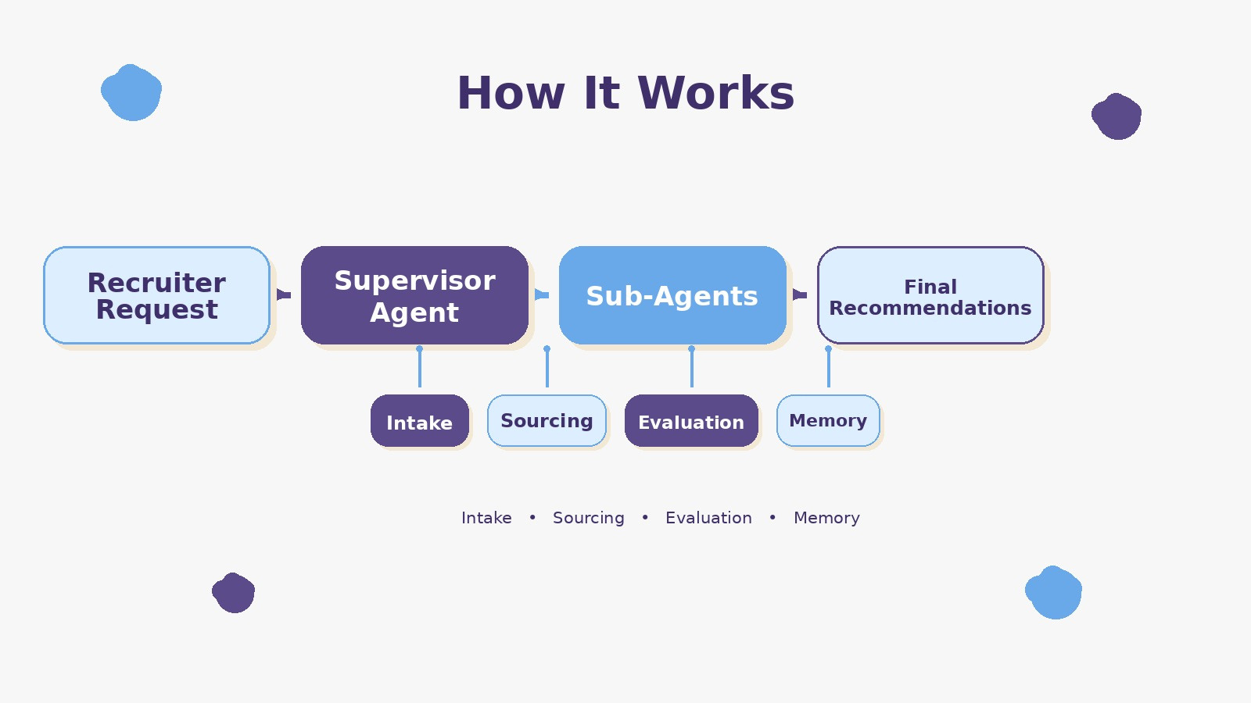
How It Works

Slide 7
Why It Is Agentic
What makes it agentic?
it is multi-step
it can ask clarifying questions
it uses tools, memory, and orchestration
it can plan and execute tasks

Slide 8

What Is Not Agentic
Non-agentic parts
databases
ATS integrations
search infrastructure
backend APIs

Slide 9

summary
LinkedIn Hiring Assistant is a strong example of agentic AI
The agentic part is planning, tool use, memory, and sub-agents
The non-agentic part is the supporting software infrastructure
Recruiters still stay in control of final decisions

