Slide 1
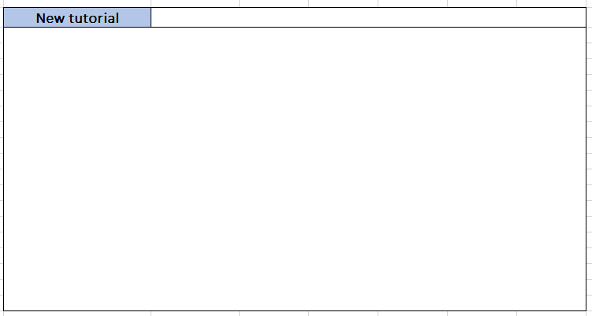
When starting the tutorial maker module
Display a window with the option that the screen shows
Allows you to create a new tutorial

Slide 2
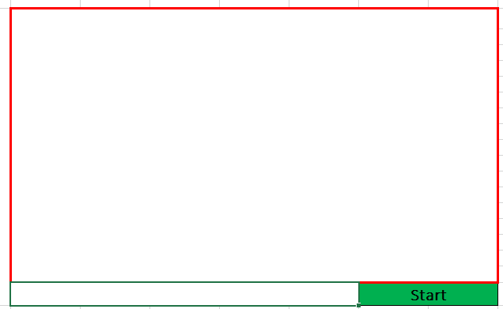
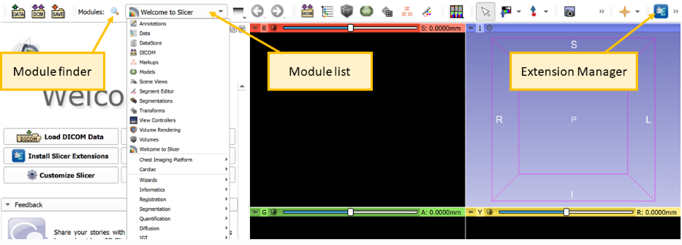
2. indicates with a red box the work area where the frames are captured
Start 3D Slicer with initial values
Start button for the user to indicate that they are going to start recording

Slide 3
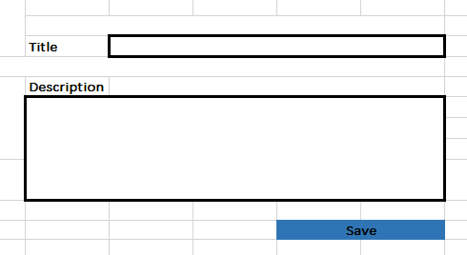
2. Inputs are displayed to enter the title and description of the new tutorial
Pressing the start button displays a new screen
Button to save the tutorial data and later start recording the frames and metadata

Slide 4
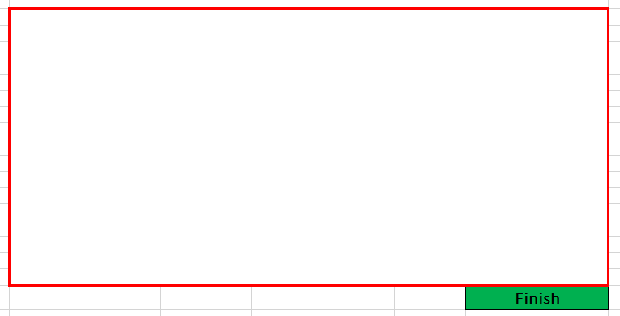
Indicates that the frame recording process has already started from any movement of the mouse or keyboard
Title: Tutorial 1
The finish button is displayed, which will stop the recording of the frames and metadata of the tutorial

Slide 5

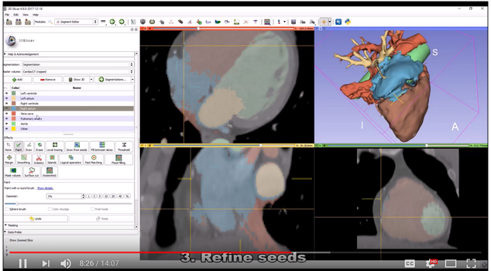
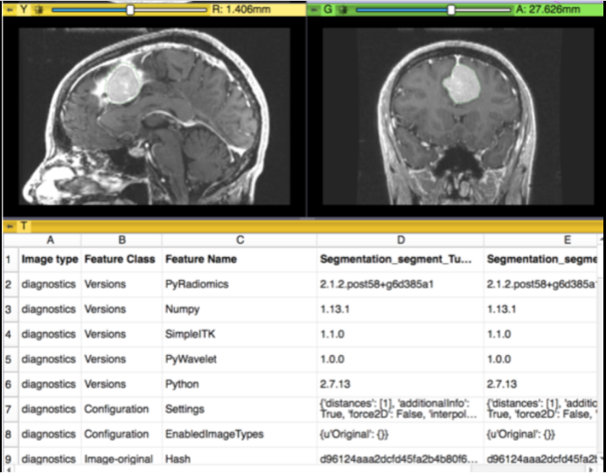
[Frame 1]
Title: Tutorial 1
Frames
[Frame 2]
Task 1 - Screenshot
(4.88798,7.9989)
(6.87664,5.9887)
(7.45345,8.9977)
Metadata
Task2-Metadata
this process is not visible to the user

Slide 6



Text Generation
Metadata
Model
trained model
Task 3- Text Generation

Slide 7

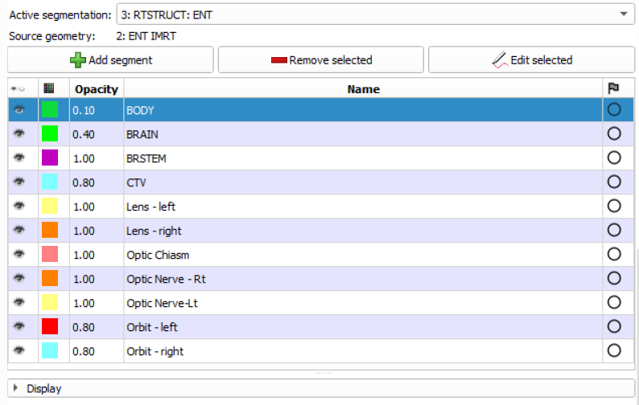
the frames and the text of the tutorial are displayed for your review
Export segmentation to labelmap volume file¶
If master representation of a a segmentation node is binary labelmap then the segmentation will be saved in standard NRRD file format. This is the recommended way of saving segmentation volumes, as it saves additional metadata (segment names, colors, DICOM terminology) in the image file in custom fields and allows saving of overlapping segments.
For exporting segmentation as NRRD or NIFTI file for external software that uses 3D labelmap volume file + color table file for segmentation storage:
Open Export to files section in Segmentations module (or in Segment editor module: choose Export to files, in the drop-down menu of Segmentations button)
Button to save the turorial once corrected and validated by the user
The text is editable for correction

Slide 8
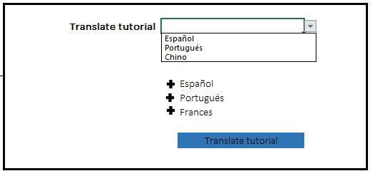
all available languages will be displayed regardless of their translation progress
multiple language selection
Task 3- Text Generation

Slide 9
Self Text
Traslate tutorial
Metadata
Model
trained model
Task 4- Self Test

Slide 10
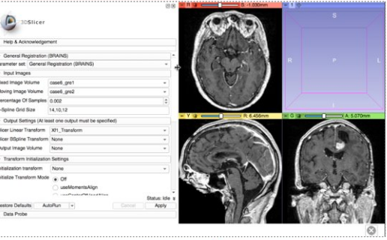

75% Complete
Task 4- Self Test

Slide 11
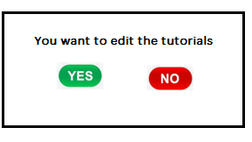

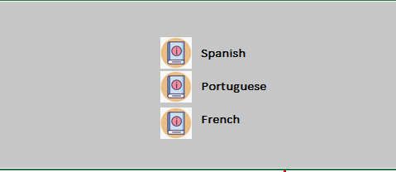
at the end the screen is displayed to edit or download the tutorials in pdf

