Slide 1

Public Library System
Team 3
Victor Munoz
Aidan Henry
Nana Ofosu Budu
Muyiwa Coker

Slide 2

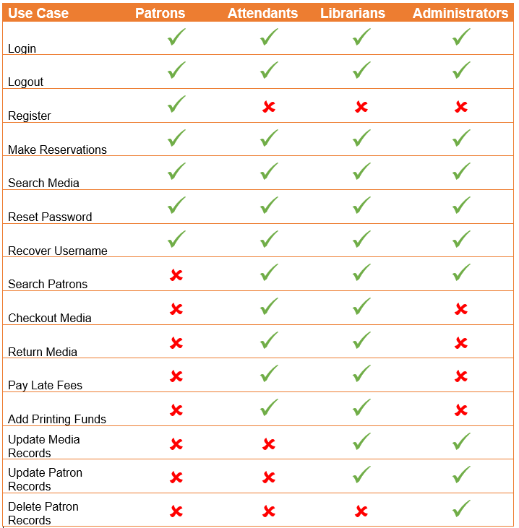
List of Use Cases
Only patrons will need to register
Staff accounts will be created by an administrator after being hired
Only librarians and administrators can edit media and patron records
Only administrator’s can delete patron records

Slide 3
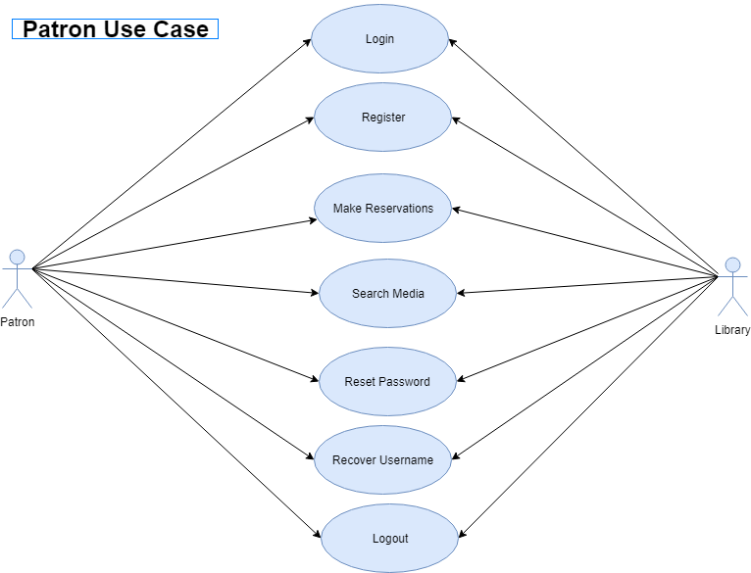
Use Case Example

Slide 4
Use Case Description Example
USE CASE | LOG IN
Description | This function allows users to gain access the system with varying levels of privileges. Patrons will redirected to the patron module while staff will be redirected to the staff module.
Actors | Patrons, Librarians, Attendants, Administrators
Preconditions | Librarians, assistants and administrators share same log in portal. Patrons have a separate log in portals Patron must have a Library Card and be registered in the database Librarians, assistants and administrators must be employed and authorized by management Username not case sensitive.
Basic Flow | Go to log in page User types in user name and password Information is validated Appropriate Web portal opens
Post-conditions | Username and Password must match data in database.
Alternate flows | Option 1 – username or password incorrect Go to log in page User types in user name and password Username or password are incorrect Attempt count increases by one If count is less than 5 show message ‘incorrect username or password’ Process restarts Option 2 – More than 4 login attempts Go to log in page User types in user name and password Username or password are incorrect Attempt count increases by one account is locked Message is displayed stating that the account is locked and to contact the administrator Process ends. User cannot continue until an administrator unlocks the account

Slide 5
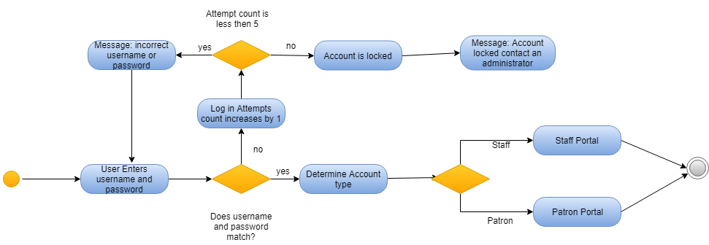
Activity Diagram Example

Slide 6
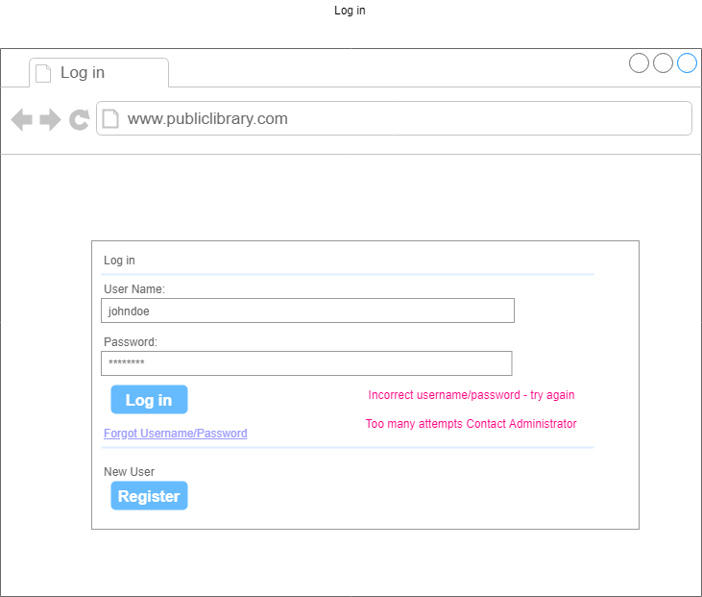
Log In Web Page Design Example

Slide 7
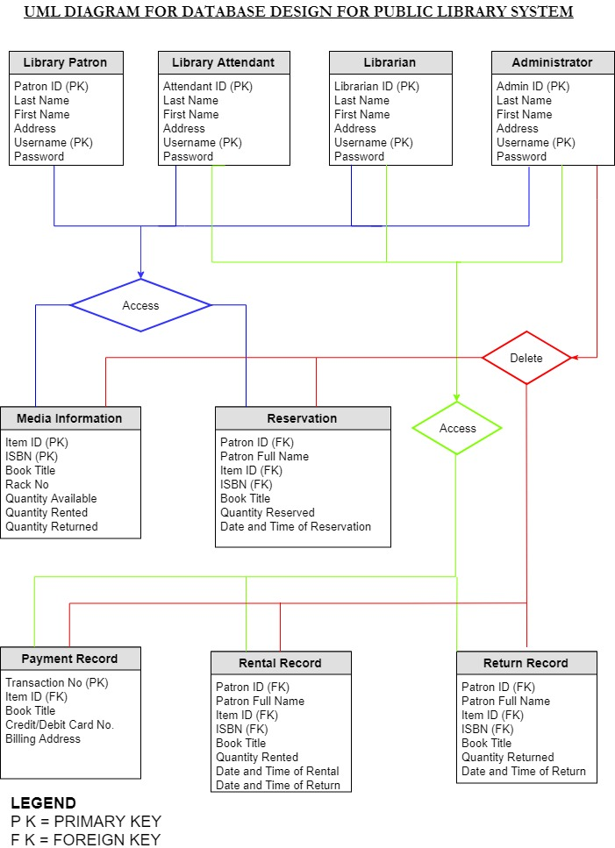

Database Diagram

