Slide 1
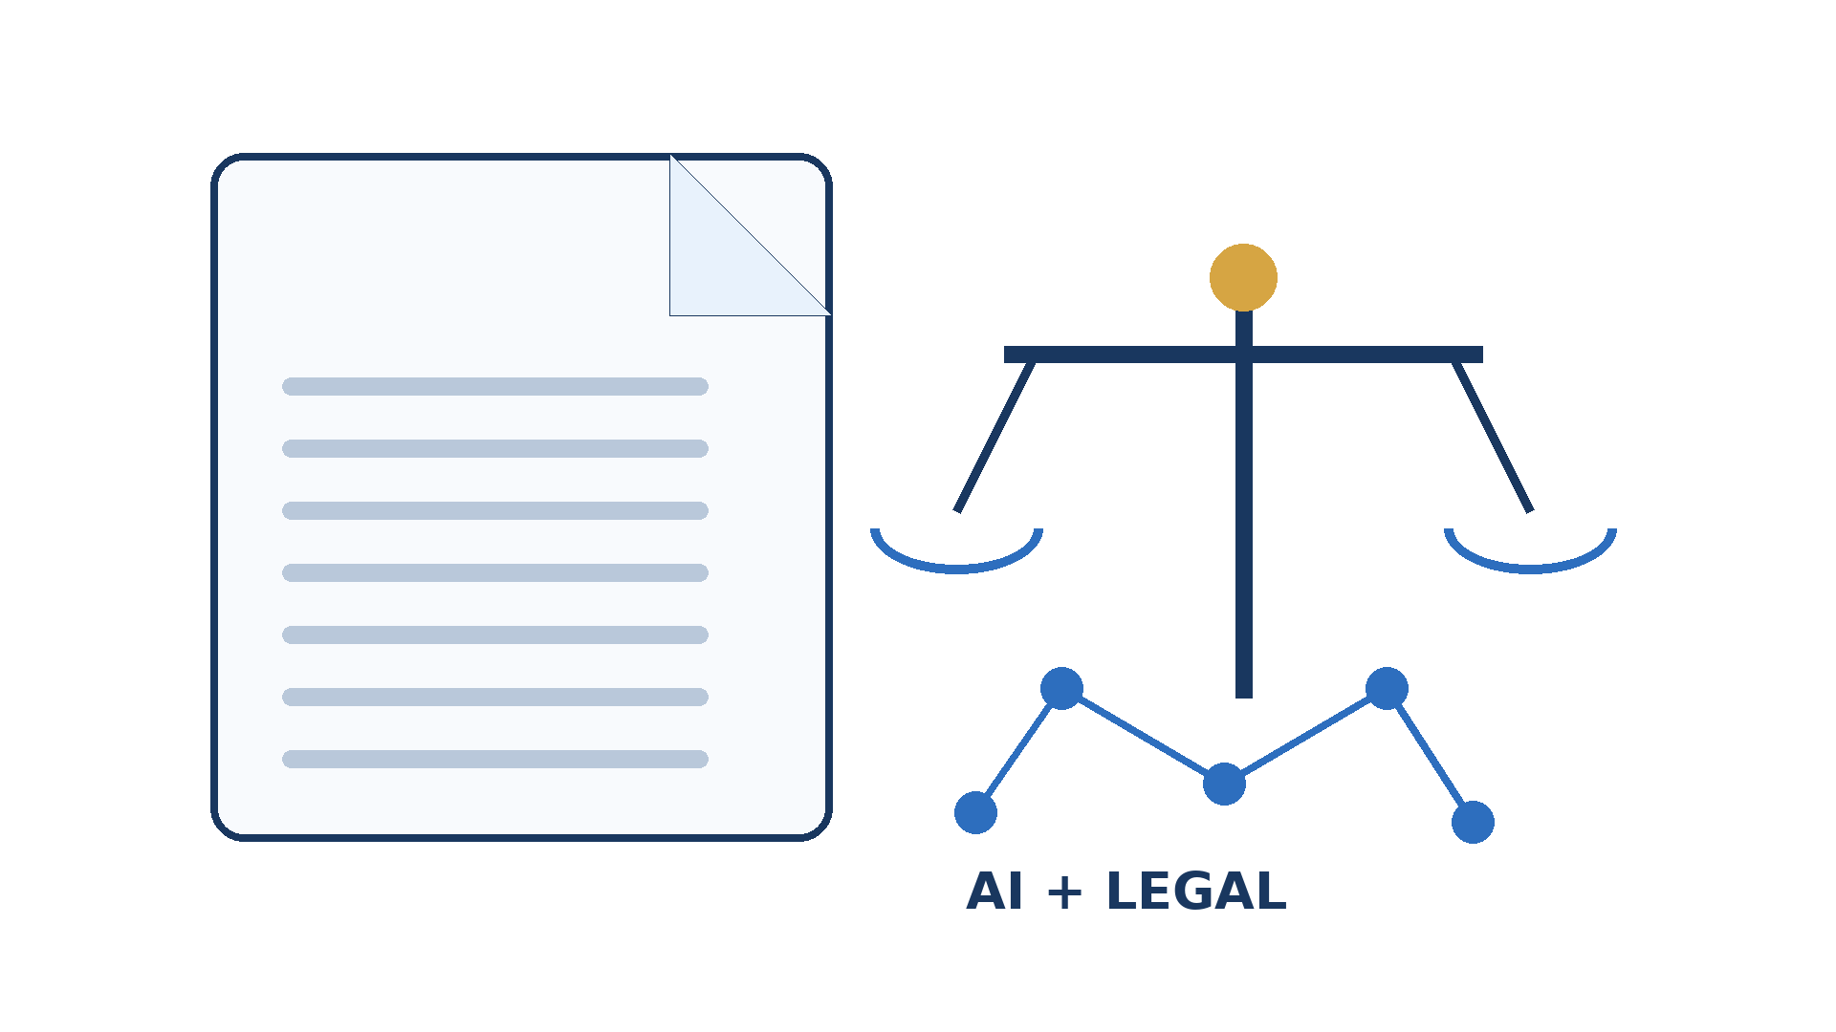
LEGALEASE
AI-Powered Legal Document Generator
Smart, structured and efficient document drafting
TEAM
Team Leader : Niveditha V M
Team Member : Kanimozhi K
Team Member : Kowsalya N
Team Member : Nivashini S
Team Member : Poornima U

Slide 2
Introduction & Problem Statement
2
• Legal documents often require time, careful wording, and knowledge of formal formats.
• Manual drafting can be repetitive and difficult for non-experts.
• Errors or missing clauses may create inconsistencies in a first draft.
• Legalease uses AI to simplify the initial document-generation process.
AI-assisted drafting • Templates • Easy editing

Slide 3
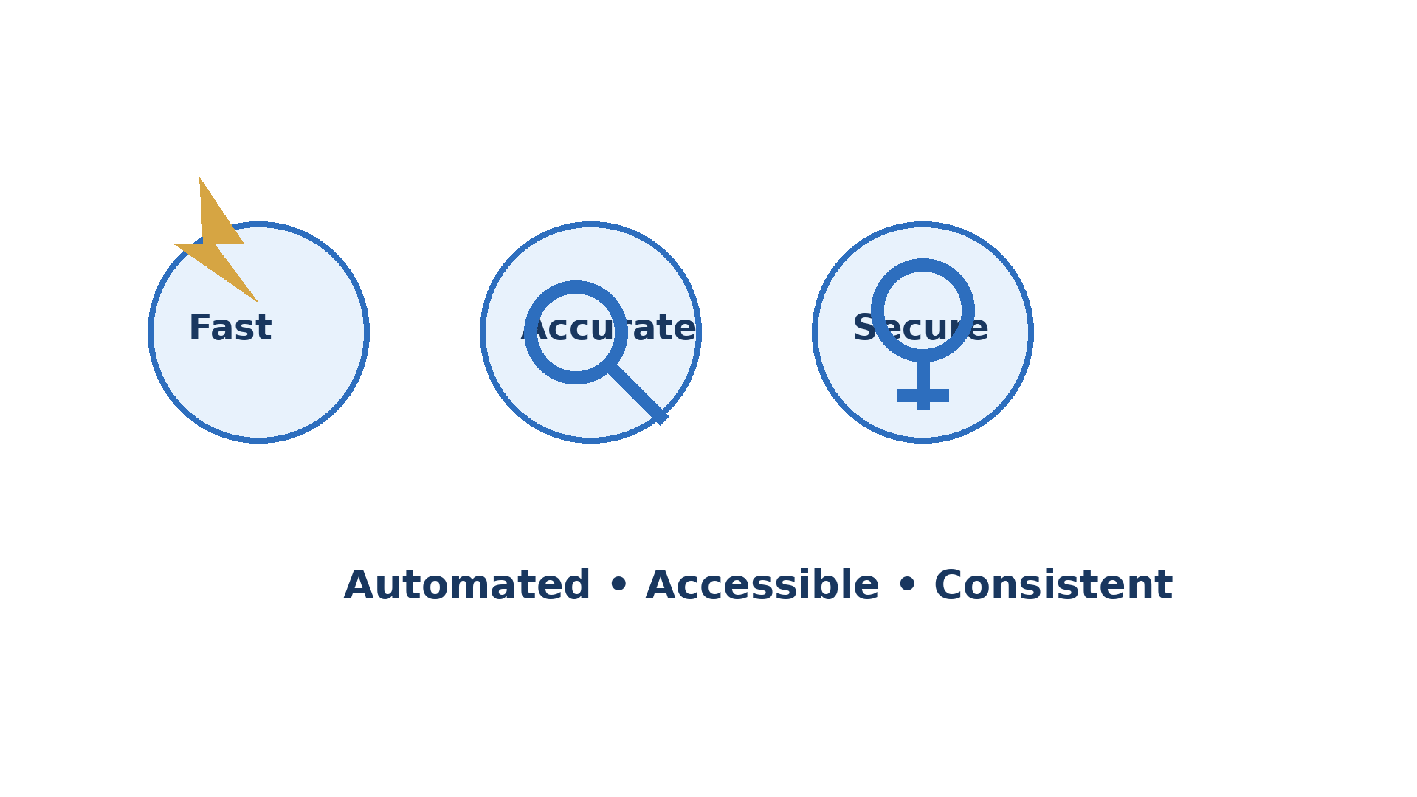
Objectives & Key Features
3
• Generate structured legal-document drafts from user-provided details.
• Provide reusable templates for common document categories.
• Use NLP/AI to organize information into appropriate sections.
• Allow users to review, edit, and export generated documents.
• Keep human review central for legal accuracy and context.
Templates — Reusable formats
AI Drafting — Natural-language input
Export — PDF / DOCX ready

Slide 4
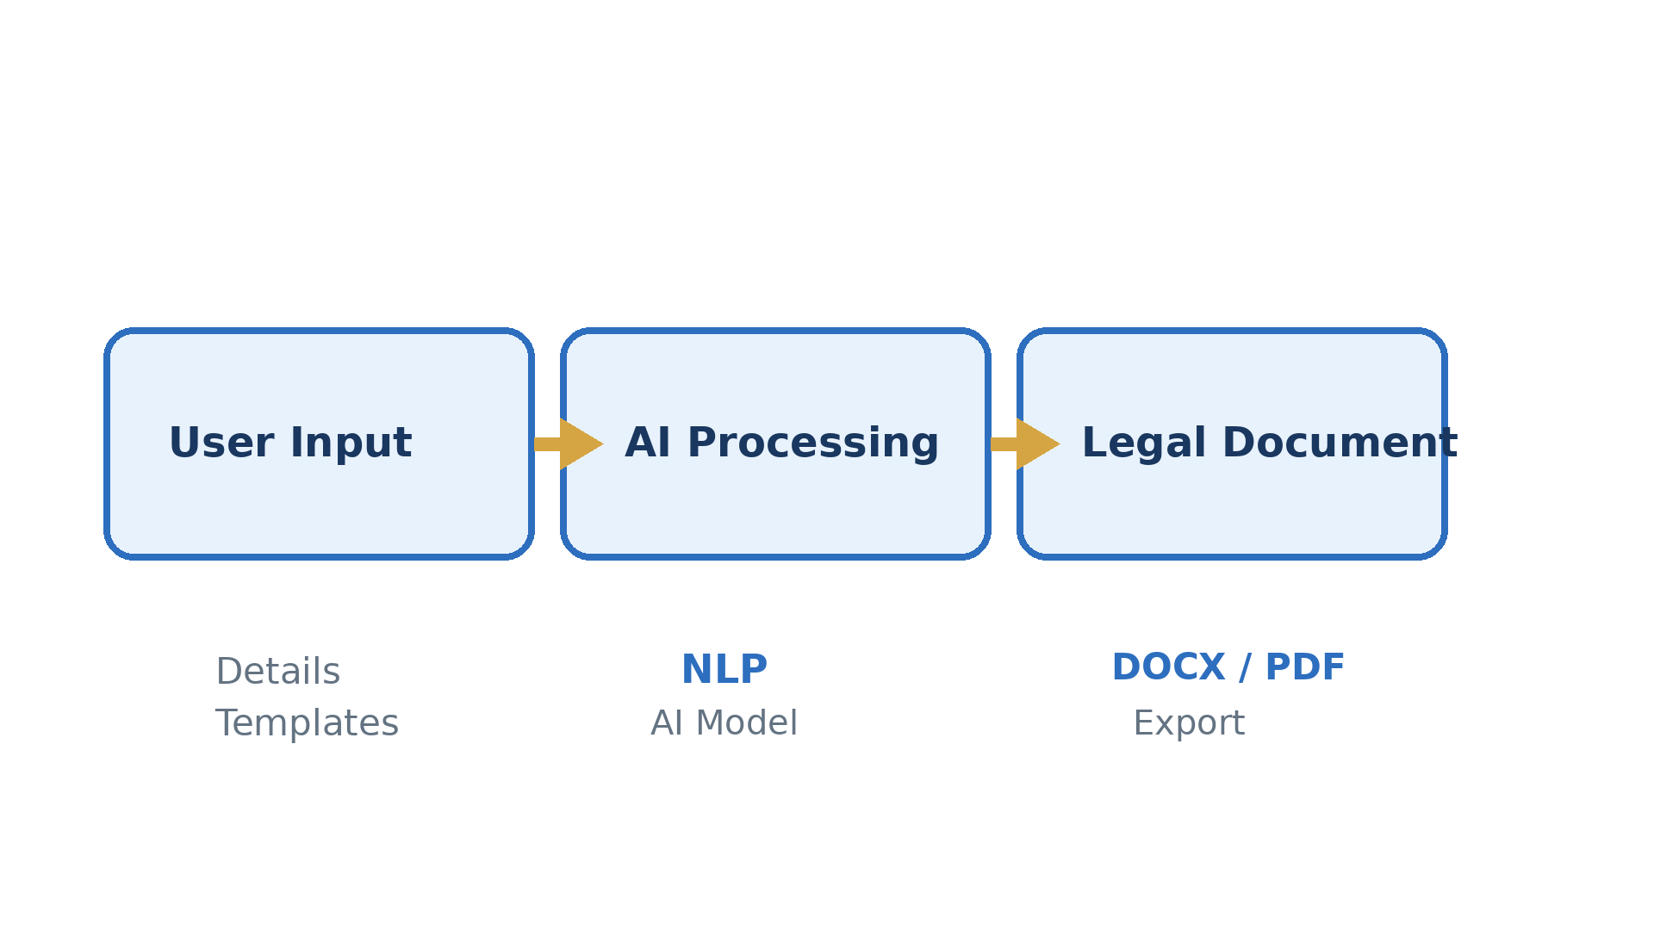
How Legalease Works
4

Slide 5
Technology, Documents & Benefits
5
• Technologies: Python/web application, NLP, AI language models, templates and database storage.
• Possible documents: agreements, notices, applications, declarations, letters and other structured drafts.
• Benefits: faster drafting, consistent formatting, accessibility and reduced repetitive work.
• AI output should be reviewed by a qualified legal professional for high-stakes legal use.
Core Value
✓ Faster first drafts
✓ Consistent structure
✓ Simple user workflow
✓ Human review supported
✓ Scalable generation

Slide 6
Future Scope & Conclusion
6
• Add multilingual legal-document generation for regional languages.
• Integrate clause libraries, document versioning and secure user accounts.
• Improve validation and explain generated clauses more clearly.
• Legalease shows how AI can assist structured legal-document drafting while keeping human review central.
• Thank You
LEGALEASE
AI + Legal Documents

