Slide 1



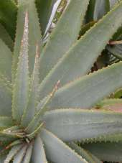
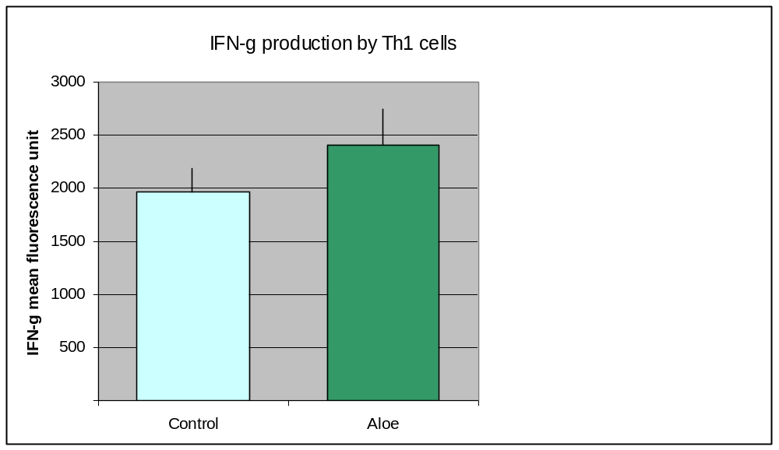
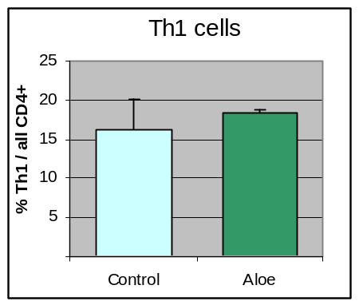
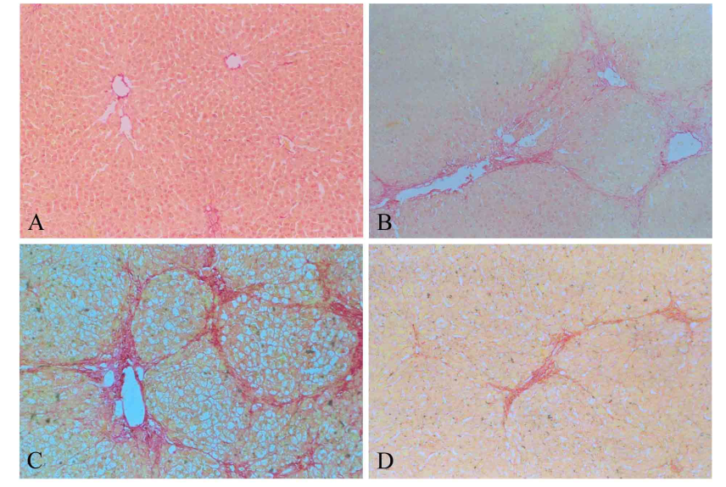
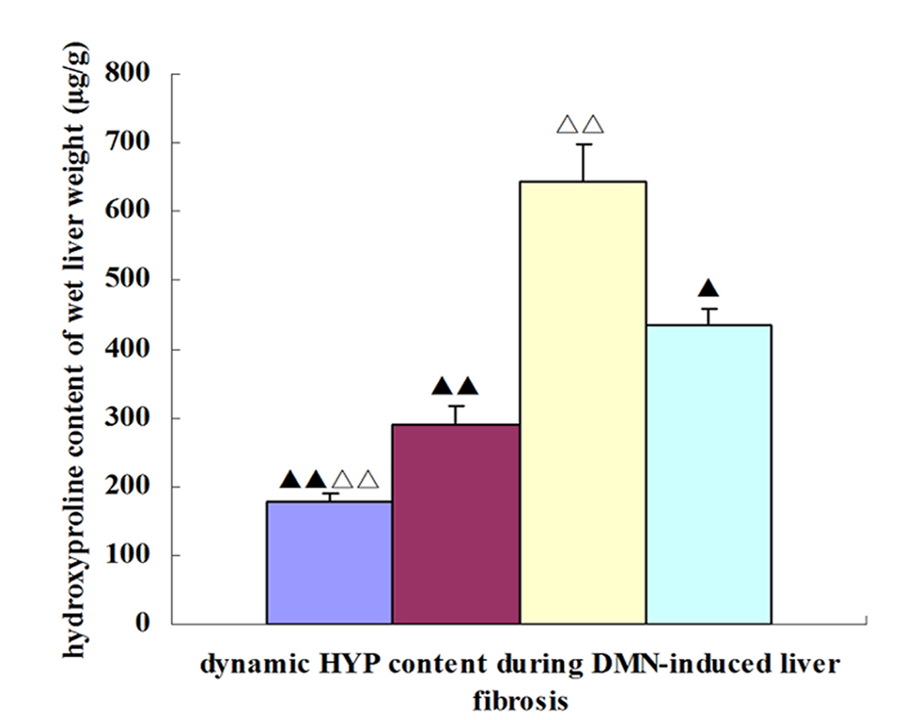
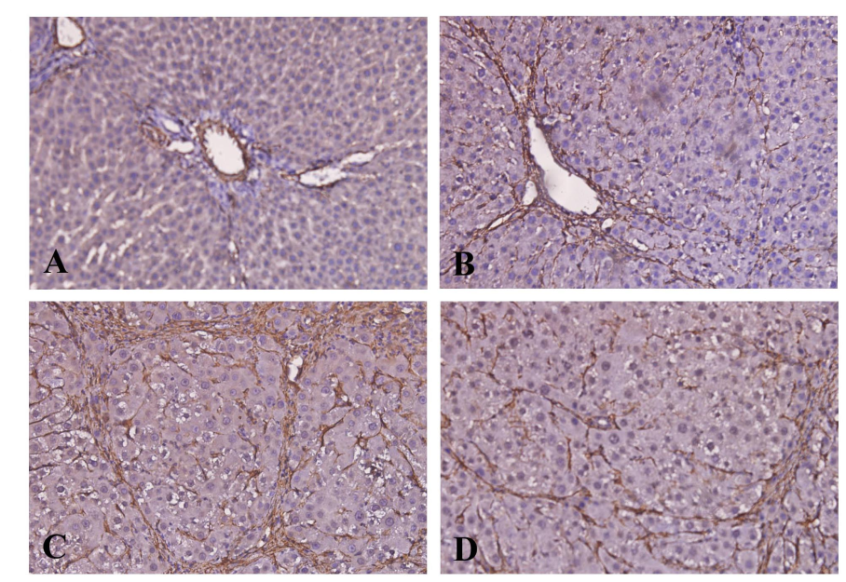
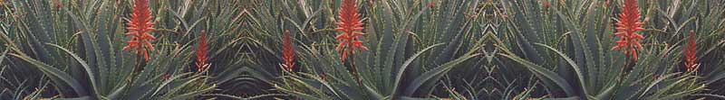
Aloe arborescens preparation and liver health
Hani El-Nezami¹, Wagida A. Anwar², Pirkka Kirjavinen¹, Janna Istola¹, Mohamed El Zarka³, Tony Moros Spiros³
¹University of Kuopio, School of Public Health and Clinical Nutrition, Kuopio, Finland, ²Ain Shams University, Faculty of Medicine, Cairo, Egypt, ³ Spiros Foundation, Egypt
Food and Health Research Centre
Background
Results
Aloe arborescens Mill var. natalensis Berger (designated as ‘ALOE’), a member of the family Liliaceae, and is valued as a family medicine for gastrointestinal complaints, skin injuries and burns.
Various pharmacological and therapeutic activities of ALOE have been investigated, and there have been many reports of anti-inflammatory effects, antidiabetic influence, and antitumorigenic effects of extracts. However, the mechanism/s by which ALOE exerts these effects is/are not clear.
Oral supplementation of ALOE appeared to modestly increase the Th1 cell action (the numbers and IFN-g production) (Figure 1), which could very well be beneficial in clearance of liver infections and tumors because these cells are central in the formation of robust anti-viral reactions and memory as well as anti-tumor responses.
Figure 1. Effect of ALOE on the interferon-gamma (IFN-g) production by Th1 cells in the liver.
Aim
Hydroxyproline content was significantly increased to 360 % (p<0.01) in DMN-water rats compared to control, such an increase coincided with the observation of marked cirrhosis and accumulation of collagen bundles in the liver by histopathological examination (Figure 2). Hepatic hydroxyproline content was decreased with improved histopathology in ALOE-treated rats, a 41% reduction in hydroxyproline content (p< 0.05) in DMN-ALOE group in comparison to DMN-water group (Figure 3).
1- to determine the effect of 3-week oral administration of ALOE preparation (Aloe arborescens, honey and distillate) on the cellular immune functions in mice liver.
2- to evaluate the anti-fibrogenic potential of ALOE preparation in relation to hepatic stellate cells (HSCs) activation and apoptosis in dimethylnitrosamine (DMN)–induced fibrotic liver in rats.
Figure 2. Effects of ALOE on histological changes (Sirius Red staining×100) of rat livers. Liver sections were obtained from control rats (A), 2 weeks DMN (B), 4-week DMN +water (C), and DMN+ ALOE (D).
Methods
Effect of ALOE on the cellular immune functions
Thirty male C57BL/6J mice were randomized into 2 groups: control (n=10) and ALOE (n=20). ALOE group received (via oral gavage ) daily, for 4 weeks the ALOE preparation (0.418g/100 g bwt). Control mice received equal physiological saline. At the end of the fourth week, all animals were sacrificed and the liver was excised and samples were investigated for the presence and cytokine production of different T-cell populations including different helper T-cell (CD4+) subpopulations (Th1, Th2, Th17 and Tregs), effector T-cells (CD8+), Natural Killer T (NKT) cells and Natural Killer (NK) cells.
Anti-fibrogenic potential of ALOE
Hepatic fibrosis was induced by DMN for 4 weeks. At the beginning of the third week, part of DMN-treated rats received ALOE preparation (0.418g/100g/day) for 2 weeks. Untreated-DMN rats were served as control. Liver histopathology and hydroxyproline content were investigated. Smooth muscle actin alpha (α-SMA) was used as a biomarker for HSCs activation using immunohistochemistry.
(C)
Figure 3. Effects of ALOE on hydroxyproline (HYP) content (b) of rat livers. Liver sections were obtained from control rats (A), 2 weeks DMN (B), 4-week DMN + water (C), and DMN+ ALOE (D). ▲p<0.05, ▲▲p<0.01, vs. DMN + water rats; △p<0.05, △△p<0.01 vs. 2 weeks DMN rats. Results are mean± SD.
(B)
(D)
(A)
In comparison to the DMN treated group, α-SMA expression in DMN-AA group was reduced significantly, however, α-SMA-positive HSCs apoptosis was not observed by confocal microscopy (Figure 4).
Figure4. Immunohistochemical analysis of α-SMA in DMN-treated rats. In control rats, vascular smooth muscle cells were strongly positive for α-SMA, whereas HSCs positive for α-SMA were rarely observed (A). Following DMN-treatment, many α-SMA-positive HSCs were detected in areas of centrilobular and periportal fibrotic bands (B), the number of α-SMA-positive HSCs increased gradually and reached peak at 4 weeks (C) in cirrhotic liver. However, a marked reduction in numbers of α-SMA–positive HSCs was observed in DMN-ALOE (D) (×200)
Conclusion
Aloe arborescens may play a role in systemic immunological activity, the presence of Natural killer T-cells was markedly reduced. Also, the study suggested that ALOE ameliorated hepatic collagen deposition in DMN-induced liver injury. Hepatic hydroxyproline content was decreased with improved histopathology in ALOE-treated rats.

