Slide 1


Deep Learning Project: Building an image captioning API using Tensorflow-Keras and FastAPI
Kanellopoulos Anastasios - Mouchakis Vasileios

Slide 2
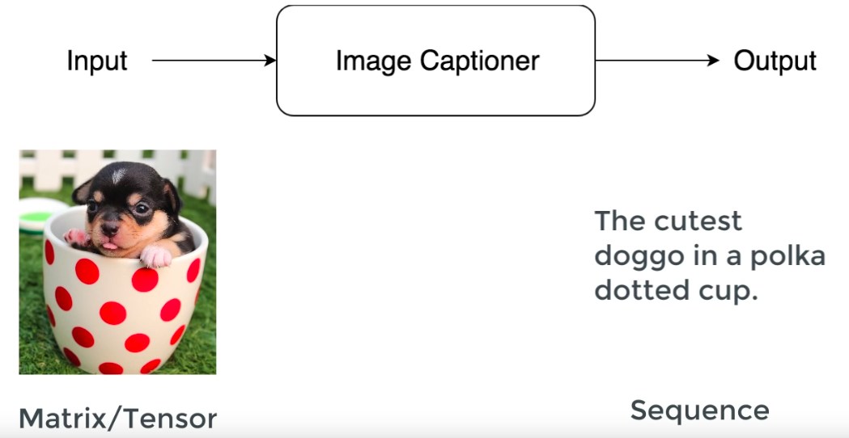
What is Image Captioning ?
Notes:
The input to the captioner is some kind of images (matrix or tensor). The output we want is basically a sequence. A set of variables that has an order into it since the order of every a word matters. So we need to map one kind of variable stemming from images (tensors) to another kind of variable (sequence). To perform such task we employ NNs that use a mathematical function to perform such mapping.

Slide 3
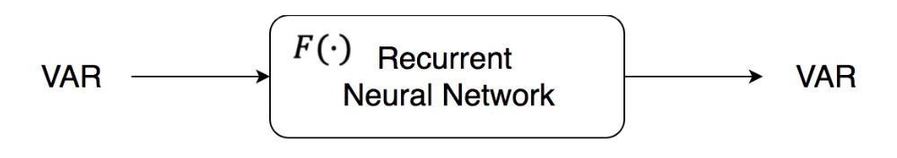
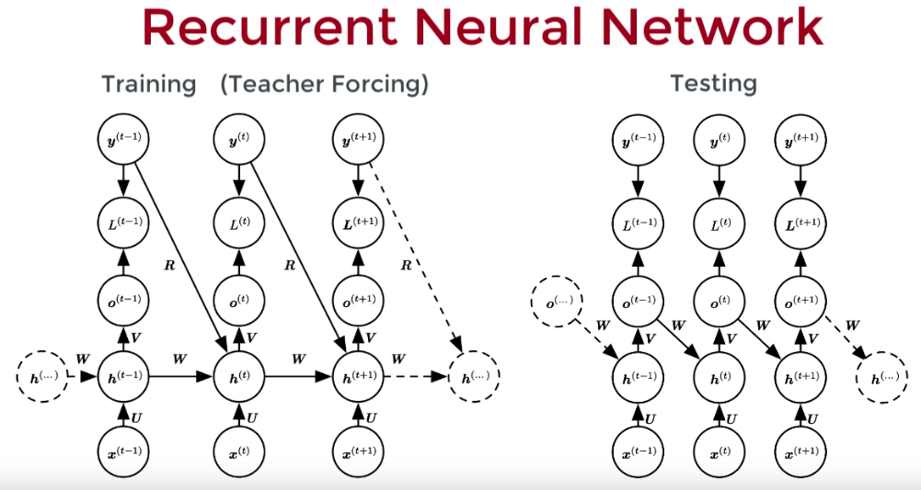
What kind of NN could we use to solve the problem ?
We need to transform a vector to a sequence
Correct labels are used to train the RNN’s next state.
We can create 1 hot encoded vectors for each word. We feed the 1 hot vector of the previous word to the next iteration directly.
Notes:
What we want to do is transform a vector into a sequence and RNNs are good at such tasks

Slide 4
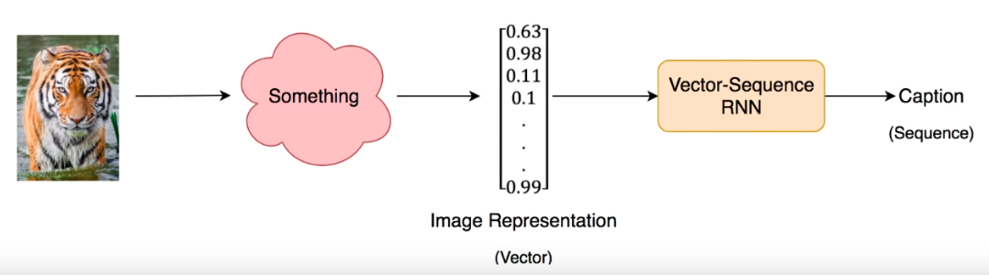
How can we transform the image into a vector ?
One approach would be to flatten the image to a 1D vector.
The problem is that the representation would be too sparse!

Slide 5
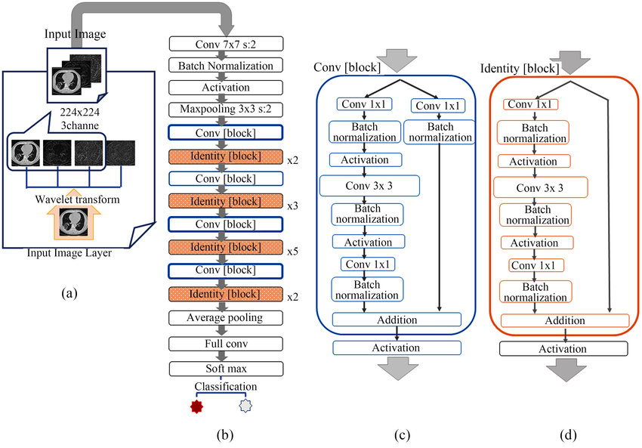
We used a pretrained ResNet50 without the final Dense layer to build a prestation of the image instead.

Slide 6
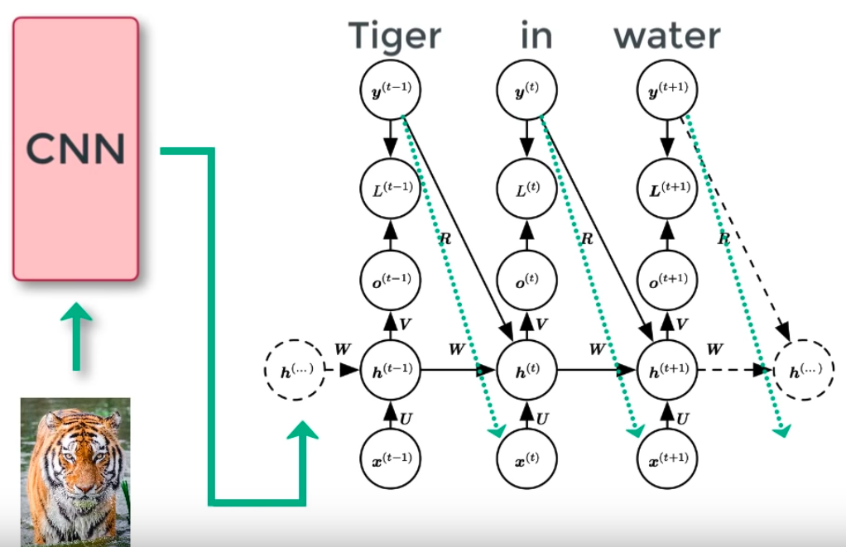
Going back to the RNNs
We can create 1 hot encoded vectors for each word and feed the 1 hot vector of the previous word to the next iteration directly. But that is not enough !

Slide 7
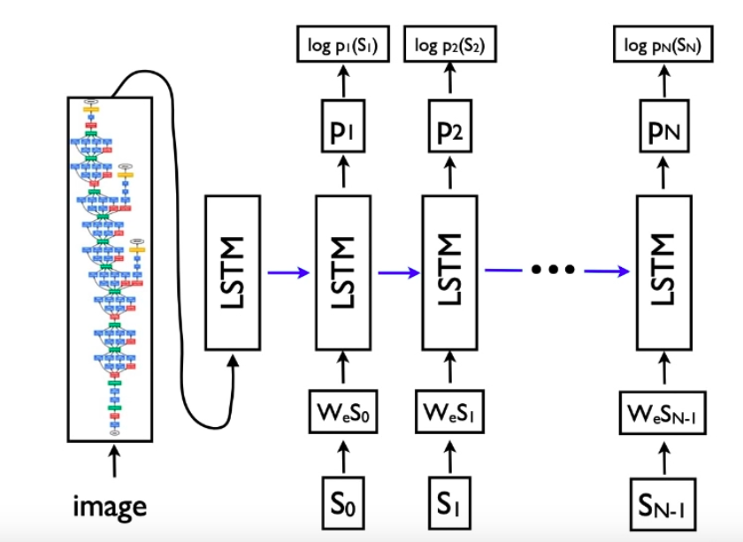
Meaning is important in captions. How can we capture meaning ?
We can learn a set of word embeddings (We) that incorporate the meaning of the word and the closeness to other words in terms of meaning and semantics.
(think distance between the words king and queen)

Slide 8
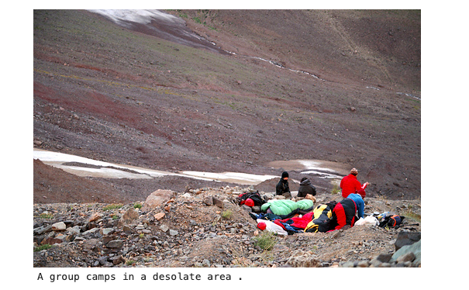
Some results of our model

Slide 9
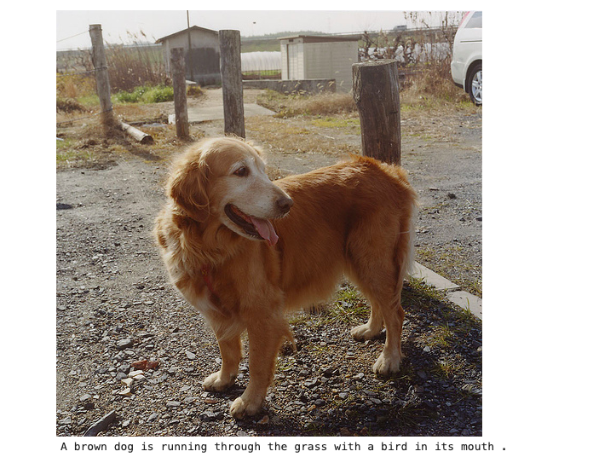
Some results of our model

Slide 10
How could we improve the model ? By paying attention! (before the RNN)
Attention mechanisms can shift the focus on certain parts of the image each time the model tries to predict a different word in the caption.
Attention requires a tensor representation of an image to preserve special features (output of a CNN layer).

Slide 11

Thank you! Lets watch a demo

