Slide 1
Developer job satisfaction
Presenter: Victoria Moulds
Notes:
Today I am going to present my data mining project on developer job satisfaction.

Slide 2
Aim Of Study
Determine factors that significantly contribute to job satisfaction.
Notes:
The aim of this project was to assess factors that impact developer job satisfaction utilizing the techniques I learnt in this lecture course.

Slide 3
Overview
Importance
Data Set
Data Cleaning
Data Analysis
Results
Notes:
I will firstly talk about the importance of this work, then I will give an overview of the data set and cleaning
techniques employed before showing the data analysis and finally I will finish by summarising the results.

Slide 4


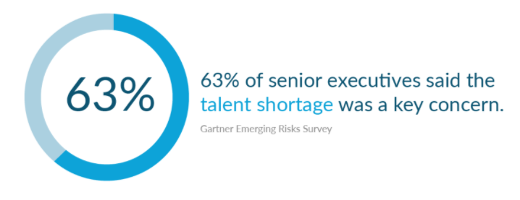
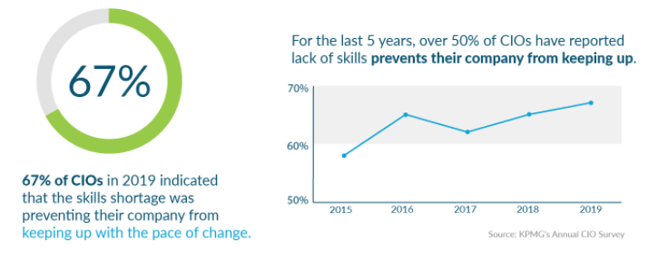
Notes:
Software development is in high demand with 23.9 million developers in 2019 and
projections showing this increasing to 28.7 million by 2024.
However, there is a shortage of skilled people to meet this demand.
A Gartner survey showed that 63% of senior executives noted this skill shortage as a key concern.
with KPMGs survey reported in 2019 that 67% of CIOs said this shortage was having a negative affect on growth for
their company.
It's therefore important that companies understand developer job satisfaction so that they can attract the right
talent and also retain this talent for many years.

Slide 5
Data set – Overview
Conducted: January – Feb
Sources: Stack Overflow, Social Media
Stackoverflow developer survey dataset
Includes job satisfaction, salary and job role
Sensitive data removed
Notes:
Stackoverflow have ran a developer survey each year for the last 10 years and the dataset is available freely online.
The data set includes information on job satisfaction along with features such as salary and job role that I thought would be useful for this analysis.

Slide 6
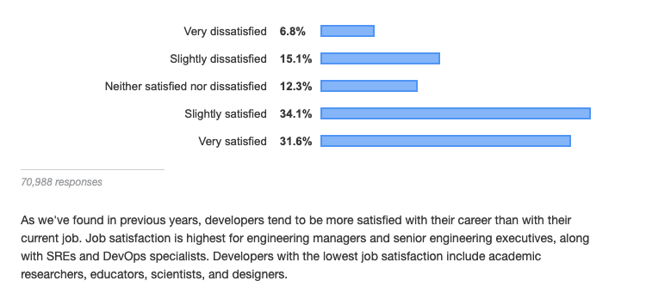
2019 Trends
Notes:
Stackoverflow have been able to highlight some trends in job satisfaction from the survey data.
For example in 2019 they noted that developer type impacted job satisfaction
with mangers and DevOps specialists being more satisfied than designers, educators, scientists and researchers.

Slide 7
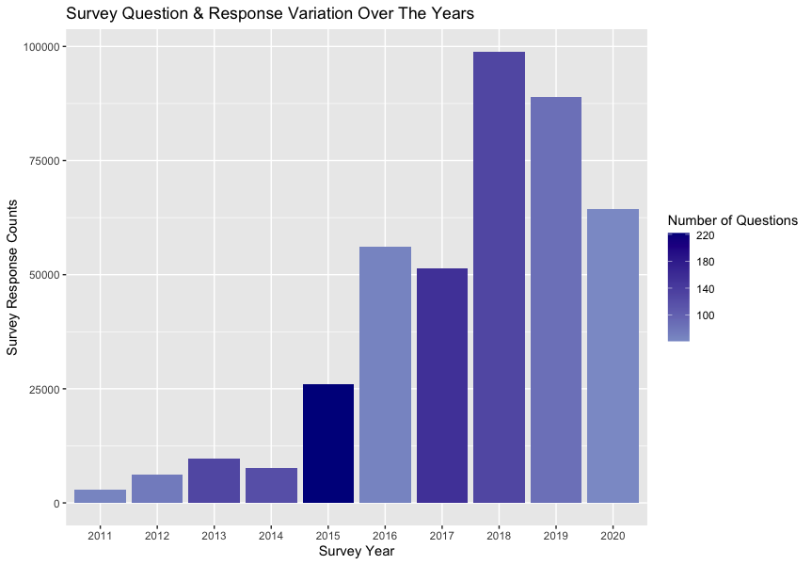
Challenges
Survey questions varied over the years
Survey result format varied
Data with a lot of variability
Class imbalance
Notes:
The data set was challenging to work with due to the variation in survey questions, the format of
the survey results the data as well as a class imbalance with more satisfied developers that unsatisfied.
This plot highlights some of this variability as it shows variations in the number of responses
as well as number of questions over the years.
Can clearly see that 2015 had the most questions while 2016 had the least and the more recent surveys 2018 - 2020
had the highest response rate.
Due to survey changing dramatically over the years I decided to concentrate my analysis on 2018 - 2020 data as these
years matched more closely than previous years.

Slide 8
Data cleaning
Notes:
I then needed to clean the data before I could use it for analysis

Slide 9
Initial variable selection
Rename columns for consistency across years
1
Drop columns containing duplicated information
2
Drop stackoverflow survey columns
3
Notes:
Firstly, I renamed columns across the years for consistency, dropped features containing duplicated information
and dropped features pertaining to the stackoverflow site.

Slide 10
Binning
2020
Salary, Age, Work Week Hrs, Years Code, Years Code Pro
2019
Salary, Age, Work Week Hrs, Years Code, Years Code Pro, CodeRevHrs
2018
Salary
Used 2018 bins for Age, Years Code & Years Code Pro
Techniques
Quantile binning to determine optimal bins for salary, work week hrs and code review hrs
Notes:
Secondly, I binned numerical data using the quantile binning method as well as bins from another year so that data
across the 3 years would match.

Slide 11
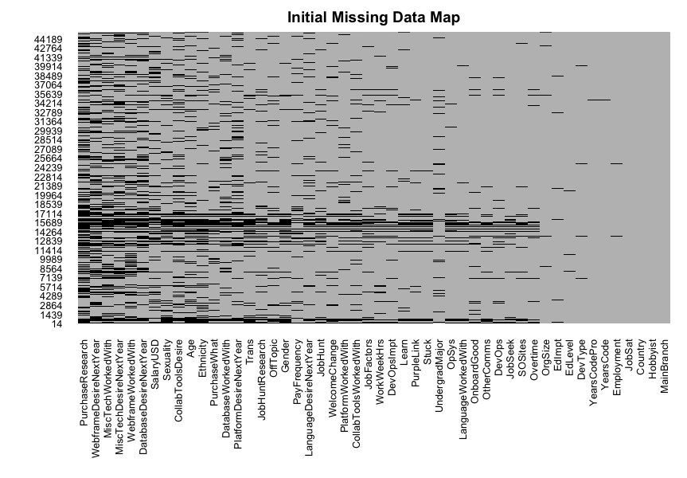
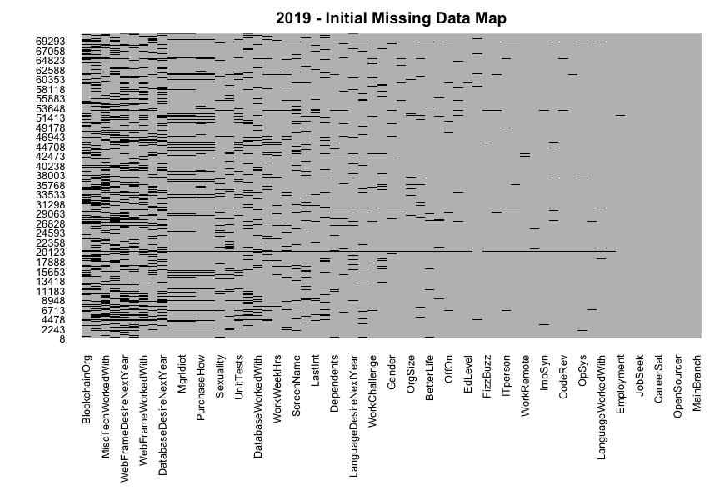
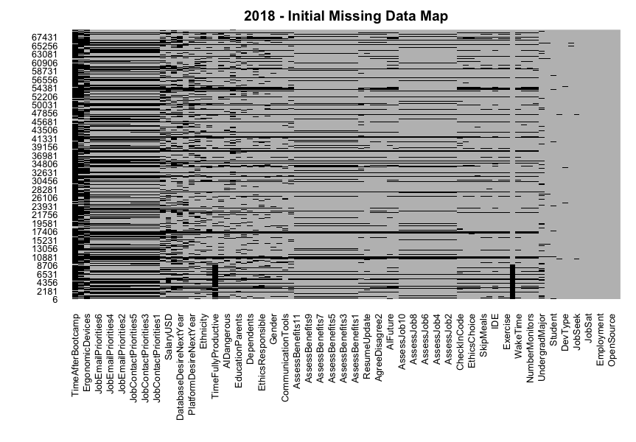
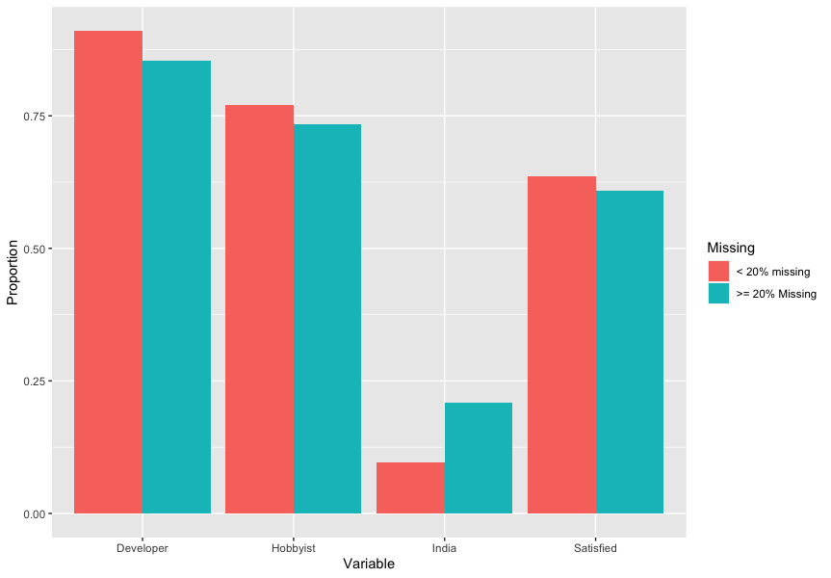
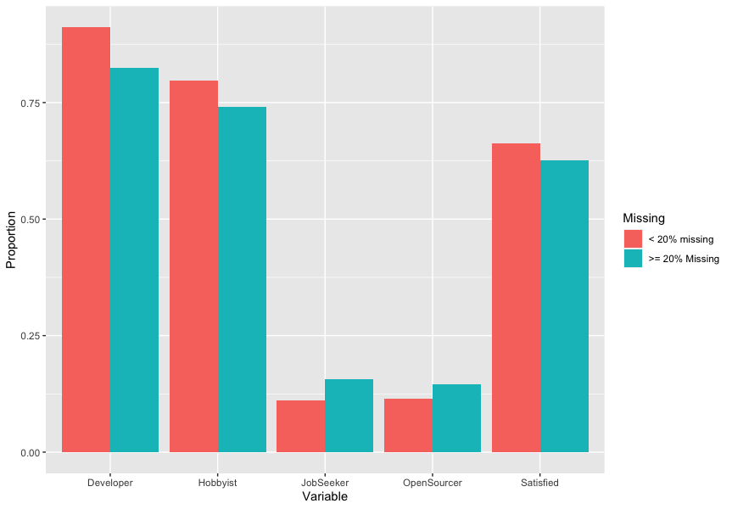
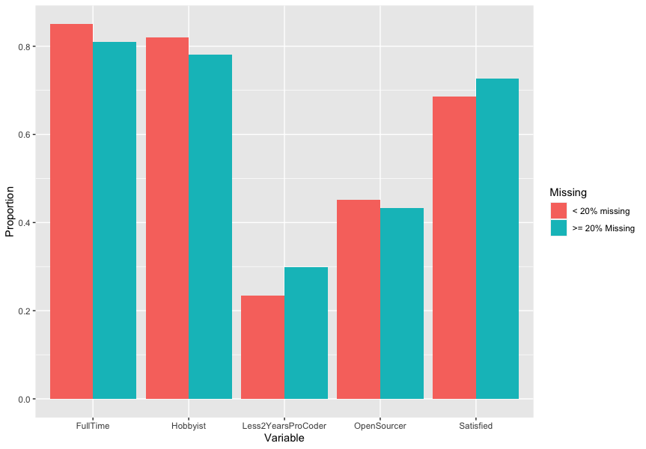
2020
2019
2018
Notes:
Thirdly, there was a LOT of missing data as you can see from this slide where black in the missing data map plots
shows questions where the answer was missing.
This could have been due to fact that some survey questions only appeared if a person answered a previous questions
Due to amount of missing data I conducted analysis to see if there were differences between people that left a lot of questions blank versus people that didn't.
The results from this analysis are shown in the bar plots where you can see a visual difference in answers to
questions e.g. in 2020 there is a higher proportion of people based in India that left a lot of questions blank
compared to those that answered most questions.
Chi2 independence test showed significant result when comparing each of these features to the amount of
missing data.
As all my data was categorical data I therefore decided to replace all the missing data with "Missing"
category for each feature as I didn't want to lose information about the missing data.

Slide 12
Feature Engineering
Dev Type
Summarized developer type into new categories e.g. Executive, Manager, Designer, Developer etc.
Are languages used in languages desired?
Language Used & Desired
Are languages desired in languages used?
Number of languages used
Number of languages desired
Satisfied
Is survey respondent satisfied or not
Notes:
As I was concerned with satisfied vs not satisfied I generated a new variable to capture this
using the Job Satisfaction.
In addition to this some questions were difficult to work with due to multiple responses being
allowed for that question so I generated some new features to help with data analysis

Slide 13
DATA ANALYSIS
MODELLING
Models: Naïve Bayes, Decision Tree, Logistic Regression and KNN
Assessment: Accuracy, AUC, precision, recall
Significance Test:
Chi-squared test of independence
FEATURE SELECTION
VISUAL CHECKS
Visually checked how features varied with satisfied response variable
Notes:
Once I had cleaned the data I then analysed each year individually before analysing all 3 years together.
I started with visually checking how features varied with satisfaction
I then used the chi2 test of independence to check if these categorical features varied significantly with developer satisfaction
I selected features based on these chi2 results to build a variety of models assessing predictive power of these features on job satisfaction.

Slide 14
RESULTS

Slide 15
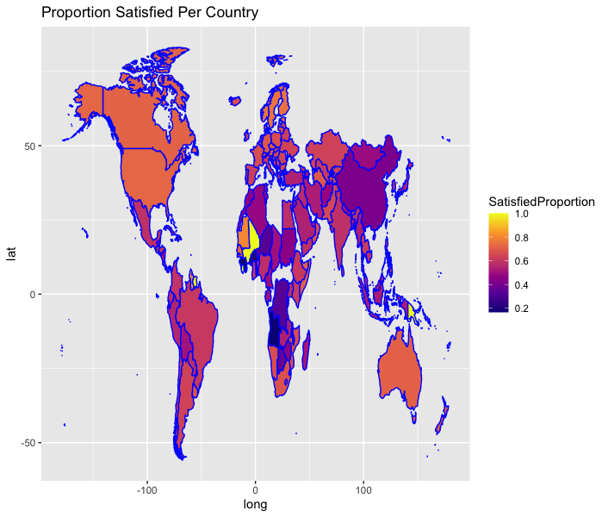
OVERALL TRENDS
FEATURE | XSQ P-VALUE | FISHER P-VALUE
Country | 0 | 0.00049975
SalaryUSDBinned | 0 | 0.00049975
YearsCodeBinned | 7.75E-175 | 0.00049975
AgeBinned | 2.29E-135 | 0.00049975
DeveloperType | 8.99E-58 | 0.00049975
languageDesiredIsBash | 3.85E-48 | 1.22E-48
OrgSize | 2.93E-30 | 0.00049975
Hobbyist | 1.06E-17 | 1.28E-17
Notes:
For all 3 years I found that country, salary, number of years coding,
type of developer, age, language desired being Bash and whether the person was a hobby coder
all had a significant chi-squared result which indicated that they were not independent of developer satisfaction.
Can clearly see from this plot of proportion satisfied per country that Australia, North America,
and European countries are more satisfied that China and African countries.

Slide 16
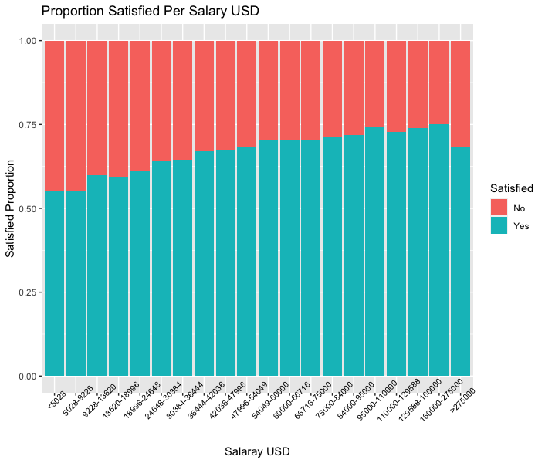
Notes:
As you might expect as salary increases then proportion satisfied also increases though there is an interesting
dip in satisfaction for people earning over $275000

Slide 17
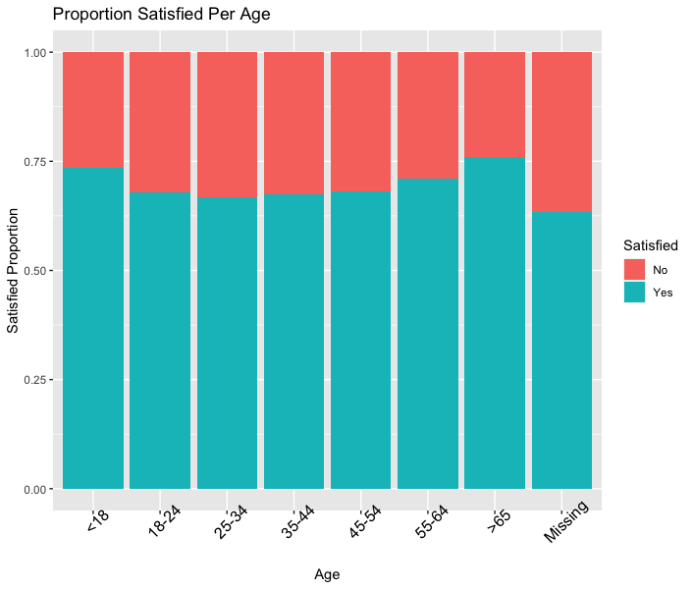
Notes:
Satisfaction tends to dip between ages of 25-44 then increase again as a person gets older. Perhaps
this due to type of work more dominant in that age group or due to life changes that typically occur during
those times in people's lives such as becoming home owners, marriage and starting families.

Slide 18
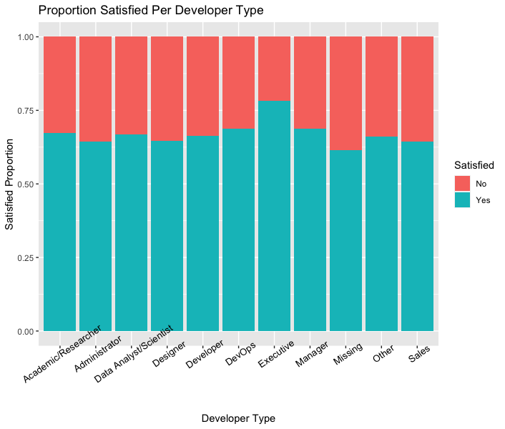
Notes:
As you might expect the type of work the person does also impacts job satisfaction with Executives and managers
being the most satisfied while designers and administrators are among the least satisfied.
It is also interesting to note that people that didn't answer this question tend to be the least satisfied.

Slide 19
2018 TRENDS
FEATURE | CHI-SQAURED P-VALUE | FISHER P-VALUE
Country | 1.64E-138 | 0.00049975
SalaryUSDBinned | 6.76E-91 | 0.00049975
YearsCode | 1.06E-32 | 0.00049975
SkipMeals | 2.97E-26 | 0.00049975
DeveloperType | 8.46E-26 | 0.00049975
HoursComputer | 1.02E-19 | 0.00049975
HoursOutside | 4.73E-18 | 0.00049975
OpenSource | 9.67E-17 | 8.83E-17
Age | 9.59E-13 | 0.00049975
isBash | 8.41E-12 | 6.43E-12
YearsCodePro | 2.38E-10 | 0.00049975
WakeTime | 1.78E-07 | 0.00049975
Student | 8.04E-07 | 0.00049975
Hobbyist | 1.31E-06 | 1.42E-06
CompanySize | 6.61E-05 | 0.00049975
isSQL | 0.003239071 | 0.003171233
isJavaScript | 0.016667886 | 0.016311696
isRust | 0.018492159 | 0.018065053
isAssembly | 0.027007233 | 0.026636647
isMatlab | 0.037925788 | 0.036638054
isPython | 0.094960237 | 0.093432399
isHaskell | 0.102322266 | 0.099493423
Employment | 0.18439126 | 0.185407296
isCoffeeScript | 0.214396043 | 0.210187827
isErlang | 0.238770707 | 0.229138532
isGo | 0.248351239 | 0.243992146
Gender | 0.267505015 | 0.262988672
isJava | 0.345328742 | 0.343373588
isKotlin | 0.476791316 | 0.472496003
isJulia | 0.552410989 | 0.522030374
Notes:
Due to the variety in questions over the years I did find some features specific to each year that showed a trend
with satisfaction that is interesting.
As can see from significance tests on 2018 questions on skipping meals, hours at a computer and hours outside
had a significant result when compared to whether someone was satisfied or not.

Slide 20
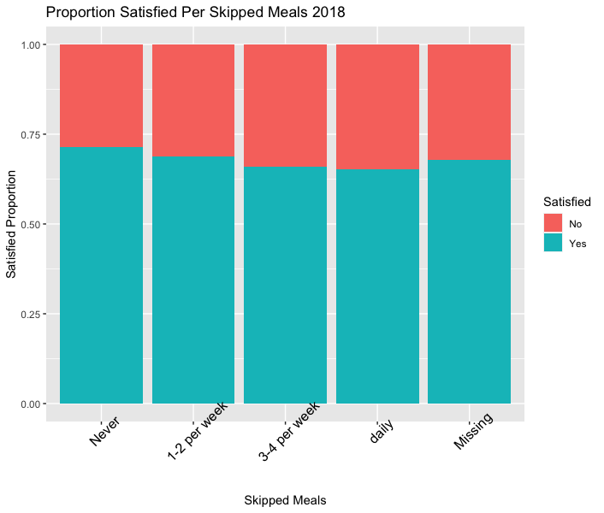
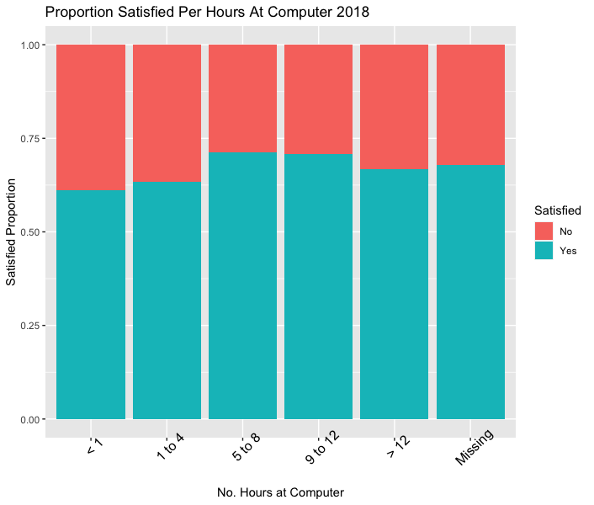
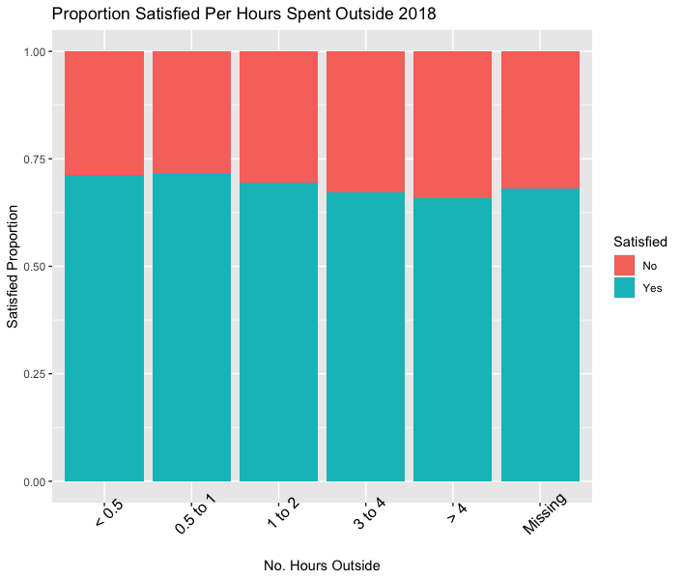
Notes:
As you might expect people that skip more meals are less satisfied than those that don't skip any.
There is also a trend in number of hours spent at a computer where as the number of hours at computer
increases so does satisfaction to a point then it decreases as the number of hours at a computer
becomes too high. While as the number of hours outside increases then so too does satisfaction.
This makes sense as people that are developers most likely want to program and so enjoy more
computer time until a point when it's perhaps impinging on their personal life.

Slide 21
2019 TRENDS
FEATURE | CHI-SQUARED P-VALUE | FISHER P-VALUE
MgrIdiot | 0 | 0.00049975
Country | 4.33E-285 | 0.00049975
SalaryUSDBinned | 9.38E-224 | 0.00049975
WorkPlan | 3.36E-140 | 0.00049975
WorkRemote | 1.39E-114 | 0.00049975
OpenSourcer | 5.70E-35 | 0.00049975
AgeBinned | 2.09E-34 | 0.00049975
Student | 4.54E-26 | 0.00049975
YearsCodeBinned | 3.66E-22 | 0.00049975
WorkWeekHrsBinned | 7.60E-22 | 0.00049975
isBash | 1.93E-19 | 1.25E-19
YearsCodeProBinned | 9.77E-15 | 0.00049975
Employment | 6.65E-13 | 0.00049975
OrgSize | 1.11E-10 | 0.00049975
DeveloperType | 1.91E-10 | 0.00049975
Hobbyist | 1.25E-07 | 1.32E-07
isScala | 6.81E-06 | 7.10E-06
isDart | 1.29E-05 | 1.43E-05
isKotlin | 8.91E-05 | 9.06E-05
Gender | 0.000121379 | 0.000109439
isPython | 0.000124243 | 0.000121797
isRust | 0.006392071 | 0.006143601
isSQL | 0.044571578 | 0.043980754
isJavaScript | 0.049868489 | 0.049829522
isErlang | 0.056507235 | 0.053610222
isGo | 0.255342015 | 0.253841221
isRuby | 0.522480221 | 0.518993506
isAssembly | 0.598516897 | 0.593207577
isClojure | 0.760156545 | 0.754908526
isElixir | 0.784623821 | 0.775896819
isJava | 0.87648016 | 0.871522394
Notes:
In 2019 they had some questions around work that were very interesting.
In fact the feature impacting satisfaction the most was how confident a person was in their manager.
In, addition work plan and ability to work remotely ranked high in the chi2 significance test.

Slide 22
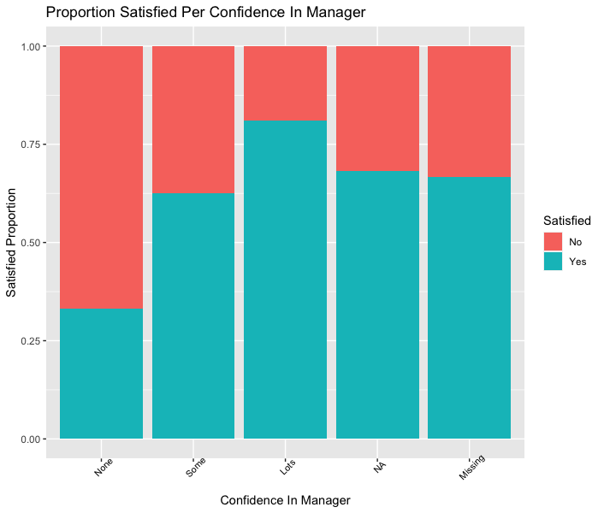
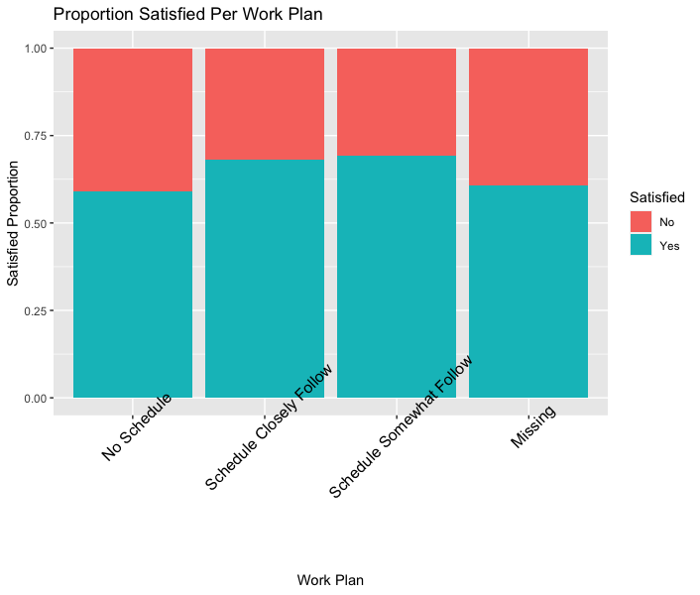
Notes:
Intuitively, as confidence in manager increases then so too does satisfaction.
People that have no work plan appear to be less satisfied than people that do have a work plan.

Slide 23
2020 TRENDS
FEATURE | CHI-SQUARED P-VALUE | FISHER P-VALUE
OnboardGood | 0 | 0.00049975
Country | 3.03E-143 | 0.00049975
SalaryUSDBinned | 7.46E-138 | 0.00049975
isBash | 7.31E-17 | 4.73E-17
Overtime | 1.25E-16 | 0.00049975
YearsCodeBinned | 2.48E-13 | 0.00049975
WorkWeekHrsBinned | 1.29E-12 | 0.00049975
AgeBinned | 1.58E-12 | 0.00049975
YearsCodeProBinned | 2.70E-07 | 0.00049975
isDart | 1.06E-05 | 1.10E-05
DeveloperType | 0.000449701 | 0.0009995
isGo | 0.000466793 | 0.000458677
isRust | 0.001457671 | 0.001399776
isKotlin | 0.002000166 | 0.002012194
Hobbyist | 0.003679813 | 0.003707453
isSQL | 0.00439912 | 0.00427359
Employment | 0.005053553 | 0.008995502
Learn | 0.022098687 | 0.018490755
Gender | 0.032413119 | 0.030913681
OrgSize | 0.064347177 | 0.069965017
isScala | 0.306328552 | 0.303844613
isAssembly | 0.316294409 | 0.305282287
isJavaScript | 0.348532354 | 0.344637613
isPython | 0.524169023 | 0.520479316
isJava | 0.568539924 | 0.564900057
isRuby | 0.750805103 | 0.734773522
Notes:
In 2020 there wasn't as many questions about working habit. However, there were 2 that appeared to
be dependent on job satisfaction based on chi2 - onboarding and overtime

Slide 24
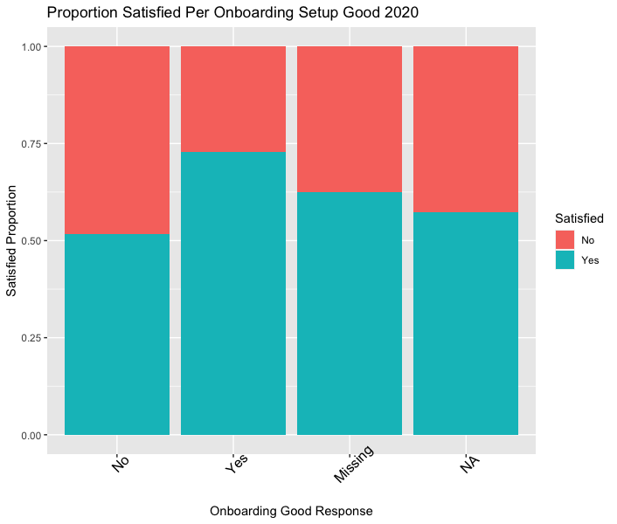
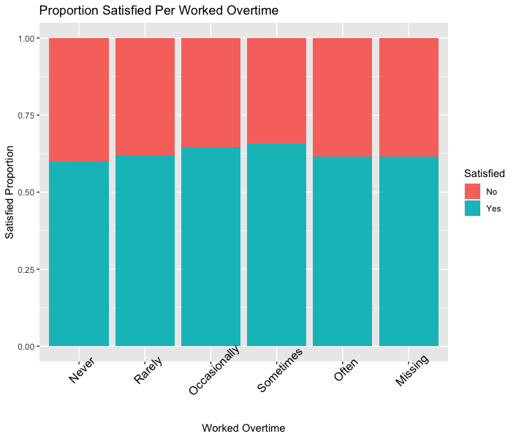
Notes:
There is a clear distinction between a good onboarding setup and no onboarding setup which makes sense as it's a nicer
experience when there is help and support when you are joining a new team or company.
Interestingly, there seems to be a slight trend with satisfaction increasing with some overtime which might be due to
monetary gain from overtime though can't tell if that is true from data I have. As expected though people that
work overtime often are the least satisfied.

Slide 25
MODEL RESULTS
ORIGINAL DATA
Year | Model | Accuracy | AUC | Precision | Recall
2018 | naive_bayes | 0.68499913 | 0.57370877 | 0.70966067 | 0.93056501
 | decision tree | 0.69976615 | 0.5 | 0.69976615 | 1
 | logistic regression | 0.69954963 | 0.58194423 | 0.70316838 | 0.98749923
 | KNN | 0.62926555 | 0.51770474 | 0.70599718 | 0.80574293
2019 | naive_bayes | 0.68617673 | 0.6919525 | 0.72556034 | 0.837646
 | decision tree | 0.69496683 | 0.58874864 | 0.70099539 | 0.93159966
 | logistic regression | 0.69915057 | 0.70227886 | 0.71586107 | 0.89643157
 | KNN | 0.6323374 | 0.59821677 | 0.69332727 | 0.7864748
2020 | naive_bayes | 0.63929638 | 0.63589129 | 0.67444888 | 0.82198011
 | decision tree | 0.63962828 | 0.61342967 | 0.6665012 | 0.85212608
 | logistic regression | 0.64248258 | 0.64993658 | 0.66258993 | 0.87677174
 | KNN | 0.58433455 | 0.55084088 | 0.64849274 | 0.73725407
ALL | naive_bayes | 0.65646484 | 0.58212222 | 0.6827484 | 0.90563291
 | decision tree | 0.66681765 | 0.5 | 0.66681765 | 1
 | logistic regression | 0.66654265 | 0.58815332 | 0.67263101 | 0.97394595
 | KNN | 0.59661269 | 0.51959216 | 0.67432401 | 0.76408229
Notes:
I then built models for each year using the features that had a significant chi2 result in addition
to building a model for all 3 years.
I used the MLR3 library in R to perform benchmark testing for 4 classification modeling techniques -
naive bayes, decision tree, logistic regression and knn.
I split the data into a train - test data set and used accuracy, auc, precision and recall to asssess the
performance of each model. The results of which are shown in this table.
None of the models had an amazing accuracy though I found that the best model was lr from the year 2019.

Slide 26
BALANCED DATA
Year | Model | Accuracy | AUC | Precision | Recall
2018 | naive_bayes | 0.62714306 | 0.66811832 | 0.62526811 | 0.6467473
 | decision tree | 0.60870192 | 0.62275532 | 0.6156536 | 0.59221355
 | logistic regression | 0.6258104 | 0.67383096 | 0.62113019 | 0.65762542
 | KNN | 0.65783028 | 0.70674926 | 0.63183024 | 0.76712231
2019 | naive_bayes | 0.70375166 | 0.7720418 | 0.68625538 | 0.74268679
 | decision tree | 0.69268473 | 0.736552 | 0.66971106 | 0.75144401
 | logistic regression | 0.71968926 | 0.79029769 | 0.70041181 | 0.76057388
 | KNN | 0.71728475 | 0.7788691 | 0.67968264 | 0.81404882
2020 | naive_bayes | 0.67956224 | 0.74586073 | 0.6616718 | 0.73548213
 | decision tree | 0.67059989 | 0.70485125 | 0.65548905 | 0.71981633
 | logistic regression | 0.68681319 | 0.75581547 | 0.6694687 | 0.73854326
 | KNN | 0.70793551 | 0.76264433 | 0.67652001 | 0.79742505
ALL | naive_bayes | 0.61277561 | 0.65634014 | 0.60785921 | 0.64513713
 | decision tree | 0.59084786 | 0.60181711 | 0.57096583 | 0.74536668
 | logistic regression | 0.6134673 | 0.65753741 | 0.60886747 | 0.64407394
 | KNN | 0.64638926 | 0.69733924 | 0.63239269 | 0.706657
Notes:
I thought this might be related to class imbalance with more satisfied that not satisfied so I balanced
the data using SMOTE in R and I found that model performance did increase. However, it still wasn't very high
which might indicate that we are missing features that contribute to job satisfaction.
Still the 2019 LR model was the best performance.

Slide 27
2019 – Lr results (Top 15)
FEATURE | LR ODDS RATIO
MgrIdiotNot at all confident | 4.553934762
AgeBinnedMissing | 2.286372609
AgeBinned35-44 | 1.959781152
AgeBinned45-54 | 1.944392671
AgeBinned25-34 | 1.799901596
AgeBinned55-64 | 1.640778072
AgeBinned18-24 | 1.6086585
CountryNicaragua | 1.532784501
WorkRemoteIt's complicated | 1.455767285
DeveloperTypeMissing | 1.398978541
MgrIdiotSomewhat confident | 1.394101221
OrgSizeJust me - I am a freelancer, sole proprietor, etc. | 1.307327097
DeveloperTypeDeveloper | 1.271768278
DeveloperTypeDevOps | 1.202251686
Notes:
When building the 2019 model I had included the confidence in
manager response and as you can see from the model co-efficients odds ratio confidence in manager
has the biggest impact on job satisfaction.

Slide 28
CONCLUSIONS
Location & Compensation
Type of work
Work Environment
Notes:
In summary I found a variety of features that can be used to determine if developer is satisfied or not.
Location & Compensation
Country
Salary
Type of work
Developer Type
Bash language desired
Work environment seems to have a significant impact
Manager confidence
Remote working
Work schedules
Onboarding

