Slide 1
Cloud Computing Project
FLIGHT DATA ANALYSIS
YAGNASRI CHOWDARY NALLURI (16293464)
VINAY KUMAR REDDY MEKA (16290945)
BHANU SREE GUJAVARTHY (16293109)

Slide 2
Motivation:
For travelers with a tight connection window, even a short flight delay can cause serious anxiety. We want to come up with a solution that can help the travelers in tracking and evaluating the flight operation trends. Our main goal is to summarize data by time period, airports and carriers and also to Identify risk precursors, and take the appropriate remedial action.

Slide 3
Objective:
Flight Data Analysis: Analysis of Flight data from 1987-2008.
Evaluation of Trends: Tracking and Evaluating the Flight operation Trends.
Perspective:
Carriers
Weather
Security
Arrival time
Distance

Slide 4
Resources:
Reference link:
https://www.transtats.bts.gov/OT_Delay/OT_DelayCause1.asp

Slide 5
System Architecture:
Google Cloud Platform
Spark
Tableau
User

Slide 6
Tools, Languages and Platform Used:
Hadoop
Pyspark
Hive
Tableau
Google Cloud Platform

Slide 7
Data Analysed:
Number of flights cancelled due to different conditions.
Total distance covered by each carrier.
Total number of flights which were diverted on each day of the week over a year.
Which airport has more air traffic.
Flight origin density
The number of flights arrived on time by different carriers per year.

Slide 8
Deployment
Link to Website:
https://public.tableau.com/profile/vinay.kumar.reddy2214#!/vizhome/Flight_Data_Analysis_15888276984630/Distancecoveredbyeachcarrier?publish=yes

Slide 9
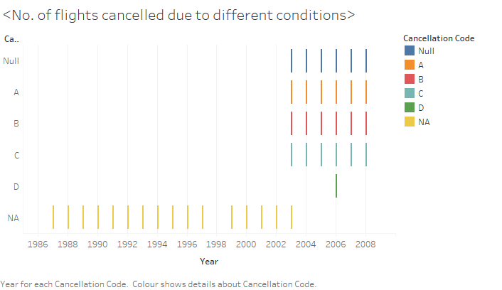
Results: Number of flights cancelled due to different conditions
A = Carrier
B=Weather
C =NAS (National Aviation System)
D = Security

Slide 10
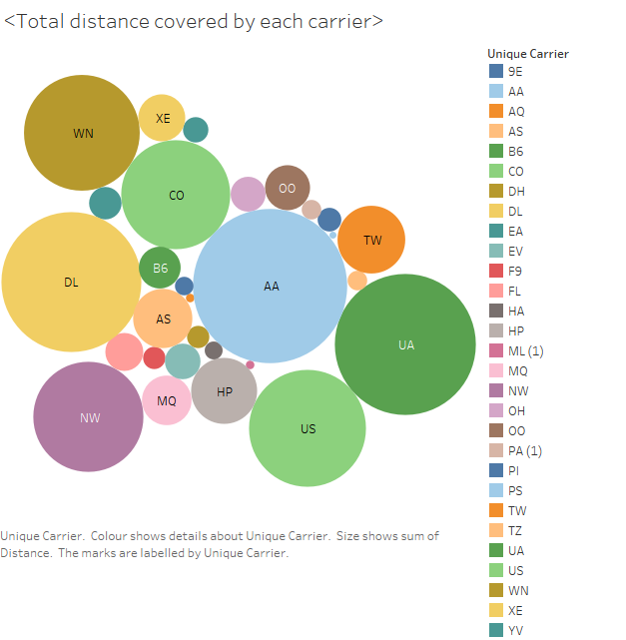
Total distance covered by each carrier
Airlines codes:
https://azcargo.cz/en/services/support/iata-airline-codes/

Slide 11
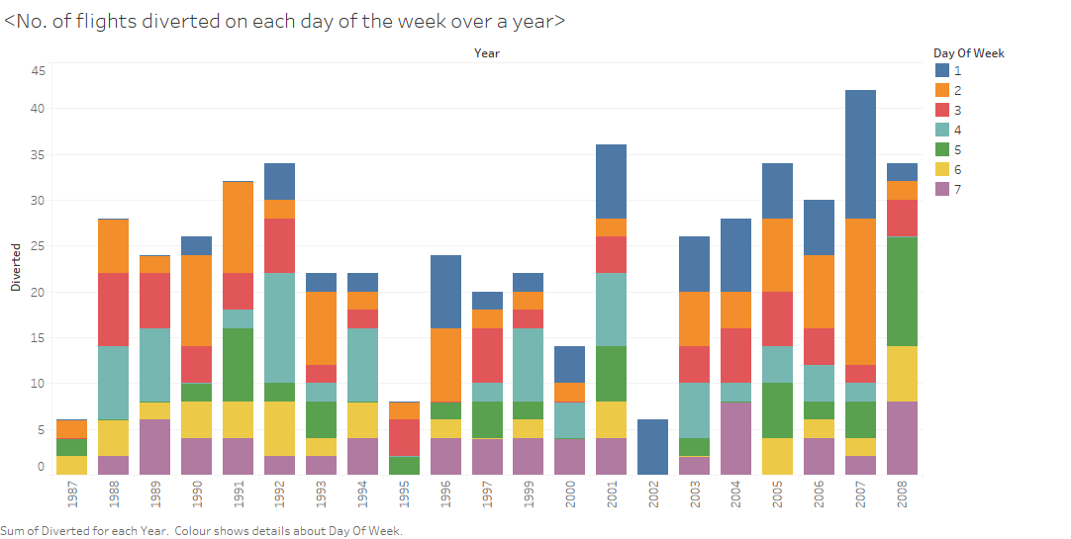
Number of flights diverted on each day of the week over a year
1=Sunday
2=Monday
3=Tuesday
4=Wednesday5=Thursday
6=Friday
7=Saturday

Slide 12
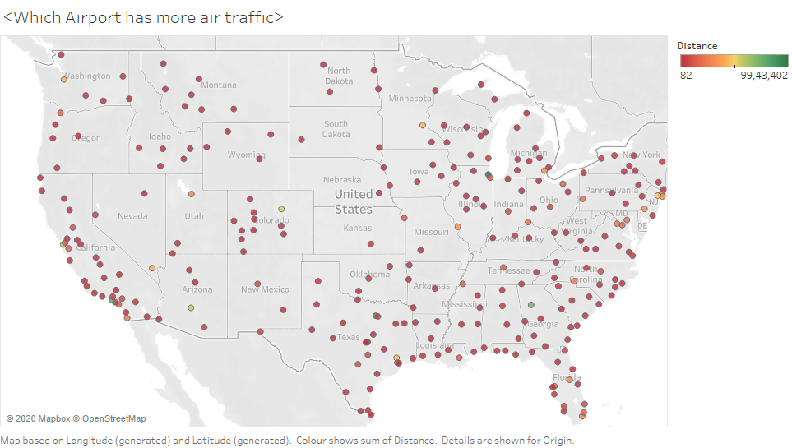
Which Airport has more air traffic.

Slide 13
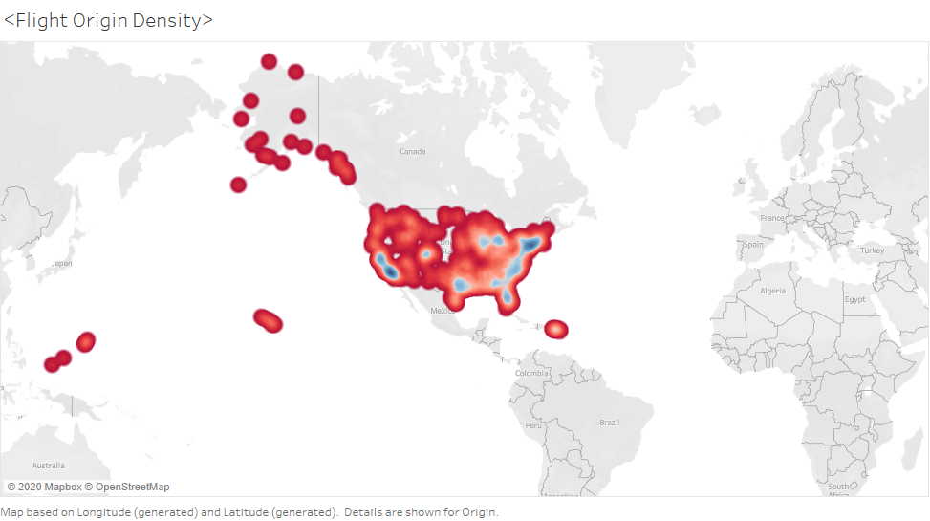
Flight origin density
Blue: More dense
Red: Less dense

Slide 14
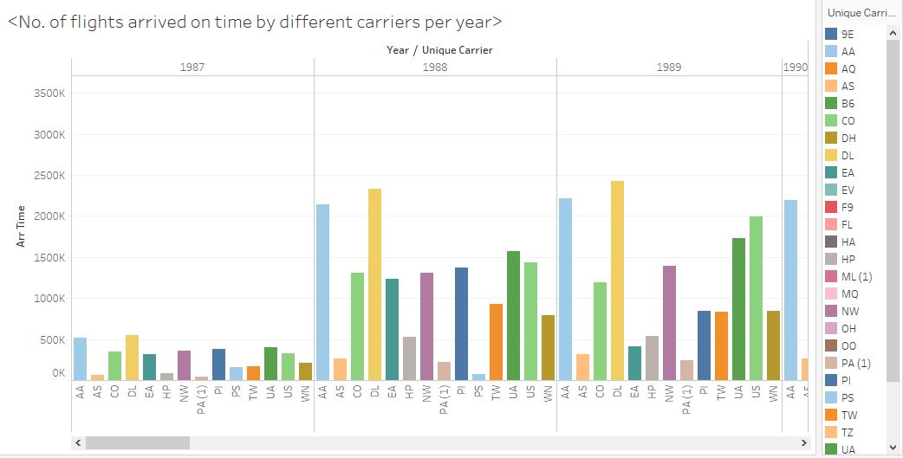
Number of flights arrived on time by different carriers per year

Slide 15
GitHub Link:
https://github.com/vmqn4/Flight-data-analaysis

Slide 16
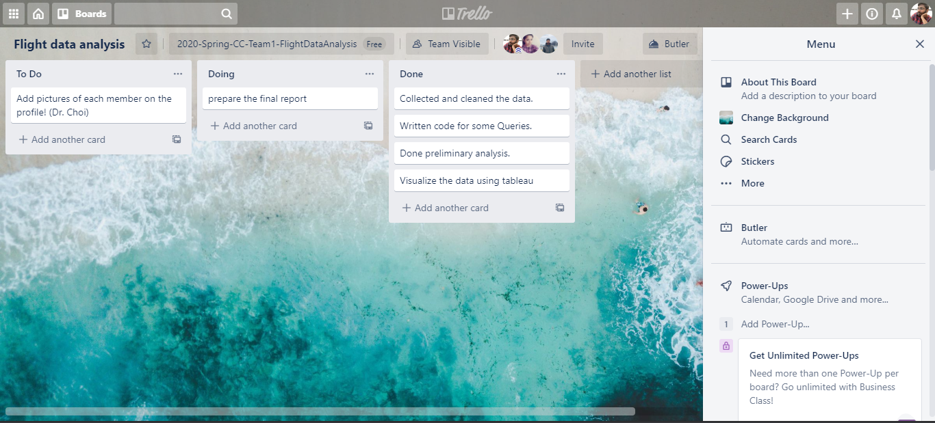
Trello Board:

Slide 17
Challenges Faced:
Handling many large data sets and setting the data in the required format.
Configuring Hive and optimizing queries to have map only phases.
Learning tableau and writing formulas in tableau.
Java heap error.

Slide 18
Learning Outcomes:
Learned how to visualize data using Tableau.
Learned how to Configure Spark and Hive.
Querying

Slide 19
Summary:
Chicago is the most busiest airport followed Dallas Fort worth and Los Angeles.
On an average Airlines operated by South West arrived on time.
East coast have more flight density i.e.. More flights are originating from east coast.
More no. of flights are delayed are due to the Carrier followed by Weather, NAS and Security issues.
American Airlines is the major carrier travelling more distance followed by United and Delta.

Slide 20
THANK YOU!

