Slide 1
TempleGuide App
Developed by:-
VINAYAK M R

Slide 2
App Description:-
This just a simple app which help as a Travel guide for important Tourist destination for places in Kerala like Ernakulam, Thrissur.
You can check description of attractive tourist locations in this places.

Slide 3
Instructions Regarding how to use this android app
Step 1:-
Download the zip file provided in the download section.
Step 2:-
Open this zip file in your android studio and try running this source code on your android device or on your Emulator.

Slide 4
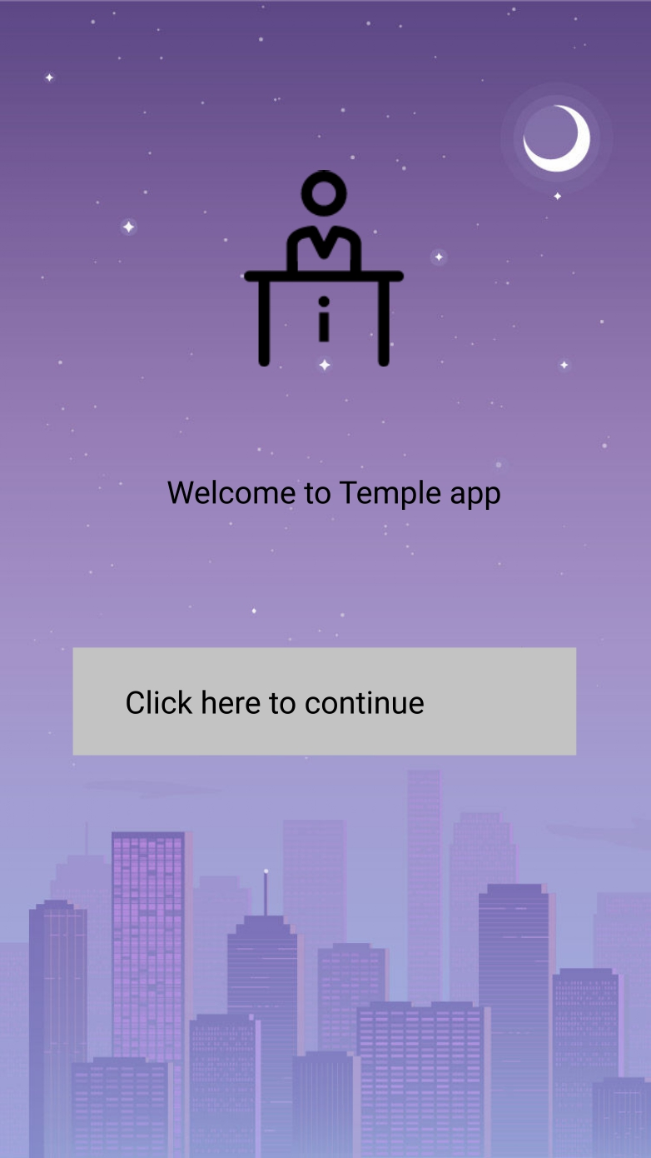
Step 3:-
In the beginning you will see a screen like this in the beginning as shown below.

Slide 5
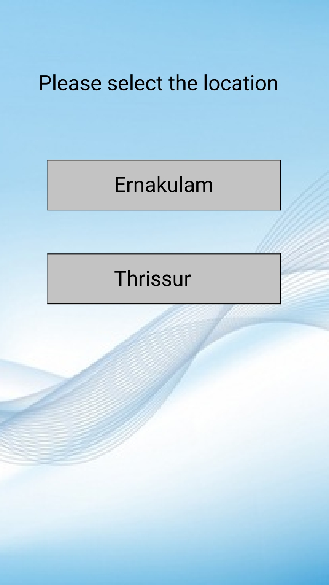
Step 4:-
After entering the click here to continue button. You will see a optional selection screen like this as shown below.

Slide 6
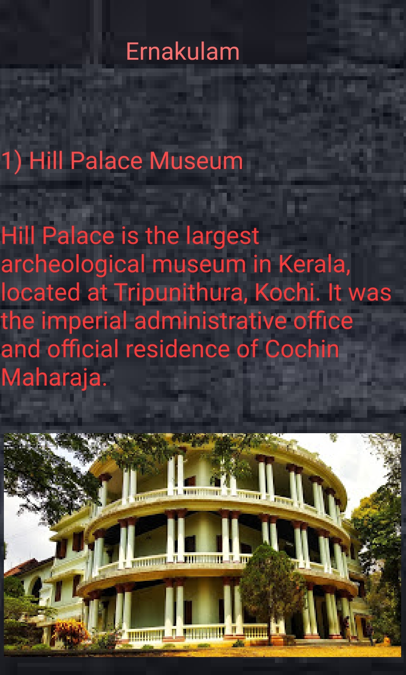
Step 5:-
* If you are then selecting the Ernakulam option you will get a screen like this as shown blow

Slide 7
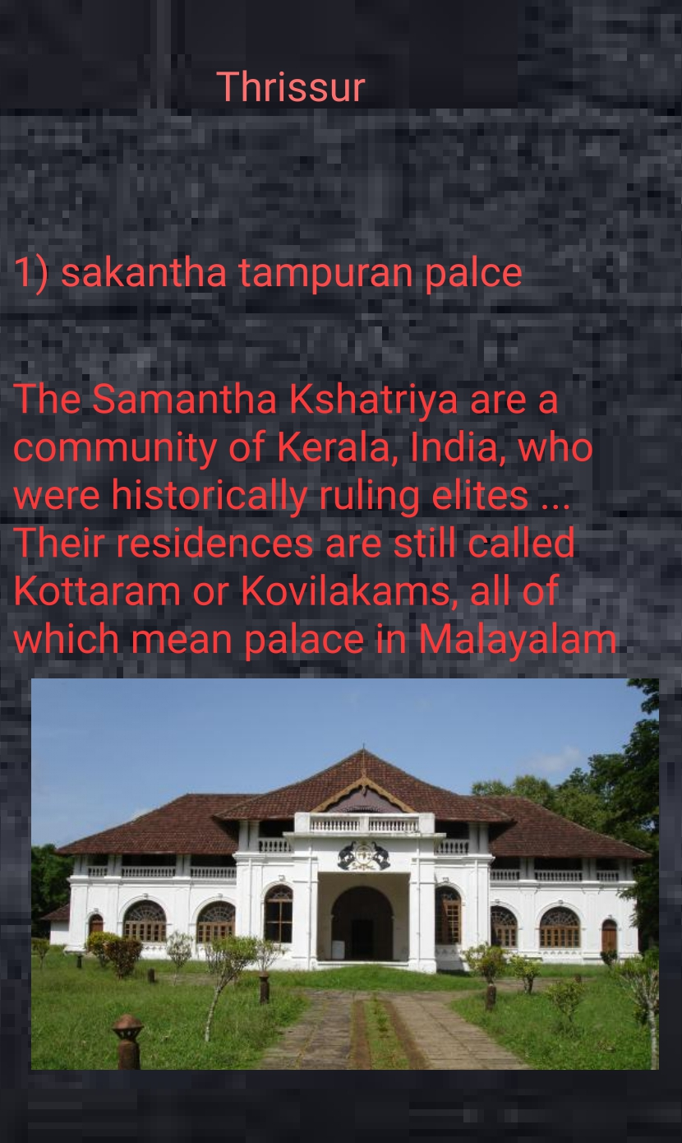
* If you are selecting the Thrissur button you will get screen like this.

