Slide 1

A/B Testing Analytics for Sales and Marketing Campaigns
Case Study on Conversion Optimization and Insights
Viraj Suthar | Email | LinkedIn

Slide 2
Project Overview
Objective:
Evaluate the effectiveness of ad strategies (Ad vs. PSA) on conversions.
Dataset:
588,101 records
user id | User ID (unique)
test group | If "ad" the person saw the advertisement, if "psa" they only saw the public service announcement
converted | If a person bought the product then True, else is False
total ads | Amount of ads seen by person
most ads day | Day that the person saw the biggest amount of ads
most ads hour | Hour of day that the person saw the biggest amount of ads

Slide 3
Data and Methodology
Data Processing:
Cleaned and preprocessed 588,101 records
Created new Feature from existing data ‘ads_hour_interaction’ which is for getting peak hours.
Analysis Methods:
Conversion Rate Analysis
Statistical Testing (Chi-Square)
Logistic Regression
Predictive Modeling using Random Forest

Slide 4
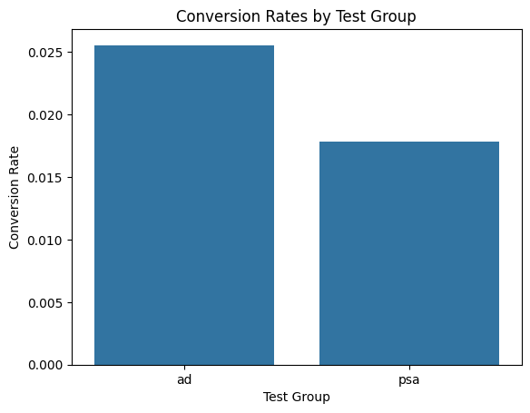
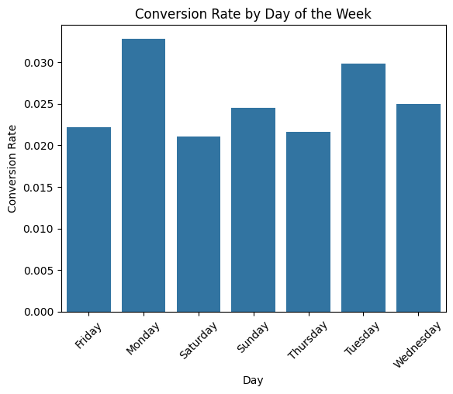
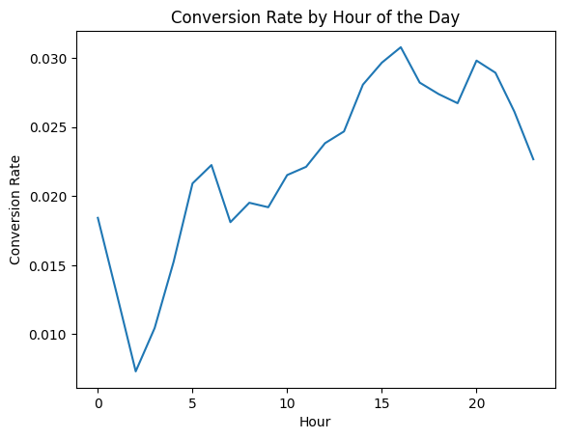
Conversion Rate Analysis
By Test Group:
Ad: 2.55%
PSA: 1.78%
Ad significantly outperforms PSA.
By Day:
Monday: 3.28% (Highest)
Saturday: 2.11% (Lowest)
By Hour:
Peak: 16:00 (3.07%), 20:00 (2.98%)
Lowest: 02:00 (0.73%), 03:00 (1.05%)

Slide 5
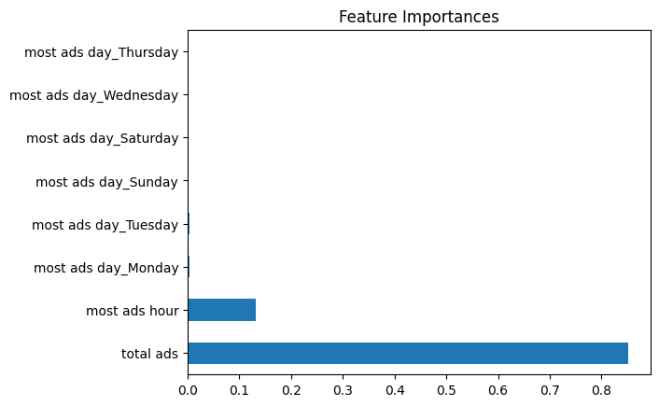
Statistical Testing
Chi-Square Test: p-value: 1.99e-13
Significant difference in conversion rates between groups.
Logistic Regression:
Key Drivers:
Total Ads (coef: 0.0057)
Most Ads Hour (coef: 0.0162)
Interaction Term (coef: 0.0003)

Slide 6
Predictive Modeling
Model Used: Random Forest Classifier
Results:
Accuracy: 97%
ROC AUC Score: 0.667
Imbalanced recall for conversions (5%).

Slide 7
Incremental Lift
Incremental Lift measures the additional conversions driven by 'Ad' over 'PSA'.
Incremental Lift: 0.77%
Significant uplift in conversions from using targeted 'Ad' campaigns.

Slide 8
Recommendations
Campaign Optimization:
Focus on high-converting days (Monday, Tuesday).
Schedule ads during peak hours (15:00–20:00).
Ad channel give more conversion rate.

Slide 9
Business Impact
Improved conversion rates by 0.77%, directly boosting revenue.
Identified peak periods for optimal campaign performance.
Provided actionable insights for future marketing strategies.

Slide 10
Conclusion
'Ad' campaigns perform better with measurable lift.
Peak days and times identified for targeted strategies.
Predictive modeling provides actionable insights.

Slide 11
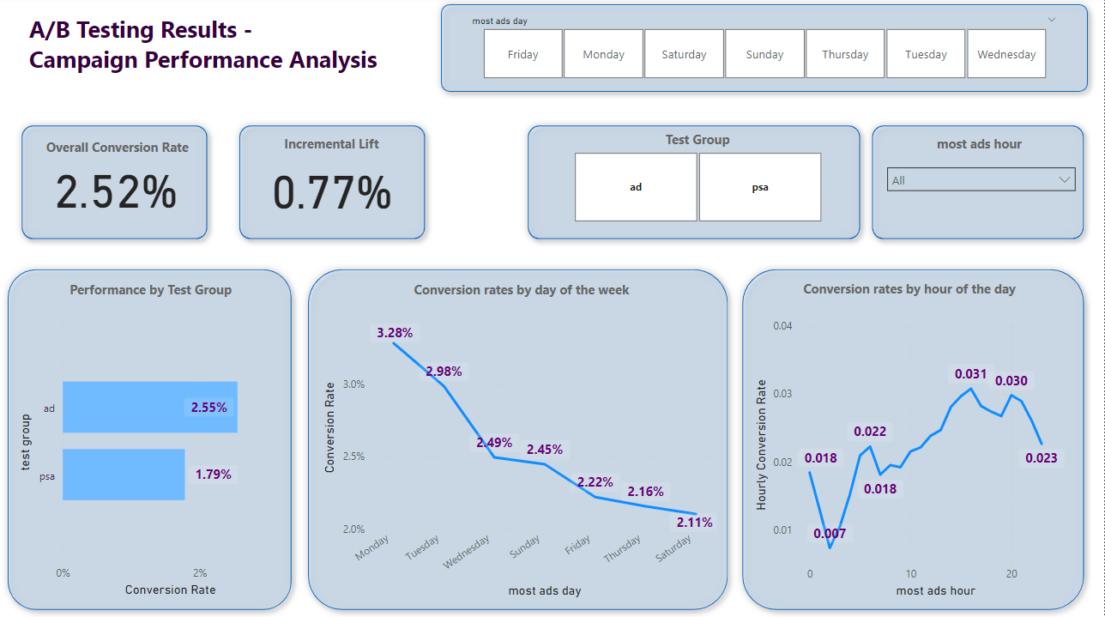
Dashboard

Slide 12
Thank You!

