Slide 1

Customer Churn Prediction Analysis
A Data-Driven Approach to Boost Customer Retention
Presented by Viraj Suthar | Email | LinkedIn

Slide 2
Project Objectives
Predict customer churn using historical data.
Identify factors contributing to customer churn.
Provide actionable insights to improve customer retention.

Slide 3
SQL: Data Exploration and Transformation
Data Exploration
Gender Distribution
Contract Analysis
Customer Revenue Contribution
2. Null Handling and Transformation
3. Views for Power BI Integration

Slide 4
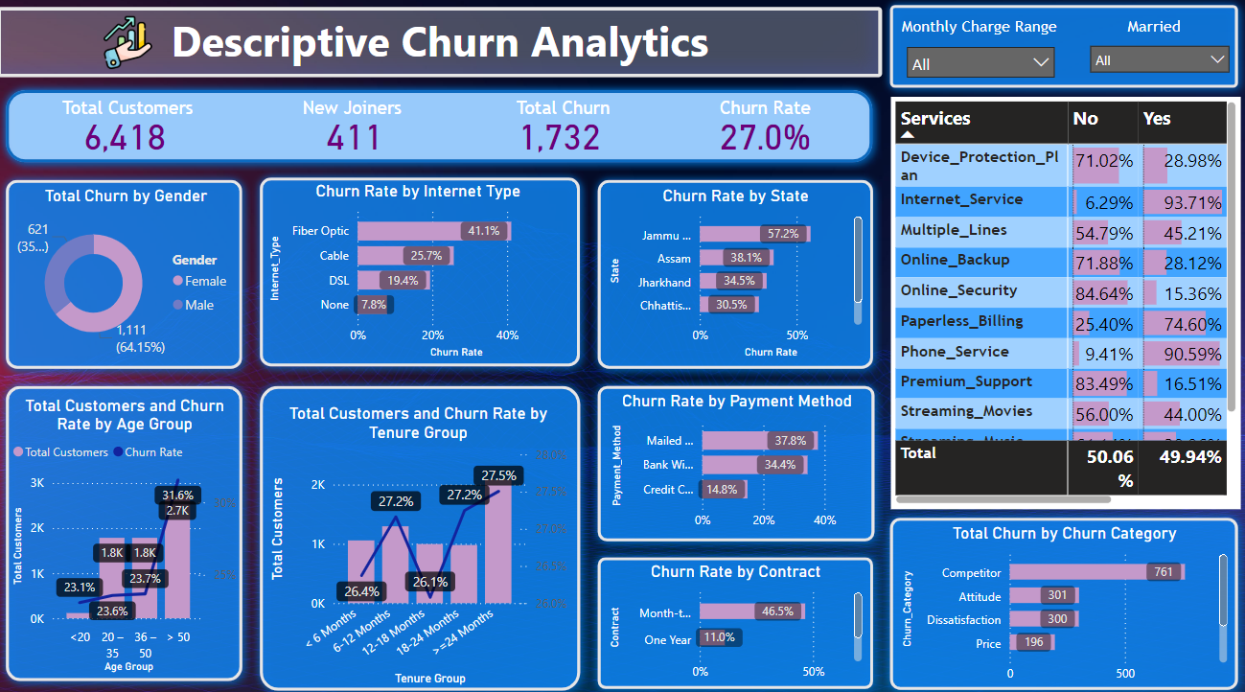
Power BI: Descriptive Insights

Slide 5
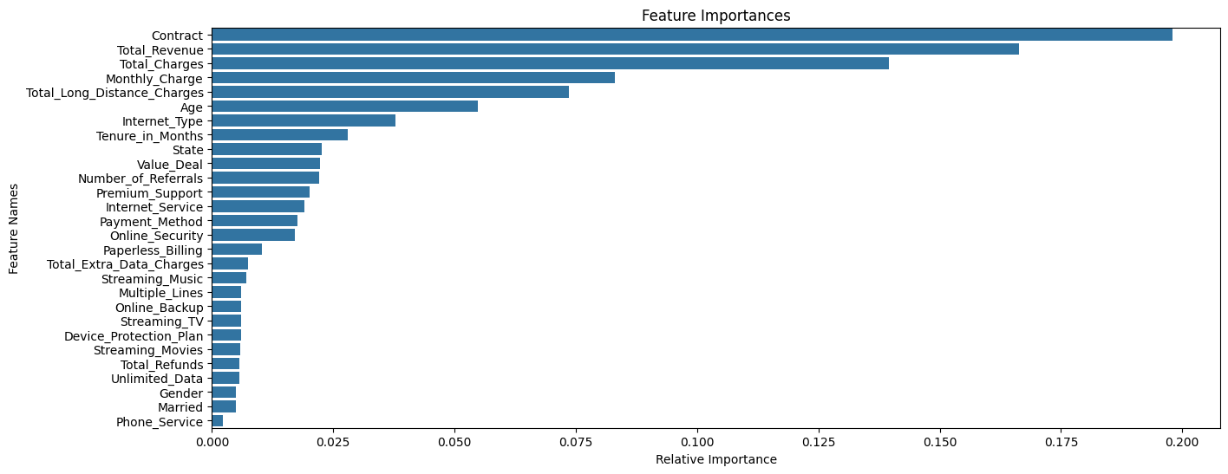
Python: Churn Prediction Model
Confusion Matrix: [[785 62]
[126 229]]
Classification Report:
precision recall f1-score support 0 0.86 0.93 0.89 847 1 0.79 0.65 0.71 355
accuracy 0.84 1202 macro avg 0.82 0.79 0.80 1202 weighted avg 0.84 0.84 0.84 1202

Slide 6
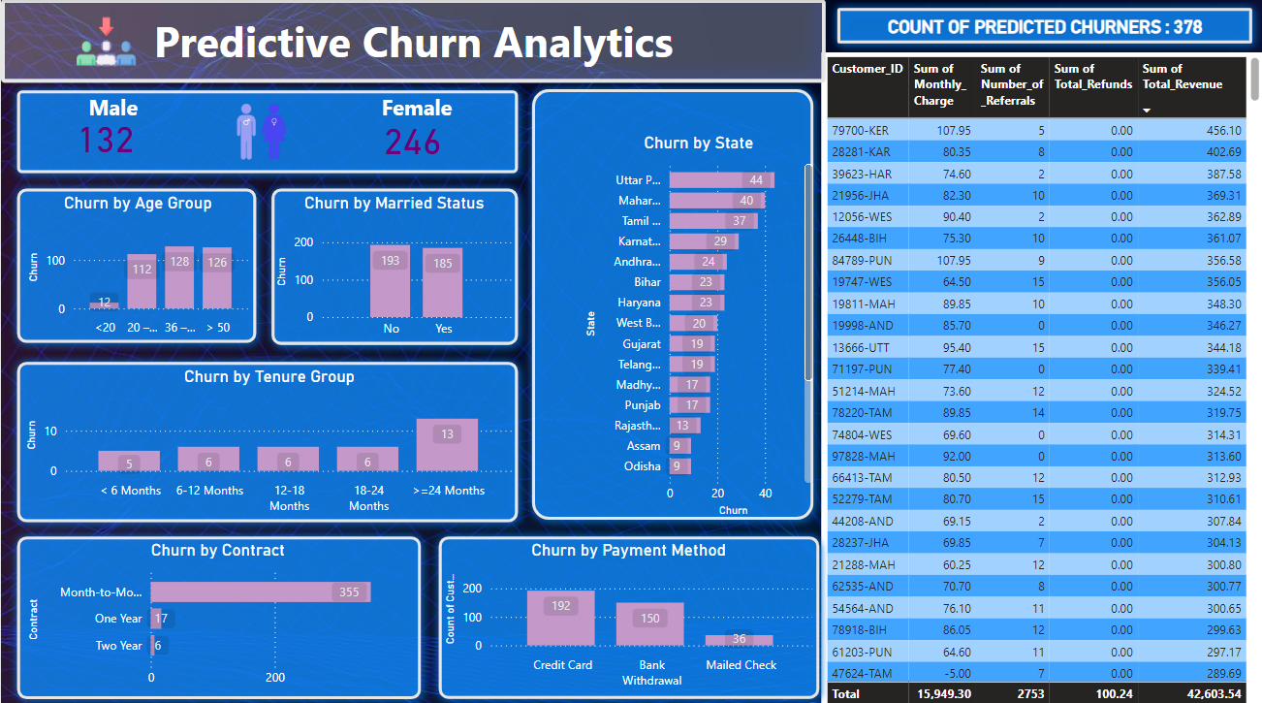
Power BI: Predictive Insights

Slide 7
Thank You!

