Slide 1

Leveraging Data for Customer Loyalty Prediction
A Case Study on Enhancing Customer Retention with Data Analytics
Viraj Suthar | Email | LinkedIn

Slide 2
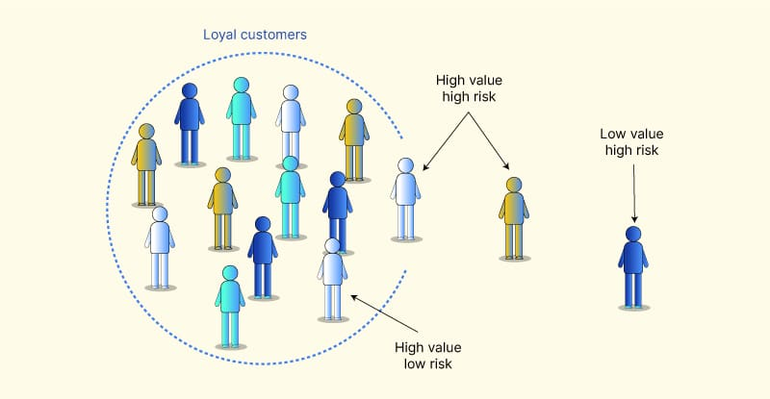
Understanding the Challenge
Problem Statement:
Businesses struggle to identify and retain loyal customers.
Solution:
Built a Logistic Regression Model to predict customer loyalty based on historical data.
Enhanced data-driven decision-making to prioritize customer retention strategies.

Slide 3
Results
 | ID | DemAffl | DemAge | DemClusterGroup | DemGender | DemReg | DemTVReg | LoyalClass | LoyalSpend | LoyalTime | prob_0
693 | 2956632 | 3 | 73 | E | U | Midlands | Midlands | Gold | 6000 | 2 | 0.993394
373 | 1154958 | 5 | 72 | B | U | South East | London | Platinum | 32050 | 12 | 0.992359
534 | 1893505 | 5 | 76 | C | U | South East | London | Gold | 6053.35 | 7 | 0.991476
251 | 708569 | 3 | 68 | E | U | Scottish | C Scotland | Silver | 4000 | 18 | 0.990983
259 | 749044 | 5 | 74 | C | U | North | N East | Gold | 6000 | 1 | 0.990753
985 | 3581411 | 2 | 61 | C | U | Midlands | Wales & West | Gold | 8513 | 4 | 0.990719
330 | 1018361 | 5 | 72 | A | U | Midlands | Midlands | Gold | 6000 | 2 | 0.989888
764 | 3470091 | 4 | 79 | C | M | South East | S & S East | Silver | 2007.95 | 1 | 0.989538
256 | 741779 | 4 | 62 | B | U | Midlands | Midlands | Silver | 5000 | 5 | 0.986807
Identified high-value customers with 81% accuracy.
Delivered top loyal customers list.

