Slide 1

Marketing Analytics
Unlocking Insights for Improved Customer Engagement and Conversions
Viraj Suthar | Email | LinkedIn

Slide 2
Business Challenges
Reduced Customer Engagement: Decreasing interactions with the website and marketing content.
Declining Conversion Rates: Lower percentage of visitors converting into customers.
High Marketing Costs: Campaign investments not delivering expected ROI.
Lack of Customer Feedback Insights: Limited understanding of customer opinions.

Slide 3
Data Sources
Customer Data: Demographics, engagement, and purchase history.
Geographic Data: Regional insights.
Engagement Data: Interaction metrics from marketing campaigns.
Customer Journey Data: Actions across stages (visit, cart, purchase).
Customer Reviews: Textual feedback and ratings.

Slide 4
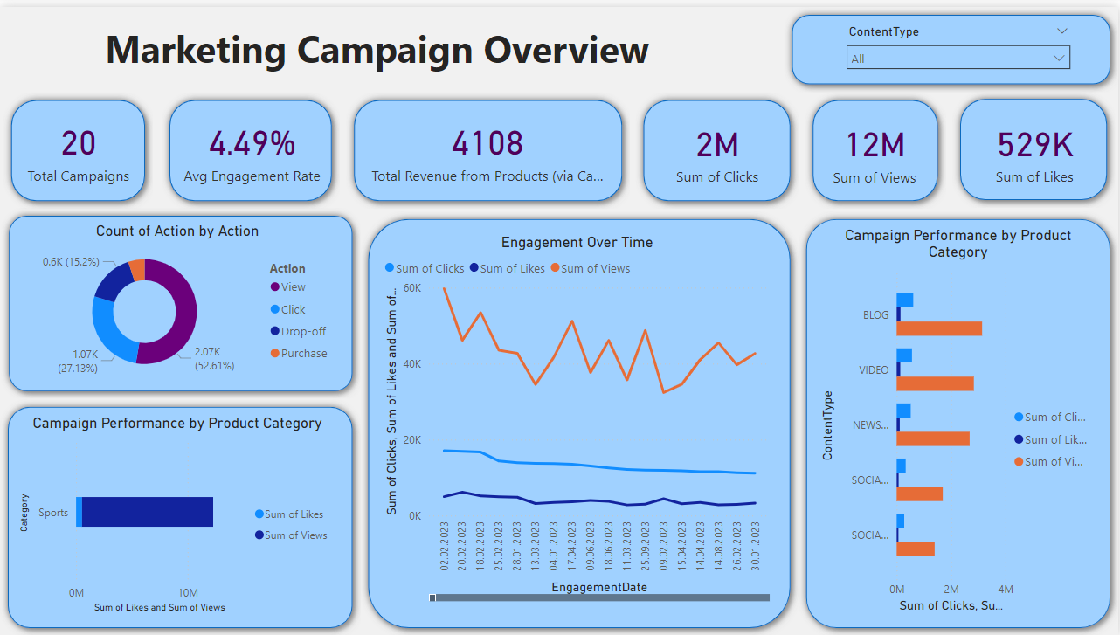

Slide 5
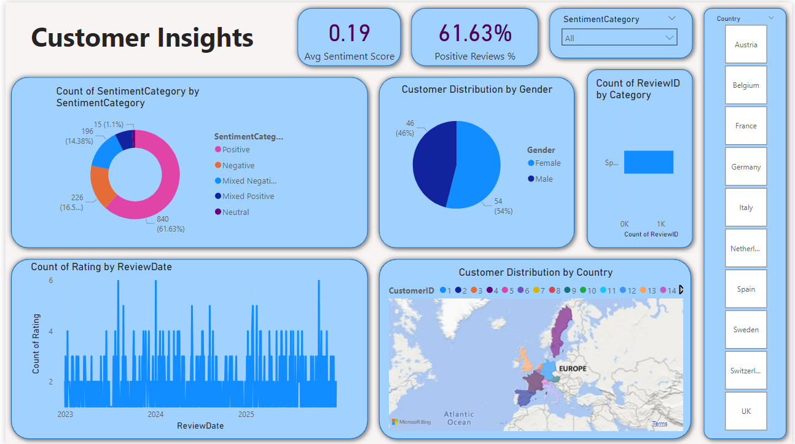

Slide 6
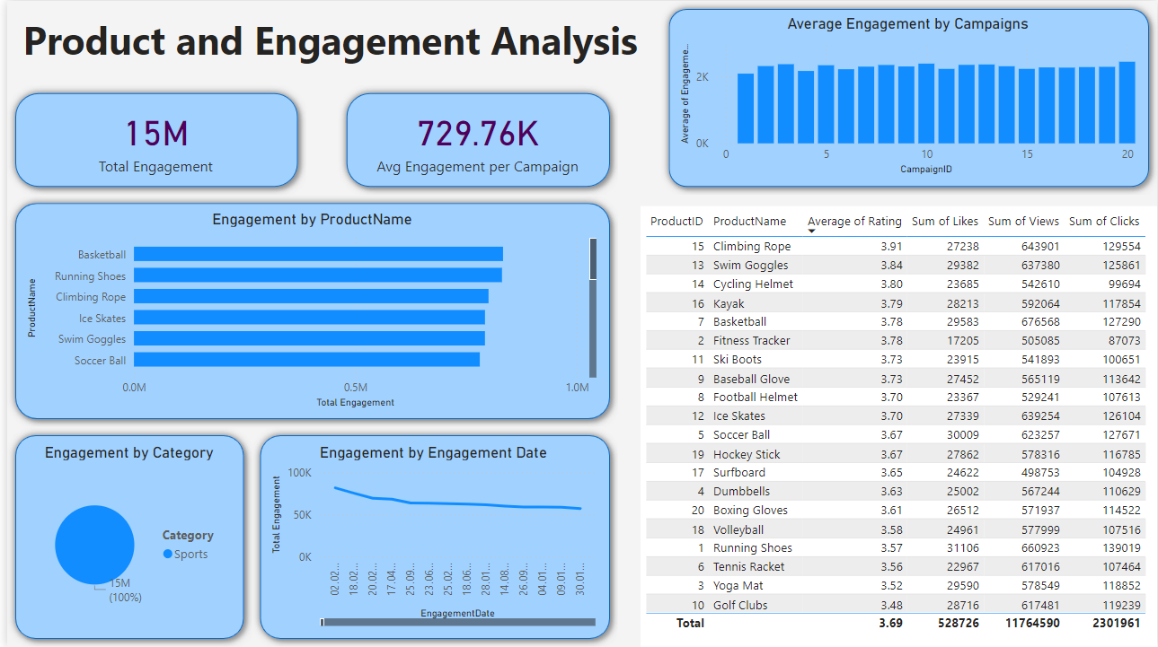

Slide 7
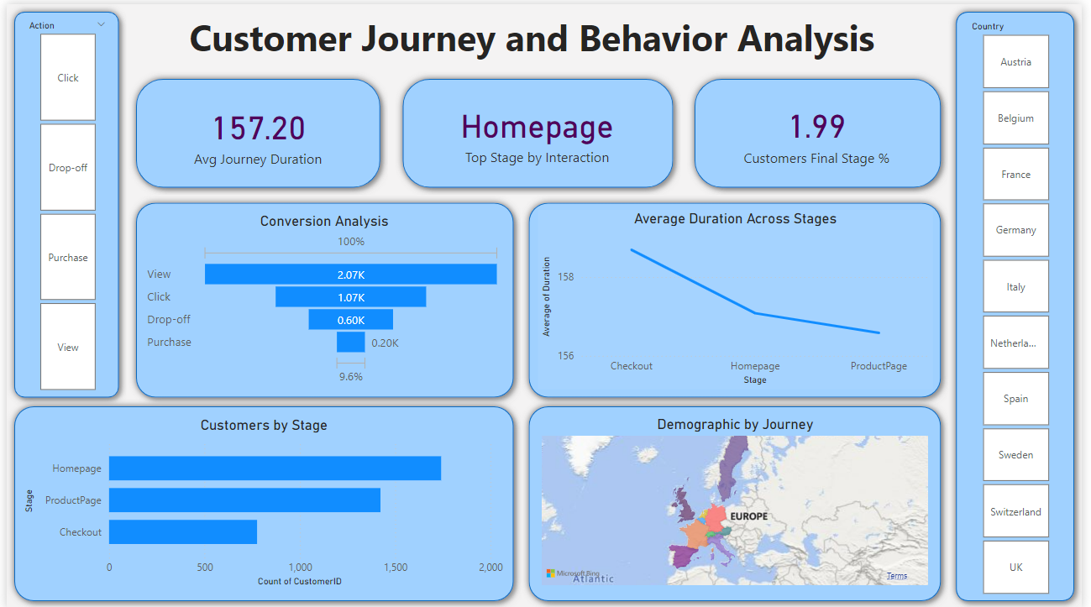

Slide 8
Thank You!

