Slide 1
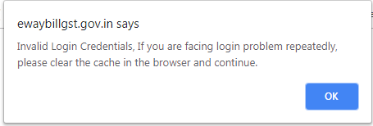

E way bill portal
Invalid login credential issue

Slide 2
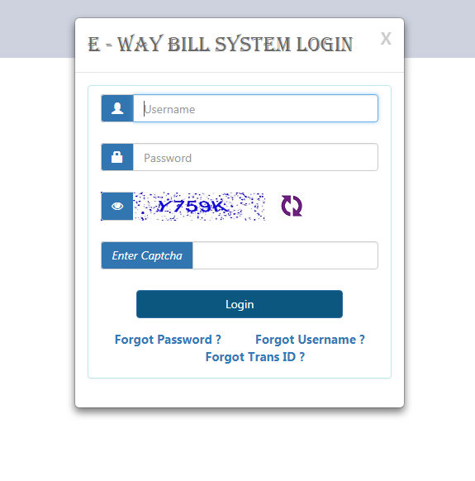
Some users are getting error while login at www.ewaybillgst.gov.in

Slide 3
Ewaybillgst.gov.in says Invalid Login Credentials. If you are facing login problem repeatedly. Please clear the cache in the browser and continue.
OK

Slide 4
If you facing problem while loading login page or while login please clear your browser cookies.
NIC (National Informatics Centre) recommended following solution for “ invalid login credential” error.

Slide 5
Recommended browsers
Browser | version
Google Chrome | 45 and above
Mozilla Firefox | 43.5 and above
Internet Explorer | 11 and above

Slide 6
How to clear browser history / cookies
Browser | Keyboard shortcut
Google Chrome | Ctrl+shift+delete
Mozilla Firefox | Ctrl+shift+delete
Internet Explorer | Ctrl+shift+delete

Slide 7
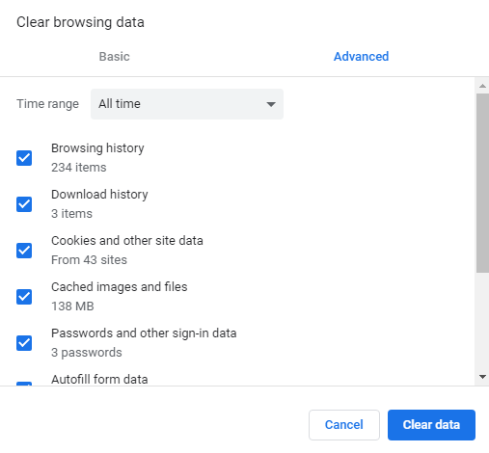
Ctrl + Shift + Delete

Slide 8
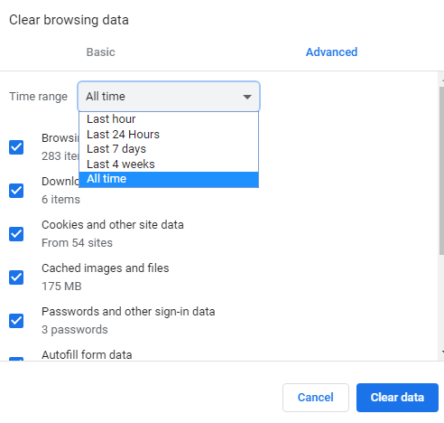
Ensure, time range selected is all time

Slide 9
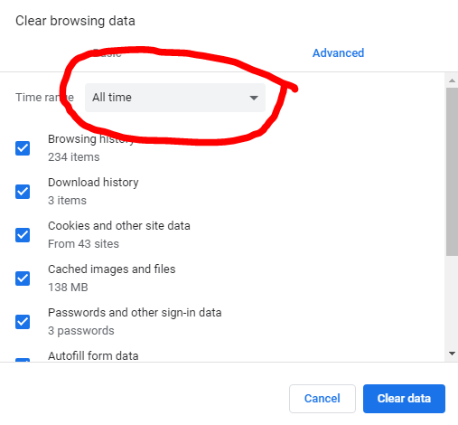
Ensure, time range selected is all time

Slide 10
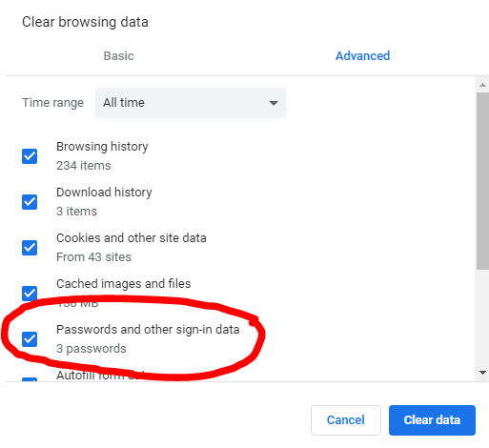
Ensure, password /sign in data is selected

Slide 11

Disadvantage:
Clearing cookies/ browser history will erase useful information, auto saved data /passwords, which may be needed for every time for login at other sites e.g. gmail, facebook.
Trick : Use different browser for www.ewaybillgst.gov.in i.e other than your regular web browser for gmail, facebook.

Slide 12
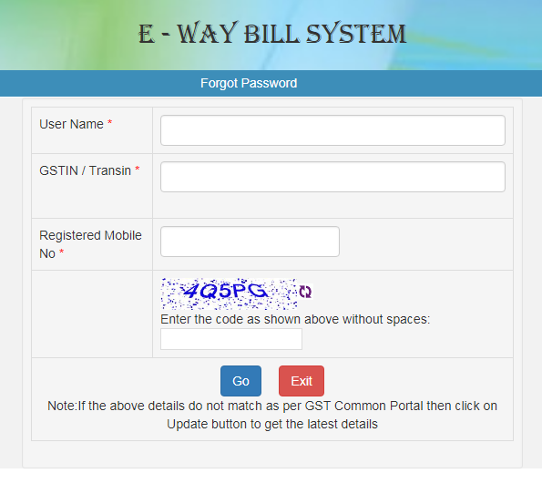
Reset password
If still problem is not resolved,
Reset password using “ forgot password” link
.

Slide 13


