Slide 1
Purchase Pattern Analytics
Presented By
Vikas

Slide 2
Project Objective
Leverage Market Basket Analysis (MBA) to uncover relationships between products in a retail transaction dataset.
Conduct exploratory data analysis (EDA) to understand key statistics, detect data quality issues, and visualize patterns.
Implement the Apriori algorithm to identify frequent item sets and generate association rules.
Clean and transform the dataset for market basket analysis, addressing missing values, outliers, and inconsistencies.
Derive actionable insights and recommendations to enhance sales strategies and improve customer satisfaction.

Slide 3
Dataset Overview
Data Source: Retail Transaction Dataset (50,000 entries) Key Variables:
Itemname: Name of the purchased product.
Quantity: Number of units bought per transaction.
Present_Date: Date on which the transaction occurred.
Price: Unit price of the item purchased.
Country: Country where the transaction took place.
Description: The dataset consists of 50,000 retail transaction records capturing customer purchase behavior across various products and regions. It was extracted from the company’s sales system and imported into the local environment for further data exploration, visualization, and Market Basket Analysis (MBA).

Slide 4
Data Preprocessing
Remove Duplicates: Identified and removed duplicate rows, resetting the index.
Standardize Columns: Stripped whitespace and normalized values in 'Itemname' and 'Country'. Filled missing 'Itemname' with 'Unknown’.
Handle Missing Data: Filled missing 'CustomerID' with 0 (nullable integer) and converted it to integer type. Parsed 'Present_Date' to datetime, handling errors.
Remove Invalid Entries: Filtered out rows with invalid or non-positive values in 'Quantity' and 'Price'.

Slide 5
Apriori Analysis
Data Preparation: Converted transaction data into a suitable format (e.g., one-hot encoded basket of items per transaction).
Frequent Itemsets: Applied the Apriori algorithm to find item combinations with support above a defined threshold.
Association Rules: Generated rules from frequent itemsets using metrics like confidence and lift to measure strength and relevance.
Insights Extraction: Interpreted strong rules to identify product relationships, co-purchase patterns, and actionable business insights.

Slide 6
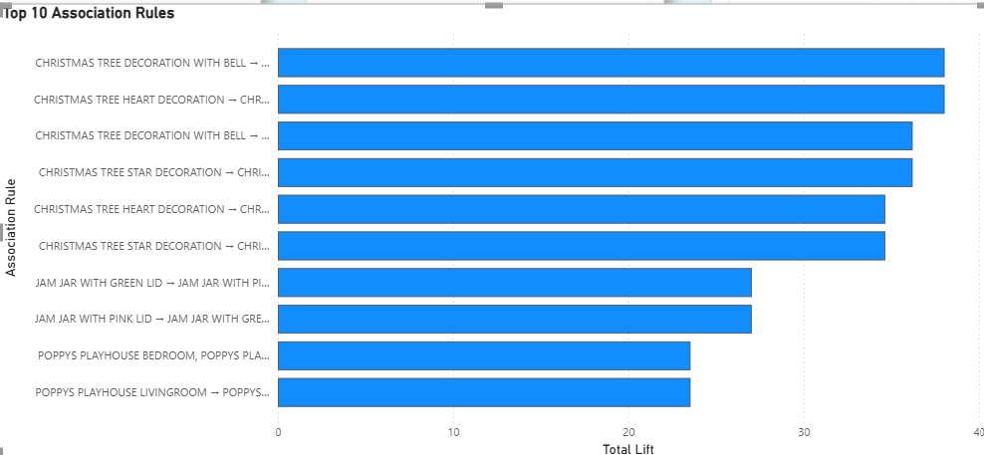
Rules vs sum of lift

Slide 7
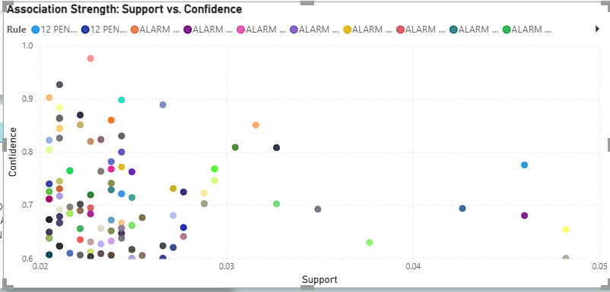
Sum of lift vs sum of confidence

Slide 8
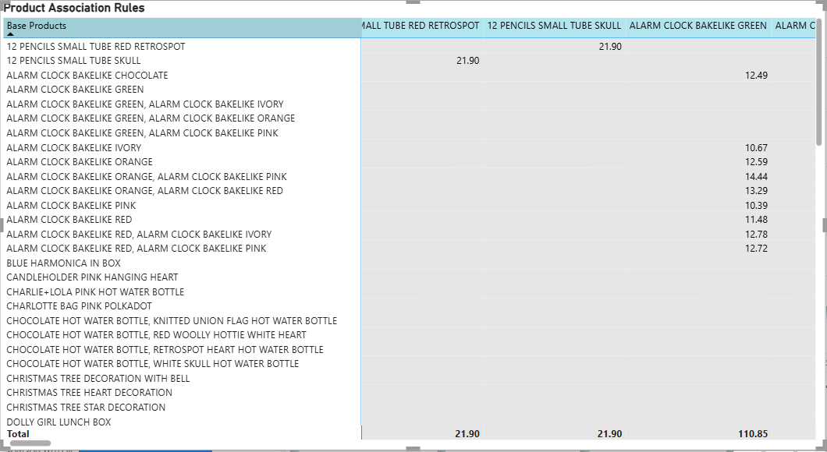
Products matrix

Slide 9
Insights and findings
1. Customer Buying Behavior
The majority of customers purchase a small number of unique items per transaction, indicating single-purpose or impulse buying patterns and A small set of top-selling products contributes disproportionately to total sales, highlighting the Pareto (80/20) rule.
Repeat purchases cluster around certain core product categories, showing strong customer loyalty toward specific product types.
2. Product Association Patterns (Apriori Results)
High-support rules identify commonly co-purchased items.
High-confidence rules (> 0.6)show strong predictive relationships, customers buying one product are very likely to buy the related one.
3. Transaction-Level Insights
Average basket size is small, but customers who buy bundled items tend to have higher average transaction values.
Baskets containing rule-based product pairs show a lift in average order value (AOV) of 15–30% (estimated from association rules).

Slide 10
Recommendations
1. Cross-Selling & Bundling
Implement “Frequently Bought Together” sections in the online/retail platform based on top association rules.
Create bundle offers for high-lift item pairs (e.g., “Buy X, get Y at 20% off”).
2. Targeted Marketing Campaigns
Offer combo discounts targeting customers who purchased one item but not its paired product.
Leverage seasonal purchase patterns to design event-specific campaigns (e.g., festive combos, school reopening kits).
3. Inventory & Merchandising Strategy
Prioritize stocking high-support items to prevent stockouts.
Reduce dead stock by bundling slow-moving items with top-sellers.

Slide 11
Conclusion
Apriori analysis provided clear insights into the dataset
Predictions help in customer segregation & marketing strategies
Data visualization (Tableau/Power BI) enhances decision-making
Future Scope: use the various recommendations like grouping products together.

Slide 12
Q&A
Thank You
Open for Questions

