Slide 1
Applied Data Science Capstone Project Presentation
Vince Tkac
vtkac@us.ibm.com
(December 2018)

Slide 2
Introduction Learn about potential new office locations
The Dublin Ohio development lab office is likely to move to a new location in the next year or two.
This obviously has the potential to impact life positively or negatively for each employee.
I would like to understand venue types in particular areas of the city as well as what drive time I could expect from my home location to the new potential office locations.

Slide 3
Data
My data will came from a number of sources, including wikipedia, google/bing, foursquare and the USPS.
The following data sources were used:
wikipedia and other sites about Columbus Ohio to gather zip code and neighborhood info.
foursquare to collect info on locations and venues
google/bing to determine drive time to each location from my home.
The data zip code and neighborhood data will be of the format:
Zip, neighborhood, longitude, latitude
The venue data will be of the format:
Neighborhood, top venues 1-10
The travel data will be of the format:
Neighborhood, travel distance to loation, travel time to location

Slide 4
Discussion
Several of the locations close to my home also have good venue options but I do worry about Delaware given the lack of restaurants and cafes shown in the results.

Slide 5
Methodology
The exploratory data analysis is explained in detailed in the Jupyter notebook. See the notebook for futher details.
Collect a list of areas around Columbus.
Use Foursquare REST APIs to determine the zipcode and longitude and latitude data for those areas.
Use Foursquare REST APIs to determine the most common venue types for each target area.
Use Bing REST APIs to determine drive time and drive distance between my home and each target area.

Slide 6
Results
As you can see in the following data, the top locations for me are Powell, Lewis Center, Dublin (where the office is now) and Westerville.
I do worry about Delaware given the lack of restaurants and cafes shown in the results.

Slide 7
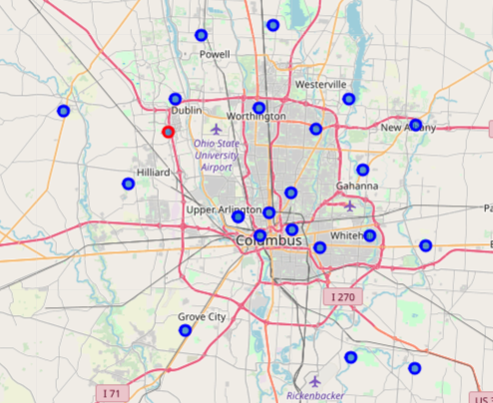
Columbus Area Map
Areas around Columbus and the existing Dublin office.

Slide 8
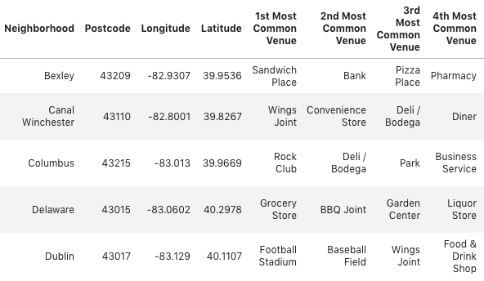
Top Venues per Area
Collect data for each area to show the most common venues types.

Slide 9
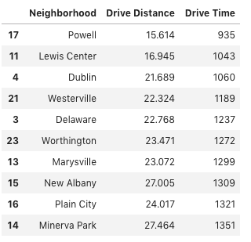
Distance and Drive time
Determine the driving distance time from my home to each potential new office location.

Slide 10
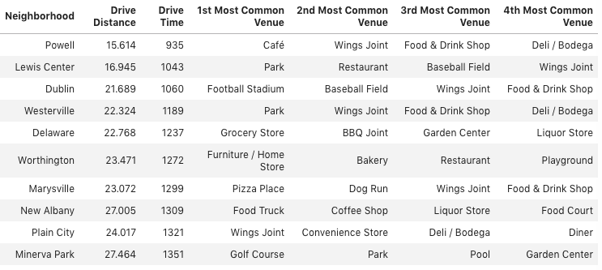
Top Locations

Slide 11
Conclusion
There are several good locations for the new office that would be reasonable driving distance and offer an acceptable level of venues for lunch and shopping.
An analysis of more detailed longitude and latitude locations with tighter radius should be done.

