Slide 1


Business Impact Presentation
1/15/2015

Slide 2

Agenda:
About VMTurbo
Sigma-Aldrich Key Requirements
POV Overview
ROI Presentation
Proposal Discussion
Appendix (ROI Numbers confirmed through plans)

Slide 3

VMTURBO Background
Founded 2009
Founding team from SMARTS (Acquired by EMC)
Backed by Bain Capital Ventures and Highland Capital Partners
Award-winning control system for virtualized and cloud environments
First product released VMTURBO Operations Manager
launched in September 2010
15,000+ users worldwide; 1,000+ customers
180+ employees (doubled over the past 9 months)

Slide 4
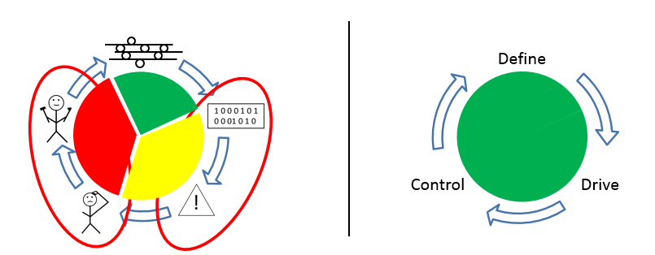
Rethinking the approach
Traditional methods wait until you have a problem, send you an alert and allow you to troubleshoot and fire fight AFTER you have a problem
Virtualization enabled us to prevent problems from happening. VMTurbo gives us the recommendations to make sure you do not leave an optimal state

Slide 5
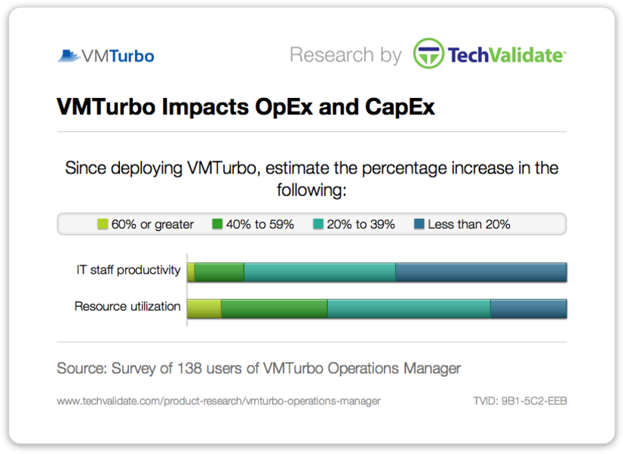
VMTurbo Improves CAPEX and OPEX
55% of customers increased IT staff productivity by 20% or more since deploying VMTurbo
VMTurbo Impacts CapEx
VMTurbo Impacts OpEx
: 9%
: 28%
: 43%
: 20%
: 2%
: 13%
: 40%
: 45%
80% of customers increased resource utilization by 20% or more since deploying VMTurbo

Slide 6
Agenda:
About VMTurbo
Sigma-Aldrich Key Requirements
POV Overview
ROI Presentation
Proposal Discussion
Appendix (ROI Numbers confirmed through plans)

Slide 7
Requirements:
Assure Application Performance
Ability to automate preventive tasks to keep environment healthy, by providing executable actions instead of just alerting when a problem happens.
Understands when to add compute or capacity to environment.
Must be able to make rightsizing recommendations simultaneously with placement and capacity with justification as to why a VM needs to be sized differently.
Improve Efficiency
Ability to make rightsizing recommendations simultaneously with placement and capacity: by doing this we must demonstrate how to safely increase VM Density.
Can create on demand reports with justification behind the recommendations and show resource peaks and averages.
Ability to converge the peak resource utilization of hosts with averages to allow an increase in VM density without impacting application performance to end users.
Tying Capacity planning with real time actions
Ability to simulate adding or removing any resource (VM’s, datastores, & hosts) to accommodate planned growth and make better decisions about hardware requirements.
Ability to increase VM count: adding VM’s into clusters and accurately forecast when additional hardware is needed to support VM’s to prevent being “blindsided“ by hardware needs.
Must be able to provide detailed reporting of plans with the decisions as to where to place the virtual machines across the infrastructure to show how to execute plan.
Future Proof and Operationalizing the Platform
Must be able to quickly and easily provide insight into the health and risks across the virtual infrastructure.
Ability to provide specific recommendations to reduce the present risks and provide preventative recommendations to prevent future problems from impacting VM performance.
Provide high level dashboards of the status of the entire environment: easily customizable and must be able to provide on demand reports based on the custom dashboards.

Slide 8
Agenda:
About VMTurbo
Sigma-Aldrich Key Requirements
POV Overview
ROI Presentation
Proposal Discussion
Appendix (ROI Numbers confirmed through plans)

Slide 9
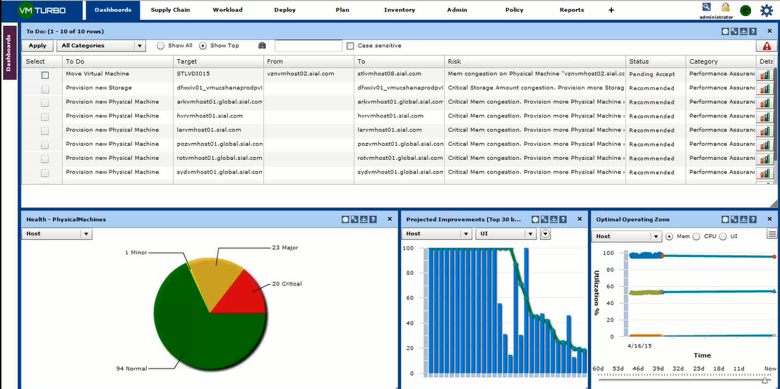
Testing VMTurbo: Assuring Application performance
Sigma-Aldrich’s current state
94 Healthy Hosts
1 Minor Hosts
23 Major Hosts
20 Critical Hosts
Once Sigma-Aldrich takes VMTurbo’s actions we will converge the environment to a healthy state.
During the POV, VMTurbo identified several actions that can be applied (manually or in automate) to move the environment into a healthy state. Both placement & sizing recommendations simultaneously with an understanding of capacity.

Slide 10
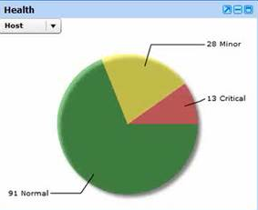
Testing VMTurbo: Assuring Application performance
January
April
Critical Performance problems grew by 6% over 3 months or 214 VMs with degraded performance compared to 119 in January.

Slide 11
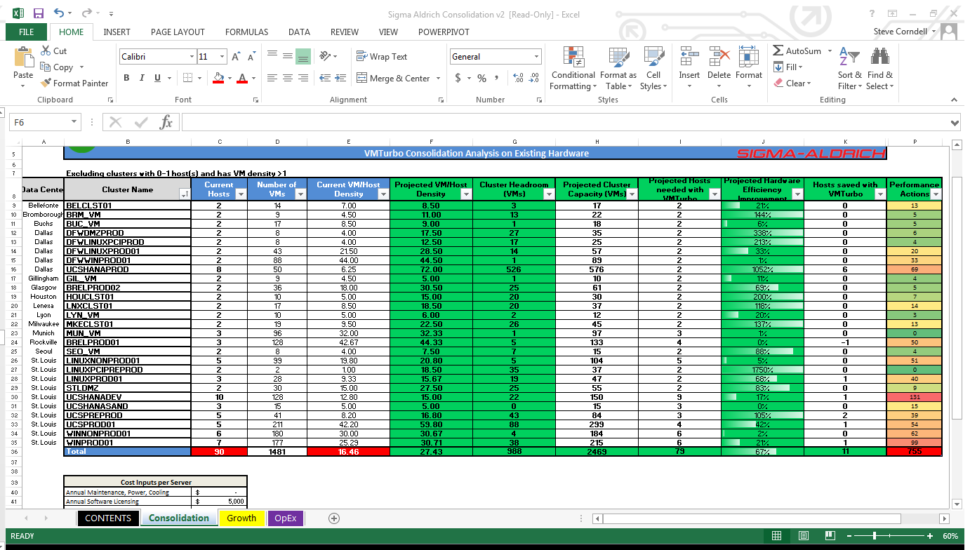
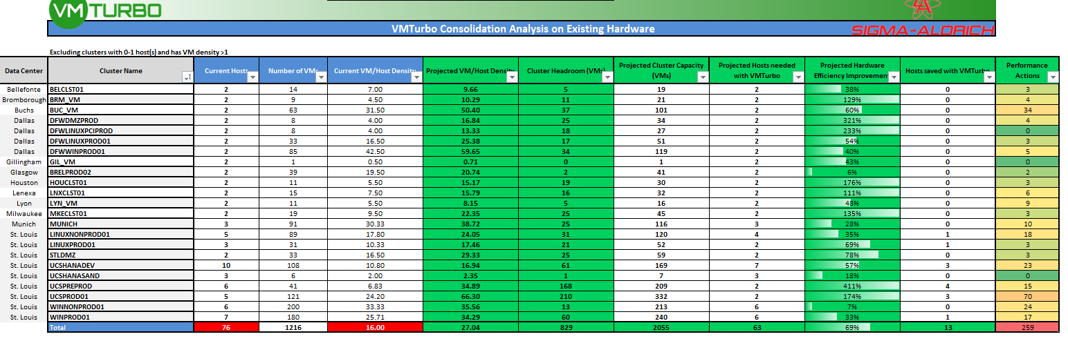
Testing VMTurbo: Performance
Jan
April
Over 4 months Sigma Aldrich added 265 VMs which led to higher levels of complexity.
As utilization on compute resources increase it becomes much more difficult to assure application performance
Sigma Aldrich took VMTurbo out of Automating performance assurance and as a result went from 259 performance actions to 755.

Slide 12
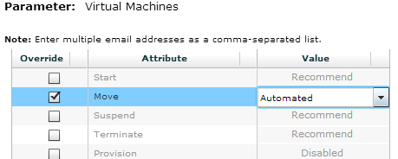
Testing VMTurbo: Assure Application Performance
Sigma-Aldrich has the ability to choose various actions around Keeping the environment healthy:
Automate: will keep the environment healthy, automatically apply the recommendation as soon as VMTurbo determines a change
Manual: ability to click the recommendations and hit apply
Recommend: read recommendations to keep environment healthy
Schedule: ability to schedule changes during maintenance windows.
Recommendations around:
vMotion
Storage vMotion
Resize
Control Options:
All VMs
By Cluster
By Network
By Storage
By Folders
By individual groups that Sigma-Aldrich can create
We have decided to test automation in one of Sigma Aldrich’s Clusters – Let’s Check out the results!

Slide 13

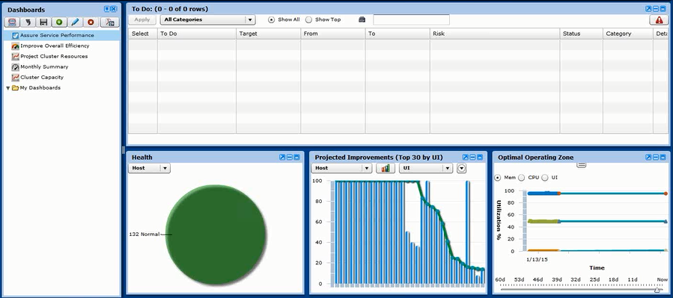
Testing VMTurbo: Assure Application Performance – VMTurbo in Automation
No Alerts, No Recommendations!
Proven from the WinnOnProd01 Cluster in automate, keeping perpetual health, this green circle with no alerts is effectively what Sigma-Aldrich’s environment will look like with VMTurbo’s control. The Demand of the Workloads will always be met, guaranteeing performance, while allowing Sigma-Aldrich to have to lowest total cost of ownership of the Infrastructure they have invested in.

Slide 14
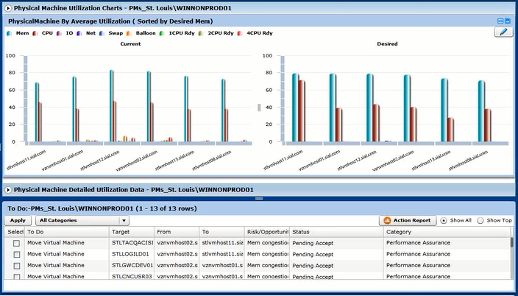
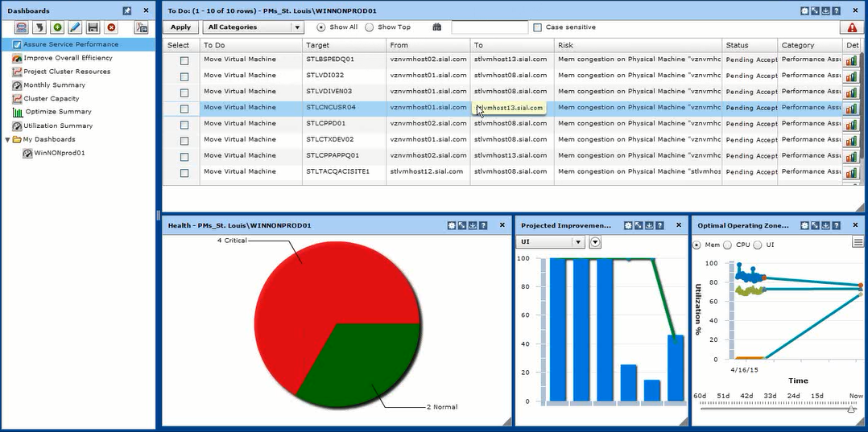
VMTurbo: Assuring Application Performance
Under Automation, VMTurbo took your WinNONProd01 cluster from the state on the left, to the state on the right. Once all of the actions are taken at the bottom and you are at the state on the right, VMTurbo will keep you there perpetually, assuring performance while maximizing the efficiency of the hardware.
After Sigma-Aldrich’s 30 day trial of VMTurbo ran out, your WinNONProd01 cluster went from a green circle with perpetual health to a risky cluster as seen on the right

Slide 15
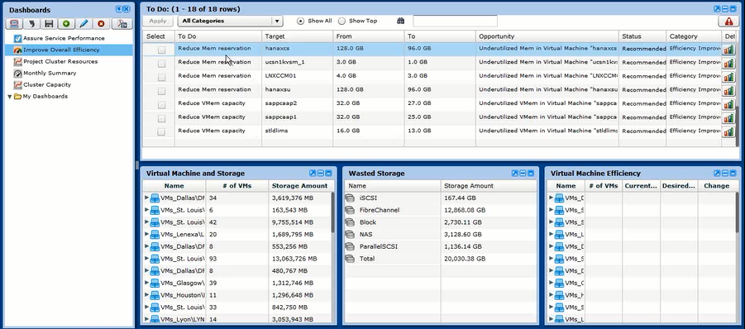
Testing VMTurbo: Efficiency
Reclaim Resources:
VMTurbo identifies areas of over-allocated resources that we can help reclaim back to assure performance

Slide 16
Testing VMTurbo: Efficiency (JAN)
69% more efficient or 13 hosts can be removed / repurposed immediately.
(data collected from Sigma-Aldrich POC with VMTurbo)

Slide 17
Testing VMTurbo: Efficiency (APRIL)
67% more efficient or 11 hosts can be removed / repurposed immediately.
(data collected from Sigma-Aldrich POC with VMTurbo)

Slide 18
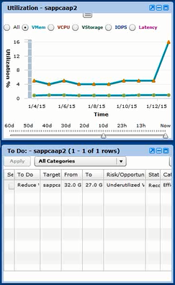
Testing VMTurbo: Efficiency - Justification behind rightsizing environment
VMTurbo will not only make these rightsizing recommendations to increase efficiency, but give the justification behind it for every resize it recommends. As we see here we are recommending to reduce vMEM on a VM from 32 GB to 27 GB taking into account its peaks and average utilization. Average Utilization is under 5% and it is peaking out around 16%, giving clear proof that we can reclaim these resources from this VM.

Slide 19
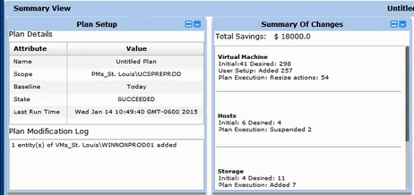
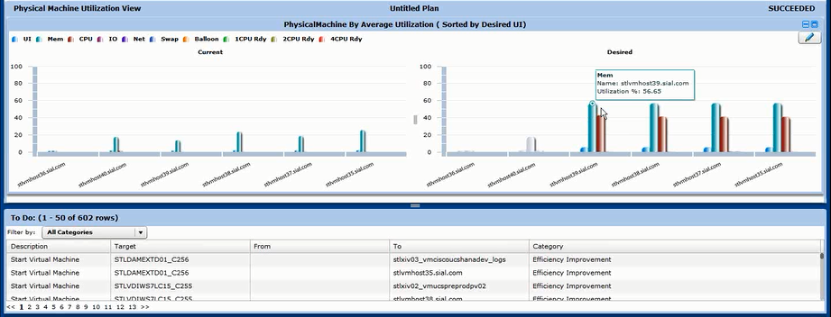
Testing VMTurbo: Capacity Planning – How to keep the environment optimized through any changes you make
VMTurbo quickly proved out how many hosts you need to support the current and new workload, and exactly where to place all of the new VM’s, as well as where to replace all of the already existing VM’s for maximum performance as well as efficiency maximization of your hosts. What is compelling here is that we added 257 VM’s into this cluster and VMTurbo STILL is able to suspend 2 hosts while running optimal performance.

Slide 20
Agenda:
About VMTurbo
Sigma-Aldrich Key Requirements
POV Overview
ROI Presentation
Proposal Discussion
Appendix (ROI Numbers confirmed through plans)

Slide 21
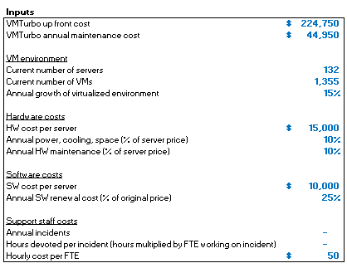

Return on Investment Summary
Projected payback period of 9 months… @35% increase in VM Density.
Proven in POV:
Average VM / Host Density:
69% (used 35%)
See Appendix for cluster projections ran

Slide 22
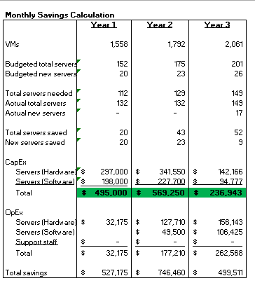
Return on Investment Summary
ROI Key Assumptions…35% increase in VM Density drives 52 less host purchases over 3 years.. $1.3 million savings

Slide 23
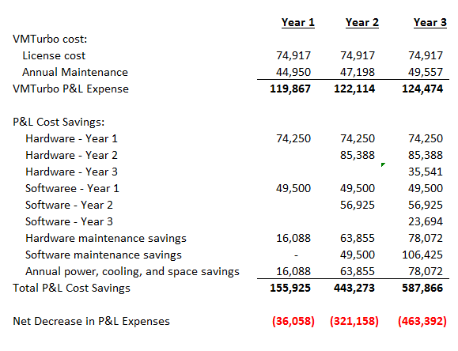
Return on Investment Summary
On a P&L basis breakeven in
LESS THAT 1 YEAR

Slide 24
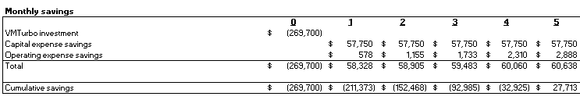
ROI BEFORE YOU BUY…
Sigma-Aldrich added 265 VM’s since January
21% Growth
Based on the growth if Sigma-Aldrich purchased VMTurbo in January, they would have already received a ROI.

Slide 25
Agenda:
About VMTurbo
Sigma-Aldrich Key Requirements
POV Overview
ROI Presentation
Proposal Discussion
Appendix (ROI Numbers confirmed through plans)

Slide 26
Operationalizing VMTurbo – the Plan
Sigma-Aldrich has worked with VMTurbo to quickly Operationalize VMTurbo:
VMTurbo license key enabled (platform is already installed, minimal time needed to upgrade to new version, add additional vCenters, and license key).
Discussed Requirements with VMTurbo Rapid Success Team.
Value Plan created:
Harmony
VM Move Actions Automated / Manually applied
Plan: Model with constraints, higher host utilization, reduce future spend / increase VM Headroom
Storage: equalize latency and IOPs
VM Right sizing's: understand the opportunity to release committed resources
Liquidity:
Examine Constraints – cluster boundaries
Plan: model without constraints
Utilization model vs. Static Tiering
Demand Drive Automated Control
Adaptive control in response to varying demand
Integrated with provisioning for intelligent initial placement
Spanning Technologies and vendor agnostic approach
New technology adoption and value

Slide 27
Operationalizing VMTurbo – the Plan
4. VMTurbo Value Milestone & Run Book creation:
1. Document initial state of Sigma-Aldrich
2. Detailed Rapid Success Recommendation and Summary report with milestones and measurable outcomes
5. Rapid Success Engagement includes:
1. Two days of on-site advanced training providing both lab and hands on instruction with a certified VMTurbo Trainer
2. Two days of consultative services from a VMTurbo Customer Success Manager to understand the use-cases outlined, people, processes and integration points and provide guidance and knowledge transfer
3. Review more complex use cases and document how to leverage VMTurbo for solving these problems
4. Provide detailed information on how VMTurbo can integrate with any relevant 3rd party solutions. 5. Additional ½ day of training where all knowledge transfer activities will be reviewed, documents will be distributed, and any topics still unaddressed will be covered.

Slide 28
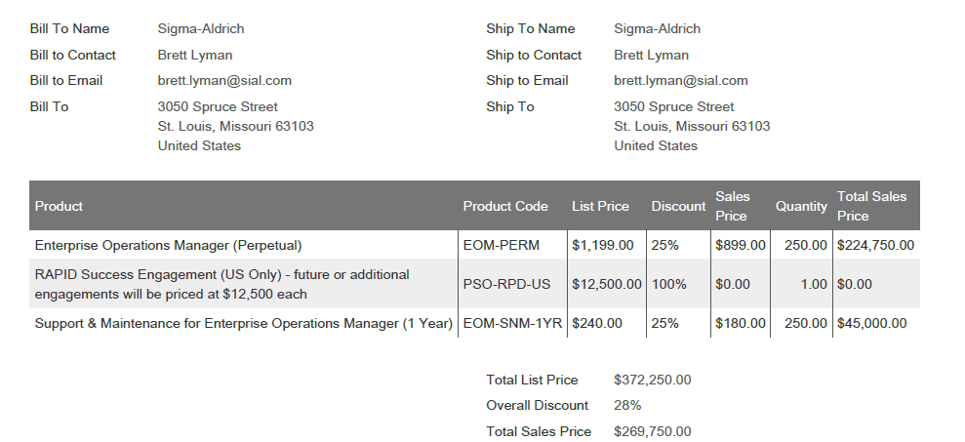
Quote
This quote reflects last years pricing: a 25% discount off of list price for 250 sockets and free Rapid Success Training for your team

Slide 29
Agenda:
About VMTurbo
Sigma-Aldrich Key Requirements
POV Overview
ROI Presentation
Proposal Discussion
Appendix (ROI Numbers confirmed through plans)

Slide 30
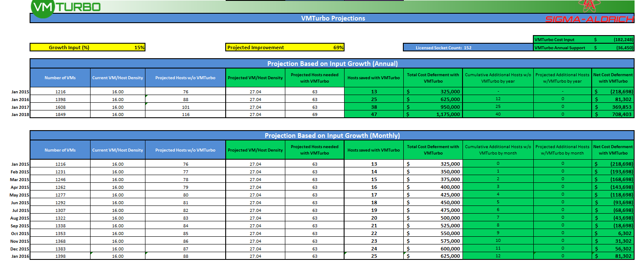
VMTurbo will allow you to defer any host purchases for the next year. At your current VM/Host density you would be purchasing 12 by January 2016
Growth @ 15%

Slide 31
Thank you

