Slide 1
Goals & Framework of a Cold Call

Slide 2


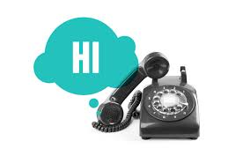


What’s in your prospecting toolkit?
Cold Call
Voicemail
Introductory
Follow-up
Email
Introductory
Follow-up
Break-up
Unsolicited calendar invites
LinkedIn InMails
Notes:
Today’s focus: cold calling and voicemails

Slide 3

Building Blocks of Cold Calling
Objection Handling
Credibility
Value Statements
Introduction
Pain
Discovery
Close
Active Listening
Qualifying
Notes:
Understanding and actively listening to the prospect, not having your own agenda - Listen to understand
If you do not know what something means – ASK!
Be genuinely curious as what they do
People like to talk about themselves
Ask why, seek to understand the prospect’s challenges.
Keeps the conversation going
Helps build a rapport with the prospect
Shows that you are actively listening to what the prospect has to say.
Adds to credibility to you

Slide 4
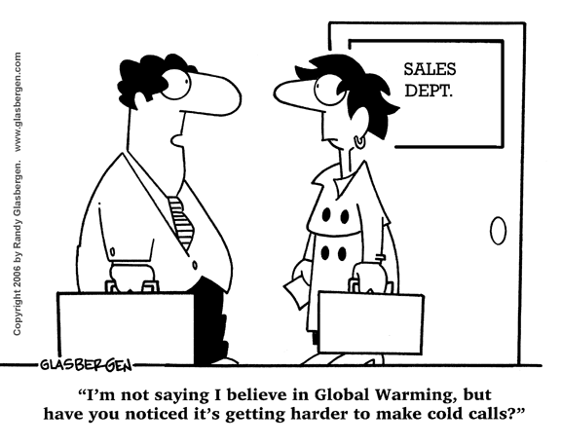
Starting An Approach to Calling
Notes:
Having the right attitude
sales people who adopt a positive and skillful approach to cold calling generally find that cold calling becomes easier.
Understanding the right building blocks

Slide 5
Every conversation counts!
The more phone calls you make…
The more activity you generate…
The more deals you do!
The more people you talk to…

Slide 6
How do you view cold calling?
Fearful
Boring, repetitive
Unpleasant
Pressurized
Unimaginative
Rejections
Thankless
Confrontational
Unproductive
Demoralizing
Unhappy
Numbers game

Slide 7
How do prospects view cold calling?
Nuisance
Unwanted
Indiscriminate, unprepared
Pressurizing
Tricky, shifty
Dishonest
Reject, repel cold callers
Shady, evasive
Contrived
Insulting
Patronizing
Disrespectful

Slide 8
What should a successful cold call be?
Honest/open
Straightforward
Interesting/helpful
Different/innovative
Thoughtful/reasoned
Prepared/informed
Professional/business-like
Efficient/structured
Respectful
Enthusiastic/up-beat
Informative/new
Thought-provoking
Time/cost-saving
Opportunity/advantage
Credible/reliable
Demonstrable/referenced

Slide 9
Goals of a Cold Call
Have a conversation
Gather information on some part of the account
Speak to a decision maker
Book a qualified meeting
*** Make three+ attempts to speak with different contacts within the organization
Notes:
Ride the bull
Decision maker
Actual
Vs. what’s still acceptable:
Learn something new about the account, get new contacts, partner that they’re working with, direct dial, etc.

Slide 10
Introduction
Navigating a
Cold Call
Impact Statement
Reason for Call
Close for Time
Objection Handling
Qualify
Qualified
Too Small/No Pain
Close/Confirm Time
Gracefully Back Out
Send Email & Calendar Invite
Webinar Invite
Notes:
Introduction: Hi my name is ______ and I’m calling from VMTurbo.
Impact Statement: We have helped companies similar to yourself, increase resource utilization by 39%
***needs to be more specific with key data points - How our solution can address critical business or technical issues AND demonstrate significant value
Obviously if possible you want to tailor it to who you’re speaking with but you also want to have a few in your back pocket for certain levels/roles and verticals
Reason for Call: I want to schedule a call with my specialist this week
Close for Time: How does Thursday at 3pm or Tuesday at 11am sound?
Objection Handling… if needed use the ledge!
Close for Time: AGAIN or Qualify (in or out)

Slide 11
What is the reason for your call?
“I’m looking to get more information about your virtual environment”
“I’m looking to find a time that better fits your schedule”
“I would like to qualify you as a VMTurbo customer”
“I want to show you how we save customers time and money”
“I’m looking to schedule time to share with you how we’ve been able to help customer’s similar to XYZ”
“I want to schedule a call with my specialist this week”

Slide 12
Impact Statements & Reason for Your Call
In a groups of 3, practice the impact statement and reason for your call:
1 Business focused
1 Technical focused

Slide 13
Zero Out Tree: “Riding the Bull”
Dial Prospect
Direct Dial to Decision Maker
General Company Number / Gatekeeper
Receive Voicemail
Leave Voicemail – 0 out and ask to speak with additional contacts
Repeat Process – 0 out 3+ times until you reach a contact
Keep notes of contacts you spoke with and all information gathered
Ask to speak with decision maker
Ask for Direct Line/Availability/Best time to reach
Ask for additional contacts and request to be transferred
Repeat Process – 0 out 3+ times until you reach a contact
Gather any additional info

Slide 14
Key Information to Gather
When is the best time to reach decision maker
Direct phone number or email for decision maker
What is the best way to schedule an appointment with decision maker
General Company Info-HQ/branches
Relationships with current vendors/partners confirm that your contact is decision maker
Key players involved in decision making process
Decision making process

Slide 15
8 Dials Before 8
LinkedIn
InMail
Connect on Social Media
Cold Call
Leverage Partner/ 3rd Party Relationships
5 Dials After 5
Join Interest
Groups
Sales Navigator Updates & Alerts
Call
During
Lunch
Leverage network and connections for warm introductions
Internal
Transfers
Email
Company
Directory
Voicemail
Request
Direct
Lines
Call IT Help Desk
Unsolicited Calendar Invite

Slide 16
Prospecting Touch Points
EXAMPLE
Day | Activity | Follow Up Action
1 | Morning Call –Leave Voicemail | Contact is Made: Follow Talk Track and Schedule Demo
 |  | No Contact Made: Leave voicemail introducing yourself (<30 seconds)
2 | Morning Call (No Voicemail) Afternoon Call (No Voicemail) | Contact is Made: Follow Talk Track and Schedule Demo
 |  | No Contact Made: No Voicemail. 0 Out and Try to speak with 3+ additional contacts to gather information
3 | Morning Call (No Voicemail) Afternoon Email – Inform them when you will try back | Contact is Made: Follow Talk Track and Schedule Demo
 |  | No Contact Made: Email informing them when you will try back
4 | Morning Call (Leave Voicemail) | Contact is Made: Follow Talk Track and Schedule Demo
 |  | No Contact Made: Leave short voicemail referencing your email and request a call back or email with best time to speak.
5 | No Touches
6 | Afternoon Call (No Voicemail)
7 | Email Unsolicited Calendar Invite with proposed time to speak
8 | Break Up Email

Slide 17
Voicemail: The 5 Golden Rules
1.) Be Specific
Your Name
Your Company
Reference Your Research
2.) Prepare and Practice
Research the company
Prepare your talk track and timing
PRACTICE PRACTICE PRACTICE!
3.) Provide a Strong Value Prop With Relevant Insight
Introduce a thought-provoking idea
Position yourself as an insider
Provide a compelling reason for a call back
4.) Reference
Their customers
Competitors
Industry trends
5.) Call To Action
Ask for a Call Back OR Request a Specific time to speak
Repeat Your Name and Number
Convey a Sense of Urgency
Notes:
1.) Be Specific
Use the prospects first name
Reference Your Research-Show them you have done your research and understand their business
2.) Prepare and Practice
3.) Provide a Strong Value Prop With Relevant Insight
Introduce a thought-provoking idea-- an idea that can help them achieve their goals or current challenges
Position yourself as an insider
Value propositions – How our solution can address critical business issues AND demonstrate significant value.
4.) Reference
Their customers
Competitors
Industry trends
5.) Call To Action
Ask for a Call Back OR Request a Specific time to speak
make it easy to connect by requesting a specific date and time to talk.
”I wanted to schedule 15 minutes to discuss my idea with you. By chance are you open Thursday at 2:30? Let me know. My phone number is 303-773-1285 or email me at abc@vmt.com. I look forward to our discussion!
If you don’t get a response, call Thursday at 2:30, further demonstrating your professionalism and interest in talking with the prospect
Repeat Your Name and Number
Convey a Sense of Urgency—ask for a call back today

Slide 18
Voicemail: Best Practices
Keep it Short and Sweet – 30 Seconds or Less
Provide Value
Speak Slowly and Clearly
The Fewer the Better – No More Than 3
Be Polite but Persistent – Follow Up
Stand Out From The Crowd
Be Enthusiastic and Positive
Deliver With Confidence
Follow Up With Email
Notes:
Be a Benefit
Provide value instead of “just checking in” or “following up”
Give the customer something they want

