Slide 1
Empowering Creative Thinking Through Programming
Valentijn Muijrers
https://github.com/vmuijrers/ECTTP

Slide 2

Wie ben ik
Valentijn Muijrers (28)
4 jaar HKU teacher in programming courses
I make games!
Programming is like having a super power

Slide 3
Course Overview
Week One: Course overview
Week Two: Variables
Week Three: Operators
Week Four: Conditions
Week Five: Loops
Week Six: Functions
Week Seven:
Week Eight: (Files, Exceptions, IO)
First Test!
Week Eleven: Lists
Week Twelve: Classes and Objects
Week Thirteen:
Week Fourteen:
Second Test!

Slide 4
Deliverables
Every week there is a lab (there will be 10 in total)!
100% presence
2 tests (individually!)
Grade:
40% labs
20% test 1
40% test 2

Slide 5

Programming is awesome
Notes:
Example! Can you make a squircle?

Slide 6
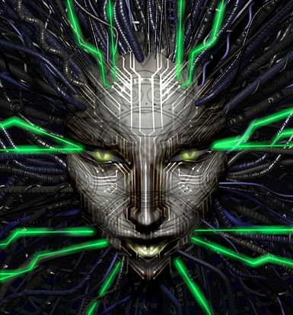
Super Power
With great power comes great responsibility
Notes:
Adhere to the Code of conduct. Do not steal code! Do not use code for evil! Also, be nice to your computer, it just executes the code you give it, nothing else (in most cases).

Slide 7
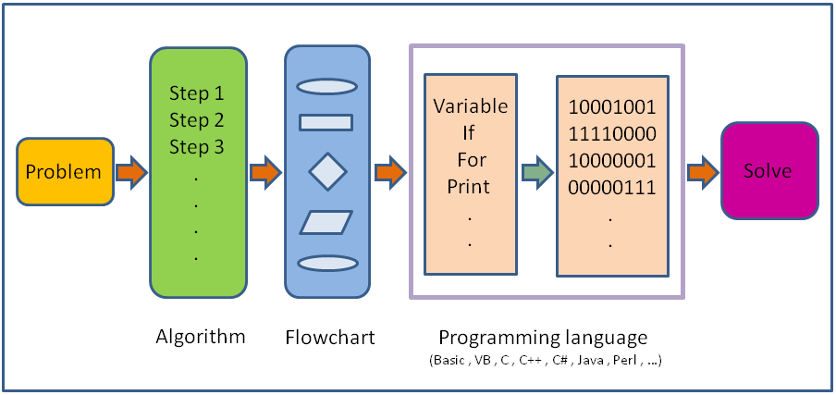
What is Programming?
Notes:
Problem solving means the ability to formulate problems, think creatively about solutions, and express a solution clearly and accurately
How you solve the problem is called an algorithm
An algorithm is a step by step list of instructions, or a program , that if followed exactly will solve the problem under consideration
These algorithms form programs which are written in programming languages (such as Python, Java, C++ or C# and many others!)

Slide 8
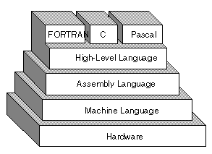
Python
Notes:
Python is an example of a high-level language
There are also low level programming languages (assembly, machine language)
High level languages use human friendly sets of instructions to create programs.
Low level languages are not as human friendly and are written for the hardware.

Slide 9
High vs Low
print(“Hello”)
The computer translates this high level language into a low level language for you:
01010101 00011101 00111100
Image coding in machine language
Clearly high level languages are faster and less prone to error than machine languages

Slide 10
Binary
All low level languages are in binary.
Binary consists of1’s and 0’s which are called bits.
Series of bits form 8-bit patterns which represent numeric values. Each bit represents either on or off. You can think of them like little switches.

Slide 11
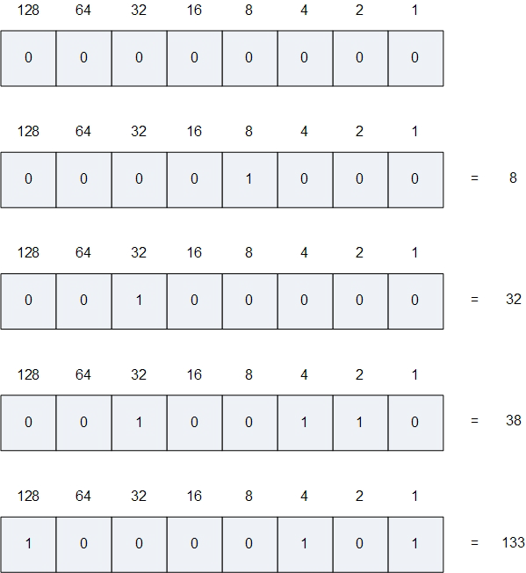
Binary Math
0000 0001 is 1
0000 0010 is 2
0000 0011 is 3
0000 0100 is 4
0000 0101 is 5
What is 28 in binary?
And 0001 1001 in decimal?
Notes:
Each bit (starting from the right), represents a power of 2. If the bit is 1 the power of 2 can be added, if the bit is 0, the power of 2 can be ignored.
The number 133 is 10000101 in binary because 2^0 + 2^2 + 2^7 = 133 (note here that the most right bit is at position 0)

Slide 12
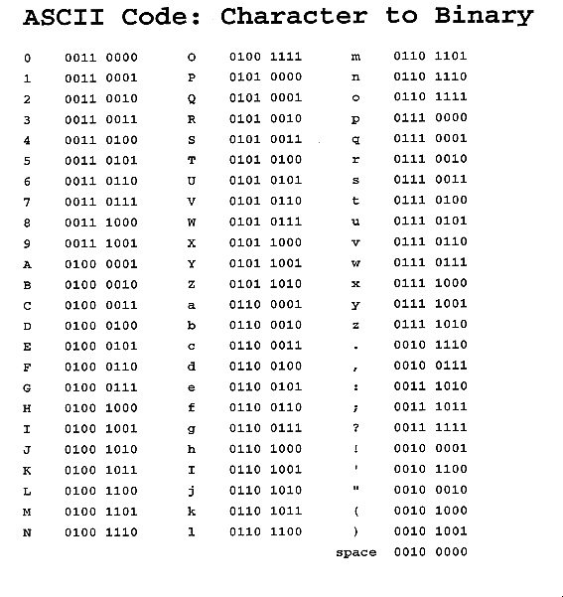
Ascii
Ascii is a way to translate letters into numbers

Slide 13

Interpreters
An interpreter reads a high-level program and executes it, meaning that it does what the program says.
It processes the program a little at a time, alternately reading lines and performing computations.

Slide 14

Compiler
A compiler reads the program and translates it completely before the program starts running. In this case, the high– level program is called the Source code, and the translated program is called the object code or the executable. Once a program is compiled, you can execute it repeatedly without further translation.
Notes:
Python is uses both an interpreter and a compiler

Slide 15
Python does both
Many modern languages use both processes. They are first compiled into a lower level language, called byte code, and then interpreted by a program called a virtual machine.
Notes:
Python uses both processes, but because of the way programmers interact with it, it is usually considered an interpreted language.
There are two ways to use the Python interpreter: shell mode and program mode. In shell mode, you type Python expressions into the Python shell. In program mode you type them into a file.

Slide 16
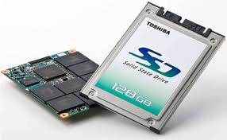
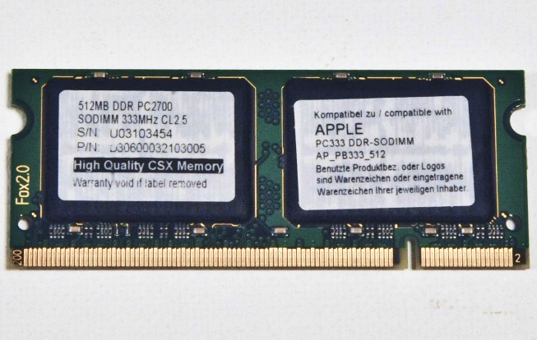
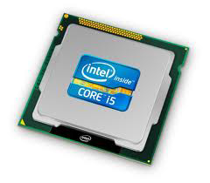
How a program works
Notes:
A program lives on your hard disk
The instructions of a program get loaded into ram. The machine code is fetched into your CPU
These instructions get decoded and then executed on your CPU

Slide 17
Where to start?
Download Python 3.6.2:
https://www.python.org/downloads/
Download Processing 3.3.5:
https://processing.org/download/?processing
Notes:
For all functionality of python:
https://docs.python.org/3.5/tutorial/index.html
For all functionality of processing:
http://py.processing.org/

Slide 18
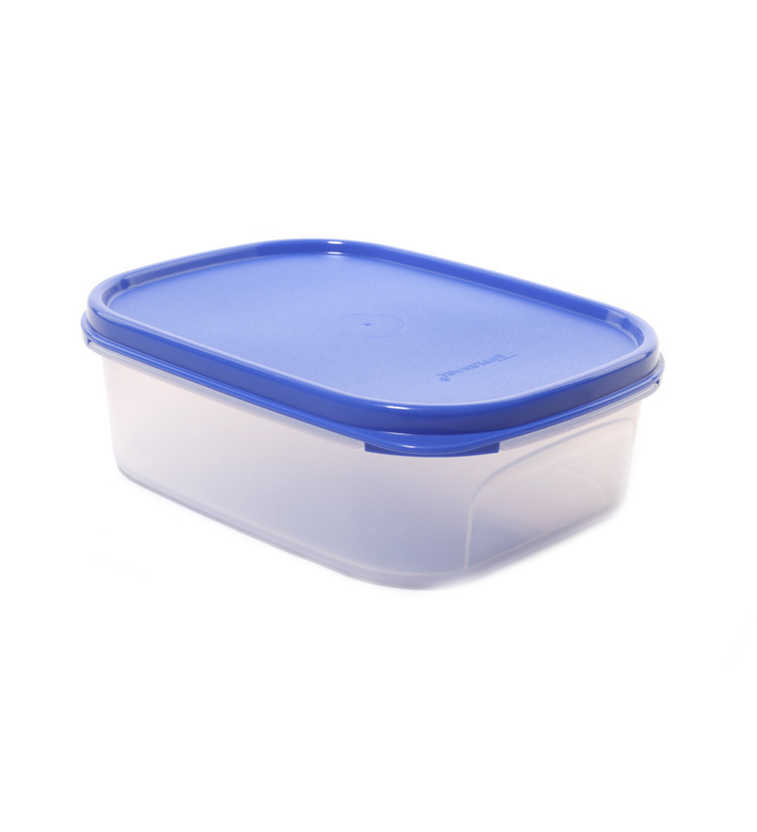
Input Variables and Output
x = 10
‘x’ is the variable
‘=’ is the assignment operator and sets the value on the left of the equation to be equal to the variable on the right
‘10’ is the value which is an integer number or a whole number
Notes:
Variables are types of data stored in containers. Think of them like a box that holds something in it.

Slide 19
Data types
Basic types:
Int = 10
Float = 10.0
Boolean = true or false (0 or 1)
String = “a set of words or characters in quotes”

Slide 20
Naming Variables
A variable can have any name but...
Don’t use spaces in your naming
Don’t use special characters: &!$*+-~,/\%^()
Don’t use numbers as the first letter of your name (recommended: don’t use numbers in your names at all)
Notes:
Other reserved words in Python which you cannot use as variable names:
False True as finally is return None continue for lambda try
Def from nonlocal while and del global not with
As elif if or yield assert else import pass break except in raise

Slide 21
Some Examples
int_MyIntegerVar = 10
string_MyStringVar = “Hello”
float_MyFloatVar = 1.0
We use the type of the variable as the first word in the variable name so that it is immediately clear what kind of type we are working with (note that this is not necessary, it is just a code convention which helps us writing good code)

Slide 22
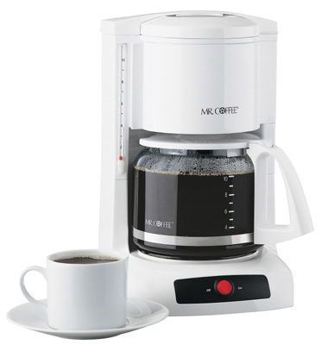
Print Something
Print is a function in python. A function is a set of instructions that does something. You sometimes put things into it. Sometimes it returns a value.
Functions are like little machines
I don’t really care how a coffee pot works. All I know is if I put water and coffee grinds into it, it makes coffee and I can take coffee out of it

Slide 23
Hello World!
Try typing the following in Processing:
print(“Hello World!”)
And press Play, below in the Console, you will see your output stating the words “Hello World!”
The Console only shows feedback from your program when it runs. It shows errors (mistakes in your program and all of your print- calls.

Slide 24
First lab is online
https://github.com/vmuijrers/ECTTP/blob/master/Labs/Lab_1.md
The deadline of each lab is 24 hours after you had the lab.
You can submit your code through the submitsystem (with the right naming here,i.e. ECTTP_homework_achternaam_voornaam_labnr.zip):
http://www.elvishasleftthebuilding.nl/ecttp/

