Slide 1
JavaScript

Slide 2
What You Can do with JavaScript
JavaScript Can Change HTML Content.
JavaScript Can Change HTML Attributes.
JavaScript Can Change HTML Styles (CSS).
JavaScript Can Validate Data.
JavaScript Can Create HTML Elements .

Slide 3
Where To place JavaScript
The <script> Tag
In HTML, JavaScript code must be inserted between <script> and </script> tags.
JavaScript in <head> or <body>
You can place any number of scripts in an HTML document.
Scripts can be placed in the <body>, or in the <head> section of an HTML page, or in both.

Slide 4
JavaScript Variables
In a programming language, variables are used to store data values.
JavaScript uses the var keyword to define variables.
An equal sign is used to assign values to variables.
In this example, x is defined as a variable. Then, x is assigned (given) the value 6:

Slide 5
JavaScript Variables
JavaScript variables are containers for storing data values.
In this example, x, y, and z, are variables:
var x = 5; var y = 6; var z = x + y;

Slide 6
JavaScript Display Possibilities
Writing into an alert box, using window.alert().
Writing into the HTML output using document.write().
Writing into an HTML element, using innerHTML.
Writing into the browser console, using console.log()

Slide 7
JavaScript Data Types
String,
Number,
Boolean,
Null
Undefined.

Slide 8
Java Script POP up Boxes
Alert Box
Confirm Box
Prompt Box

Slide 9
Java Script Objects
What is An Object
It is an element which is having certain properties
Mobile, TV, Pen , Car , Bus , Student …. Etc.
In JavaScript Every Thing is an Object .
Example : Car model , color , make all are properties of an Object

Slide 10
JavaScript Objects
Accessing Object Properties
You can access object properties in two ways
objectName.propertyName
objectName[propertyName]
Accessing Object Methods
You access an object method with the following syntax:
objectName.methodName()

Slide 11
Java Script - Arrays
Java Script Arrays or Collection of the Objects or values . Each Object will be having Similar kind of its own properties as we have seen in Early Slides .
Java Script Arrays will be surrounded with “[ ]” .
The Data Inside this Square Brackets are related to this Array .
Example : states[];
The “States” is an Array . It don’t have any values . It is an Empty Array .
Let us add one value for that Array .
States=[“Karnataka ”];
How many Values we have In States Array : 1

Slide 12
JavaScript Arrays
Creating an Array
var array-name = [item1, item2, ...];
Access the Elements of an Array
var name = cars[0];
cars[0] = "Opel";
Array Properties and Methods
The length property of an array returns the length of an array (the number of array elements)

Slide 13
Accessing The Arrays
States=[“Karnataka ”,”Andhra”,”Telangana”];
console.log(States[0]);
console.log(States[1]);
console.log(States[2]);
Array Index Positons are started from 0,1,2,3
Note : No of Values are different and Index positions are different .

Slide 14
Array Methods
Push – To add a value to end of the Array
Unshift – To add a value to Start of the Array
Splice – To Add a value in middle of the Array
POP- To Delete a value at end of the Array
Shift- To Delete a value at the Start of the Array
Splice – To Remove a value in middle of an Array
Sort – To Sort A Array
Reverse – To Reverse An Array

Slide 15
Concat() method returns a new array comprised of this array joined with two or more arrays.
Every - Returns true if every element in this array satisfies the provided testing function.
some() method tests whether some element in the array passes the test implemented by the provided function.
Filter() method creates a new array with all elements that pass the condition
ForEach() method calls a function for each element in the array.
IndexOf() method returns the first index at which a given element can be found in the array
join() method joins all the elements of an array into a string.
lastIndexOf() method returns the last index at which a given element can be found in the array
map() method creates a new array with the results of calling a provided function on every element in this array
reduce() method applies a function simultaneously against two values of the array

Slide 16
JavaScript Functions
A JavaScript function is a block of code designed to perform a particular task.
A JavaScript function is executed when "something" invokes it (calls it)
function name(parameter1, parameter2, parameter3) { code to be executed }

Slide 17
Different ways of declaring functions
function A(){}; // function declaration
var B = function(){}; // function expression
var C = (function(){}); // function expression with grouping operators
var D = function foo(){}; // named function expression
var E = (function(){ // IIFE that returns a function return function(){} })();
var F = new Function(); // Function constructor
var H = x => x * 2; // ES6 arrow function

Slide 18
Function Return
When JavaScript reaches a return statement, the function will stop executing.
If the function was invoked from a statement, JavaScript will "return" to execute the code after the invoking statement.
Functions often compute a return value. The return value is "returned" back to the "caller":

Slide 19
JavaScript Events
HTML events are "things" that happen to HTML elements.
When JavaScript is used in HTML pages, JavaScript can "react" on these events
JavaScript lets you execute code when events are detected.
HTML allows event handler attributes, with JavaScript code, to be added to HTML elements.
With single quotes:
<some-HTML-element some-event='some JavaScript'>
With double quotes:
<some-HTML-element some-event="some JavaScript">

Slide 20
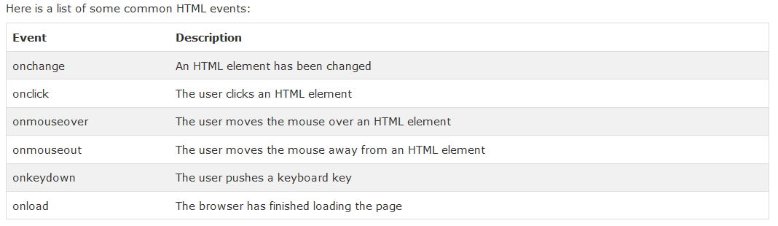
Common HTML Events

Slide 21
JavaScript HTML DOM
With the object model, JavaScript gets all the power it needs to create dynamic HTML:
JavaScript can change all the HTML elements in the page
JavaScript can change all the HTML attributes in the page
JavaScript can change all the CSS styles in the page
JavaScript can remove existing HTML elements and attributes
JavaScript can add new HTML elements and attributes
JavaScript can react to all existing HTML events in the page
JavaScript can create new HTML events in the page

Slide 22
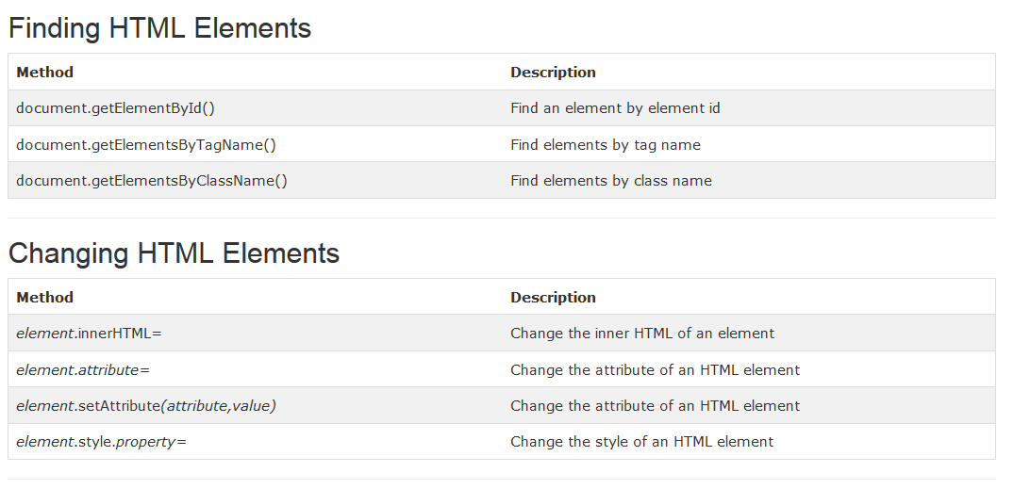

Slide 23
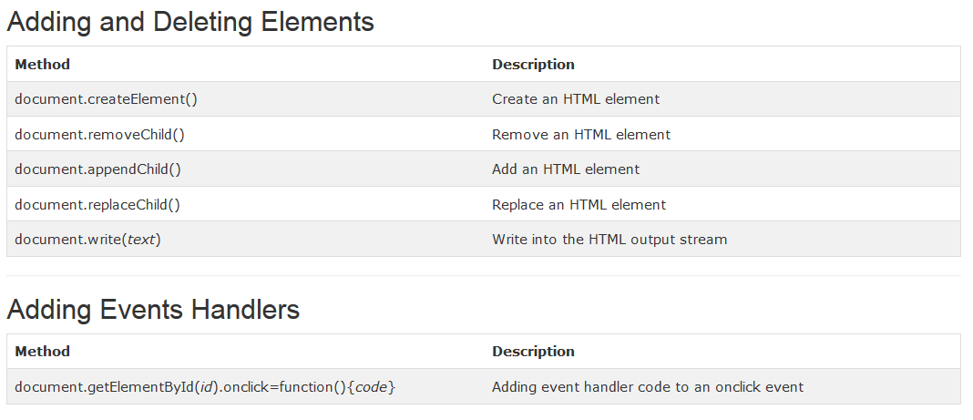

Slide 24
JavaScript HTML DOM EventListener
The addEventListener() method attaches an event handler to the specified element.
The addEventListener() method attaches an event handler to an element without overwriting existing event handlers.
You can add many event handlers to one element.
You can add many event handlers of the same type to one element, i.e two "click" events.
You can add event listeners to any DOM object not only HTML elements. i.e the window object.
The addEventListener() method makes it easier to control how the event reacts to bubbling.
When using the addEventListener() method, the JavaScript is separated from the HTML markup, for better readability and allows you to add event listeners even when you do not control the HTML markup.
You can easily remove an event listener by using the removeEventListener() method.
Syntax
element.addEventListener(event, function, useCapture);

Slide 25
JavaScript HTML DOM Navigation
DOM Nodes
According to the W3C HTML DOM standard, everything in an HTML document is a node:
The entire document is a document node
Every HTML element is an element node
The text inside HTML elements are text nodes
Every HTML attribute is an attribute node
All comments are comment nodes

Slide 26
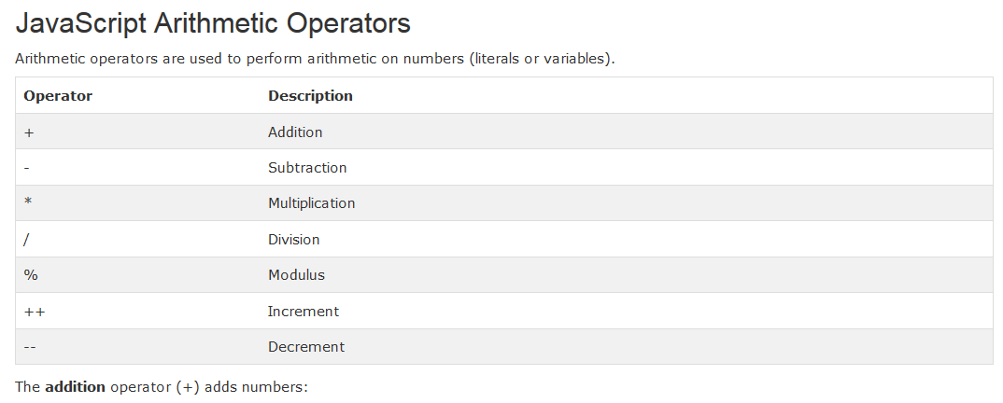
JavaScript Operators

Slide 27
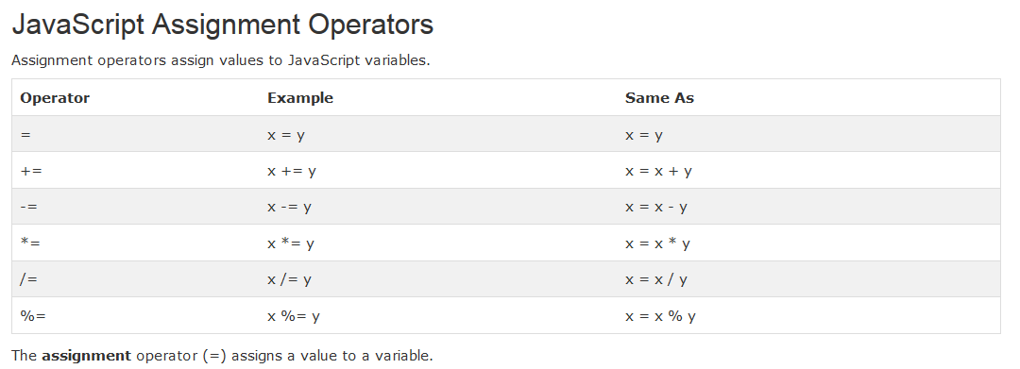
JavaScript Assignment Operators

Slide 28
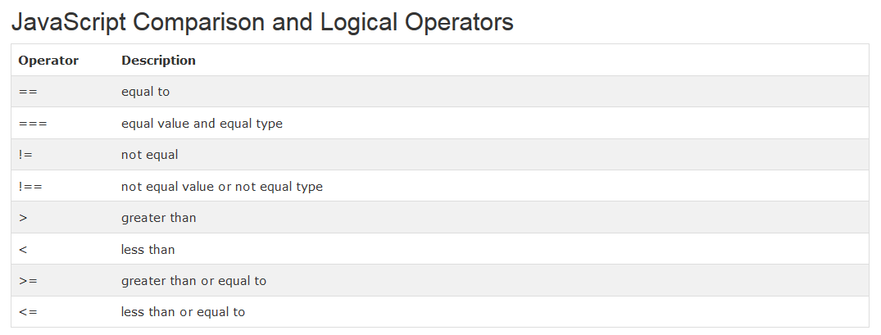
JavaScript Comparison and Logical Operators

Slide 29
JavaScript Scope
In JavaScript, scope is the set of variables, objects, and functions you have access to.
JavaScript has function scope: The scope changes inside functions
Local JavaScript Variables
Variables declared within a JavaScript function, become LOCAL to the function.
Local variables have local scope: They can only be accessed within the function.
Global JavaScript Variables
A variable declared outside a function, becomes GLOBAL.
A global variable has global scope: All scripts and functions on a web page can access it

Slide 30
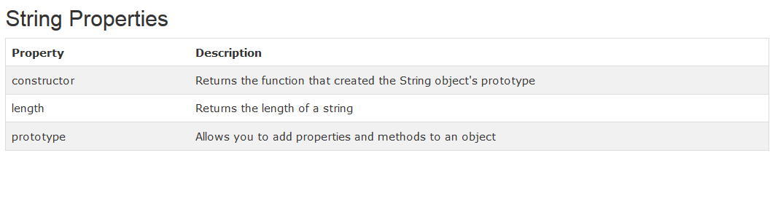
JavaScript Strings

Slide 31
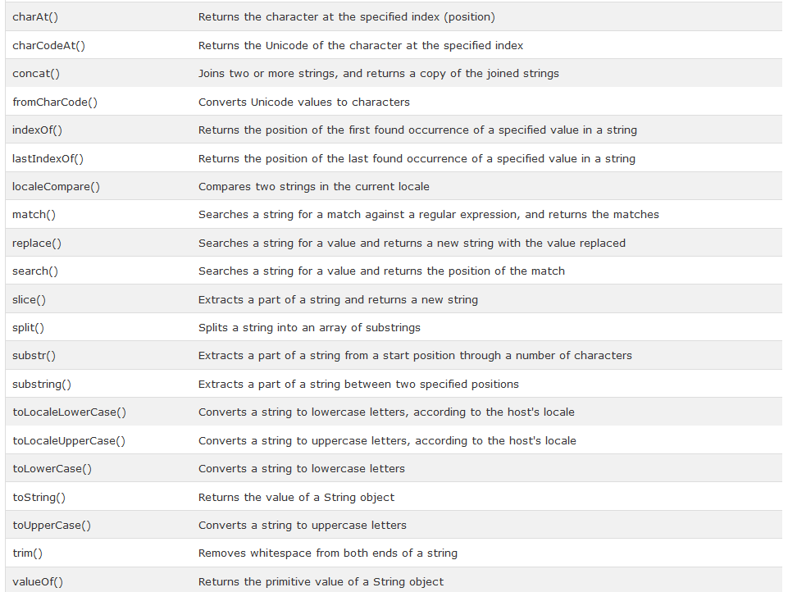
String Methods

Slide 32
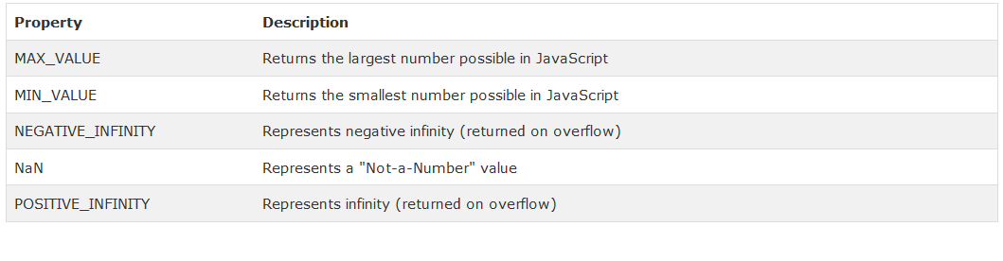
JavaScript Numbers

Slide 33
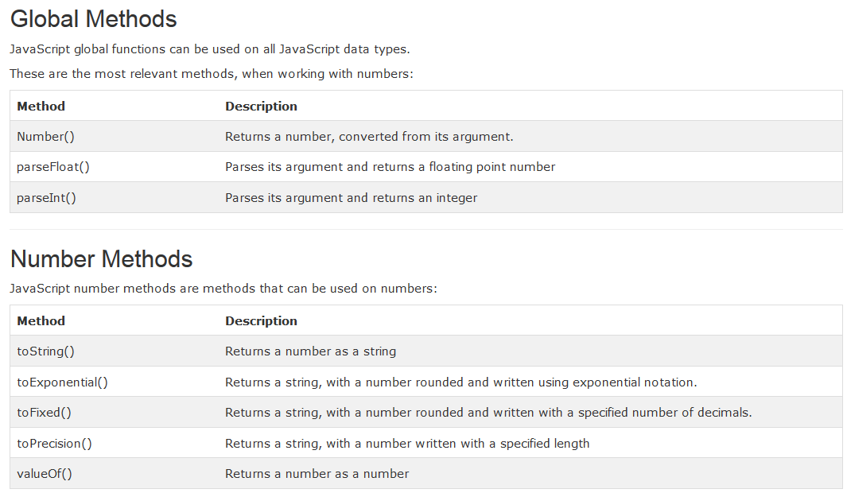
JavaScript Number Methods

Slide 34
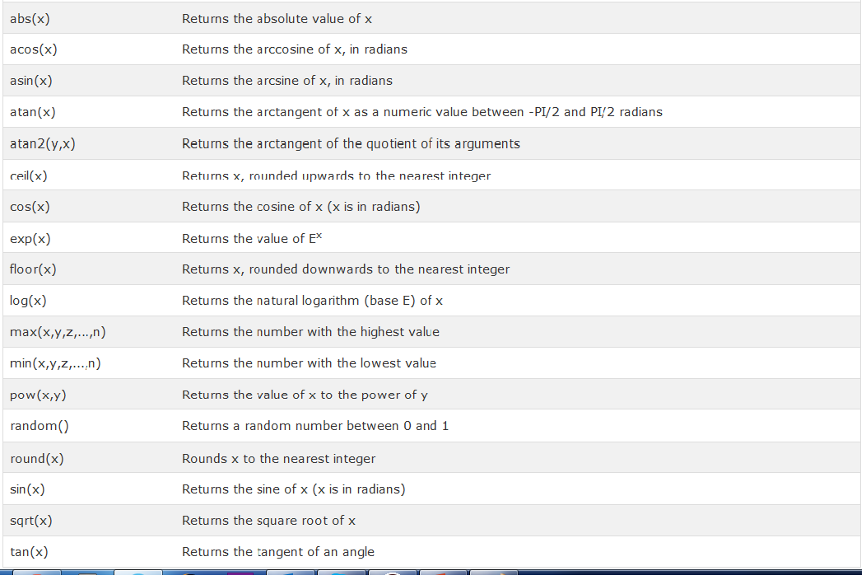
JavaScript Math Object

Slide 35
JavaScript Dates
JavaScript Date Formats
Displaying Dates
new Date() new Date(milliseconds) new Date(dateString) new Date(year, month, day, hours, minutes, seconds, milliseconds)
Displaying Dates
When you display a date object in HTML, it is automatically converted to a string, with the toString() method.
The toUTCString() method converts a date to a UTC string (a date display standard)
The toDateString() method converts a date to a more readable format

Slide 36
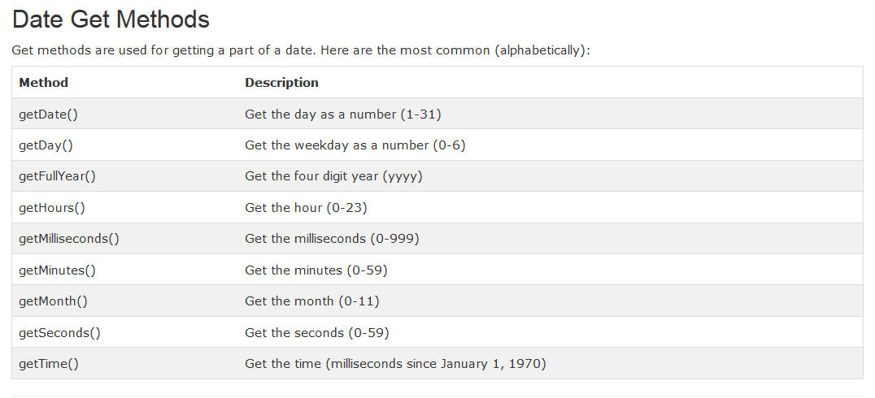
JavaScript Date Methods

Slide 37
Conditional Statements
JavaScript If...Else Statements
Use if to specify a block of code to be executed, if a specified condition is true
Use else to specify a block of code to be executed, if the same condition is false
Use else if to specify a new condition to test, if the first condition is false
Use switch to specify many alternative blocks of code to be executed
Syntax
if (condition) { block of code to be executed if the condition is true }

Slide 38
The else if Statement
Use the else if statement to specify a new condition if the first condition is false.
Syntax
if (condition1) { block of code to be executed if condition1 is true } else if (condition2) { block of code to be executed if the condition1 is false and condition2 is true } else { block of code to be executed if the condition1 is false and condition2 is false }

Slide 39
JavaScript Switch Statement
Use the switch statement to select one of many blocks of code to be executed.
Syntax
switch(expression) { case n: code block break; case n: code block break; default: default code block }
This is how it works:
The switch expression is evaluated once.
The value of the expression is compared with the values of each case.
If there is a match, the associated block of code is executed.

Slide 40
JavaScript Loops
Loops are handy, if you want to run the same code over and over again, each time with a different value.
Often this is the case when working with arrays:
Different Kinds of Loops
JavaScript supports different kinds of loops:
for - loops through a block of code a number of times
for/in - loops through the properties of an object
while - loops through a block of code while a specified condition is true
do/while - also loops through a block of code while a specified condition is true

Slide 41
The typeof Operator
You can use the typeof operator to find the data type of a JavaScript variable.
typeof "John" // Returns string typeof 3.14 // Returns number typeof NaN // Returns number typeof false // Returns boolean typeof [1,2,3,4] // Returns object typeof {name:'John', age:34} // Returns object typeof new Date() // Returns object typeof function () {} // Returns function typeof myCar // Returns undefined (if myCar is not declared) typeof null // Returns object

Slide 42
JavaScript Regular Expressions
A regular expression is a sequence of characters that forms a search pattern.
When you search for data in a text, you can use this search pattern to describe what you are searching for.
A regular expression can be a single character, or a more complicated pattern.
Regular expressions can be used to perform all types of text search and text replace operations
Syntax
/pattern/modifiers;

Slide 43
Using String Methods
In JavaScript, regular expressions are often used with the two string methods: search() and replace().
The search() method uses an expression to search for a match, and returns the position of the match.
The replace() method returns a modified string where the pattern is replaced
Using String search() With a Regular Expression
Example
Use a regular expression to do a case-insensitive search for "w3schools" in a string:
var str = "Visit W3Schools"; var n = str.search(/w3schools/i);
The result in n will be:
6

Slide 44
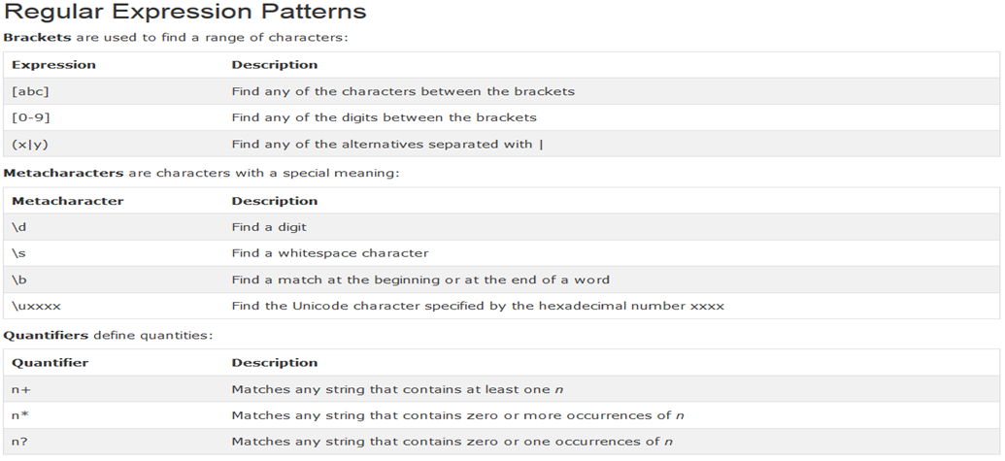
Using String search() With String
Using String search() With String
The search method will also accept a string as search argument. The string argument will be converted to a regular expression

Slide 45
JavaScript Errors Throw and Try to Catch
The try statement lets you test a block of code for errors.
The catch statement lets you handle the error.
The throw statement lets you create custom errors.
The finally statement lets you execute code, after try and catch, regardless of the result
JavaScript try and catch
The try statement allows you to define a block of code to be tested for errors while it is being executed.
The catch statement allows you to define a block of code to be executed, if an error occurs in the try block.
The JavaScript statements try and catch come in pairs:
try { Block of code to try } catch(err) { Block of code to handle errors }

Slide 46
JavaScript Window – BOM Browser Object Model
The Browser Object Model (BOM)
There are no official standards for the Browser Object Model (BOM).
Since modern browsers have implemented (almost) the same methods and properties for JavaScript interactivity, it is often referred to, as methods and properties of the BOM
The Window Object
The window object is supported by all browsers. It represents the browser's window.
All global JavaScript objects, functions, and variables automatically become members of the window object.
Global variables are properties of the window object.
Global functions are methods of the window object.
Even the document object (of the HTML DOM) is a property of the window object:
window.document.getElementById("header");
is the same as:
document.getElementById("header");

Slide 47
Window Size
Three different properties can be used to determine the size of the browser window (the browser viewport, NOT including toolbars and scrollbars).
For Internet Explorer, Chrome, Firefox, Opera, and Safari:
window.innerHeight - the inner height of the browser window
window.innerWidth - the inner width of the browser window
For Internet Explorer 8, 7, 6, 5:
document.documentElement.clientHeight
document.documentElement.clientWidth
or
document.body.clientHeight
document.body.clientWidth

Slide 48
Other Window Methods
Some other methods:
window.open() - open a new window
window.close() - close the current window
window.moveTo() -move the current window
window.resizeTo() -resize the current window

Slide 49
JavaScript Window History
Window History
The window.history object can be written without the window prefix.
To protect the privacy of the users, there are limitations to how JavaScript can access this object.
Some methods:
history.back() - same as clicking back in the browser
history.forward() - same as clicking forward in the browser

Slide 50
JavaScript Timing Events
JavaScript Timing Events
With JavaScript, it is possible to execute some code at specified time-intervals. This is called timing events.
It's very easy to time events in JavaScript. The two key methods that are used are:
setInterval() - executes a function, over and over again, at specified time intervals
setTimeout() - executes a function, once, after waiting a specified number of milliseconds
Syntax
window.setInterval("javascript function", milliseconds);
The window.setInterval() method can be written without the window prefix.
The first parameter of setInterval() should be a function.
The second parameter indicates the length of the time-intervals between each execution.
Note: There are 1000 milliseconds in one second.

Slide 51
How to Stop the Execution?
The clearInterval() method is used to stop further executions of the function specified in the setInterval() method.
Syntax
window.clearInterval(intervalVariable)
The window.clearInterval() method can be written without the window prefix.
To be able to use the clearInterval() method, you must use a global variable when creating the interval method:
myVar=setInterval("javascript function", milliseconds);
Then you will be able to stop the execution by calling the clearInterval() method.

Slide 52
How to Stop the Execution?
The clearTimeout() method is used to stop the execution of the function specified in the setTimeout() method.
Syntax
window.clearTimeout(timeoutVariable)
The window.clearTimeout() method can be written without the window prefix.
To be able to use the clearTimeout() method, you must use a global variable when creating the timeout method:
myVar=setTimeout("javascript function", milliseconds);
Then, if the function has not already been executed, you will be able to stop the execution by calling the clearTimeout() method.

Slide 53
JavaScript Cookies
What are Cookies?
Cookies are data, stored in small text files, on your computer.
When a web server has sent a web page to a browser, the connection is shut down, and the server forgets everything about the user.
Cookies were invented to solve the problem "how to remember information about the user":
When a user visits a web page, his name can be stored in a cookie.
Next time the user visits the page, the cookie "remembers" his name.
Cookies are saved in name-value pairs like:
username=John Doe

Slide 54
Create a Cookie with JavaScript
JavaScript can create, read, and delete cookies with the document.cookie property.
With JavaScript, a cookie can be created like this:
document.cookie="username=John Doe";
You can also add an expiry date (in UTC time). By default, the cookie is deleted when the browser is closed:
document.cookie="username=John Doe; expires=Thu, 18 Dec 2013 12:00:00 UTC";
With a path parameter, you can tell the browser what path the cookie belongs to. By default, the cookie belongs to the current page.
document.cookie="username=John Doe; expires=Thu, 18 Dec 2013 12:00:00 UTC; path=/";

Slide 55
Read a Cookie with JavaScript
With JavaScript, cookies can be read like this:
var x = document.cookie;
Change a Cookie with JavaScript
With JavaScript, you can change a cookie the same way as you create it:
document.cookie="username=John Smith; expires=Thu, 18 Dec 2013 12:00:00 UTC; path=/"
Delete a Cookie with JavaScript
Deleting a cookie is very simple. Just set the expires parameter to a passed date:
document.cookie = "username=; expires=Thu, 01 Jan 1970 00:00:00 UTC";

Slide 56
What is Call Back , Promise and Async and Await

