Slide 1
Develop an AI-based Password Management System
Presented by: Vinay Musanagari

Slide 2
Project Goals
Project Objective:
Understand authentication domain + related security and privacy challenges
Understand AI models and their application to password-based authentication
Design an AI-based model to effectively manage passwords
Evaluate the proposed model/solution through experimentation/analysis
Datasets Used:
ROCKYOU, PWNED (Pond Dataset)
PWLDS
Key Phases:
Dataset Preparation (On Dataset1 and Dataset2)
Neural Network Classifier (On Dataset1 and Dataset2)
Variational Autoencoder for Generation (On Dataset2)

Slide 3
Problem Statement
Password Security: Weak passwords are vulnerable to attacks
Goal: Automatically generate and classify passwords of varying strengths (weak, normal, strong)
Challenges:
Lack of labeled data
Lack of enhanced features
Effective classification and generation

Slide 4
Dataset Overview
ROCKYOU and PWNED (Pond Dataset):
Rockyou has only common passwords - for finding what password is common
Raw passwords and hash values
Breach count for each password
PWLDS Dataset (5 million passwords):
Password strength classes: 0 to 4 (Very Weak to Very Strong)
Crafted Features: Length, count of alphabets, numbers, special characters, ratios, etc.

Slide 5
Data Preprocessing (Stage 1)
PWNED Dataset Features:
Password column, hash (removed), breach count
Added features:
  Number of alphabets, digits, special characters, uppercase, lowercase
  Uppercase vs. lowercase ratio
  Repeated characters count etc
Challenge: No labels for password strength (Clustering required)

Slide 6
Clustering for Label Generation
Clustering Techniques:
K-Means, Agglomerative Clustering, and Gaussian Mixture Models
Outcome:
K-Means selected for label generation (weak, normal, strong)
Challenges: Clustering didn’t yield perfect results

Slide 7
Transition to PWLDS Dataset
Why PWLDS?:
Contains 5 million passwords with predefined strength labels (0-4)
Dataset Features Created:
Length of the password,
Count of different characters and numeric values,
Uppercase-lowercase ratio
Repeated characters
Next Step: Training a neural network classifier

Slide 8
Neural Network Classifier (Phase 2)
Model Overview:
Input Features: All that what we created (Length, count of alphabets, digits, special characters, etc)
Output: Password strength (0-4)
Performance:
94% validation accuracy
93.7% testing accuracy
Good precision, recall, and F1 scores
Training Curves: Stable convergence, no overfitting

Slide 9
Variational Autoencoder for Password Generation (Phase 3)
Generative Model: Variational Autoencoder (VAE)
Objective: Generate strong passwords with high complexity
Outcome:
Successfully generated passwords that were categorized as strong

Slide 10
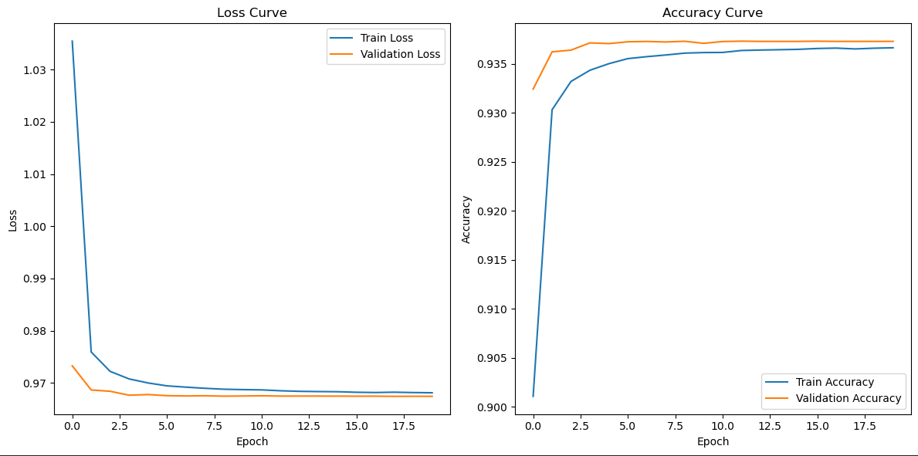
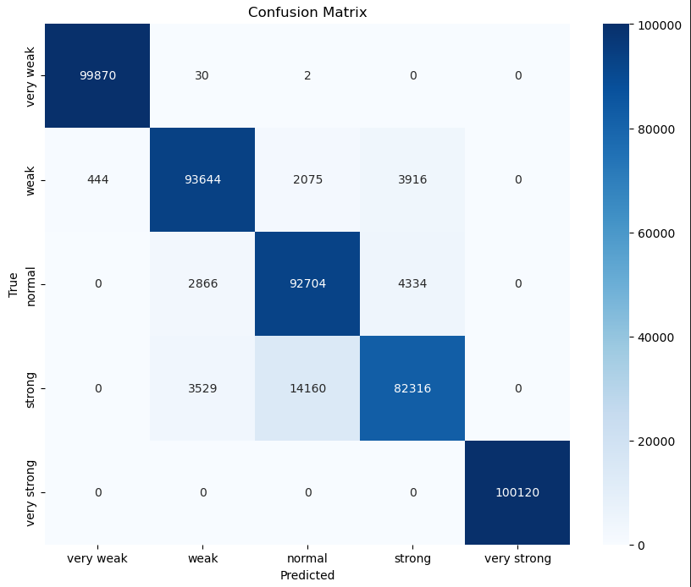
Results and Graphs
Train Accuracy: 93.66% | Val Accuracy: 93.73% | Test Accuracy: 93.71%

Slide 11
Discussion and Challenges
Initial Stage Challenges:
Issues with clustering and labeling in the first dataset (PWNED)
Transitioning to a labeled dataset (PWLDS) resolved many issues
Key Findings:
Neural network classifier performed well
VAE showed potential for generating secure passwords

Slide 12
Future Work
Improvement Areas:
Enhance the VAE to generate even stronger passwords
Experiment with other generative models
Expand and refine the dataset for more robust training
Potential Applications:
Automated password managers
Security systems

Slide 13
Conclusion
Summary:
  The project successfully classified and generated strong passwords using machine learning.
  The neural network classifier and VAE demonstrated solid performance.
Contributions: Improved password security through automated classification and generation techniques.

Slide 14
Any Questions?

