Slide 1
Websites, Servers & Cloud Computing : A Practical Approach
By Vivek Muthal

Slide 2
Topics
Introduction
Client
Server
Internet
Website / Web Application
Serverside Technologies
Clientside Technologies
Cloud Computing
Server Setup
Current Trends

Slide 3
Introduction
About Me (I am Vivek Muthal)
Why this seminar?
Because I want to share the tricks.
What is practical approach?
It is just like you do practical in lab.
Lets move to the next slide

Slide 4


Client
Who is client?
The one who request is client

Slide 5
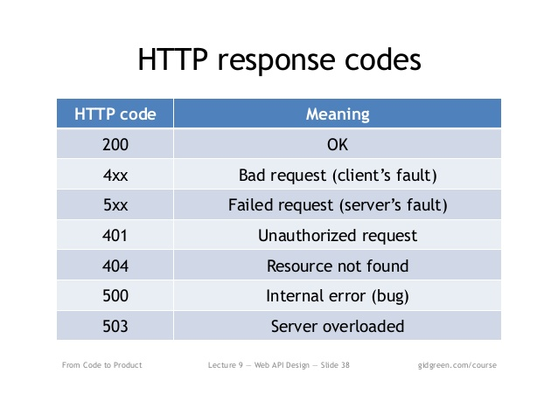

Server
The one who responds and serves.

Slide 6

Internet
Boring, we know about internet….

Slide 7
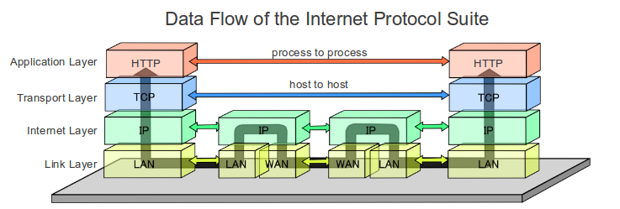
Behind the scene

Slide 8
Website / Web Application
How to create a website?
HTML / CSS / Client side Javascript / flash
How to create a web application
HMTL/ CSS/ Client side Javascript/ flash
Server side processing power
PHP, .NET, JAVA etc
Are these terms interchangeable?
Yes if you are using any server side apps which now days everyone uses like wordpress.

Slide 9
Serverside
Languages: .Net, Java, PHP,
Framework/ Libraries/ Technologies:
Joomla, Wordpress (PHP)
.Net MVC
Node.js etc
Software's
Website servers like Apache, IIS,Tomcat
Mail servers like postfix, sendmail, hmailservers etc

Slide 10
Clientside
Languages: Browser based Javascript, Java, VB Script etc
Framework/ Libraries/ Technologies:
Angular, underscore, node.js, vue.js, jquery
Adobe Flash, android etc
Software's:
Browsers
Application Clients
API consumer

Slide 11
Cloud Computing

Slide 12
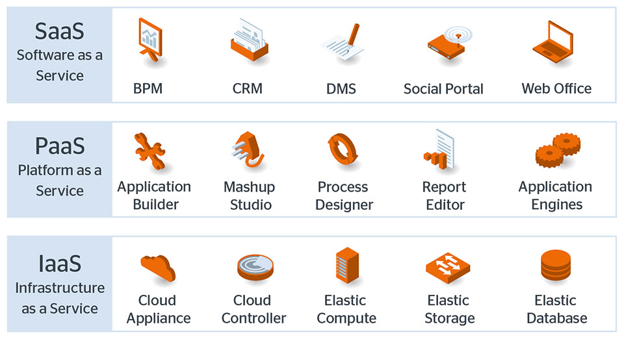
Cloud Computing

Slide 13
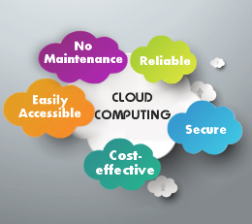
Benefits

Slide 14
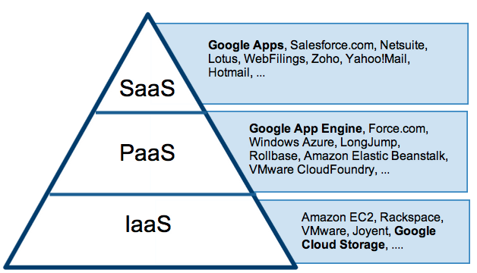
Services / Providers

Slide 15
Server setup
404 : Opps, nothing here in the slide.
Lets see the demo.

Slide 16
Current Trends
Common
Frontend
Backend
Database
Server
SaaS
Coding on cloud
Things you should study
HTML, CSS, JS
Git , Repositories

