Slide 1


PCF Operations Workshop –
High Availability
<Presenter>
<Title>
Notes:
Good afternoon everyone and thank you for taking the time to meet with me to discuss how Pivotal is helping companies build modern software

Slide 2

The Layers of built-in High Availability
Application Instance
Platform Processes
Platform VMs
Availability Zones

Slide 3
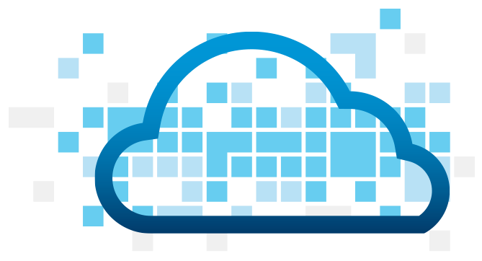
App Instance HA
Desired State
Actual State
Blobstore
Cloud Controller
Health Manager
Messaging
(NATS)
Router
DEA
DEA
DEA
Runtime
Notes:
Cloud Foundry PaaS
An application runs in a DEA, which is a droplet execution agent. The Cloud Controller orchestrates the routing and lifecycle of all DEAs in the pool. Routers manage application traffic. Health Manager reports mismatched application states to the CC. A service gateway provides an interface for services (native or external). A messaging bus manages all system communication. Apps are accessed directly through the router while web and CLI clients (e.g., vmc, STS) access Cloud Controller via RESTful services.

Slide 4

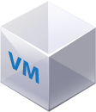

Platform Processes HA
BOSH
Pivotal CF
DB
DEA
Agent
Process
BOSH Director
Health Manager
Blobstore
Process
Agent
Messaging
NATS
Agent
Process
Health
Monitor
Cloud Controller
Target VM
Agent
Process

Slide 5

Platform Processes HA
Target VM
Cloud Controller
Agent
Process
Restart

Slide 6
Platform VMs HA
BOSH
Pivotal CF
DB
Cloud Controller
Agent
Process
BOSH Director
Re-create VM
Health Manager
Blobstore
Process
Agent
Ressurector
VM is
missing…
Messaging
NATS
Agent
Process
Health
Monitor
Cloud Controller
Agent
Process

Slide 7
Availability Zones
Zone 1
Zone 2
System components and Application instances are evenly distributed over two availability zones.
DEA
DEA
DEA
DEA
Loosing an AZ keeps instances running and available.
Router
DEA
DEA
Runtime
Notes:
Zone could = rack, for example

Slide 8
How Pivotal CF enables four layers of HA
1.
2.
3.
4.
PCF
PCF
PCF
Zone 1
Zone 2
A
B
C
A
B
C
A
B
C
A
B
C
A
B
C
A
B
C
A
B
C
Process
VM1
VM2
VM3
B
B
B
B
3. Resurrector restarts failed VMs
VM1
VM2
B
A
B
C
A
B
C
A
B
C
A
B
C
OS,
Mware
OS,
Mware
OS,
Mware
B
B
B
B
If an app fails, PCF reboots app in a new container.
If a process fails, PCF restarts the process
If an OS or network failure occurs PCF kills the VM and reboots the host in a new Virtual machine.
If a datacenter rack fails, PCF ensures applications stay running in multiple availability zones
App Fail
Process Fail
VM Fail
Rack Fail
Notes:
Application performance and reliability have a direct correlation to HA capability. Pivotal provides 4 level of HA so that you don’t need to invest in people/software to handle common failure situations. If an application fails, we will reboot it in a new container. This automated remediation addresses application bugs that result in outages. If a Pivotal process fails, we will reboot it in a new virtual machine. Our PaaS essentially monitors and remediates itself. If an OS or network failure occurs, our VM monitor will detect this and kill the VM, then reboot it in a new container. This streamlines Linux sysadmin operations. Lastly, if a datacenter rack fails, we will ensure the application stays running because we load application instances in multiple availability zones. No 2 availability zones live on the same datacenter rack. This hardware failure level resilience is very difficult to design using traditional tools provided by HP/CA/IBM.
And, by using Pivotal, you reduce the number of servers that require HP/CA/IBM monitoring tools.
http://blog.pivotal.io/cloud-foundry-pivotal/products/the-four-levels-of-ha-in-pivotal-cf
Desired State of Application is maintained by Cloud Controller. DEAs communicate status of their apps to Health Manager. HM checks with CC. CC restarts app in another DEA in case of failure
PCF Processes monitored by monit and restarted in case of failure
In case of VM failure. Health Monitor is notified. HM calls BOSH Director which calls Resurrector component which starts up the VM (with processes)
Availability Zones is a logical grouping of the deployment of System Components and DEAs. (Example would be two racks in a datacenter)

