Slide 1


PCF Operations Workshop -
Application Security Groups
<Presenter>
<Title>

Slide 2
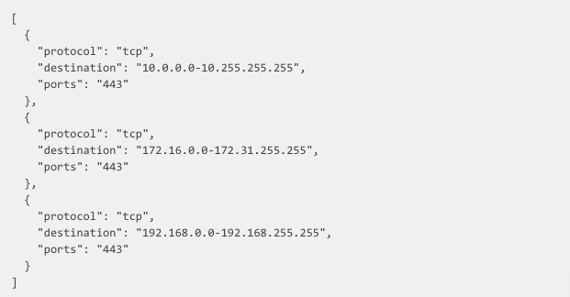
Create a Rules JSON File
Notes:
Discuss the purpose of a rule file

Slide 3
Create the Security Group
Notes:
Discuss how to create a security group in the cf CLI

Slide 4
Bind Security Group to a Org and Space
Notes:
Discuss what a running security group is

Slide 5
Bind Security Group to all Spaces in a Org
Notes:
Discuss what a running security group is

Slide 6
Bind to the Default Staging Security Group
Notes:
Discuss the difference between a Staging and Running Security Group – Staging typically need to be more open to download dependencies

Slide 7
Bind to the Default Running Security Group
Notes:
Discuss what a running security group is

