Slide 1
Xenon https://github.com/vmware/xenon/wiki

Slide 2
Why
Proliferation of custom built orchestration/control plane frameworks using a grab bag of OSS solutions
Same problems being solved in N different ways:
Common reqs
Persistence, strong consistency, high availability, metrics, audit, unified AuthZ, leader election, etc etc
We (ofcourse!) thought yet another one was in order

Slide 3
Synergy -> Tiny Framework
Re-use the same algorithm for scale out, high availability, serializeability
Manage concurrency
Manage state / persistence / queries
Leads to …
Massive reduction in needed code (14K lines)

Slide 4
What it is
A runtime powering tiny REST services
A design pattern and runtime for scalable orchestration and management logic
Production ready code with continuous integration tests, design documents, in use by other teams (e.g Photon Controller)

Slide 5
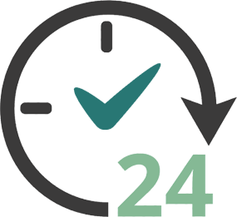
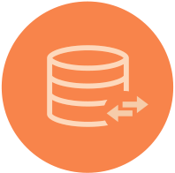




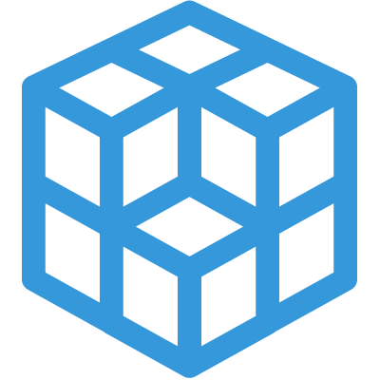
Capabilities
High Availability
Scalable
Distributed
Rich Query Interface
Declarative model
Traceable
Extensible
Self Describing API

Slide 6



Multiple services per host process, multiple nodes per group. DHT used for owner selection between service replicas across nodes
DC1 DCP Node B
DC1 DCP Node A
B
DC3 DCP Node A
F
E
A
G
C
Services used in request pipeline
Consensus + replication
Node Group Hashing (DHT)
Multi Version Deep Indexer
Per instance
UI, stats, Pub/Sub
DCP Nodes can span Data Centers

Slide 7
Decentralized Model
Scalable to lots of nodes
SWIM node discovery and maintenance
Replication with Eventual OR Strong Consistency (choose!)
Every node in a node group has the same core services
Operational simplicity

Slide 8
Indexing/Queries
Multi version, fully indexed, replicated document store
Lucene!
Query services with rich document query support modeled as tasks
Real time or historical
Collections are just queries

Slide 9
Details – Programming Model
Isolated, asynchronous components listening on URIs
Each service instance represents a “living” document
All side effects happen through REST actions on document
Replication, consensus, notifications all leveraging symmetric model
Stateless handlers are offered latest state and request body
Developer declares requirements through Service options
Replication with Strong (Eager) or Eventual consistency
Scale out (Owner selection)
Instrumentation
Persistence (with deep indexing)
And more …

Slide 10
Example service
public class ExampleService extends StatefullService{
public static class ExampleServiceState extends ServiceDocument {
public Long counter;
public String name;
}
public ExampleService() {
super(ExampleServiceState.class);
super.toggleOption(ServiceOption.PERSISTENCE, true);
super.toggleOption(ServiceOption.REPLICATION, true);
super.toggleOption(ServiceOption.INSTRUMENTATION, true);
super.toggleOption(ServiceOption.OWNER_SELECTION, true);
}
Service State Definition (PODO)
Author declares requirements, runtime fulfills them

Slide 11
Service Handler
Pure asynchronous model and task based parallelism uses a thread per core
For each request, method invoked on a service instance,
on the owner node, for strongly consistent services and services with owner selection,
or on all nodes in parallel for replicated services
A handler is 100% stateless (lambda) with two arguments
Request body
Current, committed state
No need to ever keep anything in memory!
Default behavior queues updates if an update operation is in progress, across several asynchronous steps
Fast
900,000 updates / sec in process for non replicated, non durable
50,000 update / sec for durable service, 2K JSON serialized state (deep indexing included!)
5,000 updates / sec for durable, strongly consistent, replicated service, 5 nodes

Slide 12
Example Service Handler
public void handlePatch(Operation patch) {
ExampleServiceState body = getBody(patch);
ExampleServiceState currentState = getState(update);
if (body.name == null) {
patch.fail(new IllegalArgumentException(„name is required“);
return;
}
currentState.name = body.name
patch.complete();
}
Op.complete() initiates asynchronous pipeline that:
Replicates to peers using consensus protocol
Indexes
Publishes notifications
Replies to client

Slide 13
Client Request
ComputeState body = new ComputeState();
body.cpuCount= 8;
body.name = “photon instance”;
Operation post = Operation.createPost(this, “resources/compute”)
.setBody(body)
.setCompletion((o,e) -> {
if (e != null) {
logSevere(e); return;
}
ComputeState rsp = o.getBody(ComputeState.class);
logInfo(“Creating new compute instance: %s”, compute.documentSelfLink);
});
host.sendRequest(post);

Slide 14
Hands-on

Slide 15
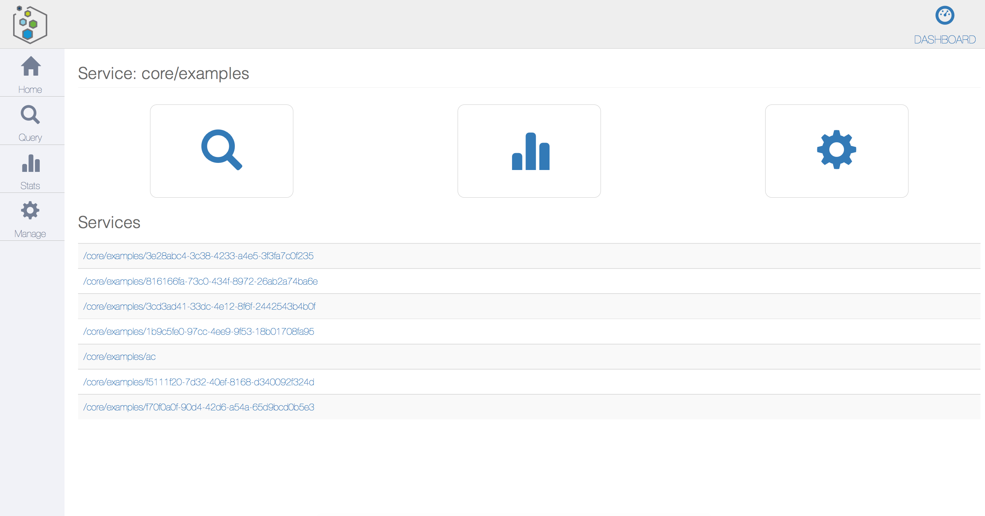
<service>/ui

Slide 16
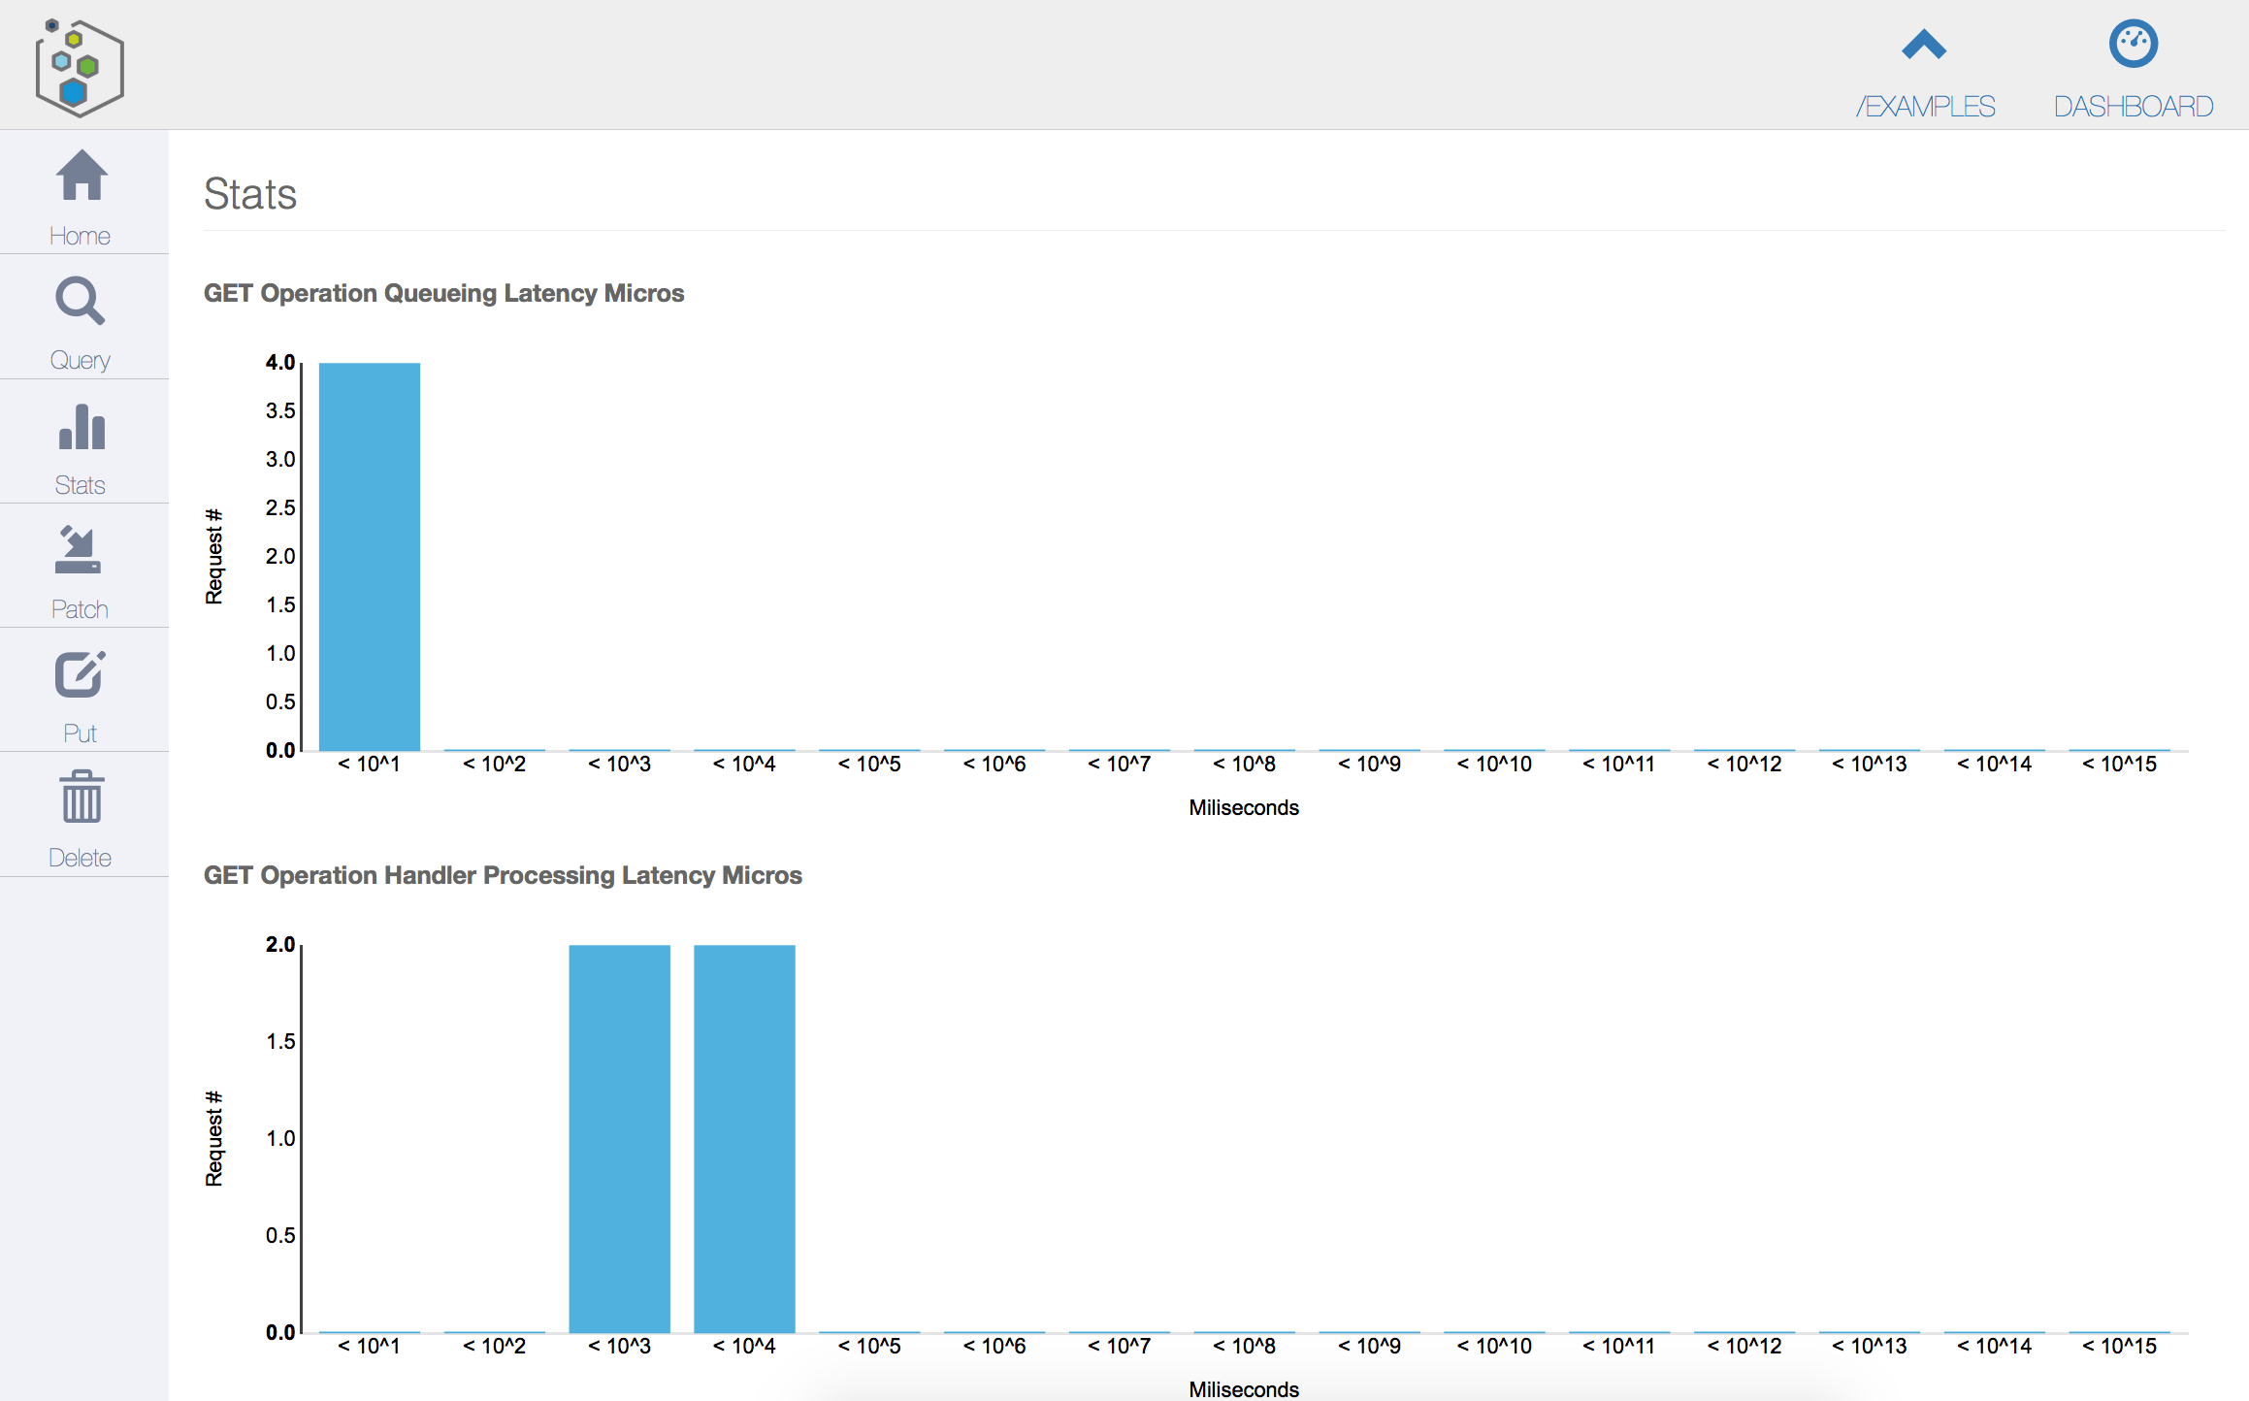
Instance Stats

Slide 17
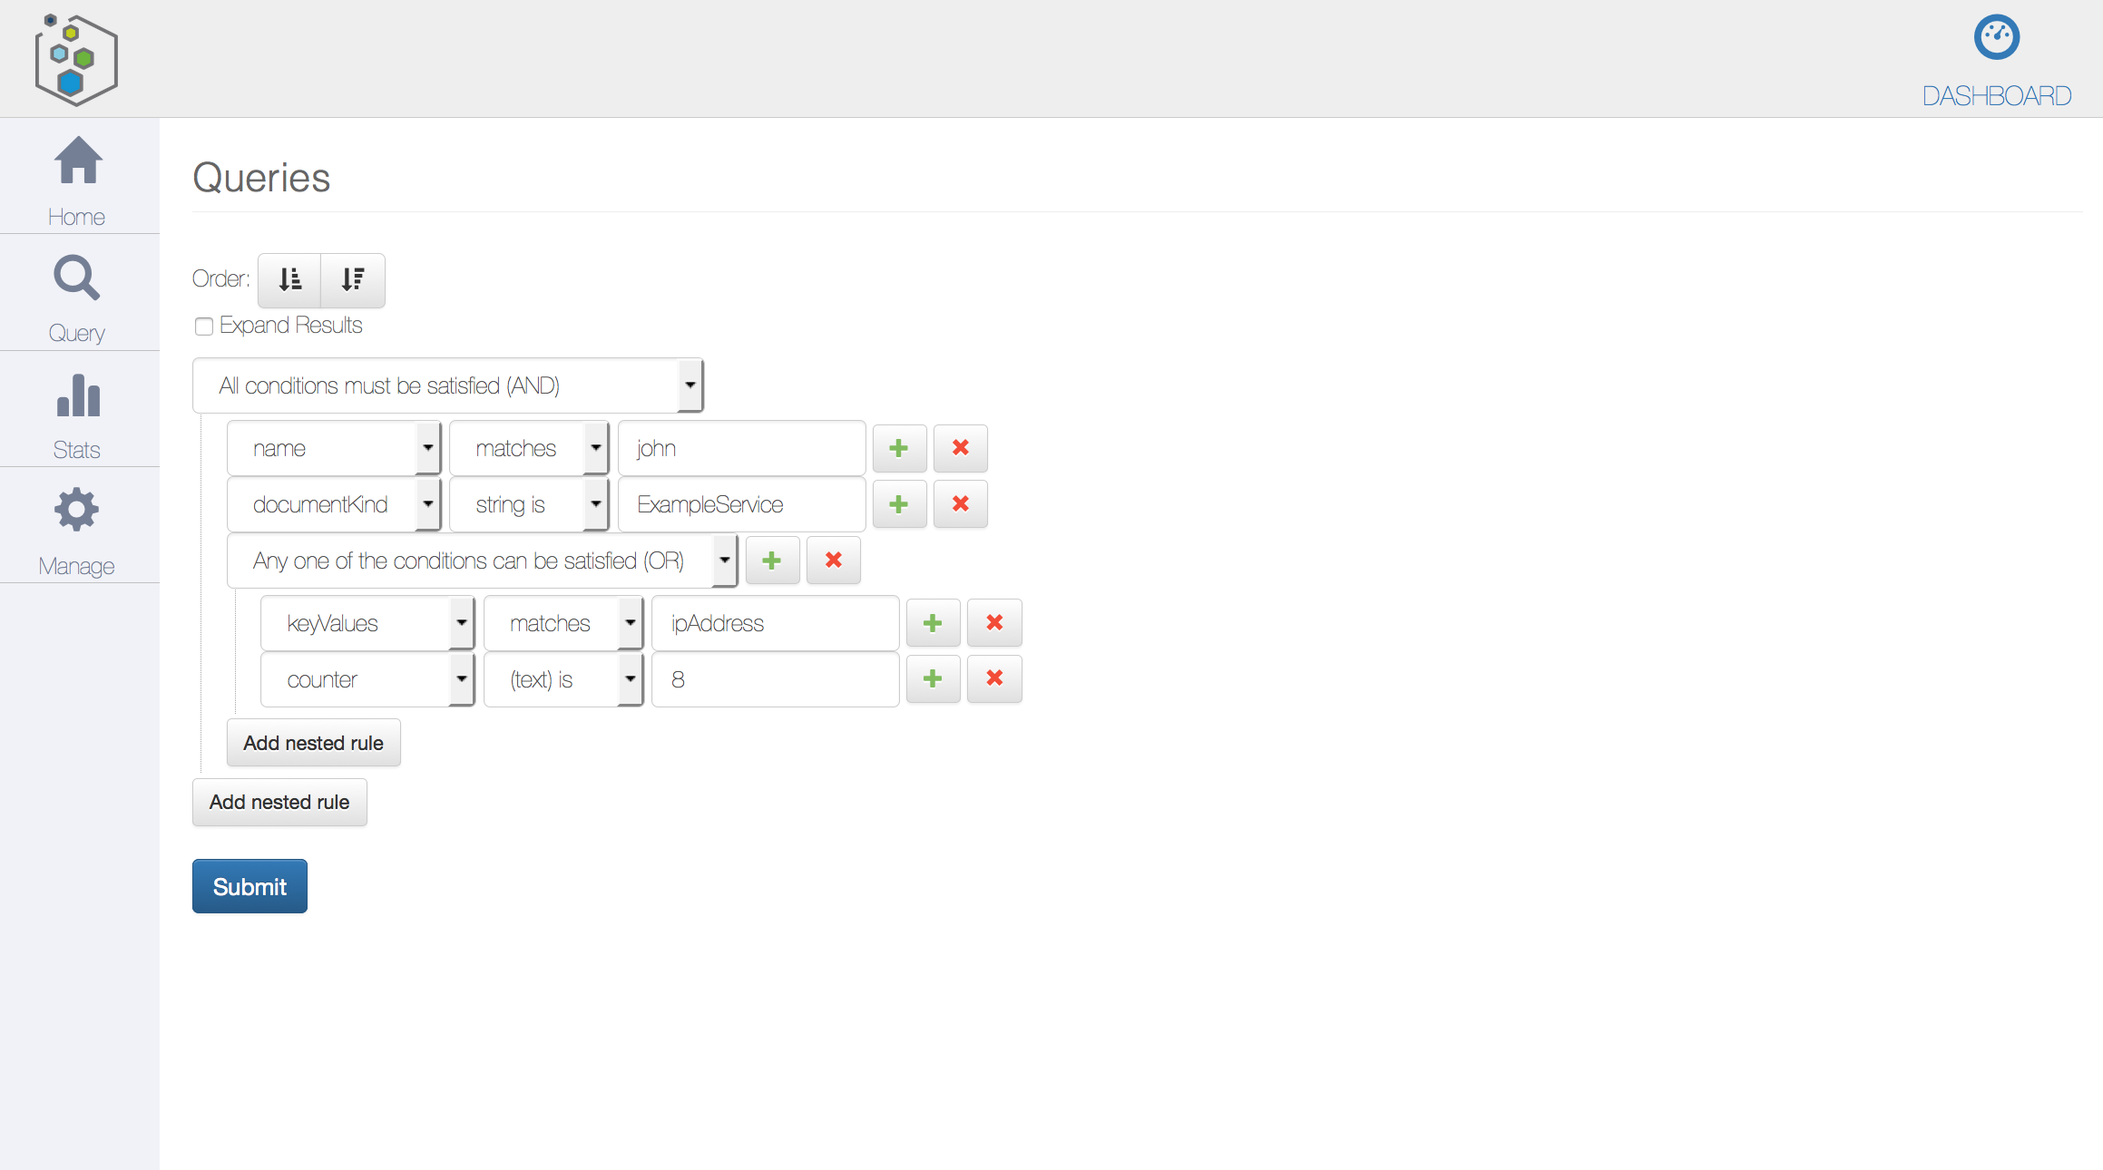
Queries

Slide 18
See Example Tutorial
curl http://192.168.1.59:8000/core/examples
{
"selfLinks": [
"/core/examples/755c582b-eef4-4e96-8450-09e7227355af"
],
"documents": {},
"documentVersion": 0,
"documentUpdateTimeMicros": 0
}
curl http://192.168.1.59:8000/core/examples/755c582b-eef4-4e96-8450-09e7227355af
{
"keyValues": {},
"name": "george",
"documentVersion": 1,
"documentKind": "com:vmware:dcp:services:common:ExampleService:ExampleServiceState",
"documentSelfLink": "/core/examples/755c582b-eef4-4e96-8450-09e7227355af",
"documentUpdateTimeMicros": 1411077167181000
}
GET resolves to a prefix query on selflink (/examples/*).
Any node will respond with same data due to eager, symmetric replication
Expand=true includes content inline

