Slide 1
Xenon / Photon Model

Slide 2
Overview
Photon Model
Xenon
Notes:
Change from initial draft: Enatai is a new VMware product being incubated in the CTO team. It provides a unified model for systems and application management across multiple infrastructures for which ‘Enatai adapters’ have been written. Customers would use the Enatai APIs to deploy and manage their systems, covering Applications to Infrastructure applications in a single coherent model and implementation across multiple infrastructure clouds.

Slide 3
Xenon

Slide 4
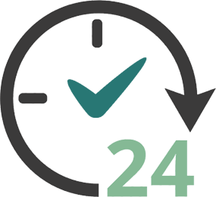
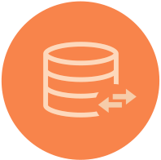




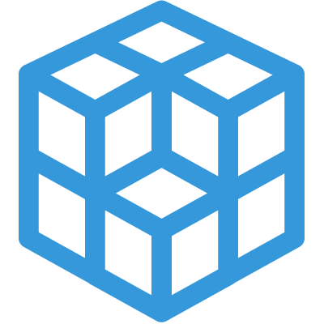
DCP
High Availability
Scalable
Distributed
Rich Query Interface
Declarative model
Traceable
Extensible
Self Describing API

Slide 5
Why
Proliferation of custom built orchestration/control plane frameworks using a grab bag of OSS solutions
Same problems being solved in N different ways:
Common reqs
Persistence, strong consistency, high availability, metrics, audit, unified AuthZ, leader election, etc etc
We (ofcourse!) thought yet another one was in order
Runtime for Photon Model and Multi Cloud Project
Build with re-use and shared contributions in mind

Slide 6
Synergy -> Tiny Framework
Re-use the same algorithm for scale out, high availability, serializeability
Manage concurrency
Manage state / persistence / queries
Leads to …
Massive reduction in needed code (14K lines)

Slide 7
What it is
A runtime powering tiny REST services
A design pattern and runtime for scalable orchestration and management logic
Production ready code with continuous integration tests, design documents, in use by other teams (e.g Photon Controller)

Slide 8



Multiple services per host process, multiple nodes per group. DHT used for owner selection between service replicas across nodes
DC1 DCP Node B
DC1 DCP Node A
B
DC3 DCP Node A
F
E
A
G
C
Services used in request pipeline
Consensus + replication
Node Group Hashing (DHT)
Multi Version Deep Indexer
Per instance
UI, stats, Pub/Sub
DCP Nodes can span Data Centers

Slide 9
Decentralized Model
Scalable to lots of nodes
SWIM node discovery and maintenance
Replication with Eventual OR Strong Consistency (choose!)
Every node in a node group has the same core services
Operational simplicity

Slide 10
Indexing/Queries
Multi version, fully indexed, replicated document store
Lucene!
Query services with rich document query support modeled as tasks
Real time or historical
Collections are just queries

Slide 11
Details – Programming Model
Isolated, asynchronous components listening on URIs
Each service instance represents a “living” document
All side effects happen through REST actions on document
Replication, consensus, notifications all leveraging symmetric model
Stateless handlers are offered latest state and request body
Developer declares requirements through Service options
Replication with Strong (Eager) or Eventual consistency
Scale out (Owner selection)
Instrumentation
Persistence (with deep indexing)
And more …

Slide 12
Example service
public class ExampleService extends StatefullService{
public static class ExampleServiceState extends ServiceDocument {
public Long counter;
public String name;
}
public ExampleService() {
super(ExampleServiceState.class);
super.toggleOption(ServiceOption.PERSISTENCE, true);
super.toggleOption(ServiceOption.REPLICATION, true);
super.toggleOption(ServiceOption.INSTRUMENTATION, true);
super.toggleOption(ServiceOption.OWNER_SELECTION, true);
}
Service State Definition (PODO)
Author declares requirements, runtime fulfills them

Slide 13
Service Handler
Pure asynchronous model and task based parallelism uses a thread per core
For each request, method invoked on a service instance,
on the owner node, for strongly consistent services and services with owner selection,
or on all nodes in parallel for replicated services
A handler is 100% stateless (lambda) with two arguments
Request body
Current, committed state
No need to ever keep anything in memory!
Default behavior queues updates if an update operation is in progress, across several asynchronous steps
Fast
900,000 updates / sec in process for non replicated, non durable
50,000 update / sec for durable service, 2K JSON serialized state (deep indexing included!)
5,000 updates / sec for durable, strongly consistent, replicated service, 5 nodes

Slide 14
Example Service Handler
public void handlePatch(Operation patch) {
ExampleServiceState body = getBody(patch);
ExampleServiceState currentState = getState(update);
if (body.name == null) {
patch.fail(new IllegalArgumentException(„name is required“);
return;
}
currentState.name = body.name
patch.complete();
}
Op.complete() initiates asynchronous pipeline that:
Replicates to peers using consensus protocol
Indexes
Publishes notifications
Replies to client

Slide 15
Client Request
ComputeState body = new ComputeState();
body.cpuCount= 8;
body.name = “photon instance”;
Operation post = Operation.createPost(this, “resources/compute”)
.setBody(body)
.setCompletion((o,e) -> {
if (e != null) {
logSevere(e); return;
}
ComputeState rsp = o.getBody(ComputeState.class);
logInfo(“Creating new compute instance: %s”, compute.documentSelfLink);
});
host.sendRequest(post);

Slide 16
DCP Hands-on
Demo

Slide 17
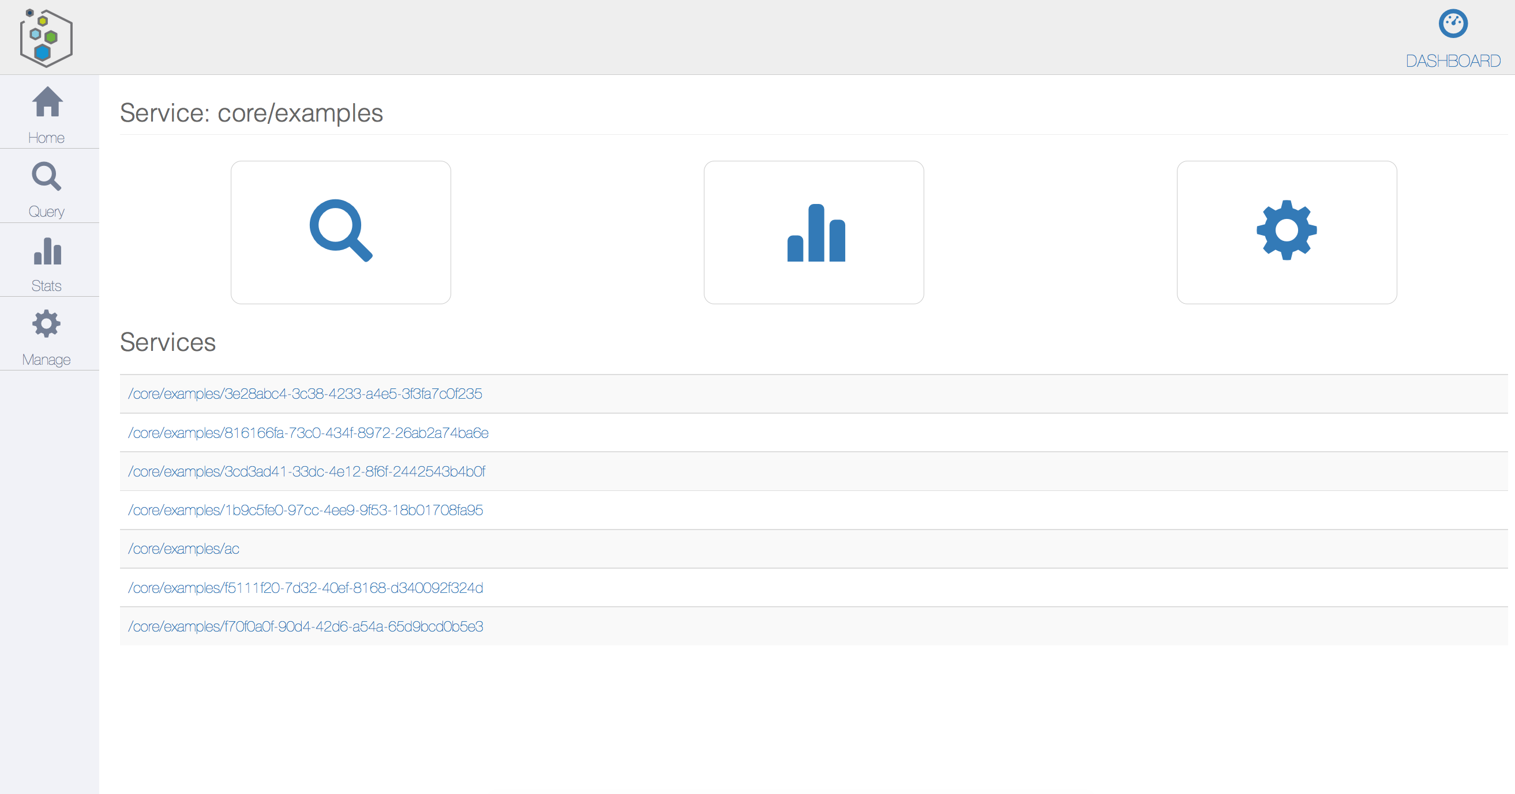
<service>/ui

Slide 18
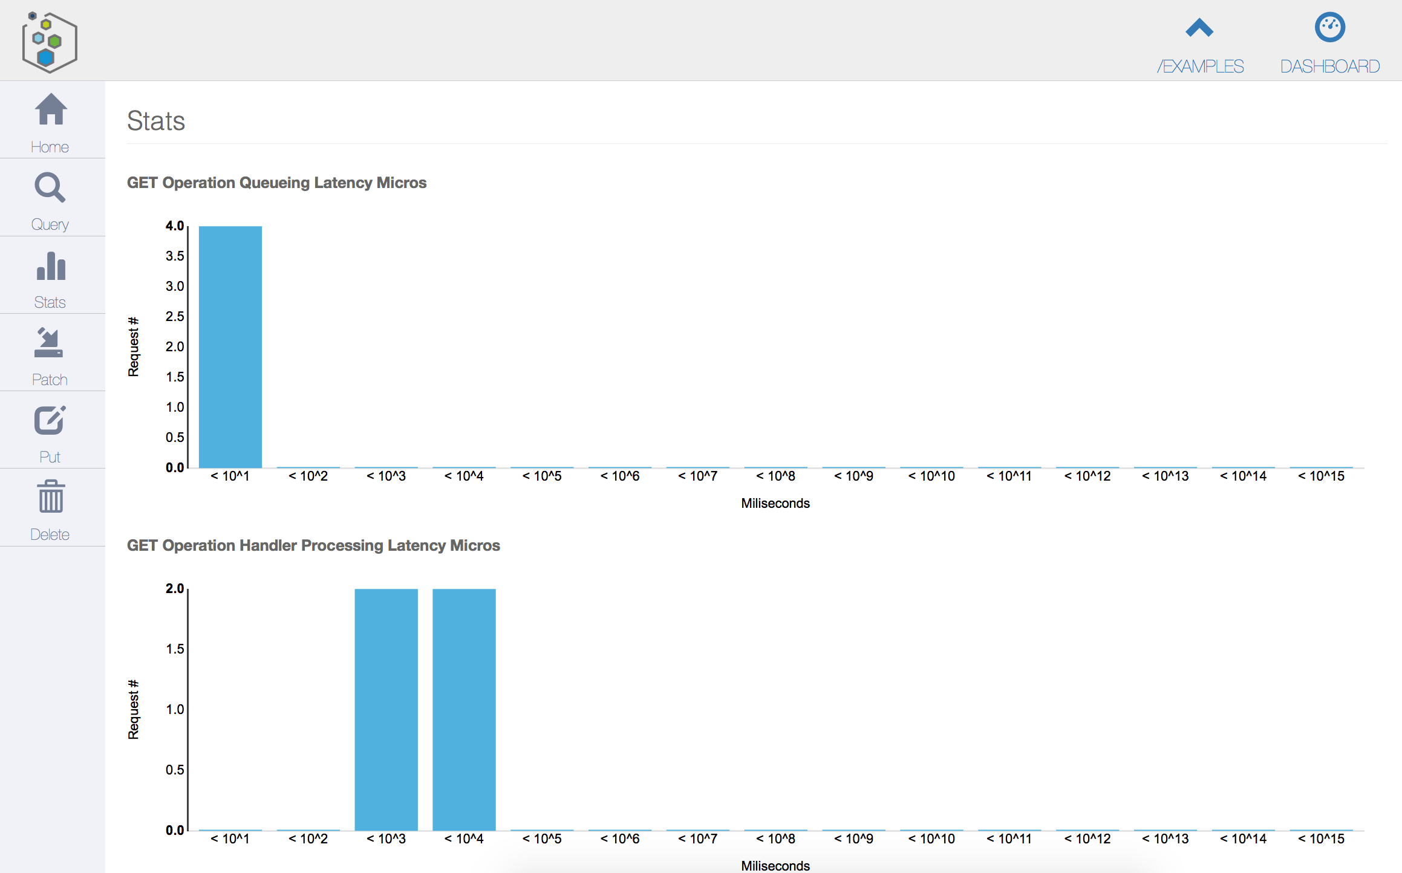
Instance Stats

Slide 19
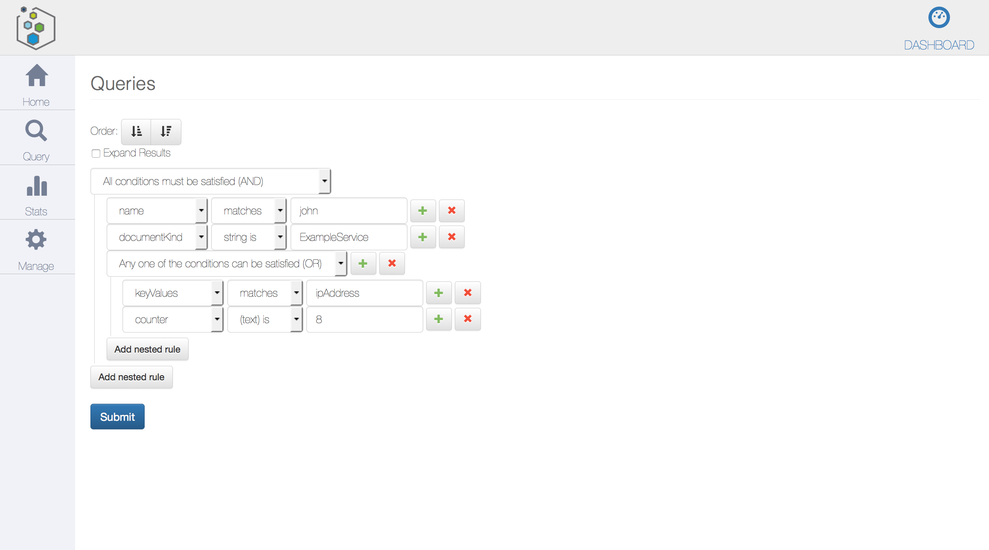
Queries

Slide 20
Hands on (demo)
curl http://192.168.1.59:8000/core/examples
{
"selfLinks": [
"/core/examples/755c582b-eef4-4e96-8450-09e7227355af"
],
"documents": {},
"documentVersion": 0,
"documentUpdateTimeMicros": 0
}
curl http://192.168.1.59:8000/core/examples/755c582b-eef4-4e96-8450-09e7227355af
{
"keyValues": {},
"name": "george",
"documentVersion": 1,
"documentKind": "com:vmware:dcp:services:common:ExampleService:ExampleServiceState",
"documentSelfLink": "/core/examples/755c582b-eef4-4e96-8450-09e7227355af",
"documentUpdateTimeMicros": 1411077167181000
}
GET resolves to a prefix query on selflink (/examples/*).
Any node will respond with same data due to eager, symmetric replication
Expand=true includes content inline

Slide 21
Photon Model

Slide 22
Motivation
Raising a human child
Multi-tier, autonomous apps
Mesos / Marathon job
Task Complexity
Floor cleaning robot
Hadoop job
Task Duration

Slide 23
Goals
Improve the efficiency of IT staff
Improve productivity of app developers

Slide 24
What is it
A set of DCP services
Application management through high level descriptions
Turn key provisioning on ESX (ESXCloud), EC2, GCE, Azure
Provision and manage Containers or VMs
Stateless adapters REST services
Probabilistic Modeling (POMDP)

Slide 25
PhotonModel
Apps
App Frameworks
Pivotal CF, Kubernetes, Mesos, etc
App Services
Registration, discovery, messaging, analytics (LI), persistence, HA, scale, etc
App Management Blueprints, Lifecycle, Policy, Monitoring, etc
Enatai / Third party
VM
C
C
C
C
C
C
VM
VM
C
C
VM
VM
C
C
VM
C
VM
VM
C
Adapters
dcp.f
vSphere
vCloud Air
ESX Cloud v1
ESX Cloud vN
Bare Metal
Photon, CoreOS, Linux) + Docker / Rocket
GCE
AWS
ESXi
Bare Metal
HyperV
KVM
Docker/Rocket
dcp.f
VMware IaaS
Third Party IaaS

Slide 26
Resource Pool
Compute Description
Resource Allocation Task
Provision Task
C
Disk Description
Network Description

Slide 27
YAML REST Operation
action: post
path: /resources/compute-descriptions
body:
documentSelfLink: {{ uuid .id }}
enumerationAdapterReference: http://localhost:8082/provisioning/esx/enumeration-service
healthAdapterReference: http://localhost:8082/provisioning/esx/health-service
supportedChildren:
- VM_GUEST
select: .documentSelfLink

Slide 28
Photon Model Hands-on
Demo

Slide 29
Container Host Description
action: post
path: /resources/compute-descriptions
body:
documentSelfLink: {{ or .selfLink ”docker-container-host" }}
networkId: {{ or .network "" }}
totalMemoryBytes: 2147483648
instanceAdapterReference: http://localhost:8082/provisioning/esx/instance-service
bootAdapterReference: http://localhost:8082/provisioning/esx/boot-service
supportedChildren:
- DOCKER_CONTAINER
select: .documentSelfLink

Slide 30
Container Host Boot Disk
action: post
path: /resources/disks
body:
id: photon-boot-vmdk
name: Photon stable vmdk
type: HDD
sourceImageReference: file:///images/photon.vmdk
select: .documentSelfLink

Slide 31
Container Host Config Disk
action: post
path: /resources/disks
body:
id: photon-config-vmdk
name: Photon configuration
type: CDROM
customizationServiceReference: http://localhost:8082/provisioning/boot-config-service/iso
bootConfig:
label: config-2
files:
- path: openstack/latest/user_data
contents: |
{{ include “cloud_config.yml” | indent 10 }}
select: .documentSelfLink

Slide 32
Container Host Resource Alloc
action: post
path: /provisioning/resource-allocation-tasks
body:
documentSelfLink: examples-photon-vmdk-{{ uuid }}
computeType: VM_GUEST
resourcePoolLink: {{ .pool }}
resourceCount: {{ .count }}
resourceDescriptionLink: /resources/compute-descriptions/photon-container-host
diskDescriptionLinks:
- /resources/disks/photon-boot-vmdk
- /resources/disks/photon-config-vmdk
select: .documentSelfLink

Slide 33
Docker Container Description
action: post
path: /resources/compute-descriptions
body:
documentSelfLink: photon-docker-container
authCredentialsLink: /core/auth/credentials/enatai-rsa
instanceAdapterReference: http://localhost:8082/provisioning/docker/instance-service
enumerationAdapterReference: http://localhost:8082/provisioning/docker/enumeration-service
select: .documentSelfLink

Slide 34
Compute Instance
curl http://192.168.13.14:8000/resources/compute/jenkins-15445f26
{
"id": "jenkins-15445f26-4b2b-424a-846b-879e10fd3c9d-1",
"descriptionLink": "/resources/compute-host-descriptions/gce-n1-standard-1",
"resourcePoolLink": "/resources/pools/d52e26e2-af5e-458e-af50-d85a4d5f1d9e",
"parentLink": "/resources/compute-hosts/gce-parentsage-surfer-749",
"diskLinks": [
"/resources/disks/3f8306b7-c384-4713-bb1a-350d9049a4f2",
"/resources/disks/4b2365ed-918d-468d-a713-a0a5f8fc26a6"
]
…
}
Parent is a compute resource representing the GCE “hypervisor” host

