Slide 1
Xenon Workshop - Queries

Slide 2
Agenda
What’s a query? Why would I use it?
How do I perform a query in Xenon?
We’ve modeled queries as tasks in Xenon
Programming model (execute a simple query task)
Explain direct pattern
Property matches
String matching, numeric range, collections + maps
Boolean clauses
Query options
Counting, sorting, debugging (e.g. INCLUDE_DELETED)
Pagination
Consistency + multi-node

Slide 3
Queries overview
What’s a query?
Indexing: parsing and storage of data for efficient lookup
Retrieval: (quickly) identify documents which match arbitrary search criteria
Example: Google search
Example: list the ESX hosts in datacenter 3 with a given network card
What’s a query in Xenon?
ServiceDocument contents are indexed using Apache Lucene
Queries are modeled as task services
Take as input the query specification to be executed
On successful completion, return the self-links of services which match

Slide 4
QueryTaskService
To perform a query in Xenon,
Send an HTTP POST to /core/query-tasks
… with a QueryTask document as the body:
{ "querySpec": { "query": { "term": { "matchValue": "Amanda", "propertyName": "name" } } } }

Slide 5
Direct queries
Query tasks support the direct pattern
Initial HTTP post is not completed in handleStart
Service performs task actions, completes operation when task completes
Caller sees query results in the initial HTTP response
{ "taskInfo": { "isDirect": true }, "querySpec": { "query": { "term": { "matchValue": "Amanda", "propertyName": "name" } } } }

Slide 6
EXPAND_CONTENT queries
Sometimes you want the entire document, not just the self-link!
{ "taskInfo": { "isDirect": true }, "querySpec": { "options": [ "EXPAND_CONTENT“ ], "query": { "term": { "matchValue": "Amanda", "propertyName": "name" } } } }

Slide 7
String matching
Basic queries
{ "taskInfo": { "isDirect": true }, "querySpec": { "options": [ "EXPAND_CONTENT“ ], "query": { "term": { "matchValue": "Amanda", "propertyName": "name“ } } } }

Slide 8
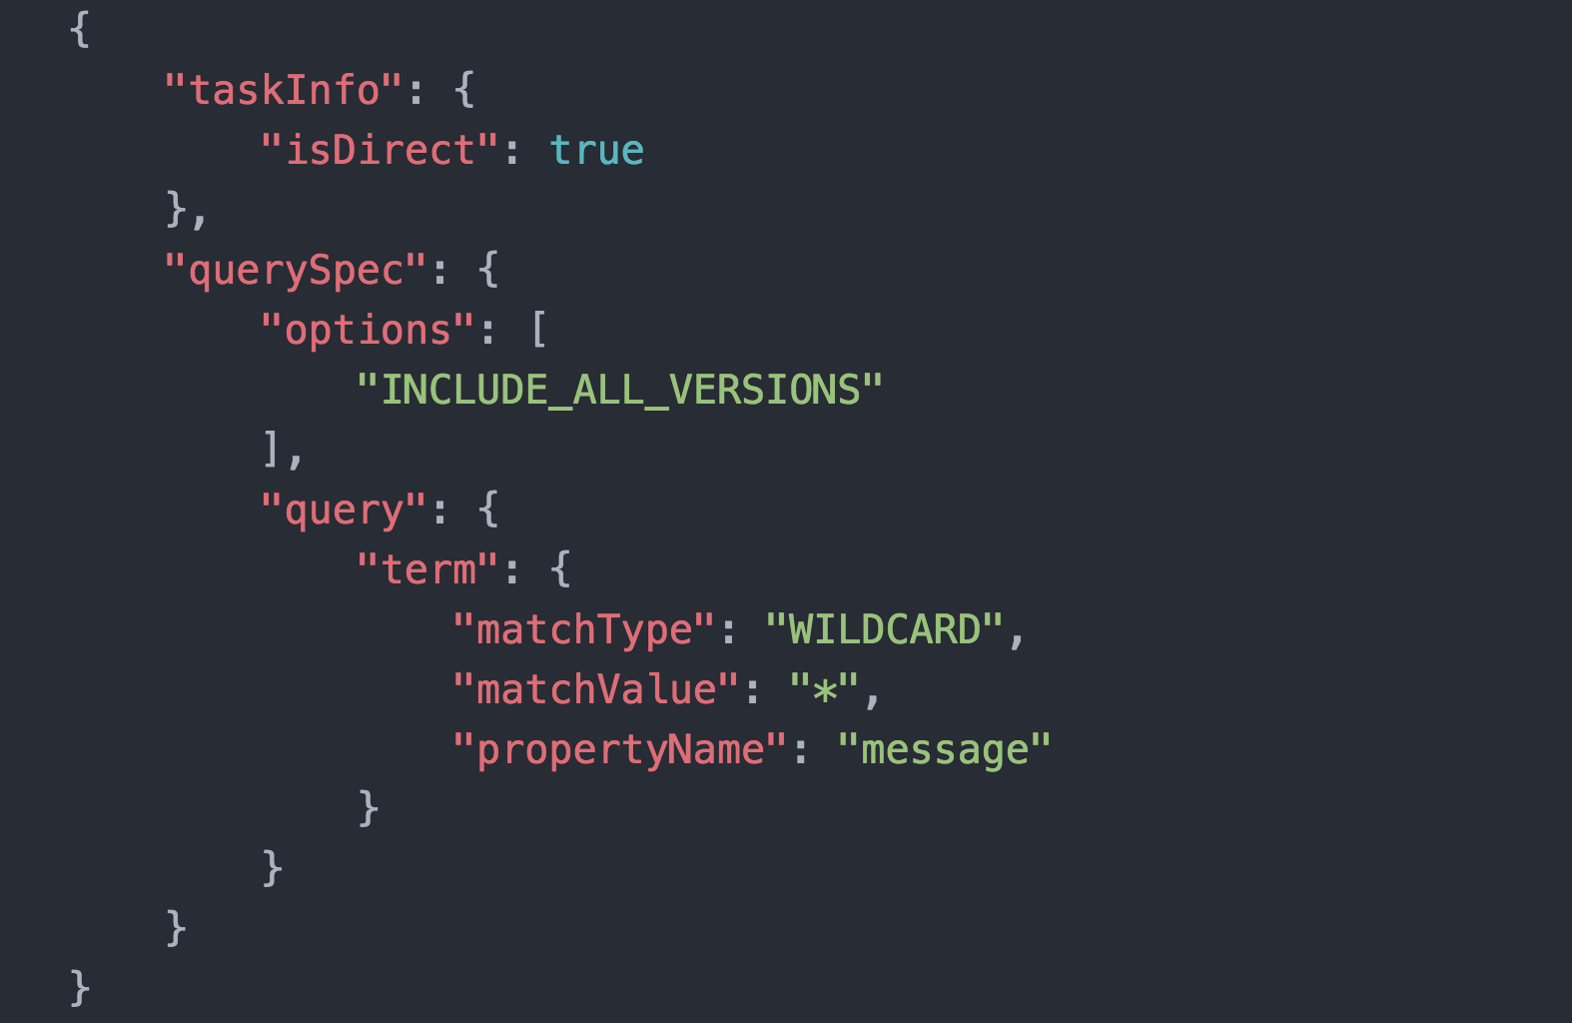
QueryTask
A task-based REST API to specify and execute queries.
Service documents that are indexed can be queried.
To create a query task send a POST to /core/query-tasks.
Following is a simple body sent to create a query task.

Slide 9
QueryTask – task state explained
taskInfo.isDirect
When set to true, the query task performs the query and returns the result immediately.
querySpec.options
EXPAND_CONTENT: the query results will include the entire document description in addition to the default documentLinks to these documents.
INCLUDE_DELETED: will include the documents that have either expired or have been marked as deleted
COUNT: will return the total number of documents and no links to them
INCLUDE_ALL_VERSIONS: will include results from a version that is either created after the query was started, or, is the latest version
SORT: will sort the results based on querySpec.sortOrder and querySpec.sortTerm. Can use additionalSortTerms and additionalGroupSortTerms to sort by multiple fields.

Slide 10
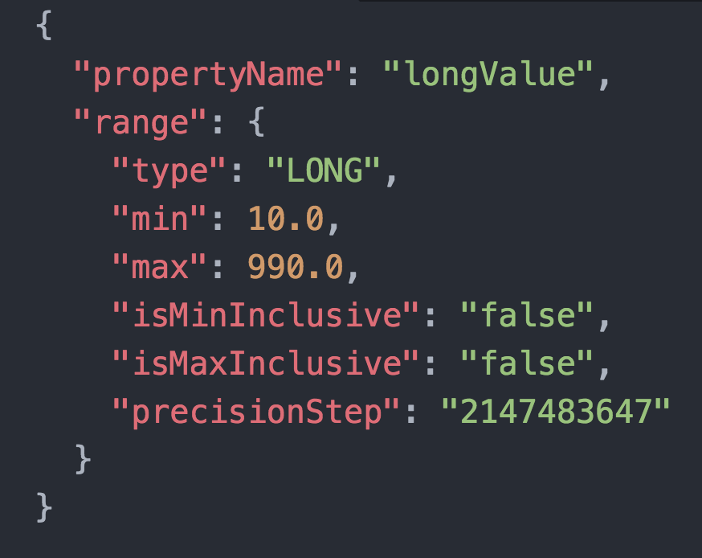
QueryTask – task state explained
querySpec.query
TERM: Match one field to a value
matchType – TERM, PHRASE, WILDCARD
propertyName – Name of the field
BOOLEAN: Encapsulates multiple queries
Can contain nested TERM or BOOLEAN
Numeric Range Query
A TERM query that finds documents based on a field’s range.

Slide 11
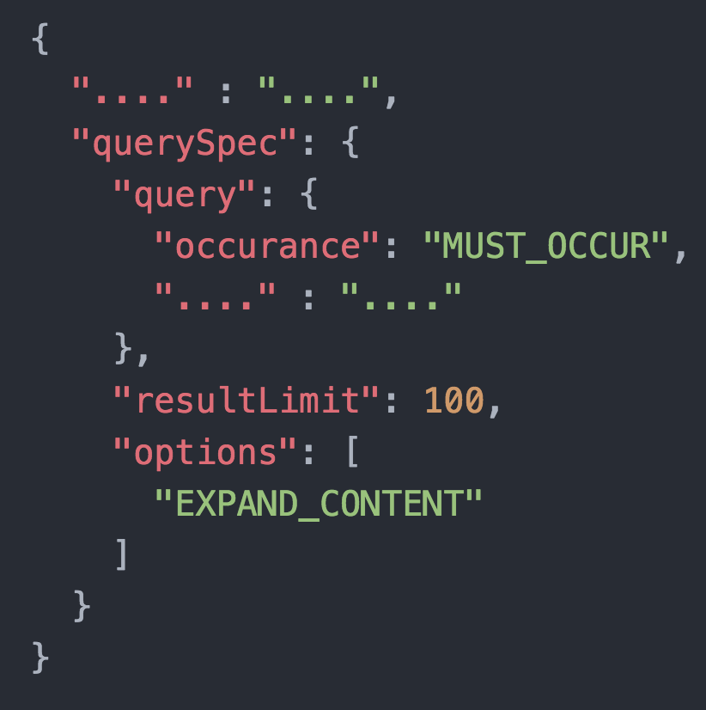
QueryTask – Paginating Results
querySpec.resultLimit > 0
Will create paginated results with the response containing just the first page link.
Traverse “nextPageLink” or “previousPageLink” to navigate across pages.
It is always a good idea to paginate results, especially if there are 1000s of documents with multiple versions of each.

Slide 12
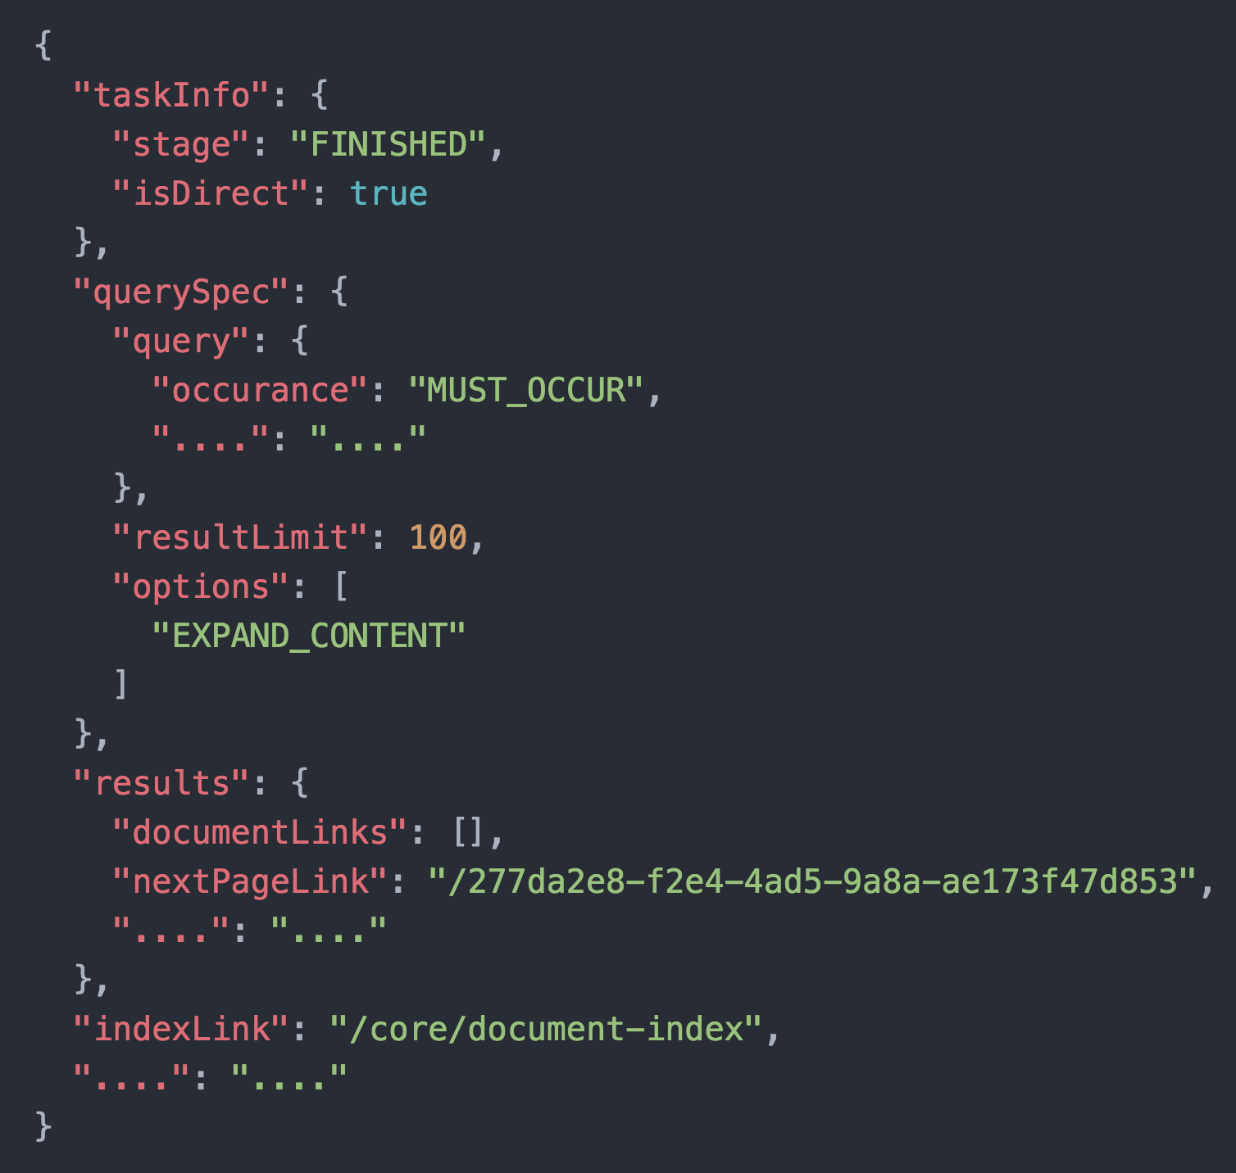
QueryTask – Paginating Results

Slide 13
QueryTask vs Local QueryTask
Unlike QueryTasks the local QueryTasks are not load-balanced and replicated.
The payload, querySpec remains the same.
How and When do I use a local query task?
POST to ‘/core/local-query-tasks’ instead of ’ /core/query-tasks’
Ideal when performing broadcast queries across nodes as they can be run concurrently.

Slide 14
Odata Query Support
The documents can also be queried using OData ‘$filter’ specification.
Issue GET on ‘/core/odata-queries?$filter=<query>’
This internally performs a DIRECT query task with EXPAND option set.
‘$count’ translates to QueryOption COUNT.
‘$limit’ can be used to set ‘resultLimit’.
‘$top’ returns the specified top results only without having to paginate.
‘$orderby’ can be used to SORT fields.
Following are some of operators supported
‘eq’, ‘ne’ → “Equal”, “Not equal”
‘gt’, ‘lt’, → “Greater than”, “Less than”
‘ge’, ‘le’ → “Greater than or equal”, “Less than or equal”
“and”, “or” → “And”, “Or”

Slide 15
OData Query Support
GET /core/odata-queries?$filter=name eq ‘instance-1’
Returns all matching documents whose ‘name’ field is ‘instance-1’
Use ‘and’, ‘or’ operators to group conditions
name eq instance-1 or counter gt 200
name eq instance-2 and status eq failed
Use ‘any’, ‘all’ operators when matching multiple values
name any ‘instance-1;instance-2’
tags.item all ‘tag1;tag2’
Factory services offer OData filter capability by default.
GET /core/examples?$filter=name eq document1 would return all documents under the factory matching the criteria.
Paginated results on a factory would return the first page result unlike QueryTasks, the ’nextPageLink’ would point to the second page.

Slide 16
Questions

