Slide 1
Xenon https://github.com/vmware/xenon/wiki

Slide 2
What it is
A runtime powering tiny REST services
IO Pipeline integrates key building blocks within each service operation
A design pattern and runtime for scalable orchestration and management logic
Production ready code with continuous integration tests, design documents, in use by other teams (e.g Photon Controller)

Slide 3
Why
Proliferation of custom built orchestration/control plane frameworks using a grab bag of OSS solutions
Same problems being solved in N different ways:
Common reqs baked in (batteries included)
Persistence, strong consistency, high availability, metrics, audit, unified AuthZ, leader election, etc etc
Simple, single, operation model

Slide 4
The Popular Way
Stand up N nodes for each of:
Orchestration code (java, go, Rust, node.js)
Your HA store (DB, Cassandra, Mongo, K/V)
Your arbitration/leader election (ZK, etcd, consul)
Your UI server (node.js, tomcat, apache)
Your cache layer (Redis, memcached)
Your translation layer (ORM)
Your message bus, event broker

Slide 5
The Xenon Way
Stand up N nodes running Xenon services:
Orchestration as stateless or stateful REST endpoints
Persist, replicate state independently
Manage concurrency with a single JVM and one thread per core across ALL services
Provide per operation owner selection (leader)
Stats
UI
Tracing
Pub / Sub
Orchestration calculus (Join, Sequence, nest)

Slide 6
Details

Slide 7
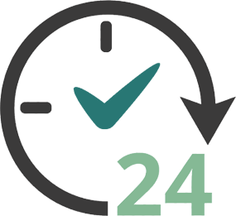
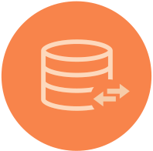




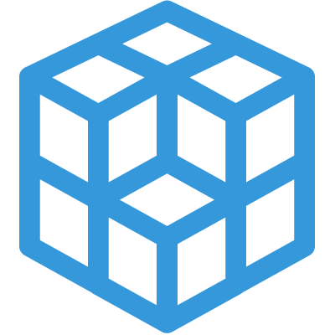
Capabilities
High Availability
Scalable
Distributed
Rich Query Interface
Declarative model
Traceable
Extensible
Self Describing API

Slide 8
Decentralized Model
Scalable to lots of nodes
SWIM node discovery and maintenance
Replication with Eventual OR Strong Consistency (choose!)
Every node in a node group has the same core services
Operational simplicity

Slide 9
Indexing/Queries
Multi version, fully indexed, replicated document store
Lucene!
Query services with rich document query support modeled as tasks
Real time or historical
Collections are just queries

Slide 10
Programming Model
Isolated, asynchronous components listening on URIs
Each service instance represents a “living” document
All side effects happen through REST actions on document
Replication, consensus, notifications all leveraging symmetric model
Stateless handlers are offered latest state and request body
Developer declares requirements through Service options
Replication with Strong (Eager) or Eventual consistency
Scale out (Owner selection)
Instrumentation
Persistence (with deep indexing)
And more …

Slide 11
Example service
public class ExampleService extends StatefullService{
public static class ExampleServiceState extends ServiceDocument {
public Long counter;
public String name;
}
public ExampleService() {
super(ExampleServiceState.class);
super.toggleOption(ServiceOption.PERSISTENCE, true);
super.toggleOption(ServiceOption.REPLICATION, true);
super.toggleOption(ServiceOption.INSTRUMENTATION, true);
super.toggleOption(ServiceOption.OWNER_SELECTION, true);
}
Service State Definition (PODO)
Author declares requirements, runtime fulfills them

Slide 12
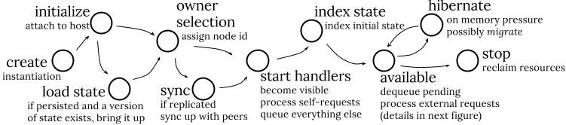
Service Lifecycle

Slide 13
Service Handler
Pure asynchronous model and task based parallelism uses a thread per core
For each request, method invoked on a service instance,
on the owner node, for strongly consistent services and services with owner selection,
or on all nodes in parallel for replicated services
A handler is 100% stateless (lambda) with two arguments
Request body
Current, committed state
No need to ever keep anything in memory!
Default behavior queues updates if an update operation is in progress, across several asynchronous steps
Fast
900,000 updates / sec in process for non replicated, non durable
50,000 update / sec for durable service, 2K JSON serialized state (deep indexing included!)
5,000 updates / sec for durable, strongly consistent, replicated service, 5 nodes

Slide 14
Example Service Handler
public void handlePatch(Operation patch) {
// get body, can be any PODO, not just self PODO
ExampleServiceState body = getBody(patch);
ExampleServiceState currentState = getState(patch);
if (body.name == null) {
patch.fail(new IllegalArgumentException(....));
return;
}
currentState.name = body.name;
patch.complete();
}
Op.complete() initiates asynchronous pipeline that:
Replicates to peers using consensus protocol
Indexes
Publishes notifications
Replies to client

Slide 15
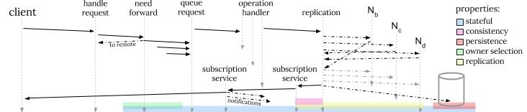
I/O Pipeline

Slide 16
Client Request
ComputeState body = new ComputeState();
body.cpuCount= 8;
body.name = “photon instance”;
Operation post = Operation.createPost(this, “resources/compute”)
.setBody(body)
.setCompletion((o,e) -> {
if (e != null) {
logSevere(e); return;
}
ComputeState rsp = o.getBody(ComputeState.class);
logInfo(“Creating new compute instance: %s”, compute.documentSelfLink);
});
host.sendRequest(post);

Slide 17
Join (Sequence, Nest)
Operation post = Operation.createPost(this, “resources/compute”).setBody(cc);
Operation post2 = Operation.createPost(this, “resources/disks”).setBody(dd);
OperationJoin join = OperationJoin.create(post,post2).setCompletion((ops, failures) -> {
if (!failures.isEmpty()) {
// handle failures
return;
}
// handle completed ops
});
// send, in parallel
join.sendWith(this);

Slide 18
Hands-on

Slide 19
See Example Tutorial
curl http://192.168.1.59:8000/core/examples
{
"selfLinks": [
"/core/examples/755c582b-eef4-4e96-8450-09e7227355af"
],
"documents": {},
"documentVersion": 0,
"documentUpdateTimeMicros": 0
}
curl http://192.168.1.59:8000/core/examples/755c582b-eef4-4e96-8450-09e7227355af
{
"keyValues": {},
"name": "george",
"documentVersion": 1,
"documentKind": "com:vmware:dcp:services:common:ExampleService:ExampleServiceState",
"documentSelfLink": "/core/examples/755c582b-eef4-4e96-8450-09e7227355af",
"documentUpdateTimeMicros": 1411077167181000
}
GET resolves to a prefix query on selflink (/examples/*).
Any node will respond with same data due to eager, symmetric replication
Expand=true includes content inline

Slide 20
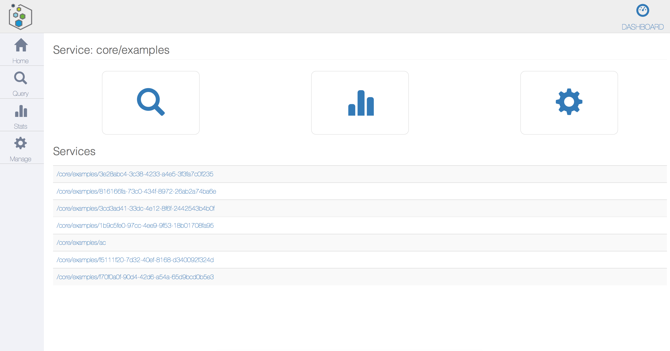
<service>/ui

Slide 21
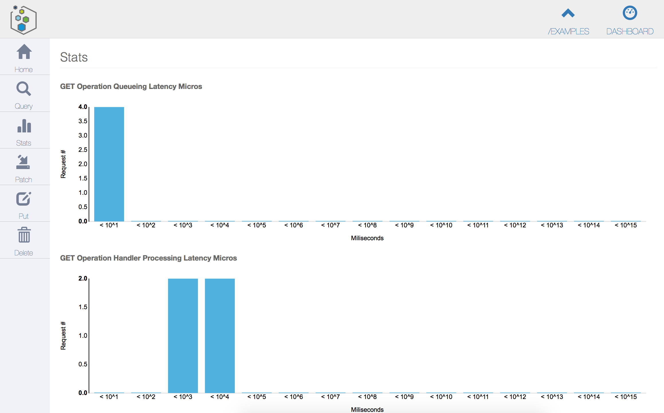
Instance Stats

Slide 22
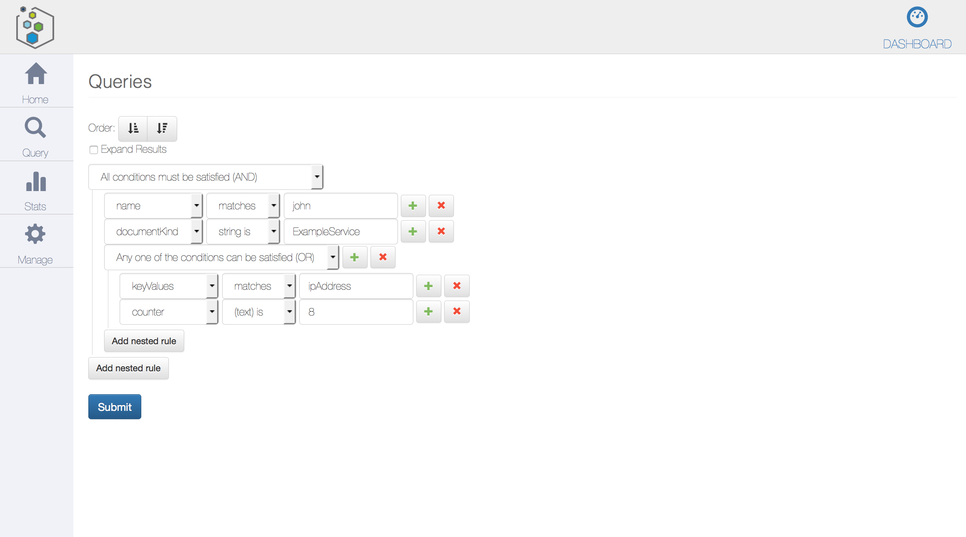
Queries

