Slide 1
Browser
1
2
port 80
port 80
yelb-ui
UI (Angular 2)
3
nginx
port 4567
yelb-appserver
4
ruby - sinatra
yelb-cache
port 6379
redis
yelb-db
Postgres
port 5432
5

Slide 2





Client connects to EC2
Angular – UI
NGINX
Redis
Internet
Client
Ruby – App server
Amazon EC2
Postgres
Amazon EC2
Amazon EC2
Amazon EC2

Slide 3
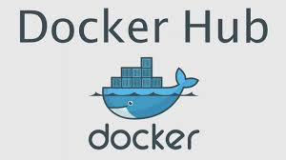






Client connects to ELB
Redis-server
Yelb-ui
Service
Yelb-appserver
Pod
Service
Client
Pod
Yelb-db
Service
Pod
ELB
Internal name resolution leverages standard out of the box K8s inner DNS resolution
Service
Pod
AWS Account
Cust Account
Dedicated Control Plane
Amazon EKS
Auto Scaling
Amazon EC2
Amazon EC2

Slide 4

Client connects to ELB
Redis-server
Yelb-ui
Service
Yelb-appserver
Task
Service
Client
Task
Yelb-db
Service
Task
ELB
Internal name resolution leverages ECS Service Discovery (aka AWS Cloud Map)
Service
Task
AWS Account
Cust Account
Multi-tenant Control Plane
Amazon ECS
Auto Scaling
Amazon EC2
Amazon EC2

Slide 5

Client connects to ELB
Redis-server
Yelb-ui
Service
Yelb-appserver
Task
Service
Client
Task
Yelb-db
Service
Task
ELB
Internal name resolution leverages ECS Service Discovery (aka AWS Cloud Map)
Service
Task
AWS Account
Multi-tenant Control Plane
Amazon ECS
AWS Fargate

Slide 6
Redis
Client connects to ELB
Yelb-ui
Amazon EC2
Yelb-appserver
Service
Client
Task
Service
Task
Postgres
ELB
Internal name resolution leverages ECS Service Discovery
AWS Account
Multi-tenant Control Plane
Amazon ECS
AWS Fargate
Amazon EC2

Slide 7







Yelb-ui source
Yelb-appserver source
Client connects to S3 web site
restaurants
cache
S3
Table
Table
Amazon API Gateway
Client
Lambda #1
Amazon DynamoDB
yelb-ui bucket
Lambda #2
Lambda #3
Lambda #4
Lambda #5
S3
AWS Lambda

Slide 8


Client starts UI container
restaurants
cache
yelb-ui container
Table
Table
Amazon API Gateway
Client
State Machine #1
Amazon DynamoDB
State Machine #2
State Machine #3
State Machine #4
State Machine #5
AWS Step Functions

Slide 9
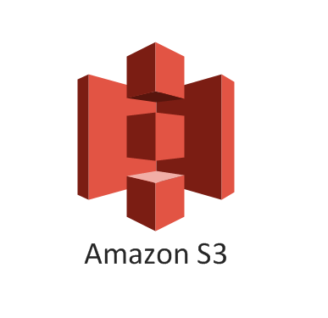

EC2
AWS
ECS
Lambda
Step Functions
Docker
Platformdeployment
Kubernetes
Linux

