Slide 1

Are You Missing a DataFrame?
The Power of Data Frames in Java

Slide 2

DATA ORIENTED
PROGRAMMING
DATA FRAME

Slide 3

Data-Oriented Programming
Data-oriented programming encourages us to model data as (immutable) data, and keep the code that embodies the business logic of how we act on that data separately.
— Brian Goetz “Data Oriented Programming in Java” https://www.infoq.com/articles/data-oriented-programming-java/
See also the DOP article series by Nicolai Parlog: https://inside.java/2024/05/23/dop-v1-1-introduction/

Slide 4
Object-Oriented vs. Data-Oriented
Data/State
Protect your privates Everything is awesome encapsulated There is no spoon state | Take my state. Please. Just data – as records, tables, collections Data is immutable
Operations
Objects responding to messages Polymorphism (allows objects of different types to respond to the same message) | Standalone functions operating on data
What Is It Good For?
Managing complex structures and behaviors Separation of concerns Taking advantage of OO language features Applying OO modeling techniques | Data exploration, ad hoc calculations Simple functions operating on simple data Separation of business logic from data Flexible data models

Slide 5
Object Oriented vs. Data Oriented Donuts
Menu
Data
ordersForDate(...)
Donut | Price | Discount Price
Old Fashioned | $1.25 | $1.00
Blueberry | $1.50 | $1.25
Apple Cider | $1.00 | $0.90
mostPopularDonuts()
DonutShop
-customers
-orders
-menu
Data
*
name()
price()
...
Donut
-name
-price
-discount Price
discountPrice()
Customers
*
VS.
Name | Street | City | State
Alice | 902 S Pacific St | Las Vegas | NM
Bob | 405 Main St | Dallas | SD
Carol | 12300 State St | Atlanta | MI
Data
name()
...
street()
*
Customer
-name
-street
-city
-state
Data
donut()
date()
Order
-quantity
-date
-status
Orders
deliver()
*
Customer | Donut | Quantity | Date
Alice | Old Fashioned | 12 | 2024-10-10
Bob | Blueberry | 6 | 2024-10-11
Carol | Apple Cider | 6 | 2024-10-11
Alice | Old Fashioned | 4 | 2024-10-12
...
...
cancel()
*

Slide 6
Object Oriented vs. Data Oriented Donuts
public List<Donut>
topThreeBestSellers(List<Order> orders) { return orders.stream() .collect( Collectors.groupingBy( Order::donut, Collectors.summingInt(Order::quantity))
) .entrySet() .stream() .sorted(
Map.Entry.<Donut, Integer>comparingByValue()
.reversed()
) .limit(3) .map(Map.Entry::getKey) .toList(); }
Menu
Data
ordersForDate(...)
Donut | Price | Discount Price
Old Fashioned | $1.25 | $1.00
Blueberry | $1.50 | $1.25
Apple Cider | $1.00 | $0.90
mostPopularDonuts()
DonutShop
-customers
-orders
-menu
Data
*
name()
price()
...
Donut
-name
-price
-discount Price
discountPrice()
Customers
*
VS.
Name | Street | City | State
Alice | 902 S Pacific St | Las Vegas | NM
Bob | 405 Main St | Dallas | SD
Carol | 12300 State St | Atlanta | MI
Data
name()
...
street()
*
Customer
-name
-street
-city
-state
Data
donut()
date()
Order
-quantity
-date
-status
Orders
deliver()
*
Customer | Donut | Quantity | Date
Alice | Old Fashioned | 12 | 2024-10-10
Bob | Blueberry | 6 | 2024-10-11
Carol | Apple Cider | 6 | 2024-10-11
Alice | Old Fashioned | 4 | 2024-10-12
...
...
cancel()
*

Slide 7
Data Oriented Programming in Java
Records, sealed classes, and pattern matching
Records model data aggregates and take advantage of static typing
Sealed classes – prevent illegal states
Pattern matching for instanceof and switch
Collections/streams/maps
Record drawbacks
Overhead: Customer—16 bytes, Donut—12 bytes, Order—16 bytes
Stream code readability is not always amazing
Brittle-ish when it comes to refactoring
Map Oriented Programming [in movie quotes]
Memory overhead—“It's large. Large. Large. So large”
Readability and maintainability—“The horror... the horror...”

Slide 8
What Is a DataFrame?
A tabular data set that can be manipulated programmatically
Made up of columns of different types, similar to a relational table
Can be created
from tabular data
a csv file
a database result set
anything else that looks like a table
…or can be made look like a table (e.g., a projection of an object graph )
programmatically
by specifying its values
from the existing data frames
Data Frame – Donut Shop Orders
Customer | Delivery Date | Donut | Quantity | Order Price
Alice | 7/10/2024 | Old Fashioned | 12 | 10.80
Alice | 7/10/2024 | Blueberry | 2 | 2.50
Bob | 7/10/2024 | Old Fashioned | 12 | null
Alice | 7/11/2024 | Apple Cider | 12 | 15.00
Alice | 7/11/2024 | Blueberry | 2 | 2.50
Carol | 7/11/2024 | Old Fashioned | 12 | 10.80
Dave | 7/12/2024 | Old Fashioned | 12 | 10.80
Alice | 7/12/2024 | Jelly | 12 | 15.00
Carol | 7/12/2024 | Blueberry | 2 | null
Bob | 7/12/2024 | Pumpkin Spice | null | 0.75

Slide 9
Why Is a DataFrame?
Provides the ability to easily transform and organize data in our code
Conceptually, just like relational database operations
Offers the benefits of developer efficiency, flexibility, and code readability
Leverages the efficiency of underlying collection frameworks
Can offer memory savings and better performance vs. the alternatives
If you have a relational database and the data is there—use the database
A lot of real-world data is not in databases
Do not need to introduce a database into the flow just to perform set operations
Is used in real-world scenarios
data transformation, data enrichment, data validation/data quality, reconciliation

Slide 10
The One Billion Row Challenge (1BRC)
Your mission, should you decide to accept it, is deceptively simple: write a Java program for retrieving temperature measurement values from a text file and calculating the min, mean, and max temperature per weather station. There’s just one caveat: the file has 1,000,000,000 rows!
— Gunnar Morling (@gunnarmorling) "The One Billion Row Challenge"
WOULD YOU LIKE TO KNOW MORE?
Announcement | https://www.morling.dev/blog/one-billion-row-challenge/
Details and Results | https://github.com/gunnarmorling/1brc
A classic Data-Oriented Programming problem!

Slide 11
1BRC Results
Pretty amazing!
Top 3 results: 1.535, 1.587, and 1.608 seconds
Reference environment: 8 cores, 128 GB RAM
Most submissions
Are many hundreds of lines of (well formatted and well factored) code
Use Vector API, low level APIs, the latest language features, the latest JVM features, and dark magic
Do not make it obvious how the algorithms work
Do not make it obvious what the code does functionally
Require intimate understanding of the JVM/compiler behavior from the developers
Took a good amount of the developer’s time (spent both writing and reading the code)
This makes sense in the context of 1BRC and doesn’t make these solutions “bad code”
Achieving absolute peak performance requires the above “sacrifices”

Slide 12
1BRC – But Optimized for Developers
What if?
instead of optimizing for peak performance we optimized for
The cycles spent developing, understanding, and maintaining this code by humans matter more than achieving the absolute minimum of CPU cycles
Deliver a working solution quickly and then optimize it if and when needed
code readability
software maintainability
developer time/effort
New requirements!
Enter DataFrame

Slide 13




1BRC With Toy Data
measurements.txt
Steps
New York City;34.1
New York City;24.3
San Francisco;22.9
Istanbul;5.9
New York City;-2.7
Istanbul;15.0
San Francisco;-5.4
Istanbul;13.2
San Francisco;35.0
Tauranga;17.4
Load the data from the file
Perform aggregation and sorting
Show results on the console

Slide 14
1BRC With Python/Pandas: Load
 | Station | Temperature
0 | New York City | 34.1
1 | New York City | 24.3
2 | San Francisco | 22.9
3 | Istanbul | 5.9
4 | New York City | -2.7
5 | Istanbul | 15
6 | San Francisco | -5.4
7 | Istanbul | 13.2
8 | San Francisco | 35
9 | Tauranga | 17.4
df = pd.read_csv( FILE, sep=";", header=None, names=["Station", "Temperature"], engine='pyarrow’ )

Slide 15
1BRC With Python/Pandas: Process
df = (df.groupby("Station", sort=False) .agg(["min", "mean", "max"])) df = df.sort_values("Station")
 | Temperature
Station | min | mean | max
New York City | -2.7 | 18.56667 | 34.1
San Francisco | -5.4 | 17.50000 | 35.0
Istanbul | 5.9 | 11.36667 | 15.0
Tauranga | 17.4 | 17.40000 | 17.4
OR
 | Temperature
Station | min | mean | max
Istanbul | 5.9 | 11.36667 | 15.0
New York City | -2.7 | 18.56667 | 34.1
San Francisco | -5.4 | 17.50000 | 35.0
Tauranga | 17.4 | 17.40000 | 17.4
df = df.groupby("station").agg(["min", "max", "mean"])
NOTE: groupby() sorts by default, to override this behavior use the sort=False parameter and then make an explicit call to sort_values() if needed

Slide 16
1BRC With Python/Pandas: Output
Station | min | mean | max
New York City | -2.7 | 18.56667 | 34.1
San Francisco | -5.4 | 17.50000 | 35.0
Istanbul | 5.9 | 11.36667 | 15.0
Tauranga | 17.4 | 17.40000 | 17.4
df.columns = df.columns.droplevel()
for index, row in df.iterrows():
print(f"{index}={row['min']:0.1f}/{row['mean']:0.1f}/{row['max']:0.1f}")
Istanbul=5.9/11.4/15.0
New York City=-2.7/18.6/34.1
San Francisco=-5.4/17.5/35.0
Tauranga=17.4/17.4/17.4

Slide 17
1BRC With Dataframe-EC: Load
URI measurementFile = CalculateAverage.class.getClassLoader()
.getResource(FILE).toURI();
CsvSchema msSchema = new CsvSchema() .addColumn("Station", STRING) .addColumn("Temperature", FLOAT) .separator(';') .hasHeaderLine(false);
CsvDataSet msDataSet = new CsvDataSet(
Path.of(measurementFile), "measurements", msSchema); DataFrame measurements = msDataSet.loadAsDataFrame();
Station | Temperature
New York City | 34.1
New York City | 24.3
San Francisco | 22.9
Istanbul | 5.9
New York City | -2.7
Istanbul | 15
San Francisco | -5.4
Istanbul | 13.2
San Francisco | 35
Tauranga | 17.4

Slide 18
1BRC With Dataframe-EC: Process
Station | Min | Mean | Max
New York City | -2.7 | 18.56667 | 34.1
San Francisco | -5.4 | 17.5 | 35
Istanbul | 5.9 | 11.36667 | 15
Tauranga | 17.4 | 17.4 | 17.4
DataFrame aggregated = measurements .aggregateBy( Lists.immutable.of(
min("Temperature", "Min"),
avg2d("Temperature", "Mean"),
max("Temperature", "Max")
), Lists.immutable.of("Station")
) .sortBy(Lists.immutable.of("Station"));
Station | Min | Mean | Max
Istanbul | 5.9 | 11.36667 | 15
New York City | -2.7 | 18.56667 | 34.1
San Francisco | -5.4 | 17.5 | 35
Tauranga | 17.4 | 17.4 | 17.4

Slide 19
1BRC With Dataframe-EC: Output
aggregated.forEach(row -> System.out.printf( "%s=%2.1f/%2.1f/%2.1f\n", row.getString("Station"),
row.getFloat("Min"),
row.getDouble("Mean"),
row.getFloat("Max"))
);
Istanbul=5.9/11.4/15.0
New York City=-2.7/18.6/34.1
San Francisco=-5.4/17.5/35.0
Tauranga=17.4/17.4/17.4

Slide 20
1BRC With Tablesaw: Load
URL measurementFile = CalculateAverage.class.getClassLoader()
.getResource(FILE); CsvReadOptions options = CsvReadOptions .builder(measurementFile) .columnTypes(new ColumnType[] {STRING, FLOAT}) .separator(';') .header(false) .build(); Table measurements = Table.read().usingOptions(options);
measurements.column(0).setName("Station"); measurements.column(1).setName("Temperature");
Station | Temperature
New York City | 34.1
New York City | 24.3
San Francisco | 22.9
Istanbul | 5.9
New York City | -2.7
Istanbul | 15
San Francisco | -5.4
Istanbul | 13.2
San Francisco | 35
Tauranga | 17.4

Slide 21
1BRC With Tablesaw: Process
Table aggregated = measurements .summarize("Temperature", min, mean, max)
.by("Station") .sortOn("Station");
Station | Min [Temperature] | Mean [Temperature] | Max [Temperature]
New York City | -2.70000 | 18.56667 | 34.10000
San Francisco | -5.40000 | 17.50000 | 35
Istanbul | 5.90000 | 11.36667 | 15
Tauranga | 17.40000 | 17.40000 | 17.40000
Station | Min [Temperature] | Mean [Temperature] | Max [Temperature]
Istanbul | 5.90000 | 11.36667 | 15
New York City | -2.70000 | 18.56667 | 34.10000
San Francisco | -5.40000 | 17.50000 | 35
Tauranga | 17.40000 | 17.40000 | 17.40000

Slide 22
1BRC With Tablesaw: Output
aggregated.forEach(row -> System.out.printf( "%s=%2.1f/%2.1f/%2.1f\n", row.getString("Station"), row.getDouble("Min [Temperature]"), row.getDouble("Mean [Temperature]"), row.getDouble("Max [Temperature]")) );
Istanbul=5.9/11.4/15.0
New York City=-2.7/18.6/34.1
San Francisco=-5.4/17.5/35.0
Tauranga=17.4/17.4/17.4

Slide 23
1BRC With Kotlin: Load
val measurementFile = object {}::class.java.classLoader.getResource(FILE) val measurements = DataFrame.readCSV( measurementFile!!, header = listOf("Station", "Temperature"), delimiter = ';’ );
Station | Temperature
New York City | 34.1
New York City | 24.3
San Francisco | 22.9
Istanbul | 5.9
New York City | -2.7
Istanbul | 15
San Francisco | -5.4
Istanbul | 13.2
San Francisco | 35
Tauranga | 17.4

Slide 24
1BRC With Kotlin: Process
Station | group
New York City | [3 x 2]
San Francisco | [3 x 2]
Istanbul | [3 x 2]
Tauranga | [1 x 2]
val aggregated = measurements.groupBy("Station") .aggregate { min("Temperature") into "min" mean("Temperature") into "mean" max("Temperature") into "max" } .sortBy("Station")
Station | Temperature
New York City | 34.1
New York City | 24.3
New York City | -2.7
Station | Min | Mean | Max
New York City | -2.7 | 18.56667 | 34.1
San Francisco | -5.4 | 17.5 | 35
Istanbul | 5.9 | 11.36667 | 15
Tauranga | 17.4 | 17.4 | 17.4
Station | Min | Mean | Max
Istanbul | 5.9 | 11.36667 | 15
New York City | -2.7 | 18.56667 | 34.1
San Francisco | -5.4 | 17.5 | 35
Tauranga | 17.4 | 17.4 | 17.4

Slide 25
1BRC With Kotlin: Output
aggregated.forEach { println(
"%s=%2.1f/%2.1f/%2.1f".format(it["Station"], it["min"], it["mean"], it["max"])
) }
Istanbul=5.9/11.4/15.0
New York City=-2.7/18.6/34.1
San Francisco=-5.4/17.5/35.0
Tauranga=17.4/17.4/17.4

Slide 26
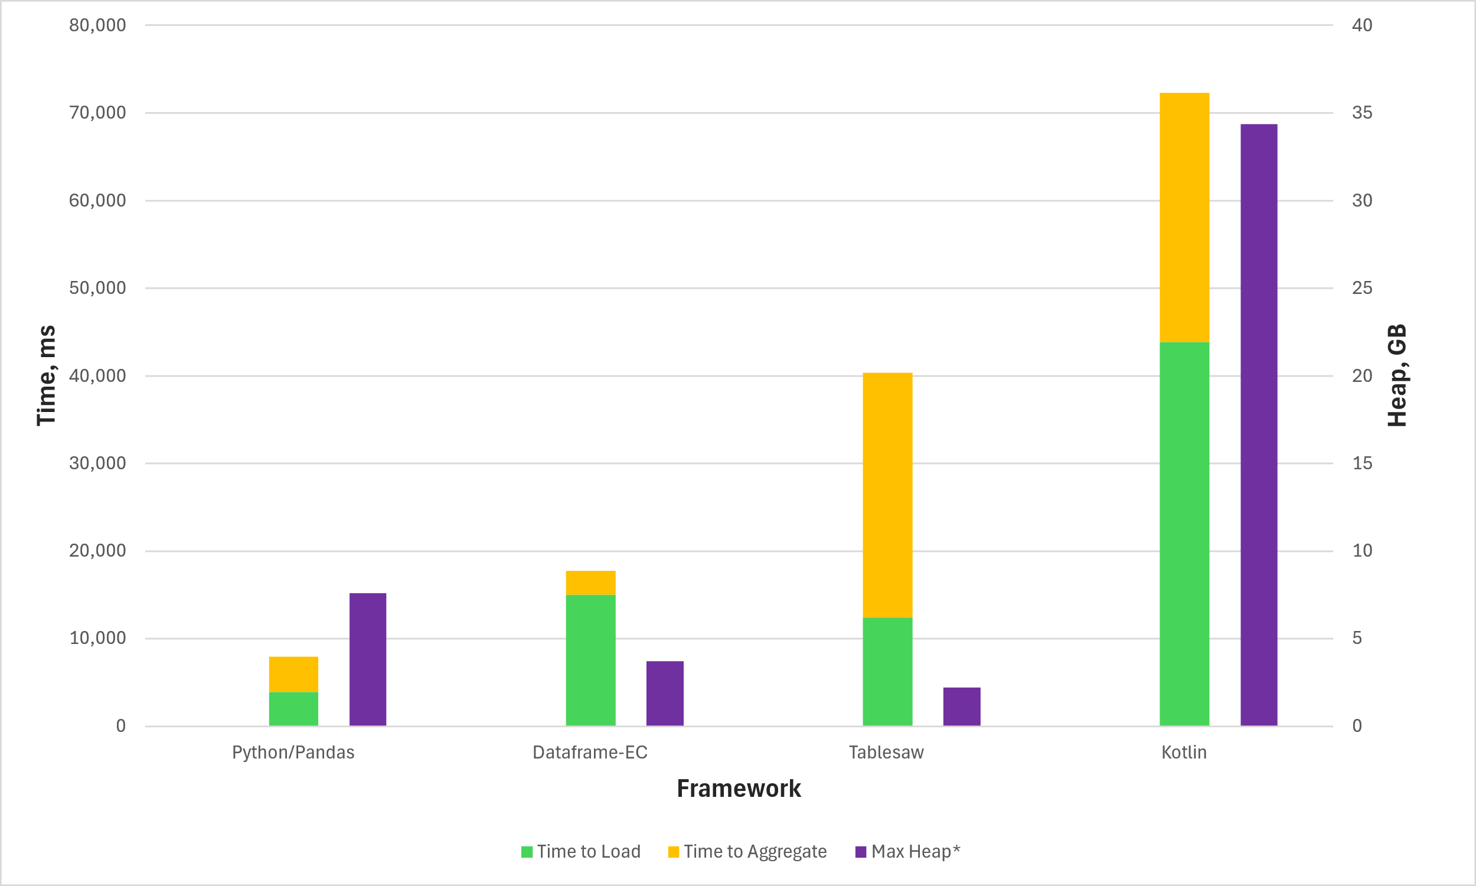
Performance: 100MRC

Slide 27
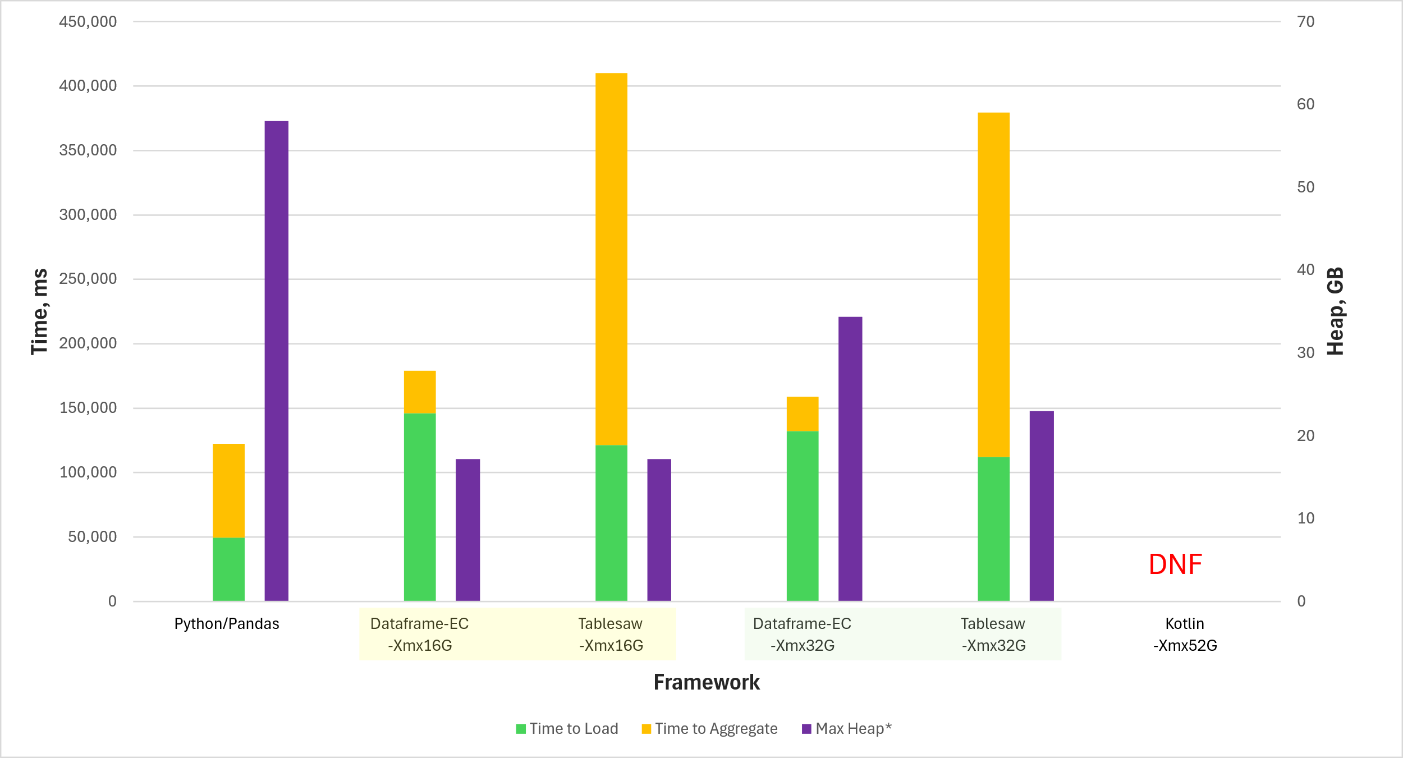
Performance: 1BRC

Slide 28
About dataframe-ec
Intuitive, simple grammar for the expression DSL used for computed columns, filters, etc.
Ability to add the expression DSL functions and aggregation functions without touching the core framework
Dealing with nulls: acceptance, high tolerance, flexibility
Built on the Eclipse Collections framework (the “-ec” in the name)
Memory efficient (for practical use cases)
Uses highly memory efficient Eclipse Collections
Takes advantage of its support for primitive types
Inspired by Eclipse Collections APIs
Exposes Eclipse Collections types in its APIs

Slide 29
Eclipse Collections – What Is It Good For?
Rich functional API with good symmetry (productivity) ✓
Memory Efficiency (performance) ✓
Optimized Eager API (performance) ✓
Primitive Collections (productivity + performance) ✓
Immutable Collections (safety + performance) ✓
Lazy and Parallel Lazy API (performance) ✓
Multimap, Bag, BiMap, Pool, Interval (productivity + type safety) ✓
Hashing Strategy Data Structures (productivity + performance)
Multi-reader data structures (safety + performance)
Mutable and Immutable Collection Factories (productivity) ✓

Slide 30
Solid Foundation: Eclipse Collections Types
…the foundation, and walls, and joints, and studs, and…
DataFrame
Customer | Delivery Date | Donut | Quantity | Order Price
Alice | 7/10/2024 | Old Fashioned | 12 | 10.80
Alice | 7/10/2024 | Blueberry | 2 | 2.50
Bob | 7/10/2024 | Old Fashioned | 12 | null
Alice | 7/11/2024 | Apple Cider | 12 | 15.00
Alice | 7/11/2024 | Blueberry | 2 | 2.50
Carol | 7/11/2024 | Old Fashioned | 12 | 10.80
Dave | 7/12/2024 | Old Fashioned | 12 | 10.80
Alice | 7/12/2024 | Jelly | 12 | 15.00
Carol | 7/12/2024 | Blueberry | 2 | null
Bob | 7/12/2024 | Pumpkin Spice | null | 0.75

Slide 31
Solid Foundation: Eclipse Collections Types
…the foundation, and walls, and joints, and studs, and…
DataFrame
MutableBooleanList bitmap
Customer | Delivery Date | Donut | Quantity | Order Price
Alice | 7/10/2024 | Old Fashioned
Alice | 7/10/2024 | Blueberry
Bob | 7/10/2024 | Old Fashioned
Alice | 7/11/2024 | Apple Cider
Alice | 7/11/2024 | Blueberry
Carol | 7/11/2024 | Old Fashioned
Dave | 7/12/2024 | Old Fashioned
Alice | 7/12/2024 | Jelly
Carol | 7/12/2024 | Blueberry
Bob | 7/12/2024 | Pumpkin Spice
12
2
12
12
2
12
12
12
2
-
0
0
0
0
0
0
0
0
0
1
10.80
2.50
NaN
15.00
2.50
10.80
10.80
15.00
NaN
0.75
1
1
0
1
1
0
0
1
0
0
MutableMap< ListIterable<Object>, MutableIntList> rowIndexByKey
Alice
Bob
Carol
Dave
[“Alice”] | [0, 1, 3, 4, 7]
[“Bob”] | [2, 9]
[“Carol”] | [5, 8]
[“Dave”] | [6]
Pool<String> pool
MutableIntList values
MutableBooleanList nullMap
MutableDoubleList values

Slide 32
Solid Inspiration: Eclipse Collections APIs
Eclipse Collections Patterns
DataFrame-EC Patterns
this.donutOrders.partition(
order -> simpleOrder.quantity < 12
)
this.donutOrders.distinct( HashingStrategies.fromFunctions(
Order::customer, Order::deliveryDate
)
);
this.donutOrders.select(
order -> order.customer().equals("Carol")
)
this.donutOrders.sortThis(Comparator
.comparing(Order::customer)
.thenComparingDouble(Order::orderPrice) );
this.donutOrders.partition("Quantity < 12")
this.donutOrders.distinct(
Lists.immutable.of("Customer", "DeliveryDate")
)
this.donutOrders.selectBy("Customer == 'Carol'")
this.donutOrders.sortBy(
Lists.immutable.of("Customer", "OrderPrice")
)

Slide 33
Donut Store Example: Data
Customers
Orders
Name | Street | City | State
Alice | 902 S Pacific St | Las Vegas | NM
Bob | 405 Main St | Dallas | SD
Carol | 12300 State St | Atlanta | MI
Dave | 102 S Main St | Phoenix | OR
Customer | DeliveryDate | Donut | Quantity
Alice | 2024-05-12 | Old Fashioned | 12
Alice | 2024-05-12 | Blueberry | 2
Bob | 2024-05-12 | Old Fashioned | 12
Alice | 2024-05-13 | Apple Cider | 12
Alice | 2024-05-13 | Blueberry | 2
Carol | 2024-05-13 | Old Fashioned | 12
Dave | 2024-05-14 | Old Fashioned | 12
Alice | 2024-05-14 | Jelly | 12
Carol | 2024-05-14 | Blueberry | 2
Bob | 2024-05-14 | Pumpkin Spice | 1
Menu
Donut | Price | DiscountPrice
Blueberry | $1.25 | $1.00
Old Fashioned | $1.00 | $0.90
Pumpkin Spice | $0.75 | $0.65
Jelly | $1.50 | $1.25
Apple Cider | $1.50 | $1.25

Slide 34
Donut Store Example: Use Cases
List Donuts in the Popularity Order
Priority Orders for Tomorrow:
Large orders (Quantity >= 12) or Bob’s orders
Total Spend per Customer
Donut Count per Customer per Day

Slide 35
List Donuts in Popularity Order
DataFrame-EC
Donut | Quantity
Old Fashioned | 48
Blueberry | 6
Apple Cider | 12
Jelly | 12
Pumpkin Spice | 1
DataFrame donutsInPopularityOrder = this.orders .aggregateBy( Lists.immutable.of(sum("Quantity")), Lists.immutable.of("Donut")) .sortBy(
Lists.immutable.of("Quantity", "Donut"),
Lists.immutable.of(DESC, ASC)) .keepColumns(Lists.immutable.of("Donut"));
Donut | Quantity
Old Fashioned | 48
Apple Cider | 12
Jelly | 12
Blueberry | 6
Pumpkin Spice | 1
Donut
Old Fashioned
Apple Cider
Jelly
Blueberry
Pumpkin Spice

Slide 36
List Donuts in Popularity Order
Tablesaw
Donut | Sum [Quantity]
Old Fashioned | 48
Blueberry | 6
Apple Cider | 12
Jelly | 12
Pumpkin Spice | 1
Table donutsInPopularityOrder = this.orders .summarize("Quantity", sum) .by("Donut") .sortOn("-Sum [Quantity]", "Donut") .retainColumns("Donut");
Donut | Sum [Quantity]
Old Fashioned | 48
Apple Cider | 12
Jelly | 12
Blueberry | 6
Pumpkin Spice | 1
Donut
Old Fashioned
Apple Cider
Jelly
Blueberry
Pumpkin Spice

Slide 37
Priority Orders for Tomorrow
DataFrame-EC
DataFrame priorityOrdersTomorrow = this.orders .selectBy(
"DeliveryDate == toDate('%s') and (Quantity >= 12 or Customer == 'Bob')"
.formatted(TOMORROW) );
Customer | DeliveryDate | Donut | Quantity
Dave | 2024-05-14 | Old Fashioned | 12
Alice | 2024-05-14 | Jelly | 12
Bob | 2024-05-14 | Pumpkin Spice | 1

Slide 38
Priority Orders for Tomorrow
Tablesaw
Table priorityOrdersTomorrow = this.orders.where( and( t -> t.dateColumn("DeliveryDate").isEqualTo(TOMORROW), or( t -> t.longColumn("Quantity").isGreaterThanOrEqualTo(12), t -> t.stringColumn("Customer").isEqualTo("Bob") ) ) );
Customer | DeliveryDate | Donut | Quantity
Dave | 2024-05-14 | Old Fashioned | 12
Alice | 2024-05-14 | Jelly | 12
Bob | 2024-05-14 | Pumpkin Spice | 1

Slide 39
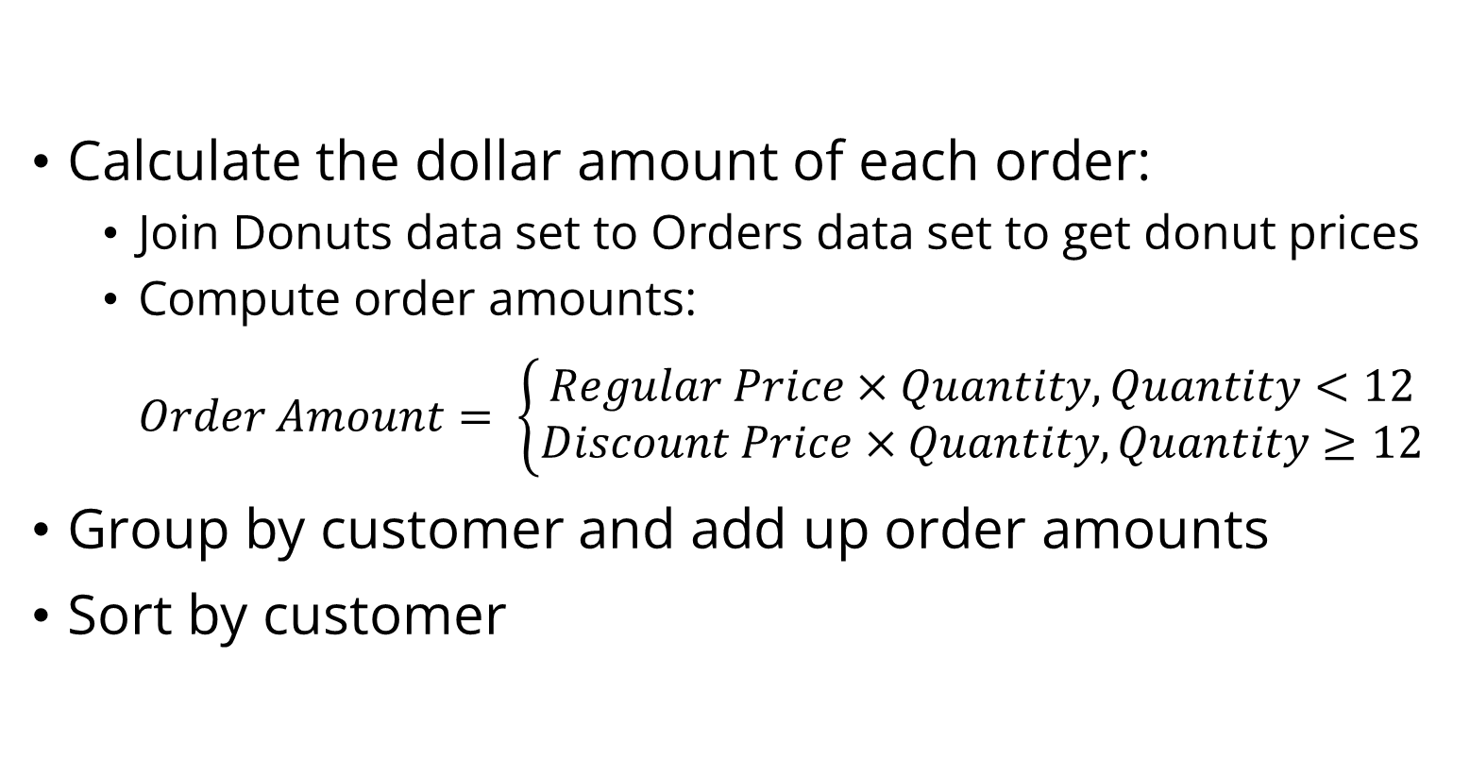
Total Spend per Customer: Steps
Calculate the dollar amount of each order:
Join Donuts data set to Orders data set to get donut prices
Compute order amounts: $Order Amount= \left\{\begin{aligned}Regular Price×Quantity, Quantity<12 \\ Discount Price×Quantity, Quantity≥12\end{aligned}\right.$
Group by customer and add up order amounts
Sort by customer

Slide 40
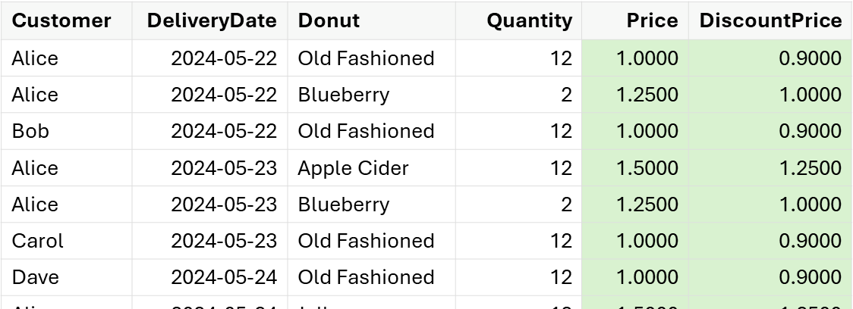
Total Spend per Customer
Join order and donut data sets
this.orders.lookupIn(this.menu) .match("Donut", "Donut") .select(Lists.immutable.of("Price", "DiscountPrice")) .resolveLookup();
Table ordersWithPrices = this.orders .joinOn("Donut") .inner(this.menu);

Slide 41
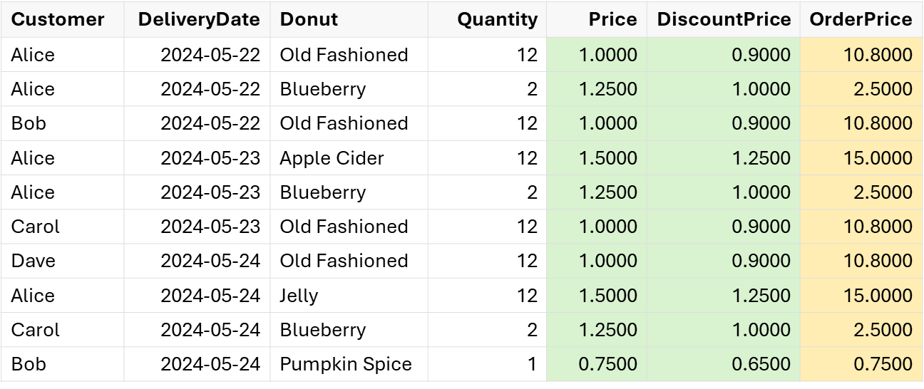
Total Spend per Customer
Add Order Price column (DataFrame-EC)
this.orders.addColumn(
"OrderPrice",
"(Quantity < 12 ? Price : DiscountPrice) * Quantity");

Slide 42
Total Spend per Customer
Add Order Price column (Tablesaw, Option 1)
DoubleColumn orderPrice = DoubleColumn.create("OrderPrice"); ordersWithPrices.addColumns(orderPrice); LongColumn quantity = ordersWithPrices.longColumn("Quantity");
orderPrice.set(quantity.isLessThan(12), ordersWithPrices.doubleColumn("Price").multiply(quantity) );
orderPrice.set(quantity.isGreaterThanOrEqualTo(12),
ordersWithPrices.doubleColumn("DiscountPrice").multiply(quantity) );

Slide 43
Total Spend per Customer
Add Order Price column (Tablesaw, Option 2)
DoubleColumn orderPrice = DoubleColumn.create("OrderPrice"); ordersWithPrices.forEach( row -> { long quantity = row.getLong("Quantity"); orderPrice.append( quantity < 12 ? quantity * row.getDouble("Price") : quantity * row.getDouble("DiscountPrice") ); } ); ordersWithPrices.addColumns(orderPrice);

Slide 44
Total Spend per Customer
Aggregate and sort
DataFrame spendPerCustomer = this.orders .aggregateBy( Lists.immutable.of(sum("OrderPrice", "Total Spend")), Lists.immutable.of("Customer")) .sortBy(Lists.immutable.of("Customer"));
Customer | Total Spend
Alice | 45.8000
Bob | 11.5500
Carol | 13.3000
Dave | 10.8000
Table spendPerCustomer = ordersWithPrices .summarize("OrderPrice", sum) .by("Customer") .sortOn("Customer");
Customer | Sum [OrderPrice]
Alice | 45.8000
Bob | 11.5500
Carol | 13.3000
Dave | 10.8000

Slide 45
Donut Count per Customer per Day
DataFrame donutsPerCustomerPerDay =
this.orders.pivot( Lists.immutable.of("Customer"), "DeliveryDate", Lists.immutable.of(sum("Quantity")) );
Table donutsPerCustomerPerDay =
this.orders.pivot(
"Customer",
"DeliveryDate",
"Quantity", sum
);
Customer | 2024-05-23 | 2024-05-24 | 2024-05-25
Alice | 14 | 14 | 12
Bob | 12 | 0 | 1
Carol | 0 | 12 | 2
Dave | 0 | 0 | 12
Customer | 2024-05-23 | 2024-05-24 | 2024-05-25
Alice | 14 | 14 | 12
Bob | 12 |  | 1
Carol |  | 12 | 2
Dave |  |  | 12

Slide 46
Takeaways
Java data frames are a useful addition to your data manipulation toolkit
Work well with Data-Oriented Programming Paradigm
Make filtering, aggregation, transformation, enrichment easy!
Data frames vs databases
A lot of data is not in databases or not in a single database
Database is not necessary, or not available, or gets in the way
Compare efficiency and performance
Common Scenarios
Ad hoc manipulation of tabular data
The types of things you might want to use Excel for
Programmatically transforming, querying, analyzing data in your application
Maybe you don’t need that Spark cluster after all
Data Science – notebooks and visualization

Slide 47



The Last Slide
This Talk + Sources
https://github.com/vmzakharov/missing-dataframe-talk
Dataframe-EC
https://github.com/vmzakharov/dataframe-ec
Eclipse Collections
https://github.com/eclipse/eclipse-collections
Other Java Dataframe Libraries
Tablesaw | https://github.com/jtablesaw/tablesaw
DFLib | https://github.com/dflib/dflib

Slide 48
Appendix
Donut Store Examples: Kotlin

Slide 49
List Donuts in Popularity Order
Kotlin
Donut | Quantity
Old Fashioned | 48
Blueberry | 6
Apple Cider | 12
Jelly | 12
Pumpkin Spice | 1
val donutsInPopularityOrder = this.orders .groupBy("Donut") .sum("Quantity") .sortBy { it["Quantity"].desc() and it["Donut"] } .select("Donut")
Donut | Quantity
Old Fashioned | 48
Apple Cider | 12
Jelly | 12
Blueberry | 6
Pumpkin Spice | 1
Donut
Old Fashioned
Apple Cider
Jelly
Blueberry
Pumpkin Spice

Slide 50
Priority Orders for Tomorrow
Kotlin
val priorityOrdersTomorrow = orders.filter { ("DeliveryDate"<LocalDate>() == TOMORROW)
&&
("Quantity"<Int>() >= 12 || "Customer"<String>() == "Bob") }
Customer | DeliveryDate | Donut | Quantity
Dave | 2024-05-14 | Old Fashioned | 12
Alice | 2024-05-14 | Jelly | 12
Bob | 2024-05-14 | Pumpkin Spice | 1

Slide 51
Total Spend per Customer
Kotlin
val spendPerCustomer = orders .join(menu, "Donut") .add("OrderPrice") { (if ("Quantity"<Int>() < 12) "Price"<Double>()
else "DiscountPrice"<Double>()) * "Quantity"<Int>() } .select("Customer", "OrderPrice") .groupBy("Customer") .sum {"OrderPrice"<Double>() named "Total Spend"}
Customer | Total Spend
Alice | 45.8000
Bob | 11.5500
Carol | 13.3000
Dave | 10.8000

Slide 52
Donut Count per Customer per Day
Kotlin
val donutsPerCustomerPerDay = orders .pivot("DeliveryDate", inward = false) .groupBy("Customer") .aggregate { sum("Quantity") }
Customer | 2024-05-23 | 2024-05-24 | 2024-05-25
Alice | 14 | 14 | 12
Bob | 12 | null | 1
Carol | null | 12 | 2
Dave | null | null | 12

