Slide 1
Are You Missing a DataFrame?
The Power of Data Frames in Java

Slide 2

Data-Oriented Programming
Data-oriented programming encourages us to model data as (immutable) data, and keep the code that embodies the business logic of how we act on that data separately.
— Brian Goetz “Data Oriented Programming in Java” https://www.infoq.com/articles/data-oriented-programming-java/
See also the article series by Nicolai Parlog: https://inside.java/2024/05/23/dop-v1-1-introduction/

Slide 3
Data-Oriented vs. Object-Oriented
Data/State
Take my state. Please. Just data – as records, tables, collections Data is immutable | Protect your privates Everything is awesome encapsulated There is no spoon state
Operations
Standalone functions operating on data | Objects responding to messages Polymorphism (allows objects of different types to respond to the same message)
What Is It Good For?
Experimentation, exploration, ad hoc calculations Simple functions operating on simple data Separating business logic from data Flexible data models | Managing complexity of structure and behavior Separation of concerns Taking advantage of OO language features Applying OO modeling techniques

Slide 4
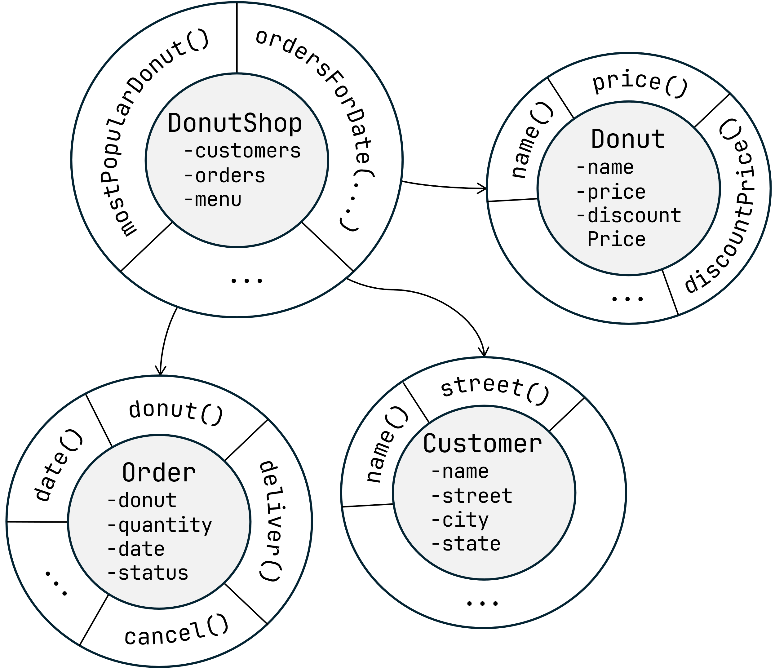
Object Oriented vs. Data Oriented Donuts
Customers
Name | Street | City | State
Alice | 902 S Pacific St | Las Vegas | NM
Bob | 405 Main St | Dallas | SD
Carol | 12300 State St | Atlanta | MI
Menu
VS.
Donut | Price | Discount Price
Old Fashioned | $1.25 | $1.00
Blueberry | $1.50 | $1.25
Apple Cider | $1.00 | $0.90
Orders
Client | Donut | Quantity | Date
Alice | Old Fashioned | 12 | 2024-10-10
Bob | Blueberry | 6 | 2024-10-11
Carol | Apple Cider | 6 | 2024-10-11
Alice | Old Fashioned | 4 | 2024-10-12

Slide 5
Object Oriented vs. Data Oriented Donuts
Customers
public List<Donut>
topThreeBestSellers(List<Order> orders) { return orders.stream() .collect( Collectors.groupingBy( Order::donut, Collectors.summingInt(Order::quantity)) ) .entrySet() .stream() .sorted(
Map.Entry.<Donut, Integer>comparingByValue()
.reversed()
) .limit(3) .map(Map.Entry::getKey) .toList(); }
Name | Street | City | State
Alice | 902 S Pacific St | Las Vegas | NM
Bob | 405 Main St | Dallas | SD
Carol | 12300 State St | Atlanta | MI
Menu
VS.
Donut | Price | Discount Price
Old Fashioned | $1.25 | $1.00
Blueberry | $1.50 | $1.25
Apple Cider | $1.00 | $0.90
Orders
Client | Donut | Quantity | Date
Alice | Old Fashioned | 12 | 2024-10-10
Bob | Blueberry | 6 | 2024-10-11
Carol | Apple Cider | 6 | 2024-10-11
Alice | Old Fashioned | 4 | 2024-10-12

Slide 6
Data Oriented Programming in Java
Records, sealed classes, and pattern matching
Records model data aggregates
Records take advantage of static typing
Sealed classes – prevent illegal states
instanceof pattern matching, switch pattern matching
Collections/streams/maps
Record drawbacks
Memory overhead (object header + object alignment, using JOL):
Customer – 16 bytes, Donut – 12 bytes, Order – 16 bytes
Record/stream code readability is not always amazing
Brittle-ish when it comes to refactoring
Map Oriented Programming [in movie quotes]
Memory overhead – “It's large. Large. Large. So large”
Readability and maintainability – “The horror... the horror...”

Slide 7
What Is a DataFrame?
A tabular data set that can be manipulated programmatically
Made up of columns of different types, similar to a relational table
Can be created
from tabular data
a csv file
a database result set
anything else that looks like a table
anything that can be made look like a table (e.g., a projection of an object graph )
programmatically
by specifying its values
by transforming the existing data frames

Slide 8
Why Is a DataFrame?
Provides the ability to group data and easily transform and organize data in our code
Provides the benefits of developer efficiency, flexibility, and code readability
Leverages the efficiency of collection frameworks
Can offer memory savings and better performance than the alternative approaches
Is used in real-world scenarios
data transformation
data enrichment
data validation/data quality
reconciliation

Slide 9

The One Billion Row Challenge (1BRC)
Your mission, should you decide to accept it, is deceptively simple: write a Java program for retrieving temperature measurement values from a text file and calculating the min, mean, and max temperature per weather station. There’s just one caveat: the file has 1,000,000,000 rows!
— Gunnar Morling (@gunnarmorling) "The One Billion Row Challenge"
Announcement | https://www.morling.dev/blog/one-billion-row-challenge/
Details and Results | https://github.com/gunnarmorling/1brc
A classic Data-Oriented Programming problem!

Slide 10
1BRC Results
Pretty amazing!
Top 3 results: 1.535, 1.587, and 1.608 seconds
Reference environment: 8 cores, 128 GB RAM
Most submissions
Are many hundreds of lines of (well formatted and well factored) code
Use Vector API, low level APIs, the latest language features, the latest JVM features, and dark magic
Require intimate understanding of the JVM and the compiler behavior from the developers
Took a good amount of the developer’s time (spent both writing and reading the code).
Do not make it obvious how the algorithms work/what exactly they do due to the solution complexity
This makes sense in the context of 1BRC and doesn’t make these solutions “bad code”.
Achieving absolute peak performance demands the above “sacrifices”.
Notes:
Developers have to be top experts in JVM and the compiler behavior from the developer

Slide 11
1BRC – But Optimized for Developers
What if?
instead of optimizing for peak performance we optimized for
The cycles spent developing, understanding, and maintaining this code by humans matter more than achieving the absolute minimum of CPU cycles
Deliver a working solution quickly and then optimize it if and when needed
code readability
software maintainability
developer time/effort
New requirements!
Enter DataFrame

Slide 12
1BRC With Toy Data
measurements.txt
New York City;34.1
New York City;24.3
San Francisco;22.9
Istanbul;5.9
New York City;-2.7
Istanbul;15.0
San Francisco;-5.4
Istanbul;13.2
San Francisco;35.0
Tauranga;17.4
Steps
Load the data from the file.
Perform aggregation and sorting.
Show results on the console.

Slide 13

1BRC with Dataframe-EC: Load
CsvSchema msSchema = new CsvSchema() .addColumn("Station", STRING) .addColumn("Temperature", FLOAT) .separator(';') .hasHeaderLine(false); URI measurementFile = CalculateAverage.class.getClassLoader()
.getResource(MEASUREMENT_FILE).toURI();
CsvDataSet msDataSet = new CsvDataSet(
Path.of(measurementFile), "measurements", msSchema); DataFrame measurements = msDataSet.loadAsDataFrame();
Station | Temperature
New York City | 34.1
New York City | 24.3
San Francisco | 22.9
Istanbul | 5.9
New York City | -2.7
Istanbul | 15
San Francisco | -5.4
Istanbul | 13.2
San Francisco | 35
Tauranga | 17.4

Slide 14
1BRC with Dataframe-EC: Process
Station | Min | Mean | Max
New York City | -2.7 | 18.56667 | 34.1
San Francisco | -5.4 | 17.5 | 35
Istanbul | 5.9 | 11.36667 | 15
Tauranga | 17.4 | 17.4 | 17.4
DataFrame aggregated = measurements .aggregateBy( Lists.immutable.of(
min("Temperature", "Min"),
avg2d("Temperature", "Mean"),
max("Temperature", "Max")
), Lists.immutable.of("Station")
) .sortBy(Lists.immutable.of("Station"));
Station | Min | Mean | Max
Istanbul | 5.9 | 11.36667 | 15
New York City | -2.7 | 18.56667 | 34.1
San Francisco | -5.4 | 17.5 | 35
Tauranga | 17.4 | 17.4 | 17.4

Slide 15
1BRC with Dataframe-EC: Output
aggregated.forEach(row -> System.out.printf( "%s=%2.1f/%2.1f/%2.1f\n", row.getString("Station"),
row.getFloat("Min"),
row.getDouble("Mean"),
row.getFloat("Max"))
);
Istanbul=5.9/11.4/15.0
New York City=-2.7/18.6/34.1
San Francisco=-5.4/17.5/35.0
Tauranga=17.4/17.4/17.4

Slide 16

1BRC with Tablesaw: Load
URL measurementFile = CalculateAverage.class.getClassLoader()
.getResource(MEASUREMENT_FILE); CsvReadOptions options = CsvReadOptions .builder(measurementFile) .columnTypes(new ColumnType[] {STRING, FLOAT}) .separator(';') .header(false) .build(); Table measurements = Table.read().usingOptions(options);
measurements.column(0).setName("Station"); measurements.column(1).setName("Temperature");
Station | Temperature
New York City | 34.1
New York City | 24.3
San Francisco | 22.9
Istanbul | 5.9
New York City | -2.7
Istanbul | 15
San Francisco | -5.4
Istanbul | 13.2
San Francisco | 35
Tauranga | 17.4

Slide 17
1BRC with Tablesaw: Process
Table aggregated = measurements .summarize("Temperature", min, mean, max)
.by("Station") .sortOn("Station");
Station | Min [Temperature] | Mean [Temperature] | Max [Temperature]
New York City | -2.70000 | 18.56667 | 34.10000
San Francisco | -5.40000 | 17.50000 | 35
Istanbul | 5.90000 | 11.36667 | 15
Tauranga | 17.40000 | 17.40000 | 17.40000
Station | Min [Temperature] | Mean [Temperature] | Max [Temperature]
Istanbul | 5.90000 | 11.36667 | 15
New York City | -2.70000 | 18.56667 | 34.10000
San Francisco | -5.40000 | 17.50000 | 35
Tauranga | 17.40000 | 17.40000 | 17.40000

Slide 18
1BRC with Tablesaw: Output
aggregated.forEach(row -> System.out.printf( "%s=%2.1f/%2.1f/%2.1f\n", row.getString("Station"), row.getDouble("Min [Temperature]"), row.getDouble("Mean [Temperature]"), row.getDouble("Max [Temperature]")) );
Istanbul=5.9/11.4/15.0
New York City=-2.7/18.6/34.1
San Francisco=-5.4/17.5/35.0
Tauranga=17.4/17.4/17.4

Slide 19
About dataframe-ec
Based on the Eclipse Collections framework (the “-ec” in the name)
Memory efficient (for practical use cases)
Uses highly memory efficient Eclipse Collections
Takes advantage of its support for primitive types
Inspired by Eclipse Collections APIs
Exposes Eclipse Collections types in its APIs
Intuitive, humane grammar for the expression DSL used for computed columns, filters, etc.
e.g., adding two numbers is expressed as “A + B”, as opposed to an internal DSL where you assemble an expression from Java method calls
Ability to add the expression DSL functions and aggregation functions without touching the core framework

Slide 20
Donut Store Example: Data
Customers
Orders
Name | Street | City | State
Alice | 902 S Pacific St | Las Vegas | NM
Bob | 405 Main St | Dallas | SD
Carol | 12300 State St | Atlanta | MI
Dave | 102 S Main St | Phoenix | OR
Customer | DeliveryDate | Donut | Quantity
Alice | 2024-05-12 | Old Fashioned | 12
Alice | 2024-05-12 | Blueberry | 2
Bob | 2024-05-12 | Old Fashioned | 12
Alice | 2024-05-13 | Apple Cider | 12
Alice | 2024-05-13 | Blueberry | 2
Carol | 2024-05-13 | Old Fashioned | 12
Dave | 2024-05-14 | Old Fashioned | 12
Alice | 2024-05-14 | Jelly | 12
Carol | 2024-05-14 | Blueberry | 2
Bob | 2024-05-14 | Pumpkin Spice | 1
Menu
Donut | Price | Price/Dozen
Blueberry | $1.25 | $1.00
Old Fashioned | $1.00 | $0.90
Pumpkin Spice | $0.75 | $0.65
Jelly | $1.50 | $1.25
Apple Cider | $1.50 | $1.25

Slide 21
Donut Store Example: Use Cases
List Donuts in the Popularity Order
Priority Orders for Tomorrow:
Large orders (Quantity >= 12) or
Bob’s orders
Total Spend per Customer
Donut Count per Customer Per Day

Slide 22
List Donuts in Popularity Order
DataFrame-EC
Donut | Quantity
Old Fashioned | 48
Blueberry | 6
Apple Cider | 12
Jelly | 12
Pumpkin Spice | 1
DataFrame donutsInPopularityOrder = this.orders .aggregateBy( Lists.immutable.of(sum("Quantity")), Lists.immutable.of("Donut")) .sortBy(
Lists.immutable.of("Quantity", "Donut"),
Lists.immutable.of(DESC, ASC)) .keepColumns(Lists.immutable.of("Donut"));
Donut | Quantity
Old Fashioned | 48
Apple Cider | 12
Jelly | 12
Blueberry | 12
Pumpkin Spice | 1
Donut
Old Fashioned
Apple Cider
Jelly
Blueberry
Pumpkin Spice

Slide 23
List Donuts in Popularity Order
Tablesaw
Donut | Sum [Quantity]
Old Fashioned | 48
Blueberry | 6
Apple Cider | 12
Jelly | 12
Pumpkin Spice | 1
Table donutsInPopularityOrder = this.orders .summarize("Quantity", sum) .by("Donut") .sortOn("-Sum [Quantity]", "Donut") .retainColumns("Donut");
Donut | Sum [Quantity]
Old Fashioned | 48
Apple Cider | 12
Jelly | 12
Blueberry | 6
Pumpkin Spice | 1
Donut
Old Fashioned
Apple Cider
Jelly
Blueberry
Pumpkin Spice

Slide 24
Priority Orders for Tomorrow
DataFrame-EC
DataFrame priorityOrdersTomorrow = this.orders .selectBy(
"DeliveryDate == toDate('%s') and (Quantity >= 12 or Customer == 'Bob')"
.formatted(TOMORROW) );
Customer | DeliveryDate | Donut | Quantity
Dave | 2024-05-14 | Old Fashioned | 12
Alice | 2024-05-14 | Jelly | 12
Bob | 2024-05-14 | Pumpkin Spice | 1

Slide 25
Priority Orders for Tomorrow
Tablesaw
Table priorityOrdersTomorrow = this.orders.where( and( t -> t.dateColumn("DeliveryDate").isEqualTo(TOMORROW), or( t -> t.longColumn("Quantity").isGreaterThanOrEqualTo(12), t -> t.stringColumn("Customer").isEqualTo("Bob") ) ) );
Customer | DeliveryDate | Donut | Quantity
Dave | 2024-05-14 | Old Fashioned | 12
Alice | 2024-05-14 | Jelly | 12
Bob | 2024-05-14 | Pumpkin Spice | 1

Slide 26
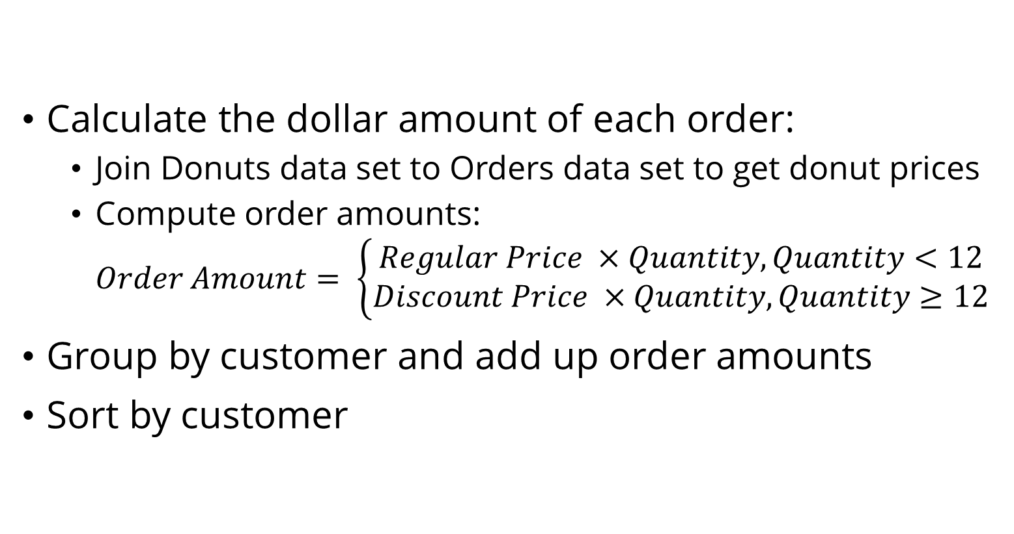
Total Spend Per Customer: Steps
Calculate the dollar amount of each order:
Join Donuts data set to Orders data set to get donut prices
Compute order amounts: $Order Amount= \left\{\begin{aligned}Regular Price ×Quantity, Quantity<12 \\ Discount Price ×Quantity, Quantity≥12\end{aligned}\right.$
Group by customer and add up order amounts
Sort by customer

Slide 27
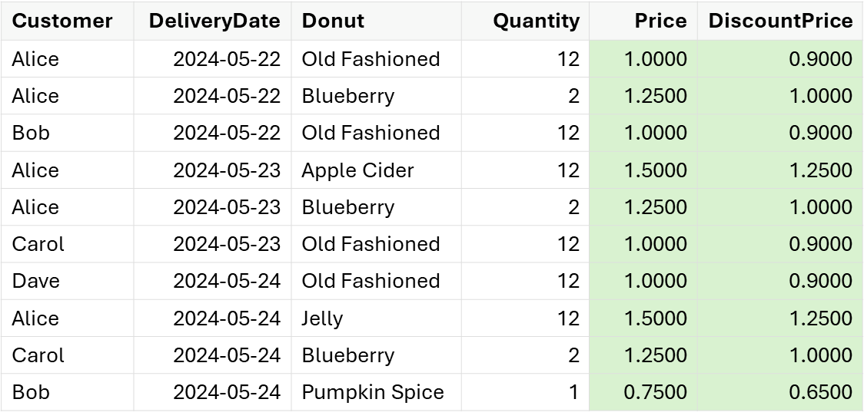
Total Spend Per Customer
Join order and donut data sets
this.orders.lookupIn(this.menu) .match("Donut", "Donut") .select(Lists.immutable.of("Price", "DiscountPrice")) .resolveLookup();
Table ordersWithPrices = this.orders .joinOn("Donut") .inner(this.menu);

Slide 28
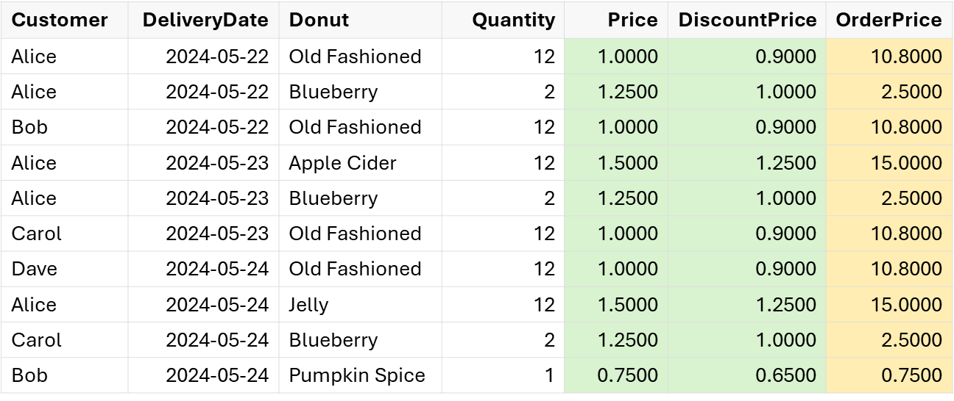
Total Spend Per Customer
Add Order Price column (DataFrame-EC)
this.orders.addColumn(
"OrderPrice",
"(Quantity < 12 ? Price : DiscountPrice) * Quantity");

Slide 29
Total Spend Per Customer
Add Order Price column (Tablesaw, Option 1)
DoubleColumn orderPrice = DoubleColumn.create("OrderPrice"); ordersWithPrices.addColumns(orderPrice); LongColumn quantity = ordersWithPrices.longColumn("Quantity");
orderPrice.set(quantity.isLessThan(12), ordersWithPrices.doubleColumn("Price").multiply(quantity) );
orderPrice.set(quantity.isGreaterThanOrEqualTo(12),
ordersWithPrices.doubleColumn("DiscountPrice").multiply(quantity) );

Slide 30
Total Spend Per Customer
Add Order Price column (Tablesaw, Option 2)
DoubleColumn orderPrice = DoubleColumn.create("OrderPrice"); ordersWithPrices.forEach( row -> { long quantity = row.getLong("Quantity"); orderPrice.append( quantity < 12 ? quantity * row.getDouble("Price") : quantity * row.getDouble("DiscountPrice") ); } ); ordersWithPrices.addColumns(orderPrice);

Slide 31
Total Spend Per Customer
Aggregate and sort
DataFrame spendPerCustomer = this.orders .aggregateBy( Lists.immutable.of(sum("OrderPrice", "Total Spend")), Lists.immutable.of("Customer")) .sortBy(Lists.immutable.of("Customer"));
Customer | Total Spend
Alice | 45.8000
Bob | 11.5500
Carol | 13.3000
Dave | 10.8000
Table spendPerCustomer = ordersWithPrices .summarize("OrderPrice", sum) .by("Customer") .sortOn("Customer");
Customer | Sum [OrderPrice]
Alice | 45.8000
Bob | 11.5500
Carol | 13.3000
Dave | 10.8000

Slide 32
Donut Count Per Customer Per Day
DataFrame-EC & Tablesaw
DataFrame donutsPerCustomerPerDay =
this.orders.pivot( Lists.immutable.of("Customer"), "DeliveryDate", Lists.immutable.of(sum("Quantity")) );
Table donutsPerCustomerPerDay =
this.orders.pivot(
"Customer",
"DeliveryDate",
"Quantity", sum
);
Customer | 2024-05-23 | 2024-05-24 | 2024-05-25
Alice | 14 | 14 | 12
Bob | 12 | 0 | 1
Carol | 0 | 12 | 2
Dave | 0 | 0 | 12
Customer | 2024-05-23 | 2024-05-24 | 2024-05-25
Alice | 14 | 14 | 12
Bob | 12 |  | 1
Carol |  | 12 | 2
Dave |  |  | 12

Slide 33
The Last Slide
Java data frames are a useful addition to your data manipulation toolkit
Support the Data-Oriented Programming Paradigm
Make it easy to do things like filtering, aggregation, transformation, enrichment
Ad hoc manipulation of tabular data
The types of things you might want to use Excel tables for
Programmatically transforming, querying, analyzing data in your application
Maybe you don’t need that Spark cluster after all
Data Science – notebooks and visualization [some of frameworks]
The this here code | https://github.com/
Dataframe-EC | https://github.com/vmzakharov/dataframe-ec
Tablesaw | https://github.com/jtablesaw/tablesaw
DFLib | https://github.com/dflib/dflib

Slide 34
Scratchpad

Slide 35
Data
ordersForDate(...)
mostPopularDonuts()
Data
DonutShop
-customers
-orders
-menu
name()
price()
Donut
-name
-price
-discount Price
discountPrice()
...
...
Data
Data
name()
street()
donut()
Customer
-name
-street
-city
-state
date()
Order
-donut
-quantity
-date
-status
deliver()
...
cancel()
...

Slide 36
WOULD YOU LIKE TO KNOW MORE?

Slide 37
Customer | DeliveryDate | Donut | Quantity | Price | DiscountPrice | OrderPrice
Alice | 2024-05-22 | Old Fashioned | 12 | 1.0000 | 0.9000 | 10.8000
Alice | 2024-05-22 | Blueberry | 2 | 1.2500 | 1.0000 | 2.5000
Bob | 2024-05-22 | Old Fashioned | 12 | 1.0000 | 0.9000 | 10.8000
Alice | 2024-05-23 | Apple Cider | 12 | 1.5000 | 1.2500 | 15.0000
Alice | 2024-05-23 | Blueberry | 2 | 1.2500 | 1.0000 | 2.5000
Carol | 2024-05-23 | Old Fashioned | 12 | 1.0000 | 0.9000 | 10.8000
Dave | 2024-05-24 | Old Fashioned | 12 | 1.0000 | 0.9000 | 10.8000
Alice | 2024-05-24 | Jelly | 12 | 1.5000 | 1.2500 | 15.0000
Carol | 2024-05-24 | Blueberry | 2 | 1.2500 | 1.0000 | 2.5000
Bob | 2024-05-24 | Pumpkin Spice | 1 | 0.7500 | 0.6500 | 0.7500

Slide 38
Customer | DeliveryDate | Donut | Quantity | Price | DiscountPrice
Alice | 2024-05-22 | Old Fashioned | 12 | 1.0000 | 0.9000
Alice | 2024-05-22 | Blueberry | 2 | 1.2500 | 1.0000
Bob | 2024-05-22 | Old Fashioned | 12 | 1.0000 | 0.9000
Alice | 2024-05-23 | Apple Cider | 12 | 1.5000 | 1.2500
Alice | 2024-05-23 | Blueberry | 2 | 1.2500 | 1.0000
Carol | 2024-05-23 | Old Fashioned | 12 | 1.0000 | 0.9000
Dave | 2024-05-24 | Old Fashioned | 12 | 1.0000 | 0.9000
Alice | 2024-05-24 | Jelly | 12 | 1.5000 | 1.2500
Carol | 2024-05-24 | Blueberry | 2 | 1.2500 | 1.0000
Bob | 2024-05-24 | Pumpkin Spice | 1 | 0.7500 | 0.6500

Slide 39
Total Spend Per Customer
Join order and donut data sets (DataFrame-EC)
this.orders.lookupIn(this.menu) .match("Donut", "Donut") .select(Lists.immutable.of("Price", "DiscountPrice")) .resolveLookup();

Slide 40
Total Spend Per Customer
Join order and donut data sets (Tablesaw)
Table ordersWithPrices = this.orders .joinOn("Donut") .inner(this.menu);

Slide 41
Total Spend Per Customer
Aggregate and sort (DataFrame-EC)
DataFrame spendPerCustomer = this.orders .aggregateBy( Lists.immutable.of(sum("OrderPrice", "Total Spend")), Lists.immutable.of("Customer")) .sortBy(Lists.immutable.of("Customer"));
Customer | Total Spend
Alice | 45.8000
Bob | 11.5500
Carol | 13.3000
Dave | 10.8000

Slide 42
Total Spend Per Customer
Aggregate and sort (TableSaw)
Table spendPerCustomer = ordersWithPrices .summarize("OrderPrice", sum) .by("Customer") .sortOn("Customer");
Customer | Sum [OrderPrice]
Alice | 45.8000
Bob | 11.5500
Carol | 13.3000
Dave | 10.8000

Slide 43
Introduction
Donald Raab
Creator, Project Lead, Committer for Eclipse Collections
Java Champion (2018)
Undefeated Tempest 2000 Champion
Member of the JSR 335 Expert Group (Lambdas, Streams)
Contributing Author, “97 Things Every Java Programmer Should Know” - O'Reilly
Vladimir Zakharov
…
…
…

