Slide 1
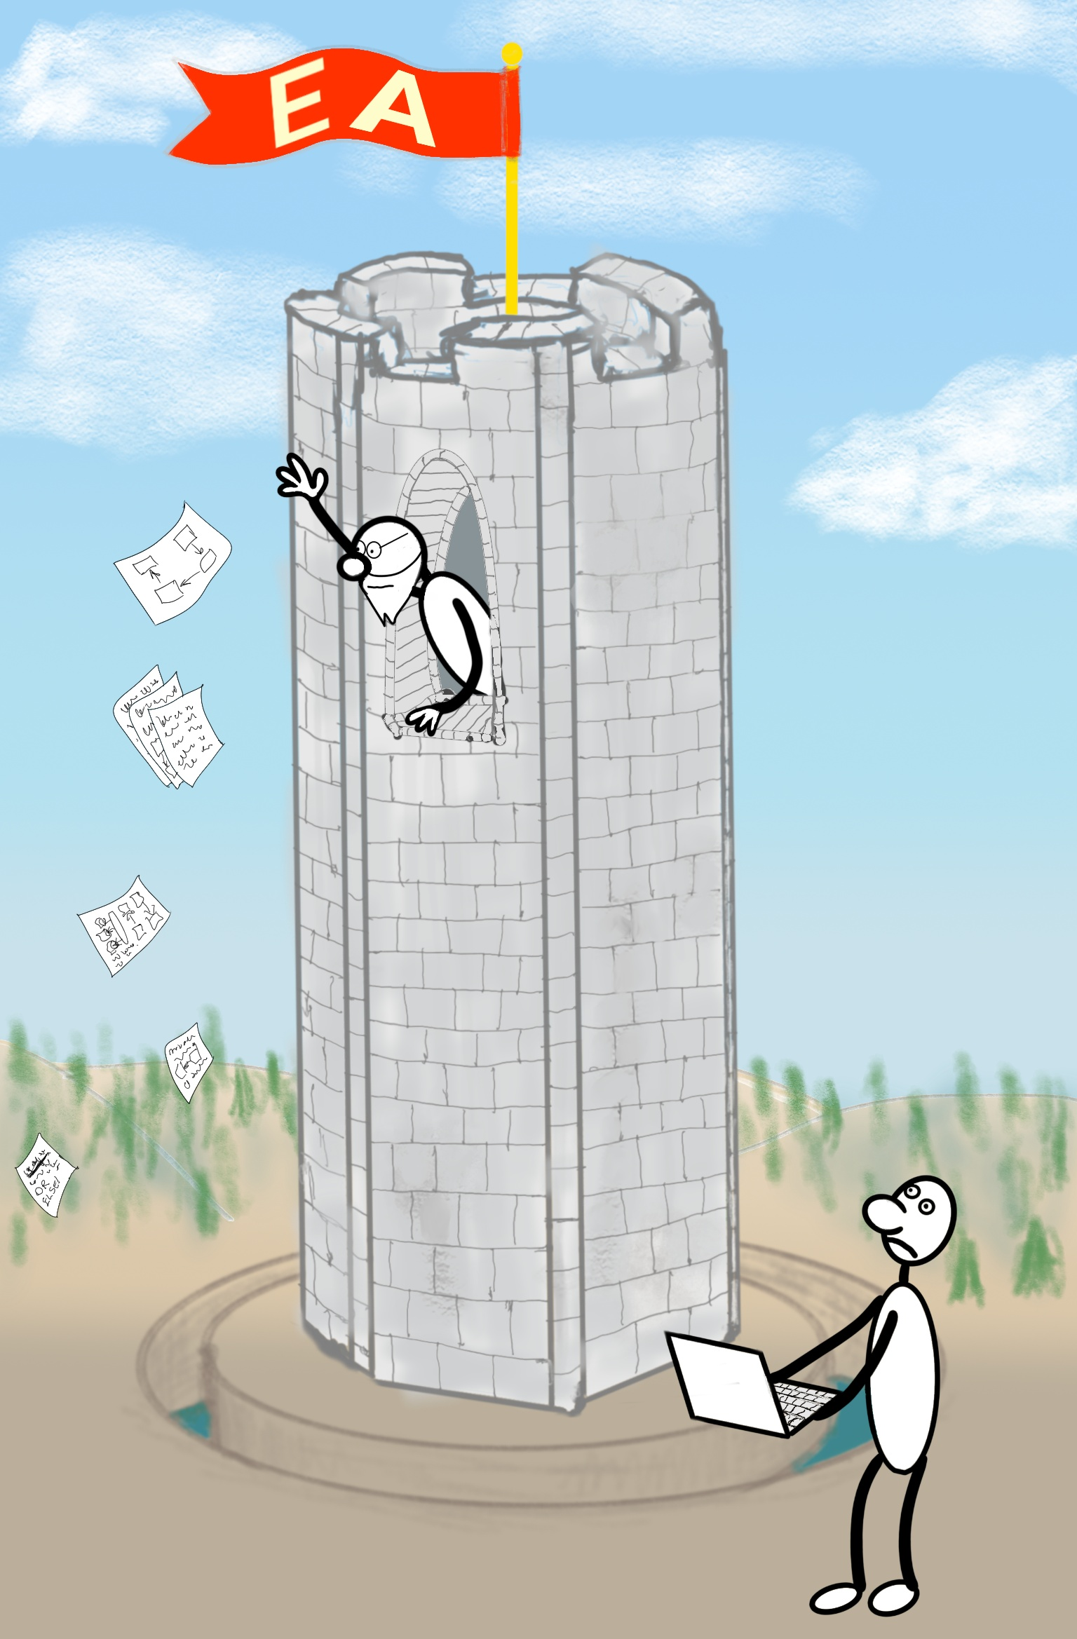
Escaping Architecture Ivory Tower with Architecture Pattern Catalog
dev2next
Colorado Springs, CO September 29 - October 2, 2025

Slide 2

What Is Architecture?
Unsatisfying attempts at defining Architecture to follow

Slide 3
What Is Architecture? [Wikipedia]
Software architecture is the set of structures needed to reason about a software system and the discipline of creating such structures and systems. Each structure comprises software elements, relations among them, and properties of both elements and relations.

Slide 4
What Is Architecture? [Martin Fowler]
[A] hazily defined notion of the most important aspects of the internal design of a software system.

Slide 5
What Is Architecture? [Grady Booch]
“Architecture is just a collective hunch, a shared hallucination, an assertion by a set of stakeholders on the nature of their observable world, be it a world that is or a world as they wish it to be”
Represented by a set of interlocking models
Architecture captures
Significant design decisions
Rationale
Patterns
Cross cutting concerns
Tribal memory

Slide 6
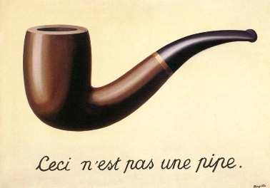

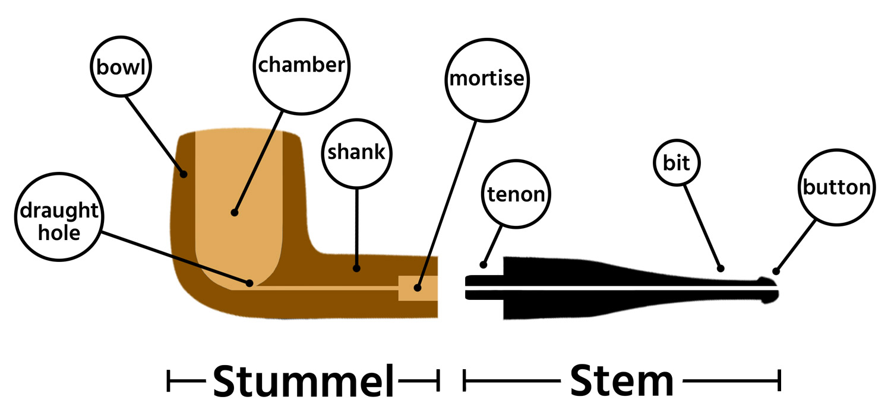
What They* Say About Models
All models are wrong, but some are useful
Comprehensiveness is the enemy of comprehensibility
Achieve amplification through simplification
* The sayers of things

Slide 7

“…a set of interlocking models…”
There are always models. If there is no explicit modeling activity, there will be many implicit models, likely incorrect and inconsistent
Explicit Modeling: Implicit (No) Modeling:

Slide 8
What Is Architecture? [Fred Brooks]
A clean, elegant programming product must present to each of its users a coherent mental model of the application, of strategies for doing the application, and of the user-interface tactics to be used …
Conceptual Integrity is the most important consideration in system design. It is better to have a system omit certain anomalous features and improvements, but to reflect one set of design ideas, than to have one that contains many good but independent and uncoordinated ideas.

Slide 9
What Is Architecture? [Ralph Johnson]
In most successful software projects, the expert developers working on that project have a shared understanding of the system design. This shared understanding is called ‘architecture.’ …
architecture is a social construct …
Whether something is part of the architecture is entirely based on whether the developers think it is important. …
Architecture is about the important stuff. Whatever that is.

Slide 10

So, What Is Architecture?
No good definition given—promise kept!

Slide 11
What Is Architect?
A facilitator—of no value if all alone all by themselves
Ensures Conceptual Integrity
“guide, as in mountaineering” [Fowler]
Follows a set of processes and methodologies
Solves problems
Designs knowledge flow
Curates a repository of information that is useful to other participants
Captures “Shared Understanding” as artifacts in various mediums
Maintains tribal knowledge
A storyteller

Slide 12
Why Is Architect?
The storytellers in a tribe tell stories
Stories explain why the world is the way it is
Running software is the ultimate truth of a software project …but it lacks creation stories (“why it is the way it is”)
Some stories can be inferred from the code
The rest can be in tribal memory in the heads of storytellers
Relying on informal storytelling to share important decisions is costly
When the stories are gone, recreating those decisions is very costly
Codifying tribal memory makes evolving systems materially easier

Slide 13
Where Is Architect?
It depends
Complexity
Risk (financial, reputational, safety & health)
From risk embracing to risk resistance
Accidental architecture – rapid innovation
Senior Designer – small team/system
Chief Architect – mid size team
The Architecture Team – large organizations
The Architecture Control Board – high complexity, high risk environments
Architecture decisions must involve developers
If you want them to follow your decisions

Slide 14
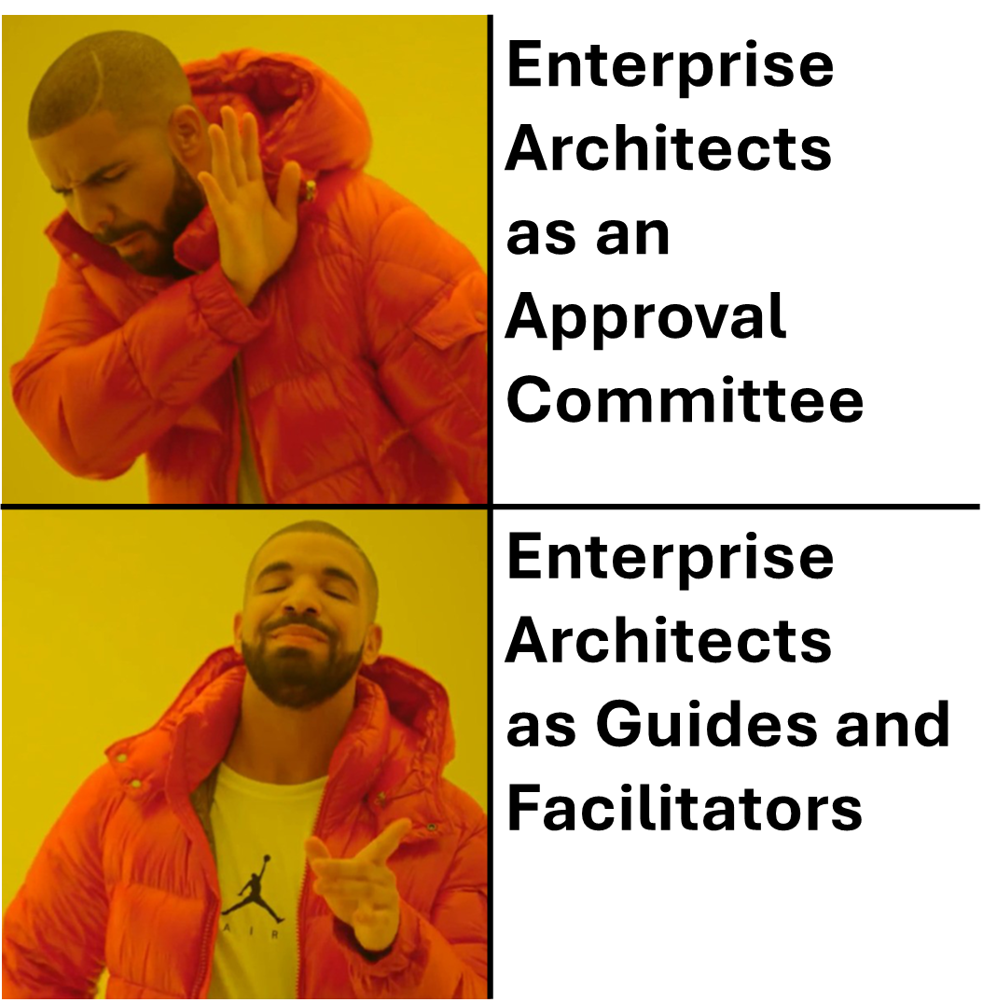

A Recursion of Architects
Shared understanding
captured as a curated repository of information
Architects →
Team 1
Team 2
…
…
Team $n$

Slide 15
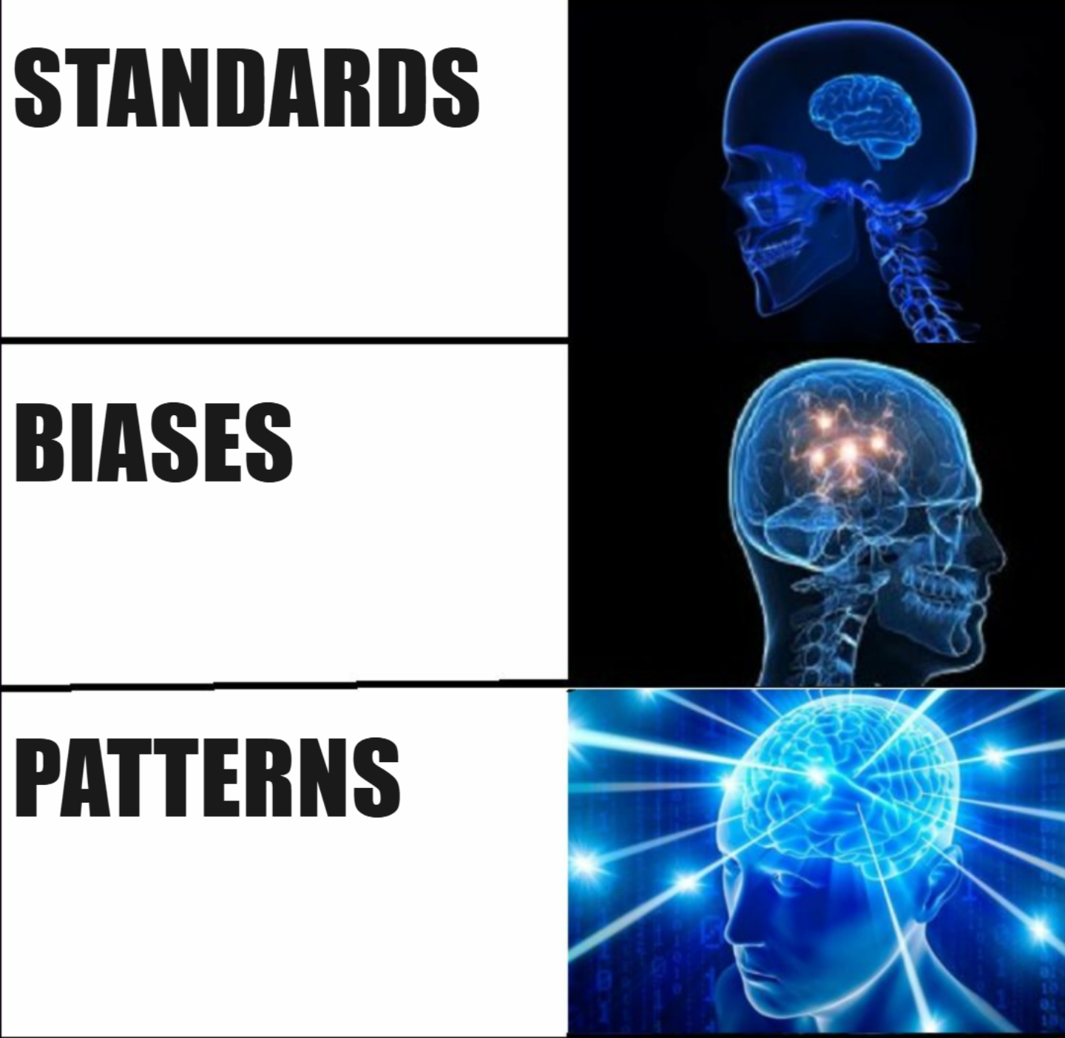
How to Capture Shared Understanding

Slide 16
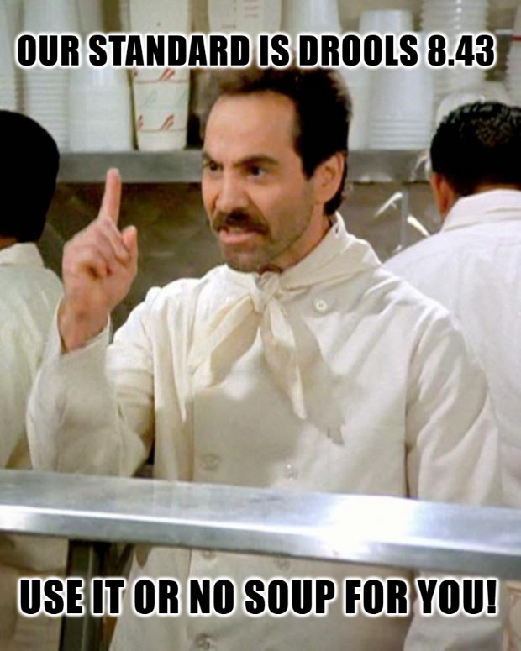
Standards
A list of “approved” software tools, e.g.:
Camunda 5.1
Kafka 3.2
Drools 8.43
...
Approved for what? Why? Why not? Unclear
Software is fungible and many of tools are Turing complete, so:
Kafka is a database
A workflow engine is a rules engine
A rules engine is a workflow engine
Standardization can lead to stagnation
What is the motivation for changing a standard?

Slide 17
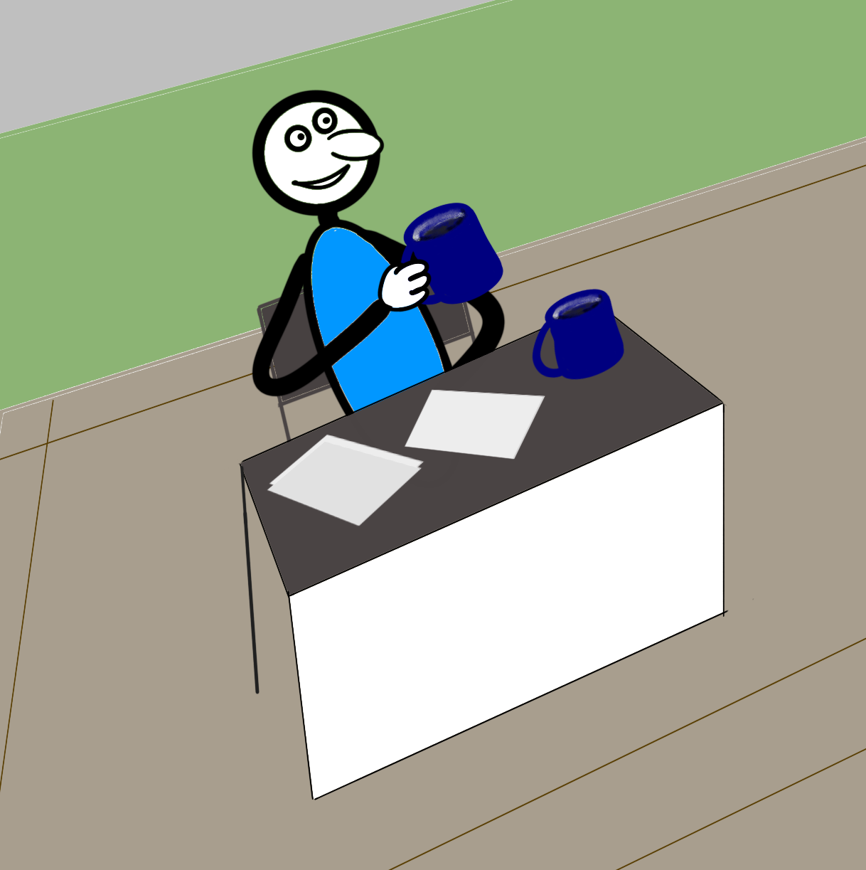
Biases – Standards Refined
“This is our bias. Why will it not work for your requirements?”
Introduces a context
Functional
Workflow
Database
etc.
Lifecycle
Legacy apps
Maintained apps
New development
ARCHITECTURE CONTROL BOARD
CAMUNDA 7 IS OUR WORKFLOW BIAS FOR NEW APPS
CHANGE MY MIND

Slide 18



Problems With Standards and Biases
A catalog of standards or biases navigates from a solution
We want to navigate from a problem
…in a context
…to a solution
…understanding tradeoffs
…specific to our organization
…with working examples to inspire and reuse
…and pointers to related problems and their solutions

Slide 19

Solution?
PATTERNS

Slide 20
What Are Patterns?
"Each pattern is a three-part rule, which expresses a relation between a certain context, a certain system of forces which occurs repeatedly in that context, and a certain software configuration which allows these forces to resolve themselves."
"A pattern language defines a collection of patterns and the rules to combine them into an architectural style. Pattern languages describe software frameworks or families of related systems."

Slide 21
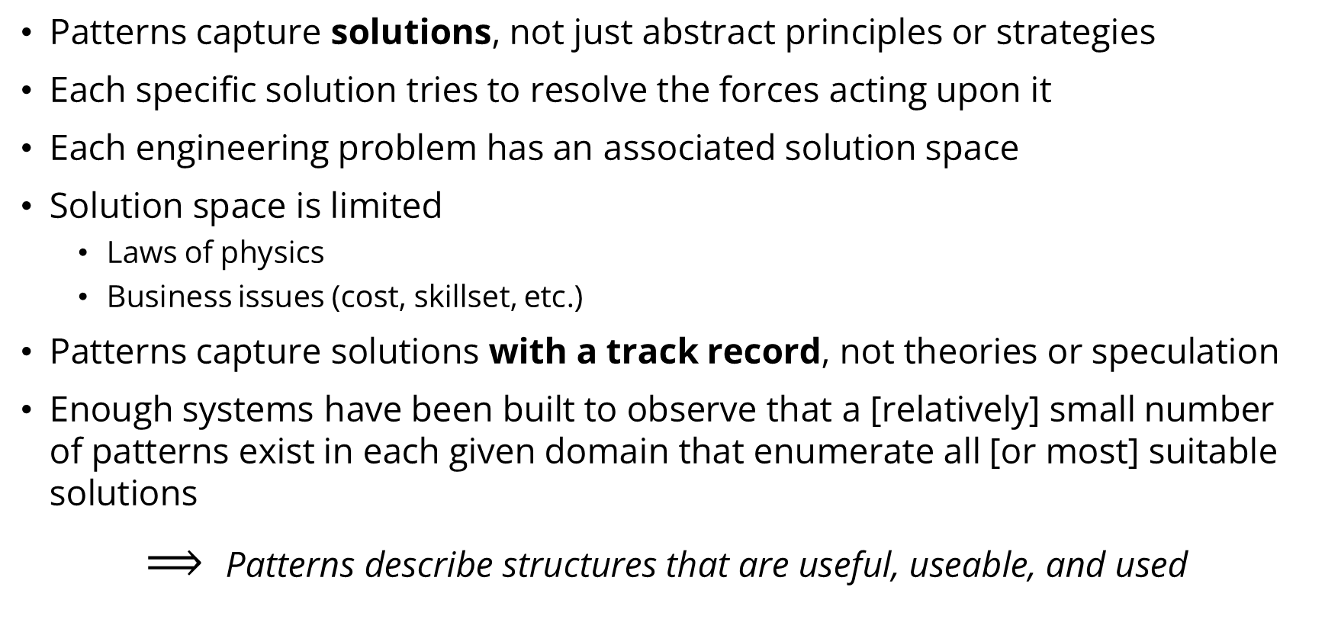
Why Do Patterns Make Sense?
Patterns capture solutions, not just abstract principles or strategies
Each specific solution tries to resolve the forces acting upon it
Each engineering problem has an associated solution space
Solution space is limited
Laws of physics
Business issues (cost, skillset, etc.)
Patterns capture solutions with a track record, not theories or speculation
Enough systems have been built to observe that a [relatively] small number of patterns exist in each given domain that enumerate all [or most] suitable solutions
$⟹$Patterns describe structures that are useful, useable, and used

Slide 22
Pattern Examples
Category | Pattern
Messaging | Publisher/Subscriber
 | Guaranteed Messaging
 | Queue with Keys (Sequential Convoy)
 | Dead Letter Queue
Storage | Relational Database
 | Key-Value Store
 | Two-Dimensional Key-Value Store
 | Cache
Resiliency | Bulkhead
 | Stateless Services
 | Horizontal Scalability
Data | Bi-temporal Milestoning
 | High Water Mark Filters

Slide 23
Pattern Description Template
Category
Sub-category
Pattern: [Pattern Name - a descriptive and unique name]
Description | A description of the goal behind the pattern and the reason for using it
Motivation | A scenario consisting of a problem and a context in which this pattern can be used
Applicability | Situations in which this pattern is usable; the context for the pattern
Structure | A graphical representation of the pattern
Consequences | A description of the results, side effects, and trade offs caused by using the pattern
Implementation | A description or an example of an implementation of the pattern
Related Patterns | Other patterns that have some relationship with the pattern
Known uses | Examples of real usages of the pattern

Slide 24
Pattern Description Example
Messaging
Pattern: Sequential Convoy [from MSFT]
Description | Process related messages in a defined order, without blocking processing of other messages
Motivation | Maintain FIFO order within subsets of messages, while still being able to scale out to handle load
Applicability | You have messages that arrive in order and must be processed in the same order. Arriving messages can be "categorized" in such a way that the category becomes a unit of scale for the system.
Structure
Consequences | Scale out by Category; Category sizes may differ by a lot; throughput limitations; evolving categories; defining category (session) boundaries
Implementation | Azure Service Bus Message Sessions
Related Patterns | Guaranteed Messaging, Competing Consumers
Known uses | Intraday P&L Accounting System [links, contact info]
A2 A1
Consumer A
Producer
A2 B2 B1 A1
Queue with Keys
B2 B1
Consumer B

Slide 25
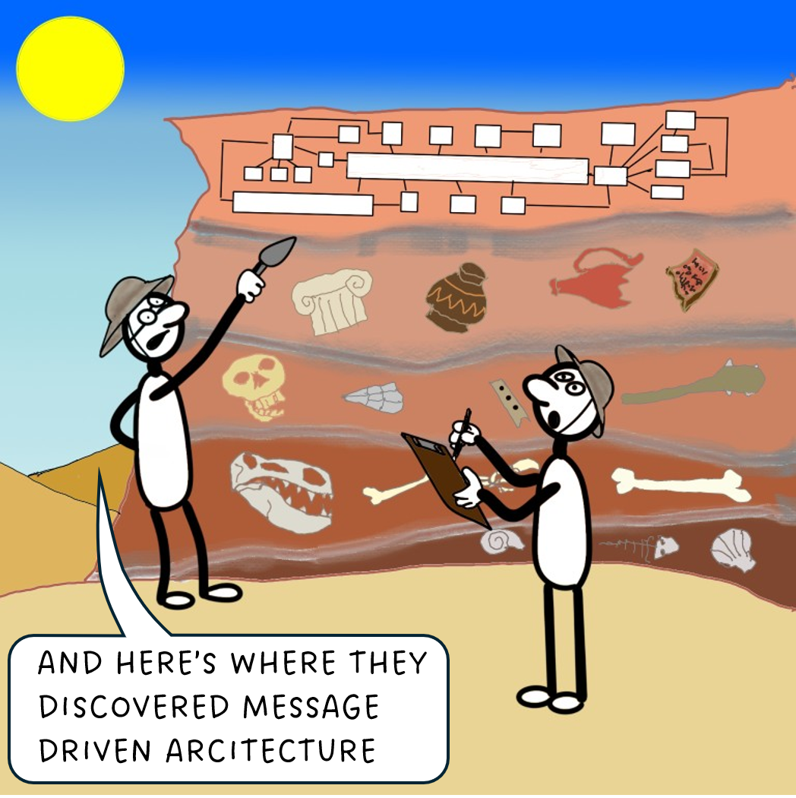
Pattern Misuse
Causes
Exuberance when patterns are discovered
Not understanding or ignoring the context
Not keeping the system simple
“Anticipatory Design”
Ambiguous definition of a pattern
Treatment
Only use a pattern if
you have the problem it solves
the positives outweigh the negatives
Ensure that the entire team understands the patterns in use
Involve the broader architecture community

Slide 26
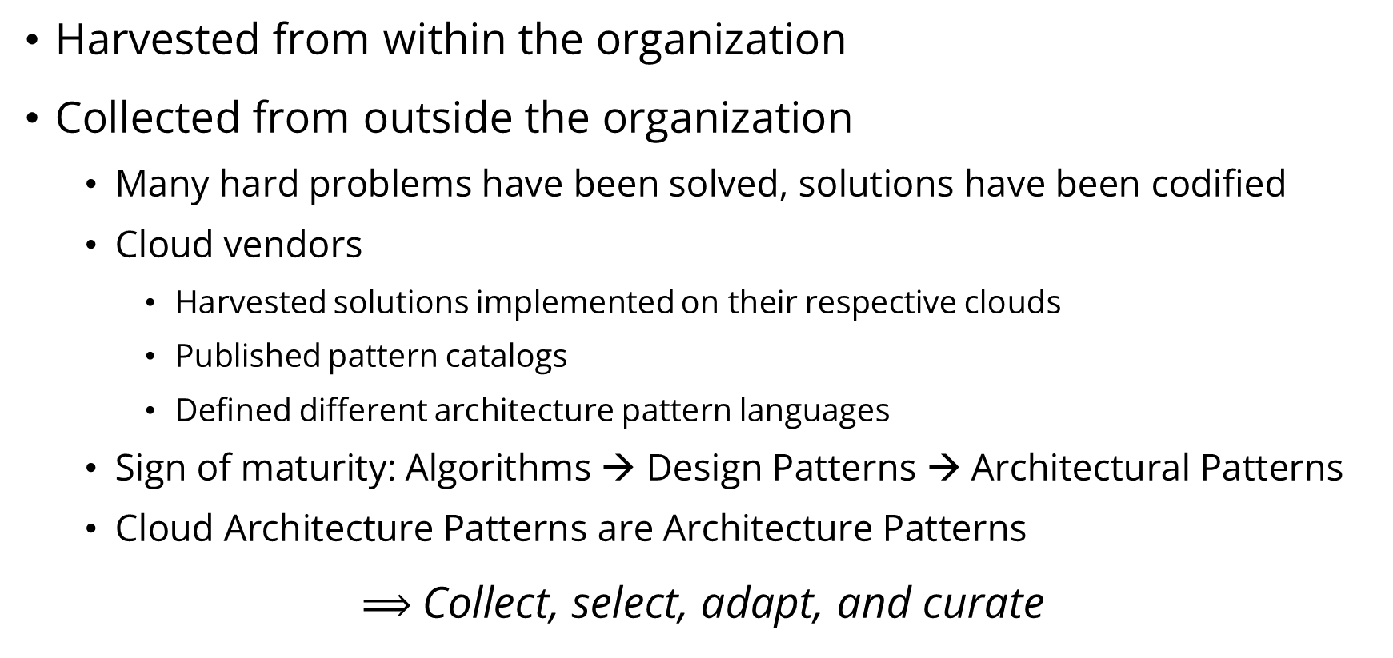
Where Do Patterns Come From?
Harvested from within the organization
Collected from outside the organization
Many hard problems have been solved, solutions have been codified
Cloud vendors
Harvested solutions implemented on their respective clouds
Published pattern catalogs
Defined different architecture pattern languages
Sign of maturity: Algorithms → Design Patterns → Architectural Patterns
Cloud Architecture Patterns are Architecture Patterns
$⟹$Collect, select, adapt, and curate

Slide 27
Pattern Catalog Examples
Microsoft https://learn.microsoft.com/en-us/azure/architecture/patterns/ “The following cloud design patterns are technology-agnostic, which makes them suitable for any distributed system. You can apply these patterns across Azure, other cloud platforms, on-premises setups, and hybrid environments.” – Microsoft
Amazon https://docs.aws.amazon.com/prescriptive-guidance/latest/cloud-design-patterns/introduction.html https://aws.amazon.com/blogs/compute/understanding-asynchronous-messaging-for-microservices/
Google https://cloud.google.com/architecture

Slide 28
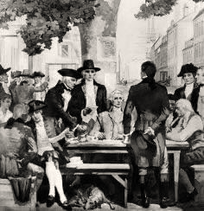
Use Case: Stock Brokerage Accounting
A stock brokerage
…buys/sells stocks
…across many accounts
…using FIFO accounting
…calculates position quantities and P&L
…used for real time reporting and compliance
Need to implement a system that captures trades and calculates quantities and P&L in real time for each trade and for each account

Slide 29
Disclaimer
Nothing that follows is accounting advice, nor legal advice, nor technology implementation advice
Always consult your accountant, lawyer, engineer as appropriate

Slide 30
Stock Trading Scenario
Time | Account | Sec | Buy/Sell | Qty | Price | Cost Basis | Trade Profit/Loss | Sec Qty | Realized Profit/Loss
9:30 AM | 123 | MSFT | Buy | 100 | $ 450.00 |  | $ - | 100 | $ -
9:35 AM | 123 | IBM | Buy | 40 | $ 240.00 |  | $ - | 40 | $ -
10:10 AM | 123 | MSFT | Buy | 50 | $ 480.00 |  | $ - | 150 | $ -
10:15 AM | 123 | MSFT | Sell | -50 | $ 475.00 | $ 450.00 | $ 1,250.00 | 100 | $ 1,250.00
10:40 AM | 123 | IBM | Buy | 60 | $ 260.00 |  | $ - | 100 | $ 1,250.00
11:30 AM | 123 | MSFT | Sell | -50 | $ 445.00 | $ 450.00 | $ (250.00) | 50 | $ 1,000.00
11:45 AM | 123 | IBM | Sell | -20 | $ 250.00 | $ 240.00 | $ 200.00 | 20 | $ 1,200.00

Slide 31
Why FIFO Matters
Time | Account | Sec | Buy/Sell | Qty | Price | Cost Basis | Trade Profit/Loss | Sec Qty | Realized Profit/Loss
9:30 AM | 123 | MSFT | Buy | 100 | $ 450.00 |  | $ - | 100 | $ -
9:35 AM | 123 | IBM | Buy | 40 | $ 240.00 |  | $ - | 40 | $ -
10:10 AM | 123 | MSFT | Buy | 50 | $ 480.00 |  | $ - | 150 | $ -
10:15 AM | 123 | MSFT | Sell | -50 | $ 475.00 | $ 480.00 | $ (250.00) | 100 | $ (250.00)
10:40 AM | 123 | IBM | Buy | 60 | $ 260.00 |  | $ - | 100 | $ (250.00)
11:30 AM | 123 | MSFT | Sell | -50 | $ 445.00 | $ 450.00 | $ (250.00) | 50 | $ (500.00)
11:45 AM | 123 | IBM | Sell | -20 | $ 250.00 | $ 240.00 | $ 200.00 | 20 | $ (300.00)

Slide 32
Why FIFO Matters
Time | Account | Sec | Buy/Sell | Qty | Price | Cost Basis | Trade Profit/Loss | Sec Qty | Realized Profit/Loss
9:30 AM | 123 | MSFT | Buy | 100 | $ 450.00 |  | $ - | 100 | $ -
9:35 AM | 123 | IBM | Buy | 40 | $ 240.00 |  | $ - | 40 | $ -
10:10 AM | 123 | MSFT | Buy | 50 | $ 480.00 |  | $ - | 150 | $ -
10:15 AM | 123 | MSFT | Sell | -50 | $ 475.00 | $ 480.00 | $ (250.00) | 100 | $ (250.00)
10:40 AM | 123 | IBM | Buy | 60 | $ 260.00 |  | $ - | 100 | $ (250.00)
11:30 AM | 123 | MSFT | Sell | -50 | $ 445.00 | $ 450.00 | $ (250.00) | 50 | $ (500.00)
11:45 AM | 123 | IBM | Sell | -20 | $ 250.00 | $ 240.00 | $ 200.00 | 20 | $ (300.00)
BIG SAVINGS!

Slide 33
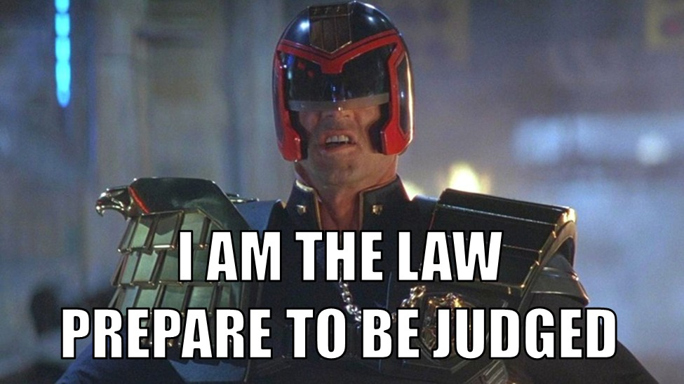
Why FIFO Matters
Time | Account | Sec | Buy/Sell | Qty | Price | Cost Basis | Trade Profit/Loss | Sec Qty | Realized Profit/Loss
9:30 AM | 123 | MSFT | Buy | 100 | $ 450.00 |  | $ - | 100 | $ -
9:35 AM | 123 | IBM | Buy | 40 | $ 240.00 |  | $ - | 40 | $ -
10:10 AM | 123 | MSFT | Buy | 50 | $ 480.00 |  | $ - | 150 | $ -
10:15 AM | 123 | MSFT | Sell | -50 | $ 475.00 | $ 480.00 | $ (250.00) | 100 | $ (250.00)
10:40 AM | 123 | IBM | Buy | 60 | $ 260.00 |  | $ - | 100 | $ (250.00)
11:30 AM | 123 | MSFT | Sell | -50 | $ 445.00 | $ 450.00 | $ (250.00) | 50 | $ (500.00)
11:45 AM | 123 | IBM | Sell | -20 | $ 250.00 | $ 240.00 | $ 200.00 | 20 | $ (300.00)
BIG SAVINGS!

Slide 34
System Requirements
Functional
FIFO trade processing for Account/Security combination
Can’t lose a trade
Real time processing for reporting and for portfolio compliance
Non-functional
Cost Efficiency
Commodity hardware
Horizontal Scalability/Elasticity
Reliability/Recoverability
Volumes
100,000 accounts
8,000 stocks
10,000 trades a minute

Slide 35
Functional Architecture
Accounting System
Trade Source
Trades
P&L Calculator
Positions, P&L
Position
Store

Slide 36
Business and Technical Requirements
Guaranteed delivery messaging from the trading system
Business Rule
FIFO within a single Account/Product combination
Partition Key: Account + Product, or Account, or Product
Persistence Layer
Structured data
Relationships with reference data
If not performant enough
Cache prices
Caching positions with periodic writes

Slide 37
High Level Architecture
System
P&L Calculator 1
Cache
Accounting Trade Queue
Trade Publisher
Accounting
Trade
Queue Manager
P&L Calculator 2
Cache
Persistent
Store
P&L Calculator n
Cache

Slide 38
Just Add Patterns
Session Consumer
System
Cache
P&L Calculator 1
Cache
Sequential Convoy
Publisher/Subscriber
Relational Store
Accounting Trade Queue
Trade Publisher
Accounting
Trade
Queue Manager
P&L Calculator 2
Cache
Persistent
Store
P&L Calculator n
Cache

Slide 39
From Patterns to Implementation
Pattern | Implementation Choices
Publisher/Subscriber (Broker/Consumer) | Azure Service Bus or Azure Event Hub
Sequential Convoy | Azure Service Bus Message Sessions
Category (Session) Consumer | Logic App with the Service Bus Peek-Lock Connector or Azure Functions with the Service Bus trigger
Cache | Azure Cache for Redis
Relational Store | Azure SQL Managed Instance

Slide 40

What Now?
Have yourselves a Pattern Catalog
Review and reuse what’s out there
Fine tune to fit your organization
Refactor your architecture function to own Pattern Catalog and keep it alive
Build a community
Thank You

Slide 41
Appendix

Slide 42
Sources
Wikipedia, https://en.wikipedia.org/wiki/Software_architecture
Martin Fowler, “Software Architecture Guide”
Grady Booch, “Architecture as a Shared Hallucination”
Fred Brooks, “The Mythical Man-Month”
Martin Fowler, “Who Needs an Architect?”
Ralph Johnson, as quoted by Martin Fowler in “Who Needs an Architect?”
Richard Gabriel, “What are Patterns”, https://hillside.net/patterns-definition

