Slide 1

Refactoring. to
Making Your Java Streams Leaner, Meaner, and Cleaner
Donald Raab, Vladimir Zakharov
dev2next • Colorado Springs, CO • September 29 - October 2, 2025
https://github.com/vmzakharov/refactor-to-ec-remake
🦤
🐿️

Slide 2
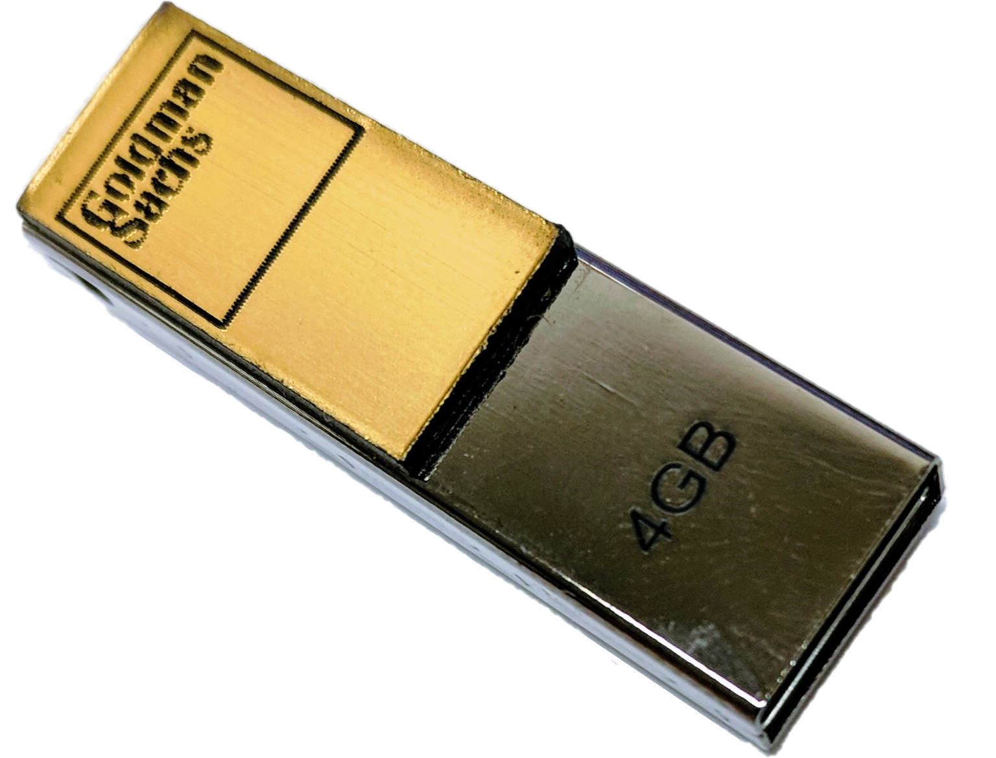
Introduction
What is Eclipse Collections?
Feature rich, memory efficient Java Collections framework
History
Eclipse Collections started off as an internal collections framework named Caramel at Goldman Sachs in 2004
In 2012, it was open sourced to GitHub as a project called GS Collections
GS Collections was migrated to the Eclipse Foundation, re-branded as Eclipse Collections in 2015
Eclipse Collections 12.0 (Java 11+) & 13.0 (Java 17+) released in June 2025
Learn Eclipse Collections with Kata
Eclipse Collections is open for contributions!
🐿️

Slide 3
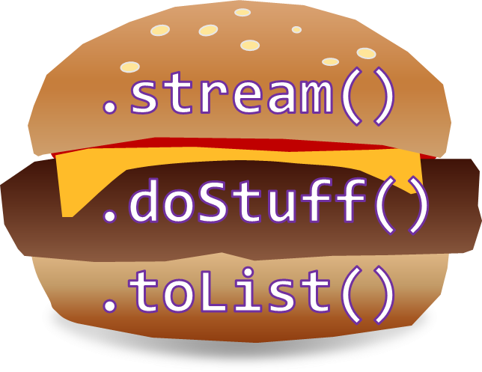
Why Refactor to EC?
Lazy or Eager
TestUtils
No “Bun” methods
Testability/Debuggability
Drop-in replacement for JDK types
Concise Code
Benefits
It’s Easy!
Intuitive humane APIs
Rich[er] APIs
Memory Savings
Better Performance ^{[citation needed ]}
Comprehensive Support for Primitive Types
🦤
Efficient Maps and Sets

Slide 4
Any Types You Need
Boolean
Byte
Char
Double
Float
Int
Long
Object
Short
Bag
BiMap
Interval
List
Map
Set
Stack
Immutable
Mutable
Sorted
Multimap
MutableIntList
LongStack
SortedBagMultimap
ImmutableObjectLongMap
MutableSortedSetMultimap
*.asLazy()
*.asParallel()
🦤

Slide 5

Instantiate Them Using Factories
Payload Type* | Container Type | Mutability | Multimap | Initialized | Lazy
Boolean Byte Char Double Float Int Long Object Short | Bags BiMaps Lists Maps Multimaps Sets SortedBags SortedMaps SortedSets Stacks | .mutable .immutable .fixedSize | .bag .list .set .sortedSet | .empty()|.of()|.with() .of(one)|.with(one) ... .of(one,…,ten) .with(one,…,ten) .of(... elements) .with(... elements) .ofAll(Iterable) .withAll(Iterable) | .asLazy()
* | Pick two for maps
ImmutableLongStack
LongStacks.immutable.with(1, 2, 3).asLazy()
🦤
LazyLongIterable

Slide 6
Evolving from JDK to EC Factories and Types
// JDK Type
Set<String>
Mutable
Immutable
How do you know if a collection is mutable or immutable?
// JDK Type | // JDK Implementation
Set<String> | new HashSet<>(List.of("1", "2", "3"))
// JDK Type | // EC Implementation
Set<String> | Sets.mutable.of("1", "2", "3")
// EC Type | // EC Implementation
MutableSet<String> | Sets.mutable.of("1", "2", "3")
// JDK Type | // JDK Implementation
Set<String> | Set.of("1", "2", "3")
// JDK Type | // EC Implementation
Set<String> | Sets.immutable.of("1", "2", "3") .castToSet()
// EC Type | // EC Implementation
ImmutableSet<String> | Sets.immutable.of("1", "2", "3")
Start
Step 1
Step 2
🐿️

Slide 7
Evolving from JDK to EC Factories and Types
// JDK Type
List<String>
Mutable
Immutable
How do you know if a collection is mutable or immutable?
// JDK Type | // JDK Implementation
List<String> | new ArrayList<>(List.of("1", "2", "3"))
// JDK Type |  | // EC Implementation
List<String> |  | Lists.mutable.of("1", "2", "3")
// EC Type |  | // EC Implementation
MutableList<String> |  | Lists.mutable.of("1", "2", "3")
// JDK Type | // JDK Implementation
List<String> | List.of("1", "2", "3")
// JDK Type | // EC Implementation
List<String> | Lists.immutable.of("1", "2", "3") .castToList()
// EC Type | // EC Implementation
ImmutableList<String> | Lists.immutable.of("1", "2", "3")
Start
Step 1
Step 2
🐿️

Slide 8
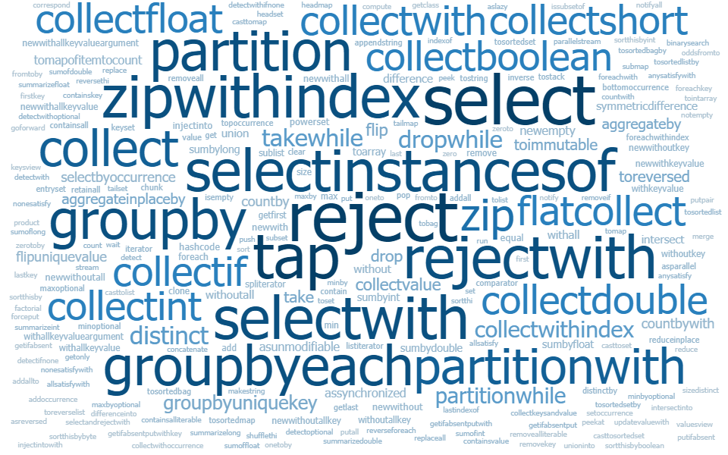
Set/Stream vs. ImmutableSet
Java Collections / Streams
Eclipse Collections
Metric - Number of Non-overloaded Methods
ImmutableSet
158
Gatherers
5
Collectors
30
Stream
50
5
Collectors2 72
10
3
Set
21
5
56
Collections
64
2
12
1
3
🐿️

Slide 9
Methods by Category - Highlights
transforming
converting
filtering
collect[With]
collect[Boolean,Byte,Char,Double,Float,Int,Long,Short]
collectIf
collectKeysAndValues
collectValues
collectWithIndex
collectWithOccurrences
flatCollect
toArray
toBag
toImmutable
toList
toMap
toReversed
toSet
toSortedBag[By]
toSortedList[By]
toSortedMap
toSortedSet
toSortedSet[By]
toStack
toString
select[With]
selectByOccurrences
selectInstancesOf
reject[With]
partition[With]
partitionWhile
grouping
groupBy
groupByEach
groupByUniqueKey
sumBy[Double,Float,Int,Long]
sumOf[Double,Float,Int,Long]
aggregateBy
aggregateInPlaceBy
wrapping
testing
finding
asLazy
asParallel
asReversed
asSynchronized
asUnmodifiable
allSatisfy[With]
anySatisfy[With]
noneSatisfy[With]
notEmpty
isEmpty
detect[With]
detect[With]IfNone
detect[With]Optional
max[By]
min[By]
🐿️

Slide 10
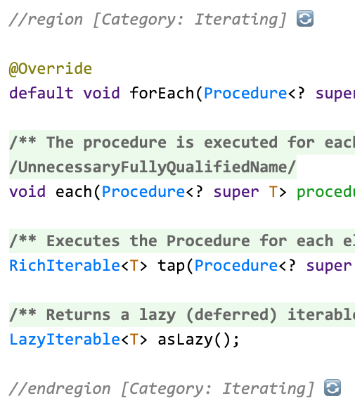
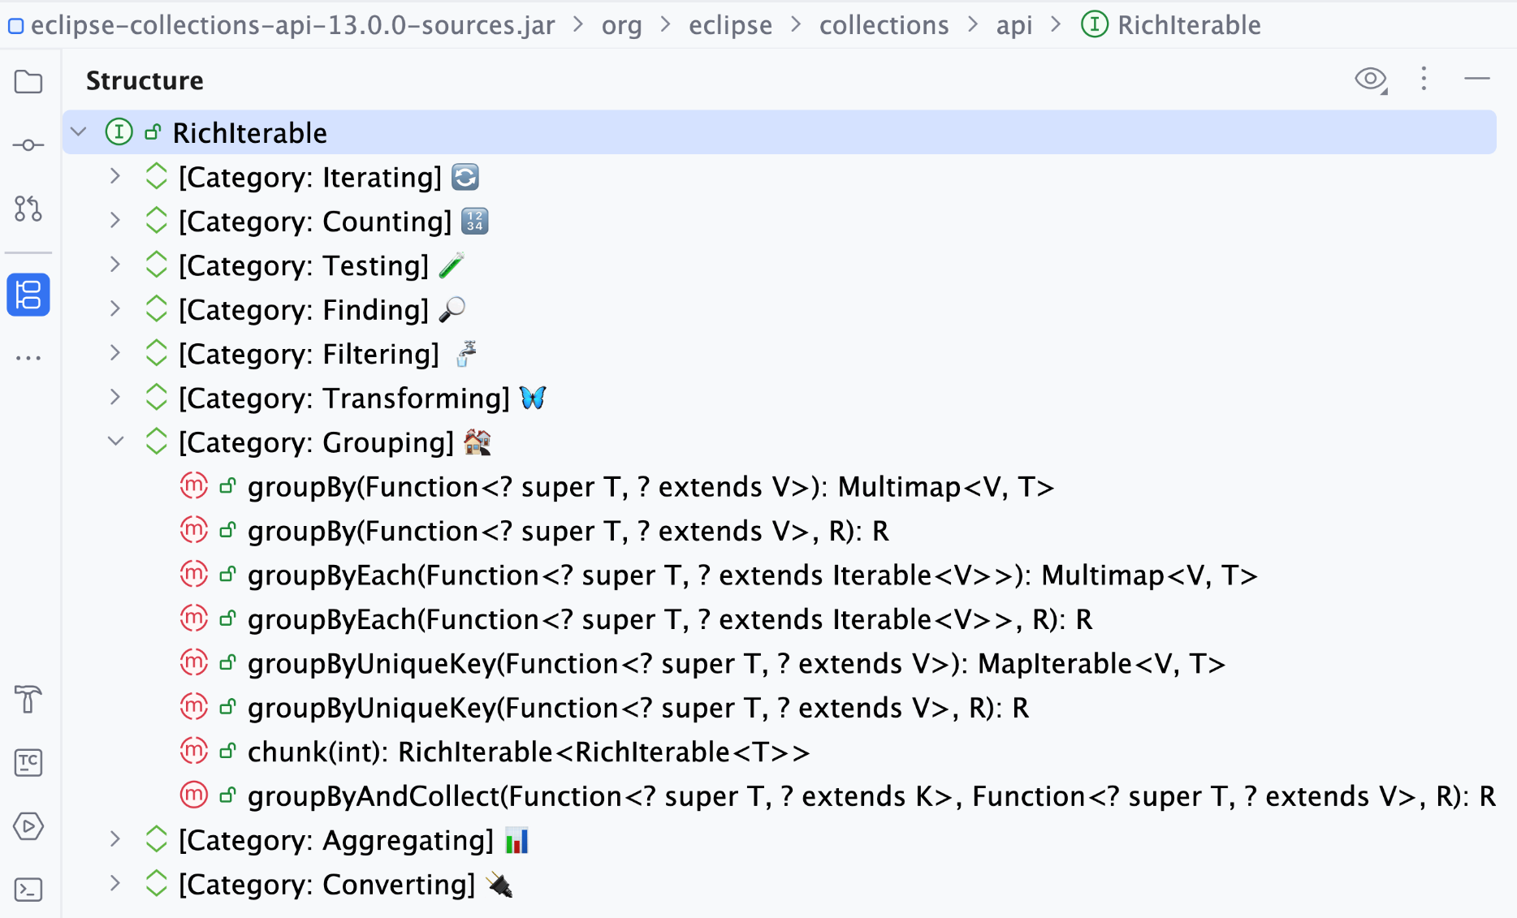
Simulating Method Categories in IntelliJ
Using Custom Code Folding Regions
🐿️

Slide 11
Let’s Do It!

Slide 12
Memory: Methodology
Java Object Layout (JOL) - OpenJDK Code Tools Project JOL (Java Object Layout) is the tiny toolbox to analyze object layout schemes in JVMs. JOL [is] much more accurate than other tools relying on heap dumps, specification assumptions, etc.
<dependency>
<groupId>org.openjdk.jol</groupId>
<artifactId>jol-core</artifactId>
<version>0.17</version>
</dependency>
Further reading
Baeldung: Memory Layout of Objects in Java
StackOverflow:
Does Java Object Layout work with Java Records?
Does Java Object Layout (JOL) work with Java 25 and Compact Object Headers enabled?
🐿️

Slide 13
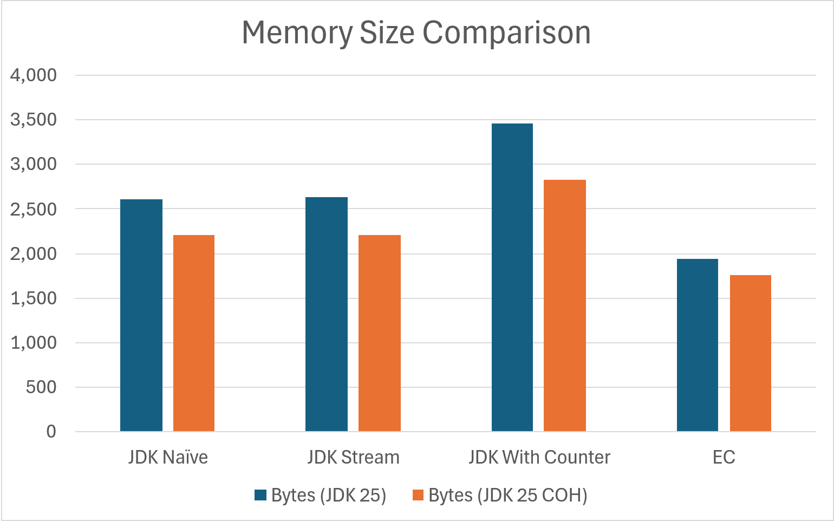
Memory: Word → Count Map
🐿️

Slide 14
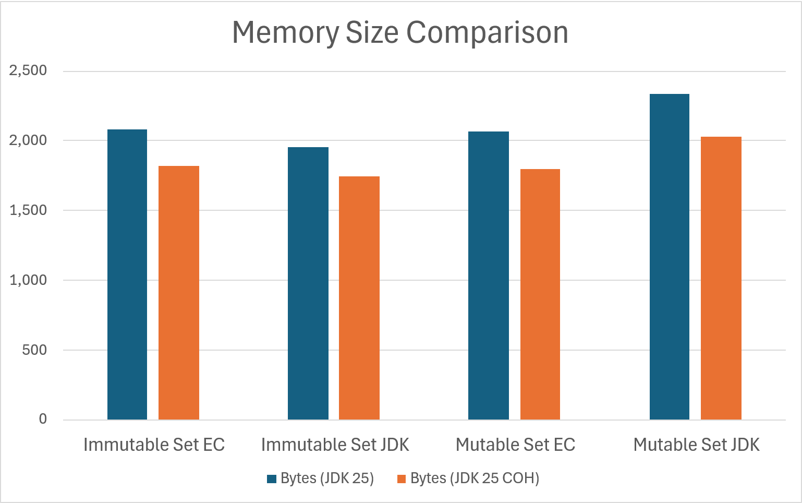
Memory: Generation Set
🐿️

Slide 15
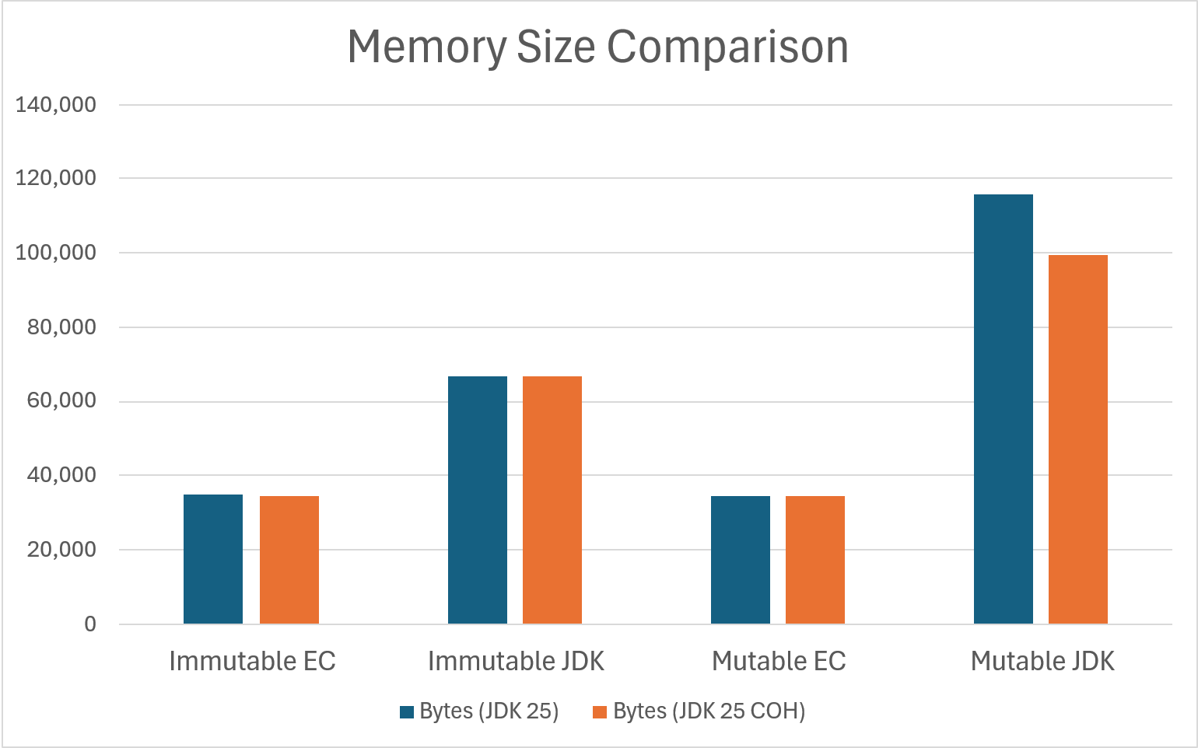
Memory: Year → Generation Map
🐿️

Slide 16
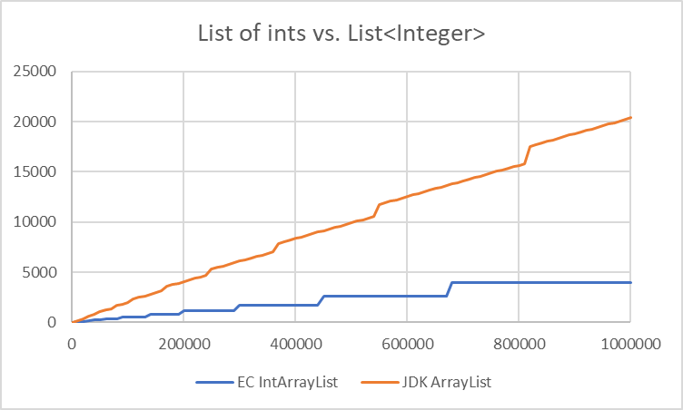
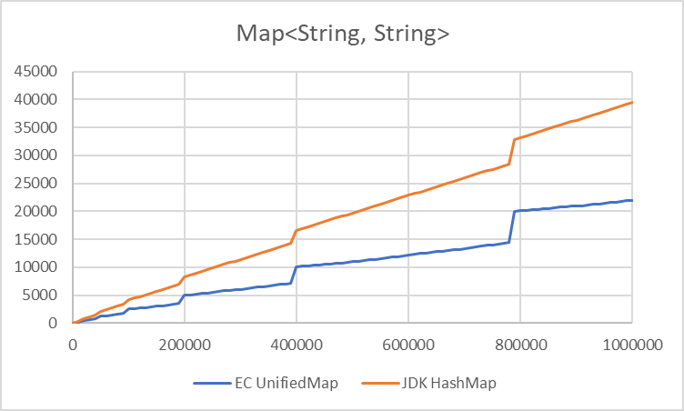
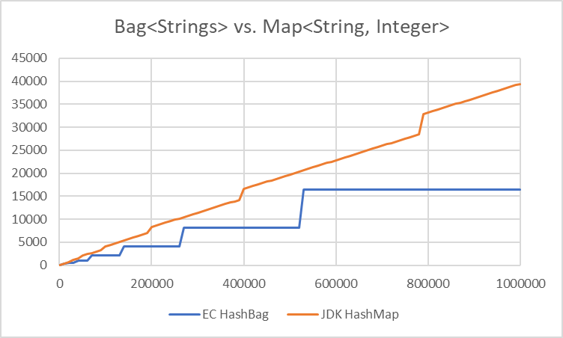
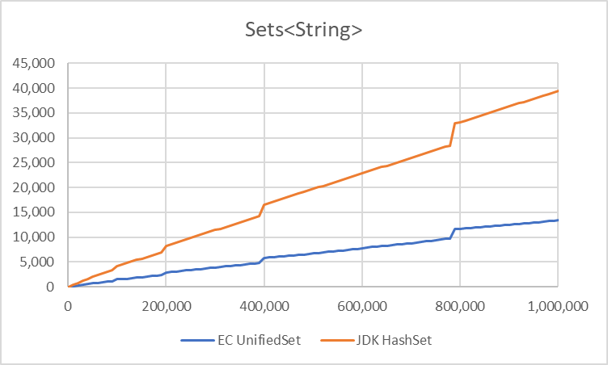
Container Overhead in KB vs. Size

Slide 17
Eclipse Collections – What’s in It for Me?
Features | Productivity | Performance | Thread Safety | Type Safety
Rich functional API with good symmetry | ✓
Memory Efficiency |  | ✓
Optimized Eager API |  | ✓
Primitive Collections | ✓ | ✓ |  | ✓
Immutable Collections |  | ✓ | ✓
Lazy and Parallel Lazy API |  | ✓
Multimap, Bag, BiMap, Pool, Interval |  | ✓ |  | ✓
Hashing Strategy Data Structures | ✓ | ✓
Multi-reader Data Structures |  | ✓ | ✓
Mutable and Immutable Collection Factories | ✓
🦤

Slide 18
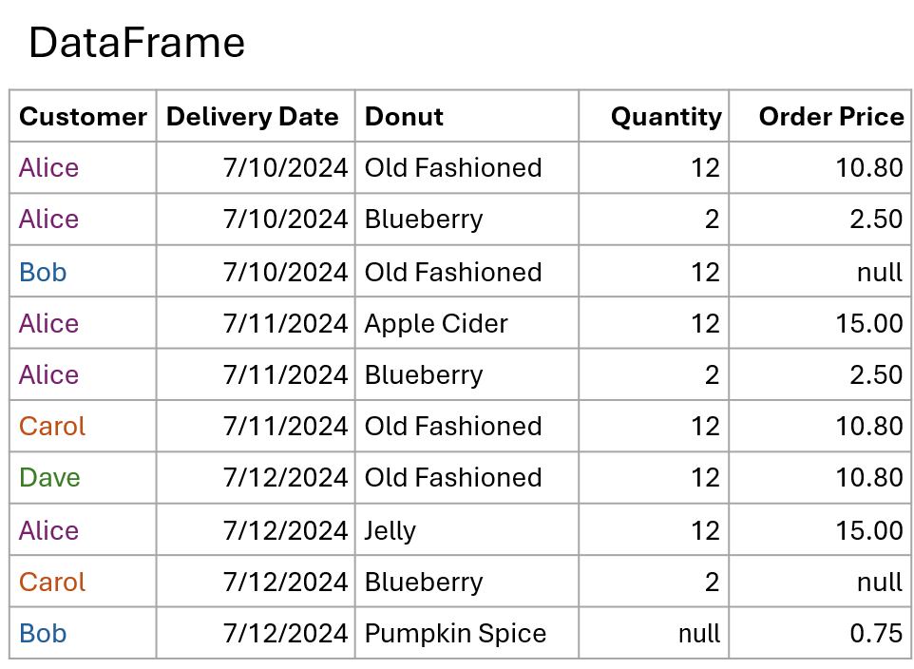
Example: DataFrame-EC
…built on the solid foundation of Eclipse Collections types
🦤
https://github.com/vmzakharov/dataframe-ec

Slide 19
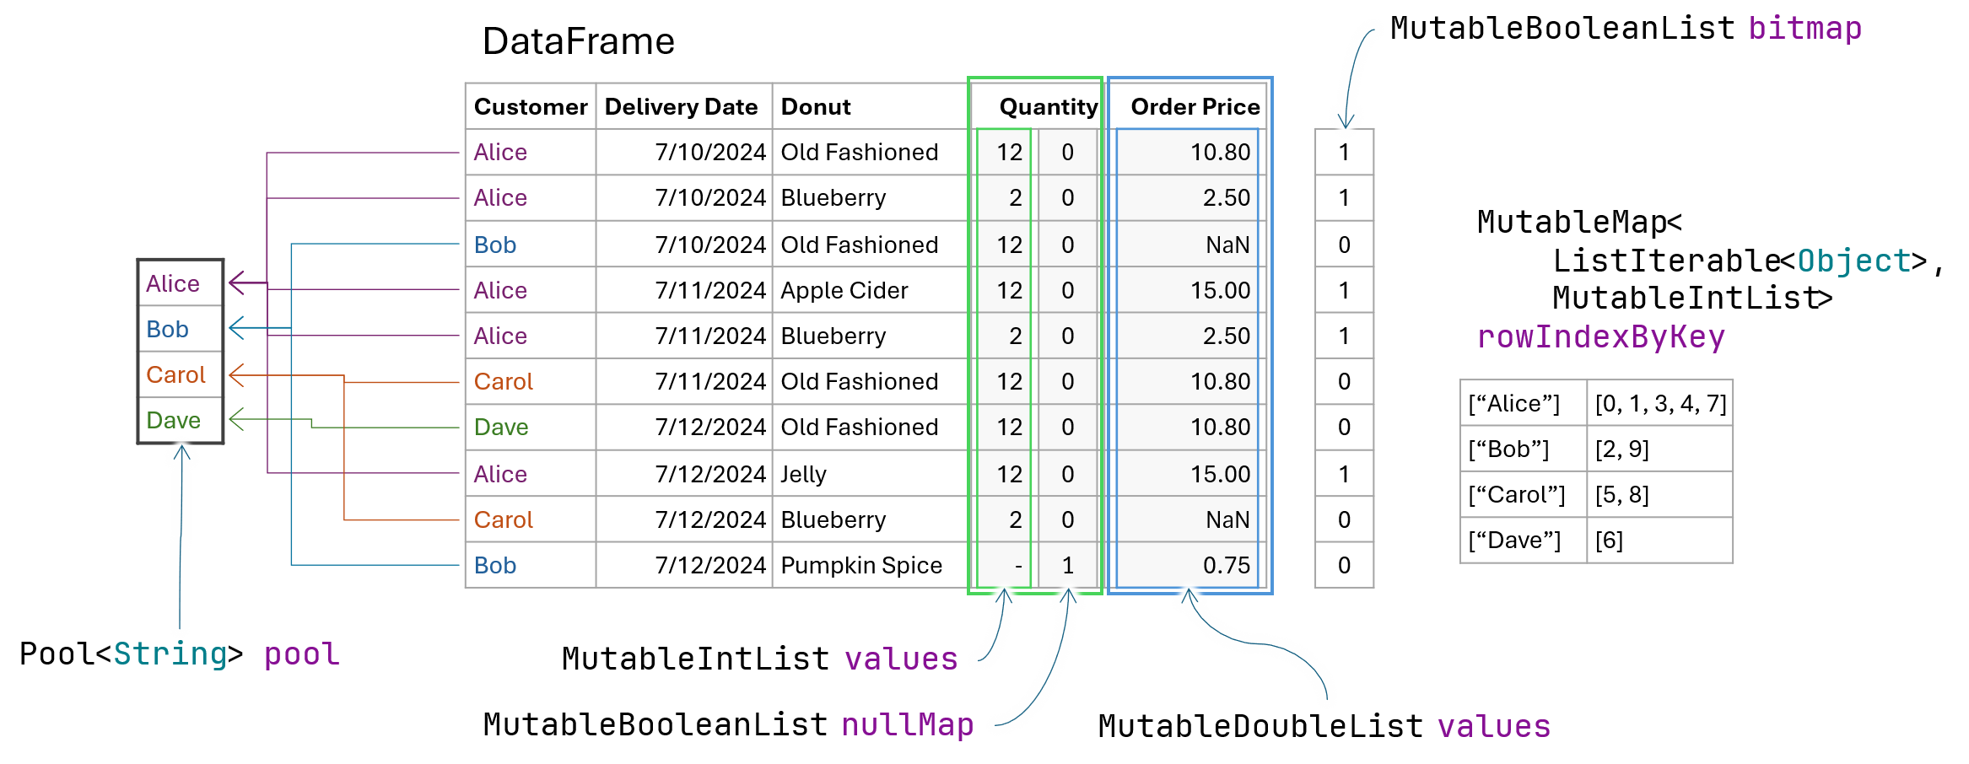
Example: DataFrame-EC
…the foundation, and walls, and joints, and studs, and…
🦤
https://github.com/vmzakharov/dataframe-ec

Slide 20

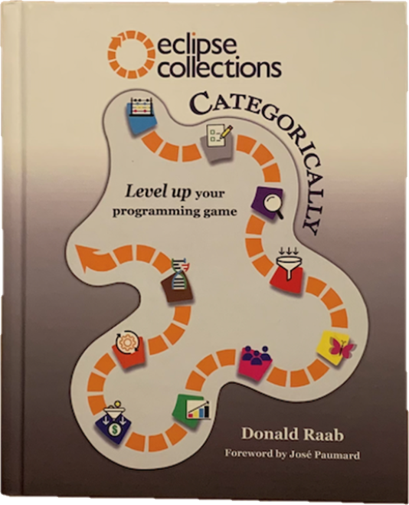
Takeaways
Expect more from your collections
Memory is an expensive resource – use it wisely
Eclipse Collections – more features with less waste
Intention revealing code – easy to write, easy to read!
Many resources available
Source code w/ Reference Guide in AsciiDoc
https://github.com/eclipse-collections/eclipse-collections
Code katas
https://github.com/eclipse-collections/eclipse-collections-kata
Book: Eclipse Collections Categorically
🐿️

Slide 21
Appendix

Slide 22
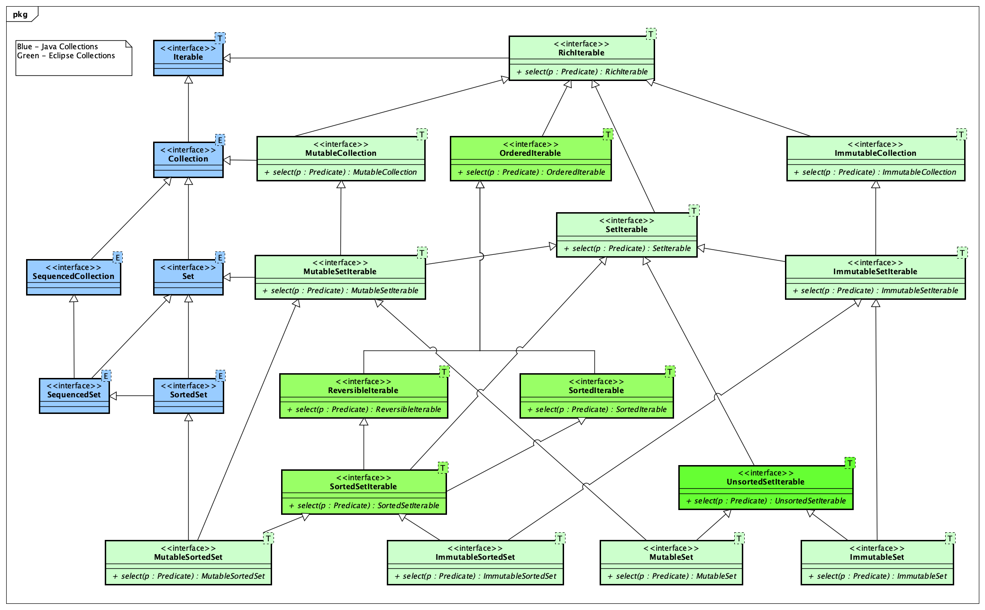
Eclipse Collections Set Type Hierarchy

Slide 23
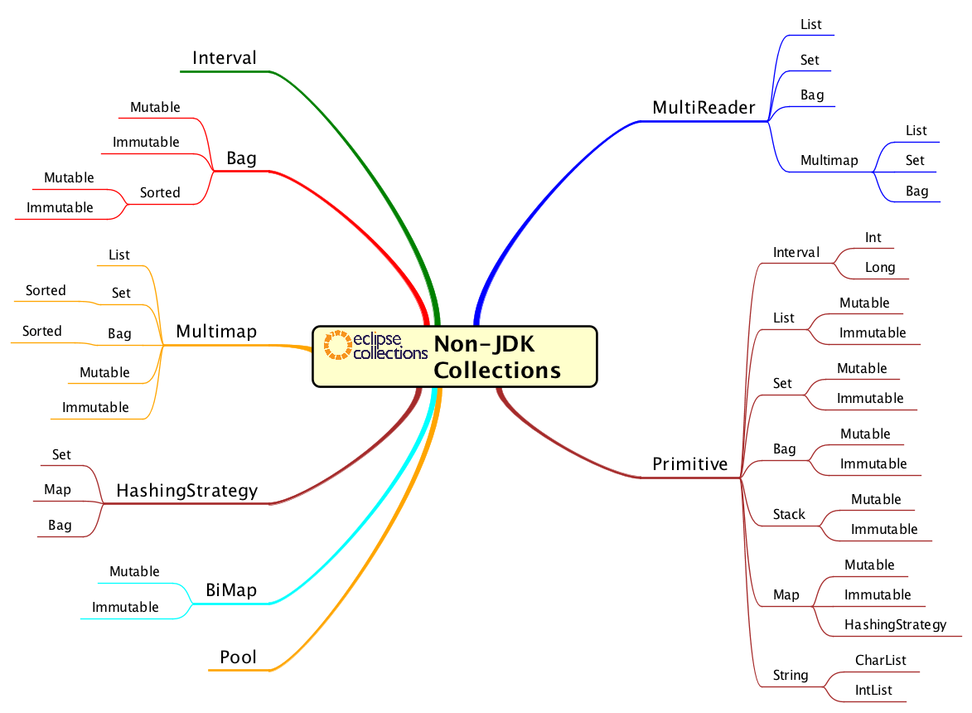
Non-JDK Collection Types in EC

