Slide 1
SLIDE 1: Title Slide
Visual: A clean, simple background. Maybe a small map icon.
Title: Route Optimization for Delivery Services
Subtitle: A Machine Learning & Operations Research Approach
Your Name: NARASIMHA.V
Date: 2/10/2026

Slide 2
SLIDE 2: Problem Statement
Visual: Bullet points. Maybe a picture of a delivery truck stuck in traffic.
Title: The "Last Mile" Problem
Content:
  Last-mile delivery is the most expensive part of the supply chain.
  Companies (Amazon, FedEx, UberEats) waste millions on fuel and overtime due to inefficient routing.
  Manual planning fails when there are more than 10 stops.
  Goal: Automate the routing process to minimize transit time, operational costs, and fuel consumption.

Slide 3
SLIDE 3: Project Objectives
Visual: A checklist icon.
Title: Key Objectives
Content:
  Build an algorithmic engine that ingests delivery addresses (Lat/Lon).
  Use Machine Learning to divide the city into distinct delivery zones.
  Solve the Vehicle Routing Problem (VRP) to find the shortest path for multiple vehicles.
  Add Real-World Constraints (Vehicle capacity limits).
  Visualize routes on an interactive map and export a PDF manifest for drivers.
  Perform a Cost-Benefit Analysis to quantify the efficiency gains.

Slide 4
SLIDE 4: System Architecture & Workflow
Visual: A simple flowchart (Input -> ML -> Optimization -> UI -> PDF).
Title: System Architecture
Content:
  Step 1: Data Generation: Create synthetic coordinates for 20 stops and 1 depot.
  Step 2: Machine Learning (K-Means): Cluster stops into 3 zones (simulating 3 trucks).
  Step 3: Optimization (OR-Tools): Calculate the shortest path for each zone (CVRP).
  Step 4: User Interface (Streamlit): Display interactive maps and metrics.
  Step 5: Generate a downloadable PDF route manifest.

Slide 5
SLIDE 5: Technology Stack
Visual: Logos of Python, Streamlit, OR-Tools.
Title: Technologies Used
Content:
  Programming Language: Python
  Machine Learning: Scikit-Learn (K-Means Clustering)
  Optimization Engine: Google OR-Tools (CVRP Solver)
  Web Framework: Streamlit
  Map Visualization: Folium
  PDF Generation: FPDF2
  Version Control: Git & GitHub

Slide 6
SLIDE 6: Machine Learning Component (K-Means)
Visual: A scatter plot showing 3 different colored clusters of dots.
Title: Machine Learning: K-Means Clustering
Content:
  Why ML? To prevent one truck from driving across the entire city.
  How it works: We feed the Latitude and Longitude of all 20 stops into the K-Means algorithm.
  The Result: The algorithm groups stops into 3 distinct geographical clusters (Zones).
  Outcome: Each cluster is assigned to one vehicle, ensuring balanced workload and reduced overlap.

Slide 7
SLIDE 7: Algorithmic Optimization (OR-Tools)
Visual: A graphic of nodes connected by lines (TSP/VRP).
Title: Route Optimization: Google OR-Tools
Content:
  Distance Calculation: We use the Haversine Formula to calculate real-world spherical distance between coordinates.
  The Problem: Capacitated Vehicle Routing Problem (CVRP).
  Capacity Constraint: Each stop has a "Demand" (1-3 boxes). No truck can exceed a maximum capacity of 15 boxes.
  The Solver: OR-Tools calculates the mathematically shortest path for each vehicle to visit every stop and return to the depot.

Slide 8
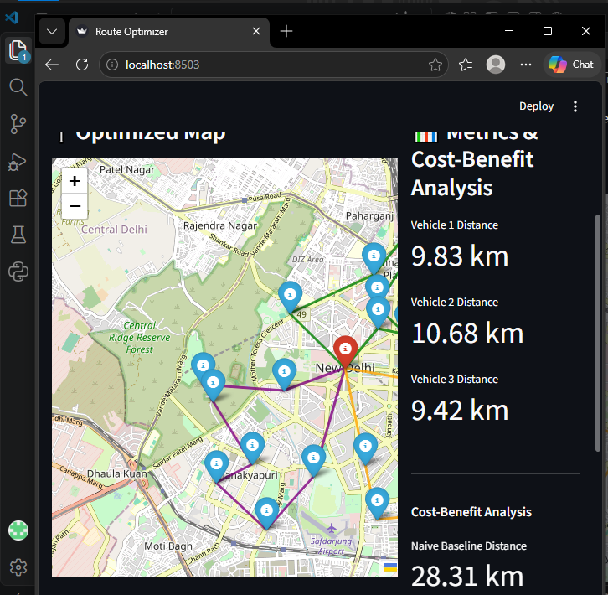
SLIDE 8: Application Interface & Results
Visual:
Title: Application Interface & Results
Content:
  Interactive Map: Color-coded routes for each vehicle.
  Metrics Panel: Displays total distance for each vehicle.
  Cost-Benefit Analysis: Compares the optimized route against a "Naive Baseline".
  ResultSuccessfully divided the 20 stops into 3 zones, keeping each vehicle's distance under 11 km and respecting the 15-box capacity limit.
  Export Feature: Generates a formatted PDF manifest for drivers.

Slide 9
SLIDE 9: Conclusion & Future Scope
Visual: Bullet points, a lightbulb icon.
Title: Conclusion & Future Scope
Content:
  Conclusion: Successfully built a full-stack ML & Optimization app that divides zones, respects capacity constraints, and minimizes travel distance.
  Future Scope:
    Integrate Google Maps API for real-time traffic data.
    Add Dynamic Re-routing (if a new order is added mid-route).
    Develop a Mobile App for drivers to update delivery status.
    Scale the algorithm to handle 100+ stops and multiple depots.

Slide 10
SLIDE 10: Thank You
Visual: A simple "Thank You" and your email/LinkedIn.
Title: Thank You
Content:
  Questions?
  vnarasimha371@gmail.com
  https://github.com/vnarasimha371-web/Route-Optimization-Project.git

