Slide 1
Neural Network for Image Classification
Shenbagaraman Ramakrishnan
Arturo Prieto
Lucas Ferreira

Slide 2
DEEP NEURAL NETWORKS
Fault tolerant ; loss of few neurons doesn’t affect the behavior
Ability to extract high level features from raw sensory data
Superior Accuracy => High computational complexity
Training and Inference

Slide 3
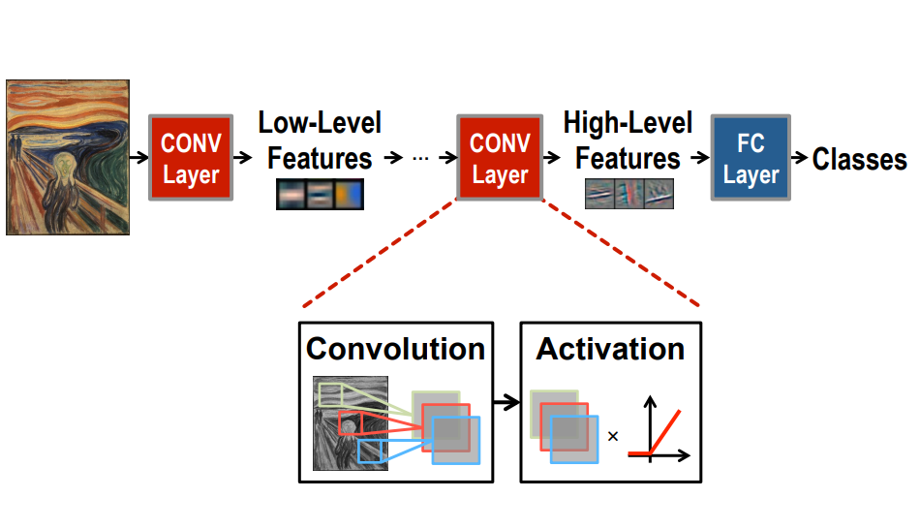
Deep Convolutional Neural Networks

Slide 4
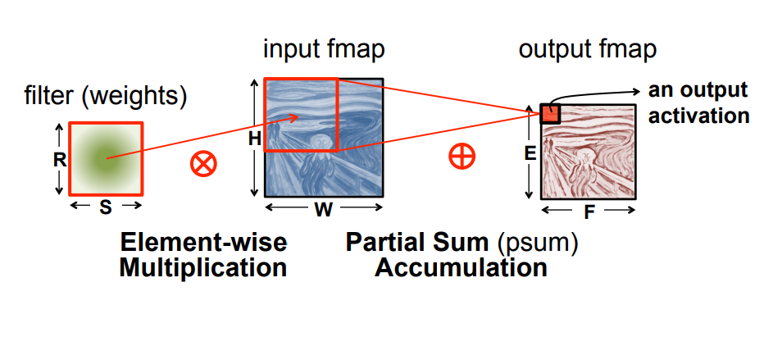
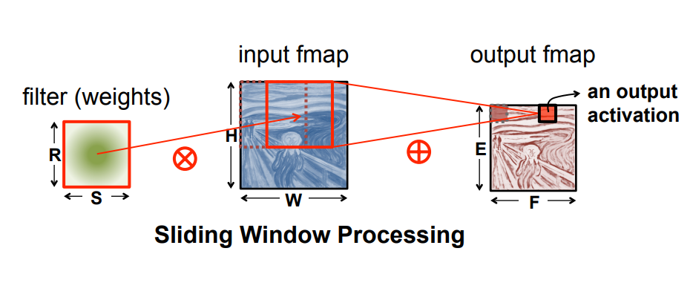
CONVOLUTION

Slide 5
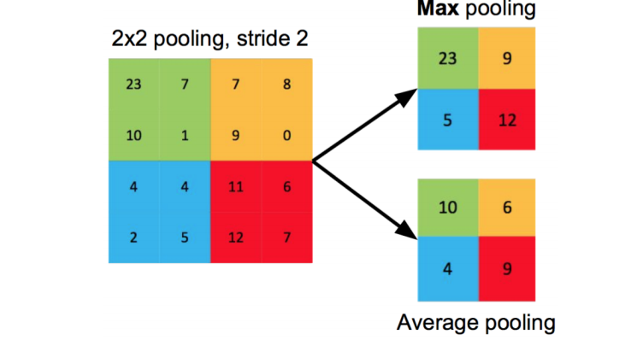
POOLING

Slide 6


IC Project definition
Classification identifying squares or circles from a picture
Black and white 64x64 pixels
1000 testing pictures

Slide 7
Neural Network design
Convolutional filter 4x4
Pooling filter 15x15
67 weights (16 conv, 48 FC1 & 3 FC2) and 5 bias (1 conv, 3 FC1 & 1 FC2)
Convolution
Pooling
FC1
FC2
61x61
4x4
3x1
1x1
RELU
RELU
SIGMOID

Slide 8
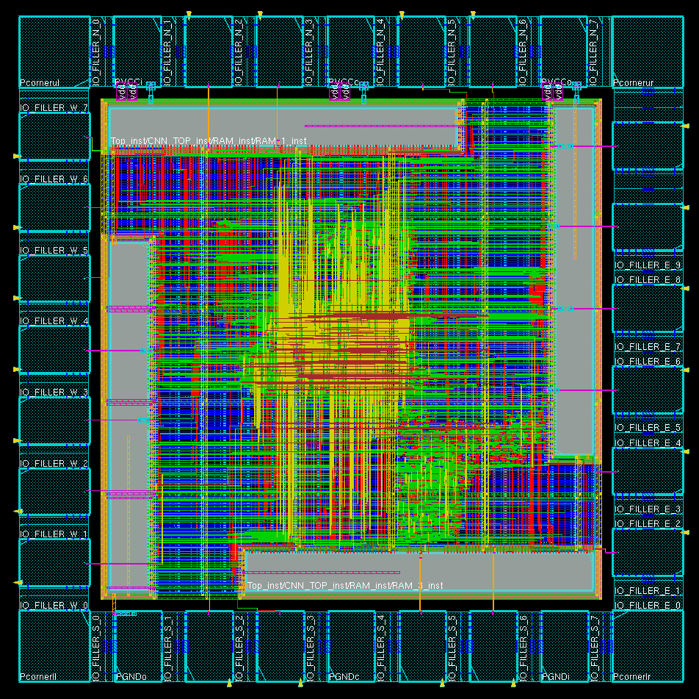
Layout
AREA
550 µm²
FREQUENCY
500 MHz

Slide 9
Grade 4
Integrate the IP’s to the top module and Understand the flow by the running behavioral simulations
Use this as a reference module now
Create your own convolution, ReLu, and Max-pool units
Run this convolutional layer for 10 different images.

Slide 10
Grade 5
Complete the CNN architecture (i.e create the fully connected layer, including a hardware friendly sigmoid activation)

Slide 11
VLSI LAB Grade 4 / 5
Convolution
Pooling
FC1
FC2
61x61
4x4
3x1
1x1
RELU
RELU
SIGMOID
Grade 4
Grade 5

Slide 12
Modules to be created:
  In RAM_IP_TOP initialize the distributed memory with the .coe files (use the Matlab script provided)
  Initialize the ifmaps as .coe files into memory
  Set up the Conv_Controller for reading from the memory
  Integrate the PE_TOP with 4 PE’s to setup element wise multiplication
  Accumulator : To accumulate the psums
  ReLU : Linear activation

Slide 13
Memory IP Specifications
In the IP catalog search for distributed memory generator;
Specify Depth(#Addresses): 16, and Data Width: 64
Load the coefficient file for one single image (output of the Matlab script)
Coe options: Radix 2
Repeat for all 4 RAM instances

