Slide 1
Interfacing keyboard with FPGA

Slide 2
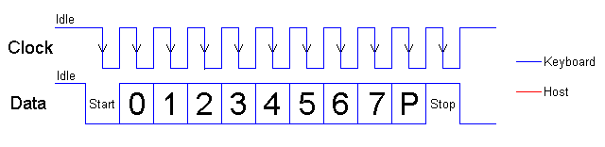
How does the keyboard send data?
Old PS/2 Keyboard sends data serially
Sampling edge is the falling edge
Main code of each key is gathered in 8 bits
Clock frequency is around 10-30 KHz

Slide 3
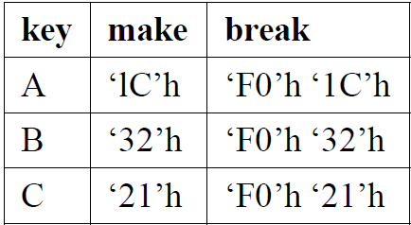
What happens when you press/release a key?
Key pressed => make code
Key released => break code

Slide 4
Make/break codes
Example of ’A’ key
When ’A’ is pressed: “1C” is sent serially through serial data line
If you are still holding it down, another “1C” will be sent.
This keeps occurring until the 'A' key has been released
when the pressed key is released: “F0” (hex) and then “1C”
For more info see: https://retired.beyondlogic.org/keyboard/keybrd.htm

Slide 5
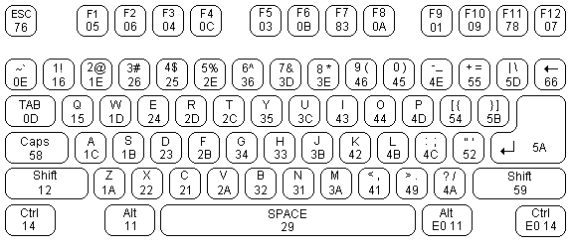
Scan codes
Each key is assigned a unique scan code.
Check the table in lab manual for all scan codes

Slide 6
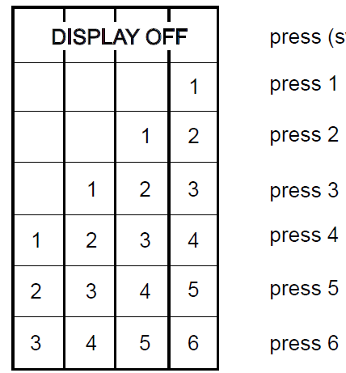
Demonstration of your design
Check the reset condition:
All 4 seven segments should be switched off at reset
pressing a stream, e.g. “1 2 3 4 5 6” one at a time
FPGA board should show the following order:
reset

Slide 7
Important Concepts
The frequency difference between FPGA and keyboard (keyboard freq. typically is a few KHz (~10-30) and FPGA in the MHz range)
    Synchronization
to avoid meta-stability between two clock domains
Keyboard operates by sampling the data line on the falling edge of its clock
Falling edge detection
of keyboard clock is the key not to miss any data from data line

Slide 8
Tips and Hints
Build a testbench for each component & TESTIt!
The sooner you realize a problem, the easier you will solve it
Comment your code wherever possible!
Document the your work process!
Make sure you keep the input/output ports of each component the same as they are provided.
Though you can create your own internal signals in the components.

Slide 9
Tips and Hints
Read the required parts from reference manual of FPGA board.
You need to understand e.g., how to refresh the 7segments
to show your digits
Almost all necessary solutions to your problems can be found in the course book. Also, searching through internet may help you for better understanding
And Finally: No Latch!

