Slide 1
SWGAN FOR IMAGE-TO-IMAGE TRANSLATION
Subtitle:A Novel Approach for Mode Collapse Mitigation and Improved Image Augmentation
K.K SINGH (Guide)
U.AjaySai (N190014)
M.Satya Vinayak (N190260)
V. Lakshmi Priya (N190914)
P.Bhargav (N190106)
S.Bhaskar Rao (N190969)

Slide 2
Table Of Contents:
Abstract
Introduction
Related Works/Existing Works
Wasserstein Generative Adversarial Network (WGAN)
Methodology
Experiments
Comparative Analysis
System Hardware
Results
Conclusion
References
Questions and Answers

Slide 3
Abstract
We present SWGAN (Sparse-enhanced Wasserstein GAN), a new method for changing images from one type to another (called image-to-image translation). It combines a strong training technique (WGAN-GP)[6] with a special "sparse loss"[5] that helps the model focus better on important image details.
To make it work well even with very few training images, we use a smart way of selecting and mixing images. Our generator creates both the new image and its internal features, while the discriminator (which checks image quality) uses layers that gradually increase in detail.
We tested SWGAN with lots of visual examples and difference maps, showing it can produce very accurate and controllable image results. This makes it a great option for image translation

Slide 4
Introduction
Introduction to Generative Adversarial Networks (GANs)[2].
A Generative Adversarial Network (GAN)[2] is a type of machine learning framework invented by Ian Goodfellow and his colleagues in 2014. It's composed of two neural networks, called the generator and the discriminator, which compete against each other.
Challenges faced by traditional GANs (mode collapse, training instability, evaluation metrics).

Slide 5
Related Works/Existing Works :
Title | Author | Publish Year | Key Concepts | Cons
GAN:Generative Adversarial nets | GoodFellow,Ian, et al | NIPS 2014 | The Base line Model | Unguided class
cGAN:Conditional Generative Adversarial nets | Mirza, Mehdi, and Simon Osindero | arXiv 2014 | uses Class label to generate class specific samples | Suffers from vanishing gradients and Mode Collapse
MetaGAN:An Adversarial approach to few-shot learning | Zhang, Ruxiang | NIPS 2018 | uses support set to generates a sample as fake class for boundary smoothing | Insignificant Improvement
ProtoGAN:Towards few sotkearning for action Recogniton | Kumar Dwivedi, Sai | CVF 2019 | Conditioning a conditional generative adversarial network with class prototype vectors | Class prototypes may not be representative for few set novel class
ContraGAN:Contrastivelearning for conditional image geeration | Kang Minguk and Jaesik Park | NIOS 2020 | Uses image embedding as well as the data to class relations by using a Contrastive loss | Some vanishing gradients Still there
LFS-GAN:Lifelong Few-Shot image generation | Seo,Juwon,Ji-Su-Kang | ICCV 2023 | Task Based Generation, Consider the loss function

Slide 6
Wasserstein Generative Adversarial Network (WGAN)
Purpose: Introduced to address limitations of traditional GANs[2], such as mode collapse and training instability.
Key Innovation: Utilizes the Wasserstein distance to enhance stability and convergence during training.
Advancement: Offers significant improvements in training dynamics and the generation of more realistic synthetic data.
Limitation: Despite advancements, WGAN’s[6] still encounter the mode collapse problem, necessitating further improvements.

Slide 7
Proposed Approach: SWGAN
SWGAN Purpose: SWGAN (Sparse-Weighted Generative Adversarial Network) was developed to address the persistent challenges faced by traditional GANs[2], specifically in image-to-image translation tasks. These challenges include training instability, mode collapse, and the generation of low-diversity outputs. SWGAN introduces novel techniques to stabilize training and encourage diversity, ensuring high-quality image generation across various tasks.
Innovative Approach: SWGAN integrates several innovative approaches, including sparse loss, controlled perturbations, and Lipschitz continuity. The use of sparse loss[5] regularizes the model to focus on meaningful features, enabling better disentanglement of representations. Controlled perturbations are applied to introduce variability, making the model more robust and capable of handling diverse image transformations. Lipschitz continuity, enforced via gradient penalties, ensures that the discriminator remains stable during training, preventing mode collapse and enhancing the overall generation process.
Key Features: Smoother Convergence: SWGAN exhibits improved training stability compared to traditional GANs[2]. The incorporation of regularization techniques ensures that the model converges more reliably, producing high-quality and diverse synthetic images without suffering from common GAN pitfalls like mode collapse.

Slide 8
Performance Metrics: Reduced Discriminator Loss: The discriminator in SWGAN becomes more effective at distinguishing between real and generated images, as indicated by the reduced discriminator loss. This improvement contributes to the generator’s ability to produce realistic outputs. Increased Generator Loss: A higher generator loss suggests that the generator is effectively challenged by the discriminator, pushing it to generate diverse and more realistic images, thereby mitigating mode collapse.
Significance: SWGAN represents a promising solution to the inherent challenges of traditional GANs[2] in image-to-image translation tasks. By combining sparse loss[5], controlled perturbations, and Lipschitz continuity, SWGAN offers a more stable and reliable framework for high-quality image generation. This approach not only advances the state of generative modeling but also opens up new possibilities for research and applications, including in fields like medical imaging, art generation, and domain adaptation.

Slide 9
Methodology :
Step-1: Initialization
Set up the environment and import necessary libraries.
Load and preprocess mini-ImageNet dataset (train, validation, test).
Define the Convolutional Neural Network (CNN) architecture for the generator and discriminator models.
Define custom loss functions and data augmentation functions.
Step-2:Data Preprocessing
Normalize the input images.
Apply a mask to the images to introduce noise.
Create data generators for train, validation, and test datasets using the Data_GeneratorRaviLabel class
The data generator class is responsible for sampling images and creating batches for training.

Slide 10
Step-3:Model Definition
Define the generator model (make_generator_model):
Sequential CNN layers with normalization and activation functions.
Output layer with sigmoid activation to generate images.
Define the discriminator model (make_discriminator_model):
Sequential CNN layers with normalization and activation functions.
Output a decision score for real vs. generated images.
Step-4:Training Functions Define custom components Define the Wasserstein loss functions (wgan_generator_loss, wgan_discriminator_loss). Define the sparse loss[5] to promote meaningful feature activation. Optionally include mean squared error (MSE) as part of the generator loss for pixel-wise supervision.
Define the gradient penalty function Compute the gradient norm on interpolated images to enforce Lipschitz continuity, essential for stable WGAN training.
Discriminator training step (train_discriminator_step) Compute WGAN discriminator loss with added gradient penalty. Backpropagate gradients and update the discriminator weights.
Generator training step (train_generator_step) Generate fake images and hidden representations. Evaluate the discriminator's output on the generated images. Compute generator loss using: WGAN generator loss (adversarial loss), Sparse loss[5] on activations (for feature disentanglement), MSE loss (for image-to-image translation accuracy). Combine these with appropriate weights. Backpropagate gradients and update generator weights.

Slide 11
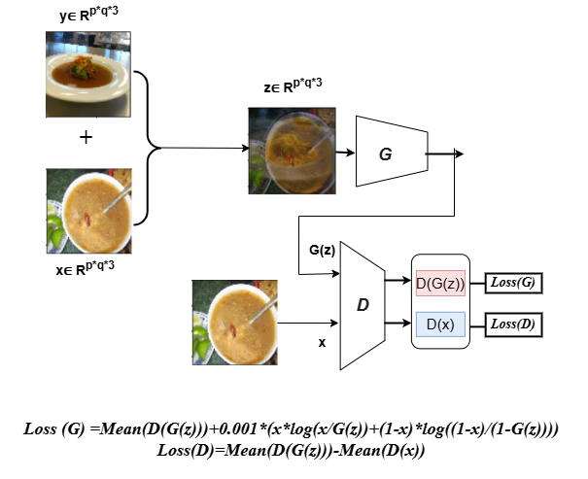
Model Architecture Diagram

Slide 12
Step-5: Training Loop:
Initialize optimizers for generator and discriminator.
Train the models for a specified number of epochs:
Iterate over batches from the data generator.
Update generator and discriminator using the training step function.
Log and print the losses for monitoring.
Step-6: Evaluation:
Generate and visualize sample images from the generator.
Save the trained models and plot the training losses.

Slide 13

Formula Used :
SWGAN :
Where:
ρ is the target activation (the desired mean activation).
ρ̂ i is the mean activation of the learned activations.
The sum runs over all activations in the layer.

Slide 14
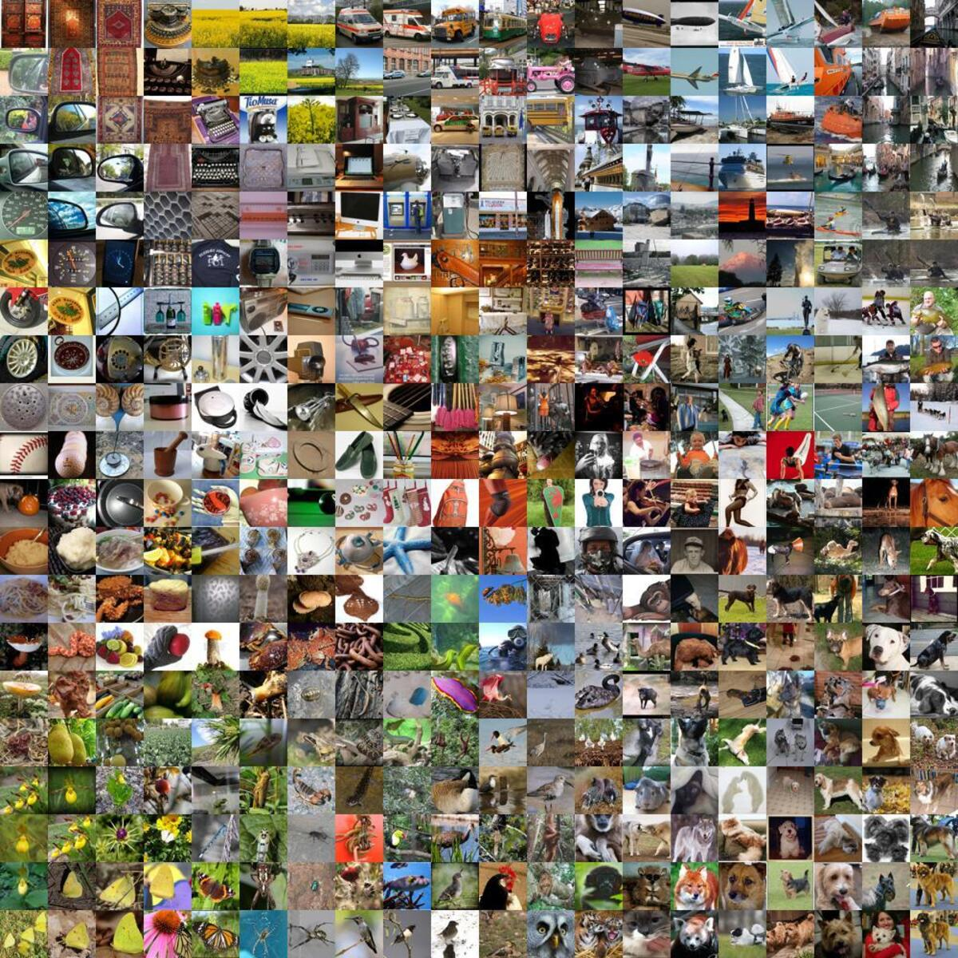
Experiments - Datasets Used
Libraries Used: Tensorflow, Keras, Numpy, Random, Math, Cv2, Matplotlib Mini ImageNet Dataset:

Slide 15
System Hardware:
Google Colab TP4 GPU
System RAM Used: 7.5 / 12.7 GB
GPU RAM Used: 1.6 / 15 GB
Disk Used: 34.2 / 112.6 GB

Slide 16
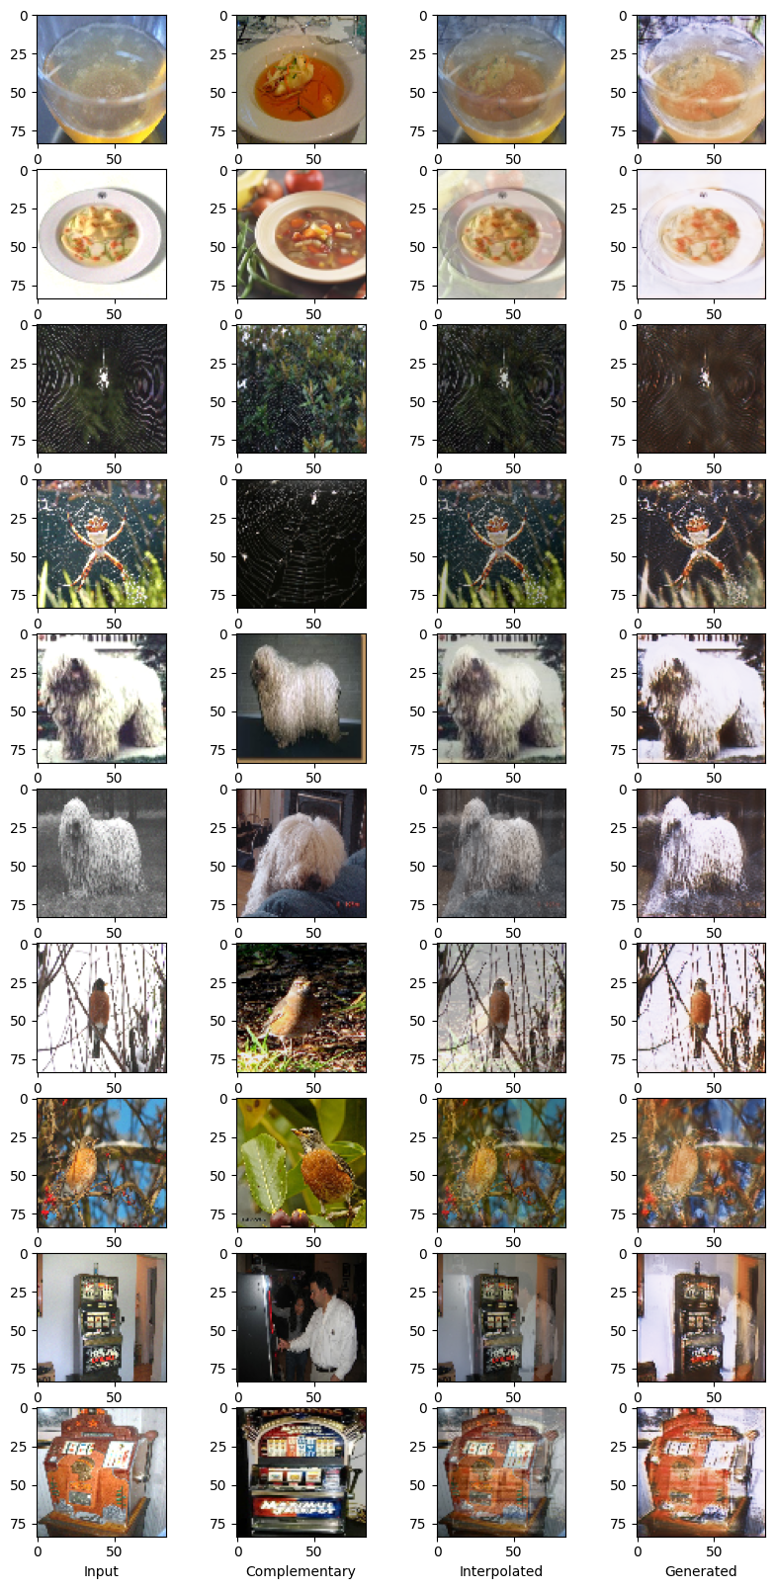
Result : After 25 Epochs

Slide 17
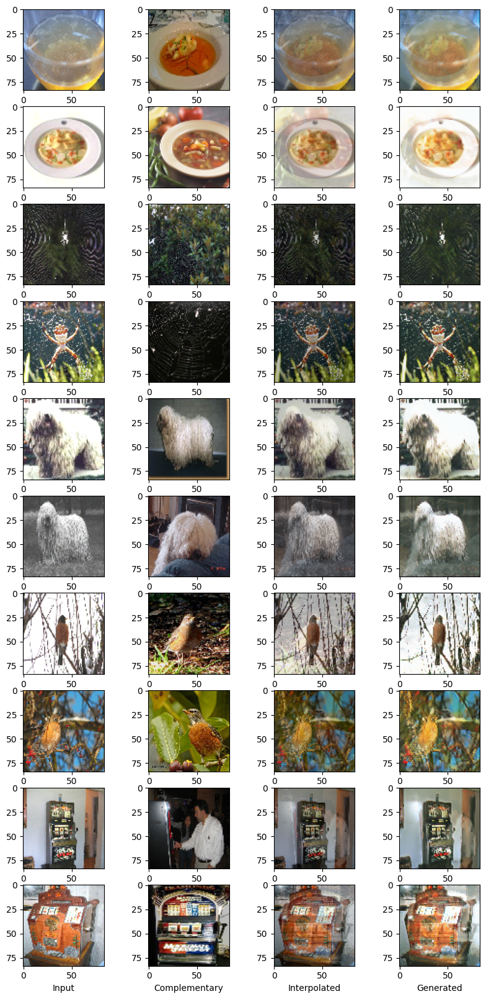
After 100 Epochs

Slide 18
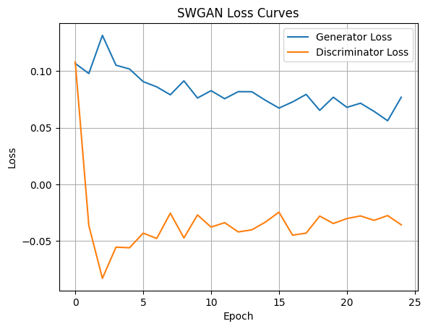
SWGAN Graph :
Graph After 25 Epoch

Slide 19
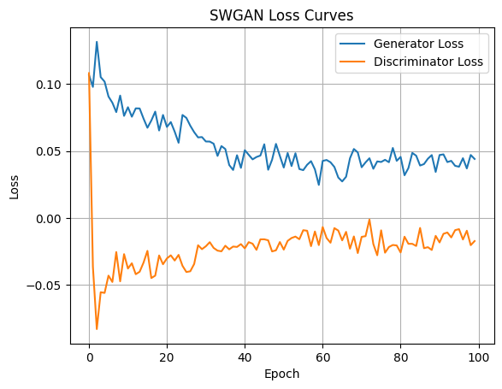
Graph After 100 Epoch

Slide 20
Question and Answers?

Slide 21
Conclusion
Advancements over traditional GANs[2] and WGAN’s[6]
Future potential in generative modeling and data augmentation

Slide 22
References
https://colab.research.google.com/drive/1a_qyHrIHFyNJR4Zbhs5jn5rpd_2PV3P9?usp=drive_link
[2]. John, Maria, and S. Santhanalakshmi. "Image augmentation using GAN models in Computer Vision." 2021 2nd International Conference on Smart Electronics and Communication (ICOSEC). IEEE, 2021.
[3]. Cui, Jiequan, Zhuotao Tian, Zhisheng Zhong, Xiaojuan Qi, Bei Yu, and Hanwang Zhang. "Decoupled kullback-leibler divergence loss." Advances in Neural Information Processing Systems 37 (2024): 74461-74486.
[4]. Ji, Shuyi, Zizhao Zhang, Shihui Ying, Liejun Wang, Xibin Zhao, and Yue Gao. "Kullback–Leibler divergence metric learning." IEEE transactions on cybernetics 52, no. 4 (2020): 2047-2058.
[5]. Cui, Jiequan, Beier Zhu, Qingshan Xu, Zhuotao Tian, Xiaojuan Qi, Bei Yu, Hanwang Zhang, and Richang Hong. "Generalized Kullback-Leibler Divergence Loss." arXiv preprint arXiv:2503.08038 (2025).
[6]. Patil, Mallanagouda, Malini M. Patil, and Surbhi Agrawal. "WGAN for Data Augmentation." In GANs for Data Augmentation in Healthcare, pp. 223-241. Springer International Publishing, 2023.

Slide 23
Thank you

