Slide 1
Special Topic
Registration Database
Team Number – 13
Team Members:
Prathiba P - PES1201700112
V Nayana - PES1201701580
Krithi D - PES1201701789

Slide 2
Abstract
Students take up special topic courses during fourth and sixth semester
Administration requires their choices
Database keeps track of the students, professors, courses offered and mini projects.
Provides an easy interface for students to register

Slide 3
Case Study
Currently registration done using Google Forms
Data stored in form of spreadsheets
Multiple Shortcomings:
Students can register multiple times – Data Redundancy
Difficult to lookup data
Students can register for each other – Security Risk

Slide 4
Tools Used
User Interface – HTML, CSS
Database – phpMyAdmin
Linking database and PHP

Slide 5
Problems Faced
Authentication
Difficult to ensure students are registering for themselves
Can be done through an SMTP server
All methods are not foolproof

Slide 6
Tools for better implementation
Distributed Databases
Reduces work load on single server
Improves speed of application
Better Encryption Tools
Improves Security
Prevents students from registering for each other

Slide 7
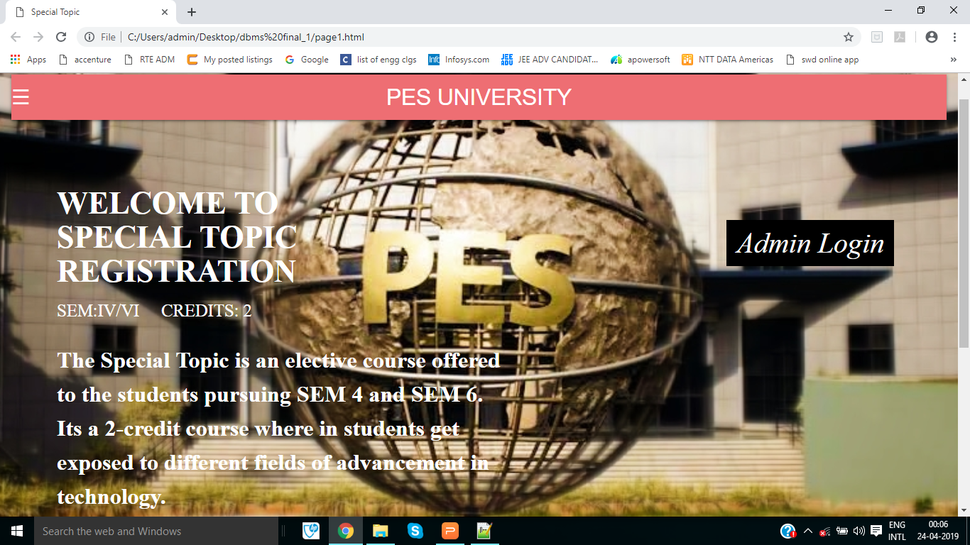
Demo

Slide 8
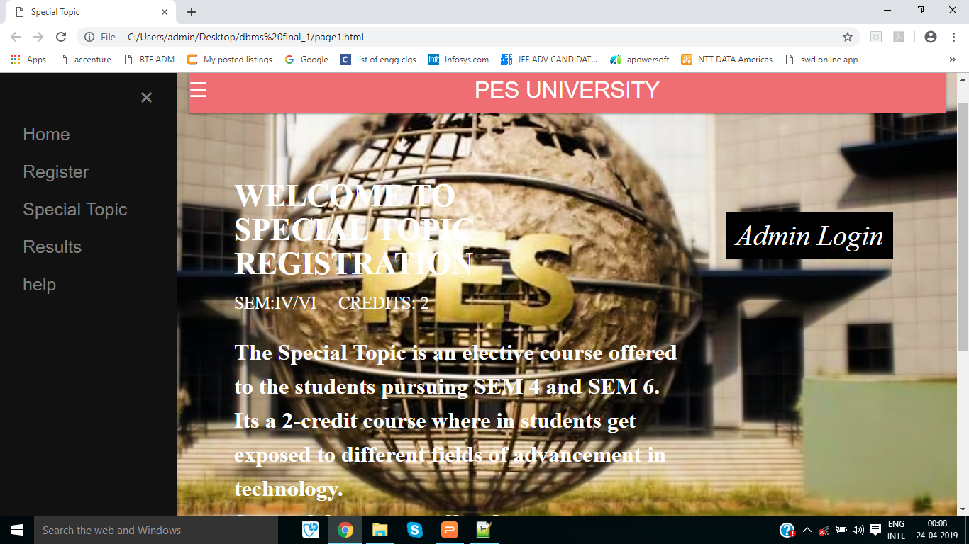
Thank You

Slide 9
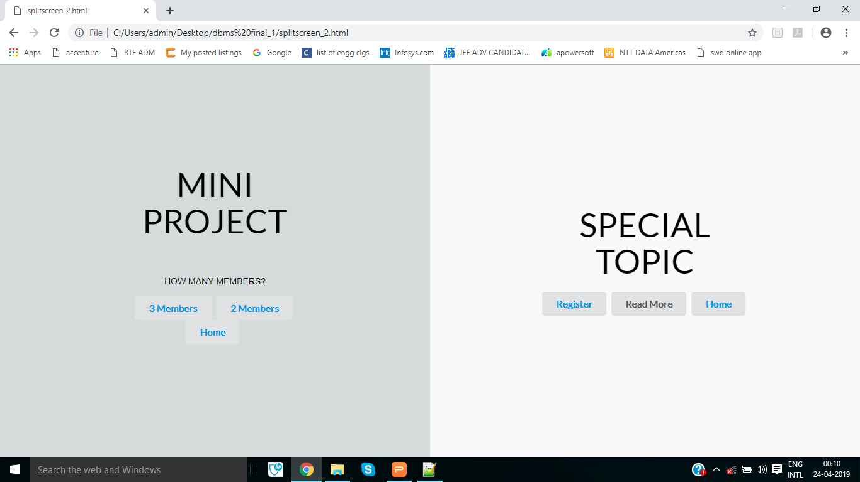

Slide 10
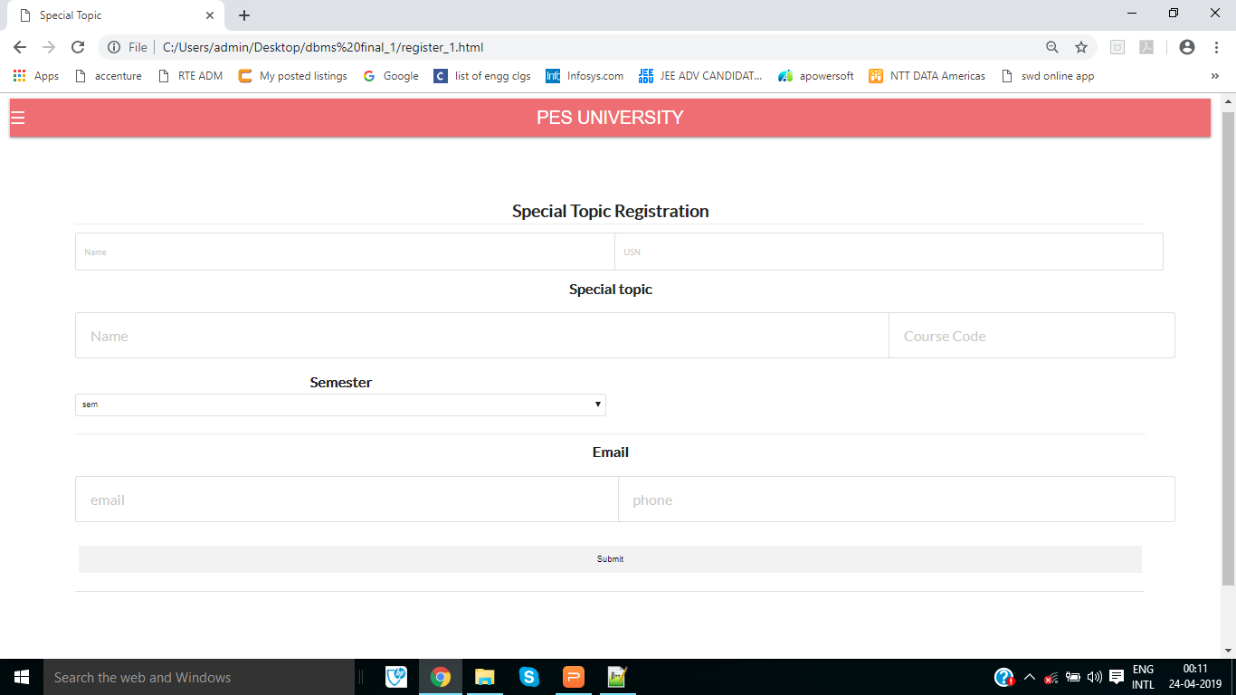

Slide 11
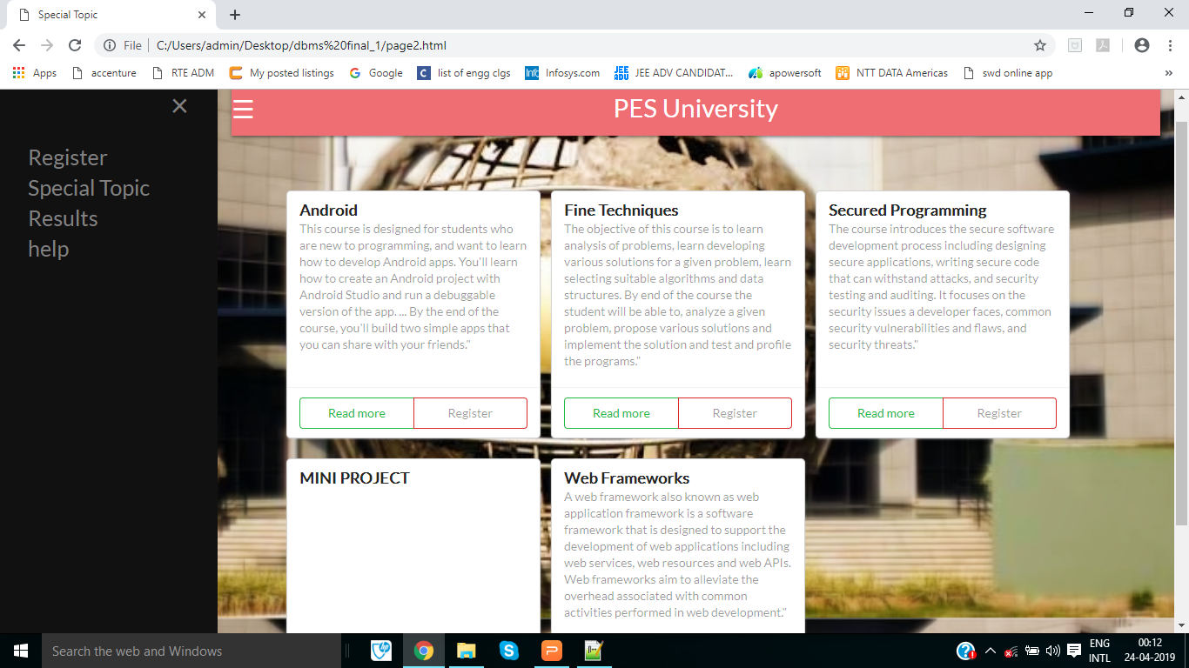

Slide 12
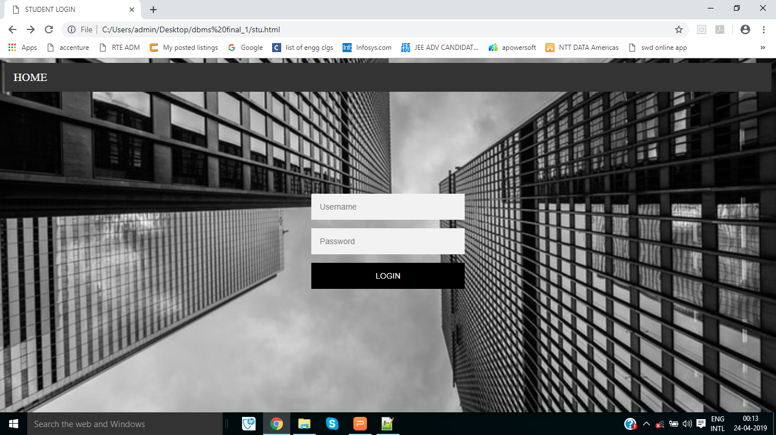

Slide 13


