Slide 1
Inverted Pendulum

Slide 2
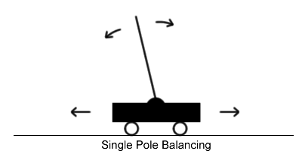
Inverted Pendulum
A control system benchmark historically used in feedback control engineering.
A pole affixed to a cart via a joint which allows movement along a single axis. The cart is able to move along a track of fixed length.

Slide 3
A trial typically begins with the pole off-center by a certain number of degrees.
The goal is to keep the pole from falling over by moving the cart in either direction, without the cart falling off either edge of the track.

Slide 4
Architecture
Client:
(Java Applet)
Server:
Controller
Sensor
Socket
Communication
Physics
UI
Updating
Actuator

Slide 5
ControlServer.java
Wait for client’s connection
Receive the measurement data from the sensor
Calculate the force to be applied on the cart
Currently it only consider the pole angle to calculate the force

Slide 6
Client.java
Main class for the client Applet
Takes simulation parameters from the user
Connect to the server
Start the four threads on client
Physics.java
Contains the physics data of the simulation environment
Simulate the physical process
Pendulum.java
Contains all the physics parameters of one inverted pendulum (mass, dimension, position …)

Slide 7
UpdatingUIThread.java
According to the data in Physics, update the image in the user interface
Sensor.java
Take measurements on Physics
Send data to controller
Currently measures pole angle, pole angle derivate, cart position, cart position derivate
Actuator.java
Once receive the data from the controller, update the force applied in Physics

Slide 8
Parameters for simulation
Simulation Speed
the ratio of simulation clock's speed over the real time clock speed
Simulation step size (in simulation second)
the size of each step in this time-driven simulation
Sensor Type
Time-Based sensor or Event-Based sensor
Sensor sampling rate (per simulation second)
samples the sensor will measure per simulation second
Threshold for the event based sensor

Slide 9
To Compile:
javac *.java
To Run:
First, run the controller (server)
java ControlServer
Second, Run the client (Applet):
appletviewer Client.java

Slide 10
To solve the “java.security.AccessControlException”:
Add a “.java.policy” file in your home directory
Add the following policy in the “.java.policy”:
grant {
permission java.net.SocketPermission
“127.0.0.1:25533”,
“connect, resolve”;
};

