Slide 1

TON DUC THANG UNIVERSITY
Faculty of Information Technology
DECISION TREE AND ASSOCIATION RULE LEARNING
Mid-term project of Data Mining and Knowledge Discovery (505043)
Huynh Van Duy (51703006) – Tran Quoc Linh (51703006)
Adviser Tran Thanh Phuoc (Ph. D.)
Ho Chi Minh, October 5-th, 2019

Slide 2
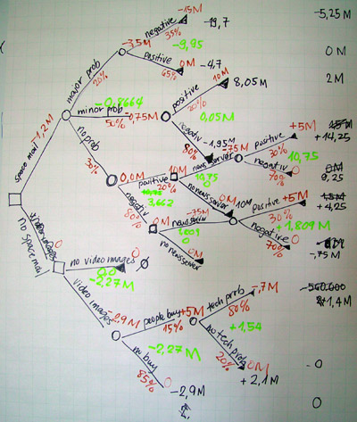
DECISION TREE
A decision tree is a decision support tool that uses a tree-like model of decisions and their possible consequences, including chance event outcomes, resource costs, and utility. It is one way to display an algorithm that only contains conditional control statements.

Slide 3



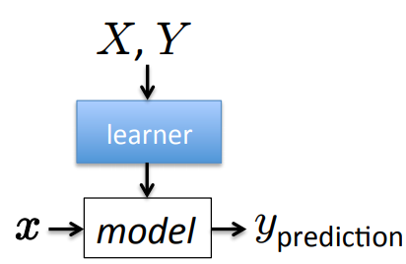

DECISION TREE
Given: labeled training data
  Assumes each with
Train model:
  model := classifier.train(X, Y)
Test: new unlabeled instance
  y_prediction := model.predict(x)

Slide 4
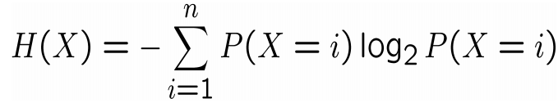
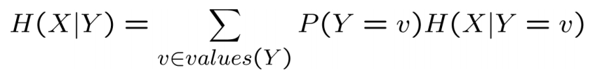
DECISION TREE
Information gain tells us how important a given attribute of the features is.
Use this information to decide the ordering of attributes in the nodes of a decision tree:
Entropy of a random variable:
Conditional entropy of X given Y:

Slide 5
DECISION TREE: EXPERIENCE
Heart Disease UCI: This database contains 76 attributes, but all published experiments refer to using a subset of 14 of them. In particular, the Cleveland database is the only one that has been used by ML researchers to this date. The "goal" field refers to the presence of heart disease in the patient. It is integer valued from 0 (no presence) to 4.
14 attributes: age, sex, chest pain type, resting blood pressure, serum cholesterol (mg/dl), fasting blood sugar (> 120 mg/dl), resting electrocardiographic results (0, 1, 2), maximum heart rate achieved, exercise included angina, oldpeak, the slope of the peak exercise ST segment, number of major vessels (0-3), thal (3 = normal, 6 = fixed defect, 7 = reversable defect) and target which refer to the type of heart disease (0-4).

Slide 6
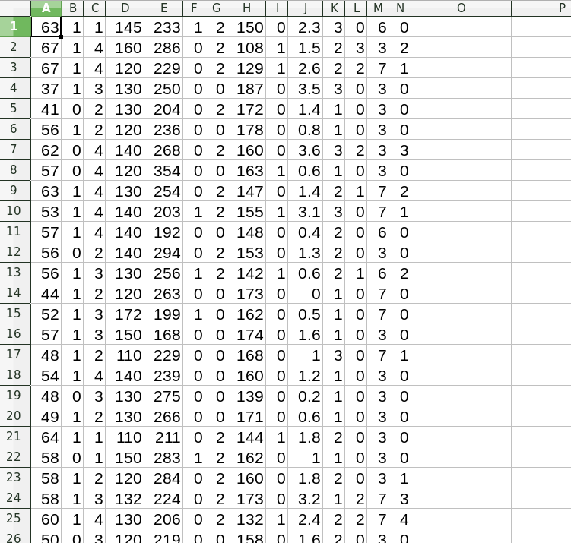
DECISION TREE: EXPERIENCE

Slide 7
DECISION TREE: EXPERIENCE
This database contains 297 samples. We split this database into 2 subset: train (248) and test (49).
Library: sklearn.tree.DecisionTreeClassifier.
Result:
  Train accuracy: 53%
  Test accuracy: 49%

Slide 8
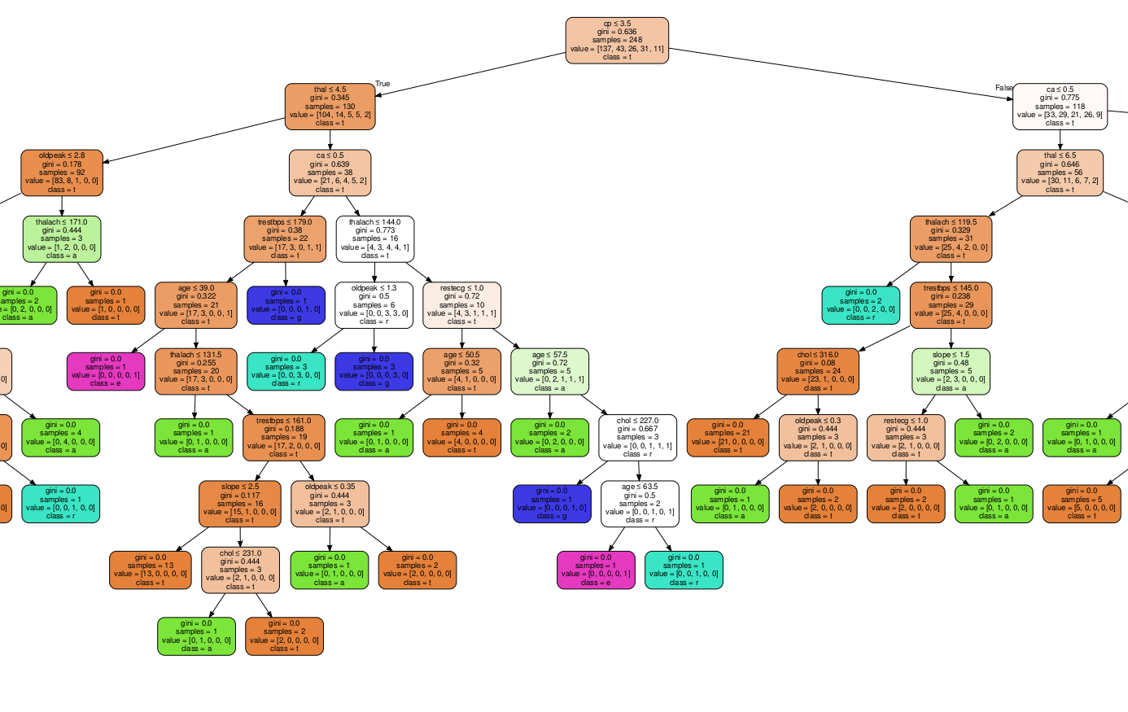
DECISION TREE: EXPERIENCE

Slide 9
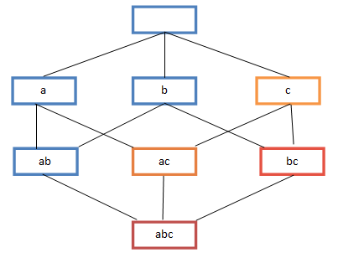
ASSOCIATION RULE LEARNING
Association rule learning is a rule-based machine learning method for discovering interesting relations between variables in large databases. It is intended to identify strong rules discovered in databases using some measures of interestingness.

Slide 10
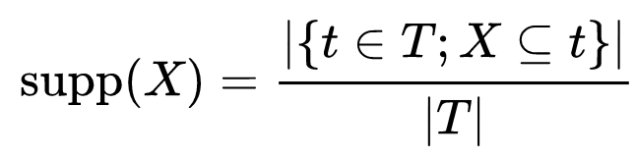
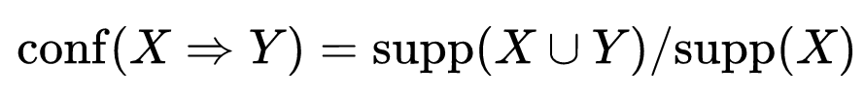
ASSOCIATION RULE LEARNING
Support is an indication of how frequently the itemset appears in the dataset. The support of X with respect to T is defined as the proportion of transactions t in the dataset which contains the itemset X:
Condidence is an indication of how often the rule has been found to be true.The confidence value of a rule, X → Y , with respect to a set of transactions T, is the proportion of the transactions that contains X which also contains Y.

Slide 11
ASSOCIATION RULE LEARNING
Many algorithms for generating association rules have been proposed:
  Apriori alogrithm uses a breadth-first search strategy to count the support of itemsets and uses a candidate generation function which exploits the downward closure property of support.
  Eclat algorithm is a depth-first search algorithm based on set intersection. It is suitable for both sequential as well as parallel execution with locality-enhancing properties.
  FP-growth algorithm is an improvement of apriori algorithm. FP growth algorithm used for finding frequent itemset in a transaction database without candidate generation.
  ...

Slide 12
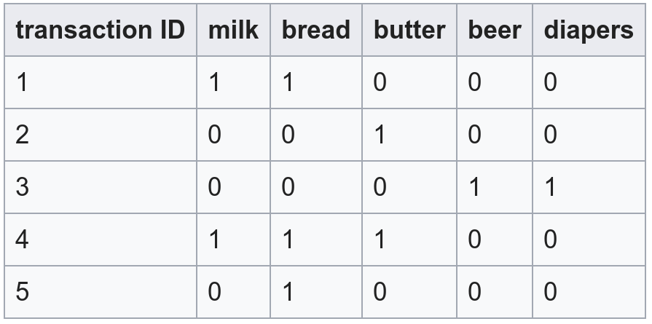
ASSOCIATION RULE LEARNING: EXPERIENCE
Given list of transactions with unique items. Find all association rules, which satisfy with the given min support and min confidence.

Slide 13
THANKS FOR YOUR ATTENTION!

