Slide 1
Face Recognition using Principal Components Analysis
Dinh Vu
June 05th, 2018

Slide 2
Contents
Motivation
Problem Description
How to solve
Deliverable
Schedule

Slide 3
1. Motivation
Facial recognition is a technology capable of identifying a person from digital images
There are many applications using facial recognition

Slide 4








































2. Problem Description
Training Set
Test Set

Slide 5
2. Problem Description
Use public data base Japanese Females Facial Expression (JFFE)
163 training images and 50 test images
Grayscale photos
Size of each image: 64x64 = 4096
Detect right person

Slide 6
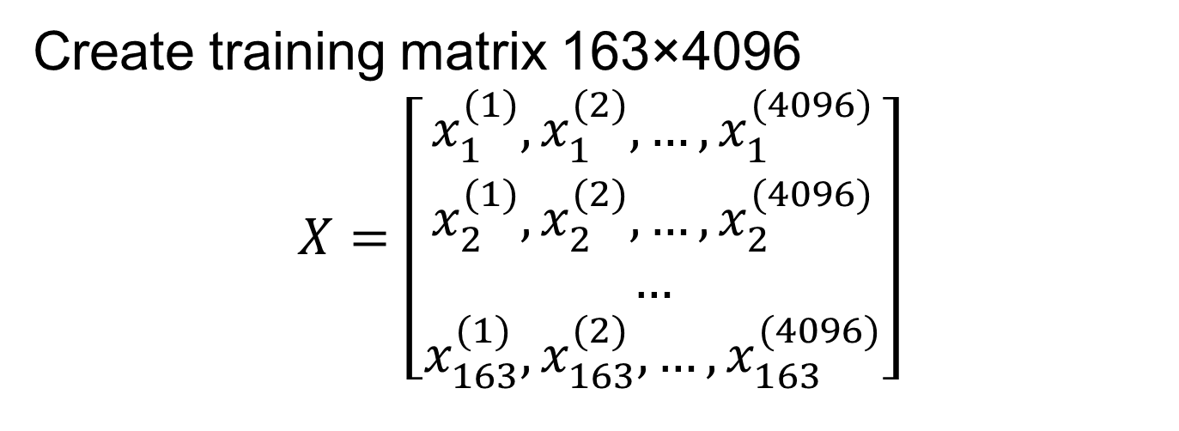
3. How to solve
Create training matrix 163×4096
$$X=\left[\begin{aligned}x_{1}^{(1)},x_{1}^{(2)},…,x_{1}^{(4096)} \\ x_{2}^{(1)},x_{2}^{(2)},…,x_{2}^{(4096)} \\ … \\ x_{163}^{(1)},x_{163}^{(2)},…,x_{163}^{(4096)}\end{aligned}\right]$$

Slide 7
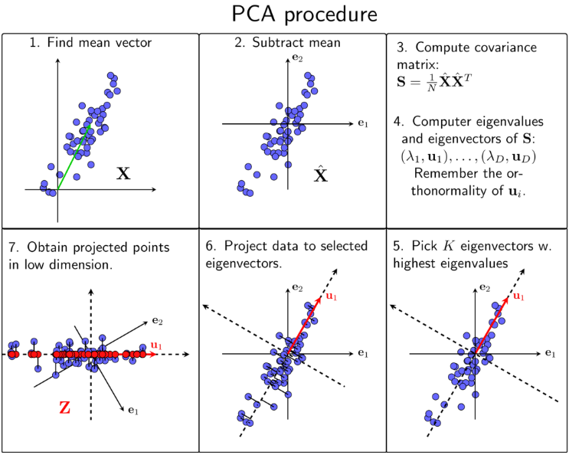
3. How to solve

Slide 8
4. Deliverable
Matlab version
k = 50;
[train_matrix, test_matrix] = createDataset();
[project_train_img, k_eig_vec, mean] = train_PCA(train_matrix, k);
recon_error = train_recon(train_matrix, project_train_img, k_eig_vec,m);
project_test_img = test_PCA(test_matrix, k_eig_vec, mean);
id = identify(project_train_img,project_test_img);

Slide 9
4. Deliverable
C version
void cpuMatAdd(int* A, int* B, int Nrows, int Ncols, int* C) {}
void cpuMatSub(float* A, float* B, int Nrows, int Ncols, float* C) {}
void cpuMatMul(float *A, float *B, int m, int n, int p, float *C) {}
void cpuMatMulScalar(float *A, int Nrows, int Ncols, float lambda, float *B) {}

Slide 10
4. Deliverable
C version
void cpuMatTranspose(float *A, int Nrows, int Ncols, float *B) {}
void cpuNorm2(float *A, int Nrows, int Ncols, float Norm) {}
void PowerMethod(float *A, int n, float eps, float *eigVec, float eigVal) {}
void trainPCA (int *trainMat, int size, int Ntrain, int k, float *project_train_img, float *k_eig_vec, float *mean) {}

Slide 11
4. Deliverable
CUDA C version
__global__ void gpuMatAdd(float* A, float* B, float* C, int Nrows, int Ncols) {}
__global__ void gpuMatSub(float* A, float* B, float* C, int Nrows, int Ncols) {}
__global__ void gpuMatMul(float *A, float *B, float *C, int m, int n, int p) {}
__global__ void gpuMatTranspose(float *A, float *B, int Nrows, int Ncols) {}

Slide 12
4. Deliverable
CUDA C version
__global__ void gpuNorm2(float *A, int Nrows, int Ncols, float Norm) {}
__global__ void reduceGmem(int *g_idata, int *g_odata, unsigned int n) {}

Slide 13
5. Schedule
Finished Matlab version
Debug C and CUDA C version
Compare 3 version

Slide 14
THANK YOU FOR LISTENING

